Slide 1
Carbon Dioxide and GIS
CO₂ Virtual Science Data Environment
January 4th, 2010
Cameron Goodale, Emily Law, Andrew Hart, Rishi Verma
Jet Propulsion Laboratory, California Institute of Technology

Slide 2
Purpose
One Stop Shopping
Provide Data and Services
Extensible

Slide 3
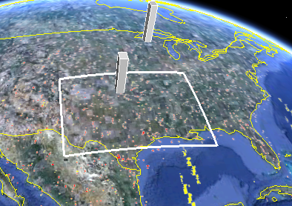
Data Discovery Demo > link
Technologies Used
Apache OODT
Google Maps
Javascript / jQuery
PHP

Slide 4
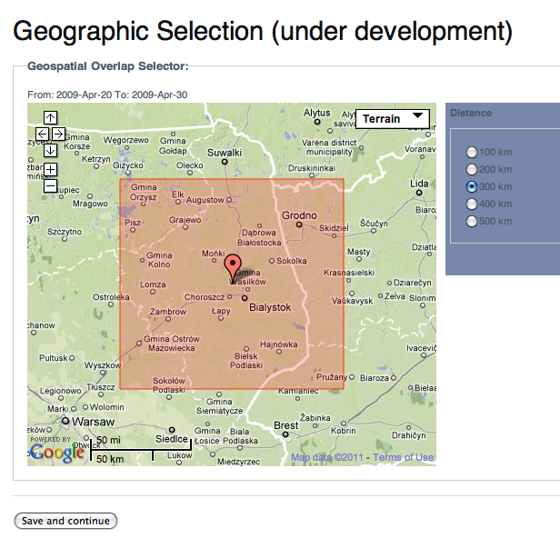
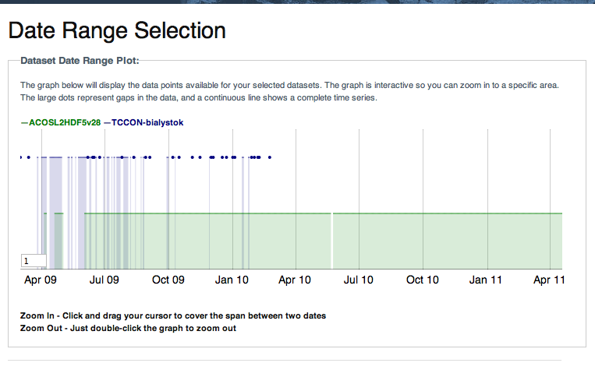
Data Services Demo > link
Technologies Used
Apache OODT
Climate Data eXchange
Google Maps
Javascript
MongoDB
PHP
Python

Slide 5
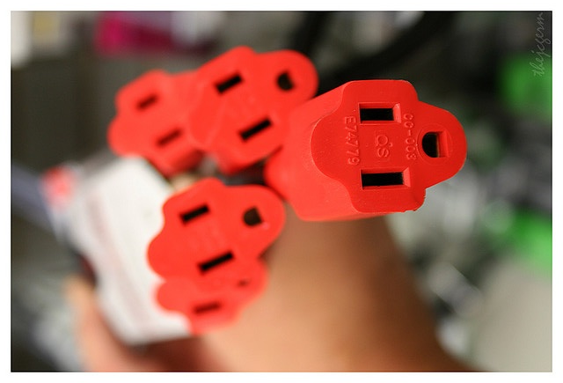
Extending CO₂ Research
Open Source / Open Standards
Chan, Jeremy. ”You are Powerless…without us”. photo. September 4, 2006. Online Image. <http://flic.kr/p/qMzVw>

Slide 6
Questions / Contact
Cameron.E.Goodale@jpl.nasa.gov
co2-general@jpl.nasa.gov

