Slide 1
Information Quality Cluster - Fostering Collaborations
H. K. (Rama) Ramapriyan, Science Systems and Applications, Inc. & NASA Goddard Space Flight Center
Ge Peng, North Carolina State University & NOAA National Centers for Environmental Information
David Moroni, Jet Propulsion Laboratory, California Institute of Technology, Pasadena, CA
12 January 2017
Acknowledgements: Much of this work was already presented at SciDataCon 2016 with co-author contributions from Chung-Lin Shie, a contractor affiliated with NASA GSFC. These activities were carried out across multiple United States government-funded institutions (noted above) under contracts with the National Aeronautics and Space Administration (NASA) and the National Oceanic and Atmospheric Administration (NOAA). Government sponsorship acknowledged.
2017 Winter ESIP Meeting

Slide 2
Topics
Information Quality Cluster (IQC)
Definition of Information Quality
IQC Objectives
“Many Global Players”
Related Activities
ESIP IQC Activities
Use Case Evaluation Summary
Conclusion

Slide 3
Information Quality Cluster
Vision
Become internationally recognized as an authoritative and responsive information resource for guiding the implementation of data quality standards and best practices of the science data systems, datasets, and data/metadata dissemination services.
Closely connected to Data Stewardship Committee
Open membership (as with all Collaboration Areas in ESIP)

Slide 4
Information Quality
Scientific quality
Accuracy, precision, uncertainty, validity and suitability for use (fitness for purpose) in various applications
Product quality
how well the scientific quality is assessed and documented
Completeness of metadata and documentation, provenance and context, etc.
Stewardship quality
how well data are being managed, preserved, and cared for by an archive or repository
Service Quality
how easy it is for users to find, get, understand, trust, and use data
whether archive has people who understand the data available to help users.
Information Quality is a combination of all of the above

Slide 5
ESIP Information Quality Cluster (IQC) - Objectives
Share Experiences
Actively evaluate best practices and standards for data quality from the Earth science community.
Improve collection, description, discovery, and usability of information about data quality in Earth science data products.
Support:
Data product producers with information about standards and best practices for conveying data quality; provide mentoring as needed
Data providers/distributors/intermediaries establish, improve, and evolve mechanisms to assist users in discovering, understanding, and applying data quality information properly.
Consistently provide guidance to data managers and stewards on the implementation of data quality best practices and standards as well as for enhancing and improving maturity of their datasets.

Slide 6
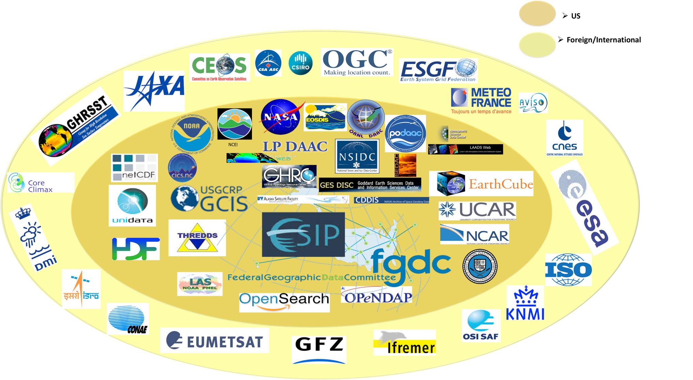
Many Global Players

Slide 7
Some Related Activities
NASA ESDSWG Data Quality WG (Recommendations) – 2014-present
NOAA Dataset Lifecycle Stage based Maturity Matrices – 2009 – present
Quality Assurance framework for Earth Observation (QA4EO)
ISO Metadata Quality Standards (19115:2003; 19157:2013; 19158:2012)
EUMETSAT CORE-CLIMAX Data System Maturity Matrices
NASA Earth Science Data System Working Groups (ESDSWG) – Metrics Planning and Reporting WG (Product Quality Checklists) – 2010-2012
GEOSS Data Quality Guidelines and GEO DMP Implementation Guidelines
CEOS Essential Climate Variables (ECV) Inventory Questions
NCAR Community Contribution Pages

Slide 8
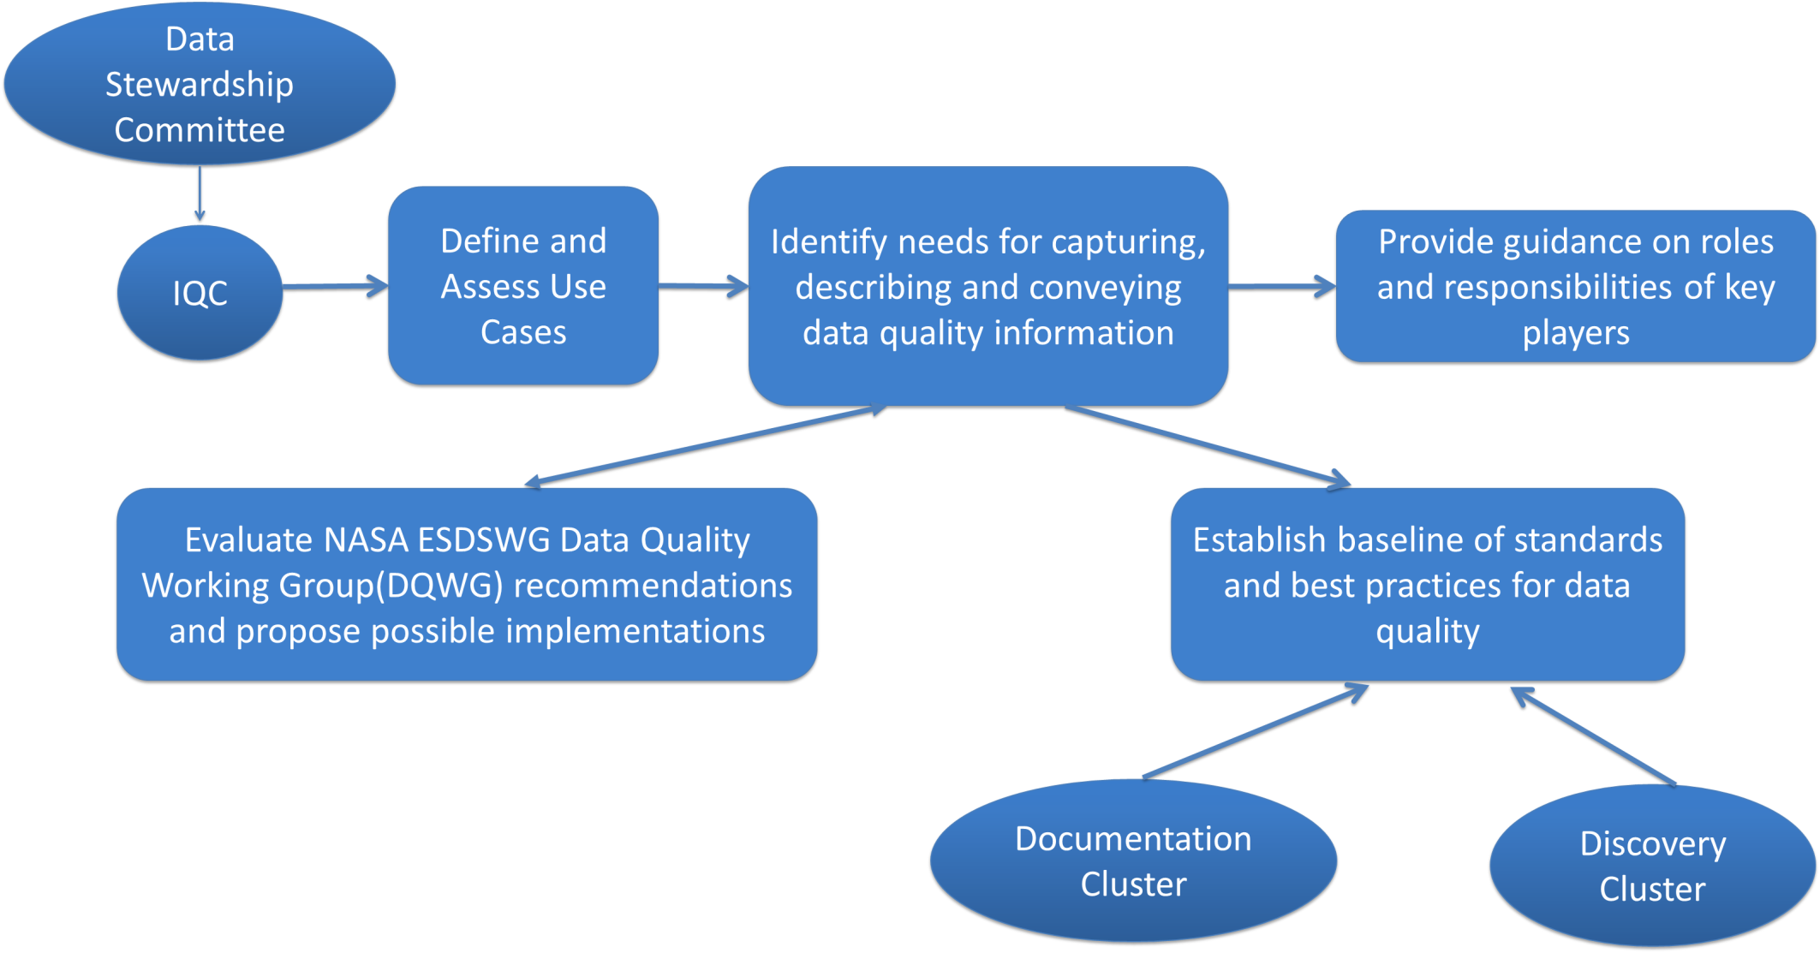
ESIP IQC Activities

Slide 9
Use Case Evaluation Summary
“Dataset Rice Cooker Theory” - Bob Downs, David Moroni, and Joseph George
Problem: Data products assimilated using heterogeneous data sources are plagued with unknown and/or incomplete quality characterization, thus leading to improper handling of input data used in assimilation.
Solutions: a) Full disclosure of errors, uncertainties, and all available quality information of input data;
b) Understanding and properly conveying how above quality issues impact the final data product; c) analysis as a function of time and at the pixel level; d) ensure that the integrity and intended use of data is upheld through proper integration of heterogeneous data sources.
“Appropriate Amount/Extent of Documentation for Data Use” - Ge Peng, Steve Olding, and Lindsey Harriman
Problem: Reducing the amount of time required for the typical data user to determine what information they need and increasing the level of satisfaction via user feedback on the proper use of information provided to the user.
Solutions: a) Provide tiered access to user-relevant information – DOI landing pages, User guides, ATBDs; b) effective product filtering algorithms and tools; c) user feedback mechanism.
“Improving Use of SBC LTER Data Portal” - Margaret O’Brien, Sophie Hou, Ross Bagwell, and Hampapuram Ramapriyan.
Problem: The Santa Barbara Coastal (SBC) Long Term Ecological Research (LTER) data portal is seeking how to improve the user’s ability to discover the SBC LTER data collections and help the user to better understand the data characteristics as a means of determining if a dataset of interest is suitable for a user’s intended usage.
Solutions: a) Data providers should supply sufficient information on data quality to help the SBC LTER data portal improve categorization of various datasets; b) refine the keyword search algorithm; c) improve the data discovery interface using usability evaluations; d) advise data producers to use proper terms in “tag” datasets; e) review datasets for completeness and quality of information.
“Citizen Science” – Ruth Duerr, Han Qin, Chung-Lin Shie, and Bhaskar Ramachandran
Problem: Crowd-sourced data often lacks support from subject-matter experts, thus translating to unknown or poorly understood data characteristics.
Solutions: a) Training data producers on how to better sample and document each measurement/observation; b) improved communication between data distributors and data producers; c) encourage data users to read associated documentation and provide feedback on use and issues found.

Slide 10
Conclusion
Capture, description, discovery, and usability of information about data quality in Earth science data products is critical for proper use of data.
Many groups are involved in developing and documenting best practices.
ESIP IQC, as a multilateral group is well placed to promoting standards and best practices.
Use Case Submission and Evaluation is an on-going process; working sessions are an efficient mechanism for vetting and finding solutions.
Membership in IQC is open: You are invited to participate!
Monthly telecons feature guest speakers on a variety of topics connected with Information Quality.

Slide 11
Thank you for your attention!
Hampapuram.ramapriyan@ssaihq.com
David.F.Moroni@jpl.nasa.gov
Ge.Peng@noaa.gov

Slide 12
Session Agenda
Introducing the IQC – David Moroni
Agriculture and Climate Cluster – Jeff Campbell (USDA)
Disaster Lifecycle Cluster – Speaker TBD
CEOS/WGCV Land Product Validation – Pierre Guillevic (U of MD)
Obs4MIPS – Robert Ferraro (JPL)
Panel Discussion – 50 Minutes

Slide 13
NASA Earth Science Data System Working Groups (ESDSWG) – Data Quality Working Group DQWG
Mission: “Assess existing data quality standards and practices in the inter-agency and international arena to determine a working solution relevant to Earth Science Data and Information System Project (ESDIS), Distributed Active Archive Centers (DAACs), and NASA-funded Data Producers.”
Initiated in March 2014
2014-2015:
16 use cases analyzed, issues identified from users’ points of view and ~100 recommendations made for improvement
Consolidated into 12 high-priority recommendations
2015-2016:
Extracted 4 “Low Hanging Fruit” (LHF) recommendations from previous 12
25 solutions to address these recommendations have been identified and assessed for operational maturity and readiness for implementation, with an initial focus on four “low-hanging fruit” recommendations; solutions that exist as open-source and in an operational environment were ranked as highest priority for implementation.
Details in poster by Yaxing Wei et al

Slide 14
Data Stewardship Maturity Matrix
NOAA NCEI/CICS-NC Scientific Data Stewardship Maturity Matrix (DSMM) provides a unified framework for assessing the maturity of measurable stewardship practices applied to individual digital Earth Science datasets that are publicly available
Assesses maturity in 9 categories (e.g., preservability, accessibility, data quality assessment, data integrity) at 5 levels (1 = Not Managed; 5 = Optimally Managed)
Provides understandable data quality information to users including scientists and actionable information to decision-makers
Peng, G. et al, 2015. “A unified framework for measuring stewardship practices applied to digital environmental datasets”, Data Science Journal, 13. doi:10.2481/dsj.14-04
(Self-assessment template: tinyurl.com/DSMMtemplate)

Slide 15
QA4EO
Established and endorsed by the Committee on Earth Observation Satellites (CEOS) in response to a Group on Earth Observations (GEO) Task DA-06-02 (now Task DA-09-01a)
Four International Workshops - 2007, 2008, 2009, and 2011
Key Principles (from http://qa4eo.org/docs/QA4EO_guide.pdf)
“In order to achieve the vision of GEOSS, Quality Indicators (QIs) should be ascribed to data and products, at each stage of the data processing chain - from collection and processing to delivery
A QI should provide sufficient information to allow all users to readily evaluate a product’s suitability for their particular application, i.e. its “fitness for purpose”.
To ensure that this process is internationally harmonized and consistent, the QI needs to be based on a documented and quantifiable assessment of evidence demonstrating the level of traceability to internationally agreed (where possible SI) reference standards.”
Framework and 10 Key Guidelines established (e.g., establish Quality Indicator, establish measurement equivalence, expression of uncertainty)
A few cases studies are available that illustrate QA4EO-compliant methodologies [e.g., NOAA Maturity Matrix for CDRs, WELD: Web - Enabled Landsat Data (NASA-funded MEaSUREs Project), ESA Sentinel-2 Radiometric Uncertainty Tool]
Notes:
http://qa4eo.org/resources/
http://qa4eo.org/case-studies/

Slide 16
ISO 19157:2013 - Geographic information -- Data quality*
Establishes principles for describing the quality of geographic data
Defines components for describing data quality
Specifies components and content structure of a register for data quality measures
Describes general procedures for evaluating the quality of geographic data
Establishes principles for reporting data quality
Defines a set of data quality measures for use in evaluating and reporting data quality
Applicable to data producers providing quality information to describe and assess how well a data set conforms to its product specification
Applicable to data users attempting to determine whether or not specific geographic data are of sufficient quality for their particular application
Examples of DQ Elements: Completeness, Thematic Accuracy, Logical Consistency, Temporal Quality, Positional Accuracy
* From: http://www.iso.org/iso/home/store/catalogue_tc/catalogue_detail.htm?csnumber=32575

Slide 17
ESIP Information Quality Cluster Activities
Coordinate use case studies with broad and diverse applications, collaborating with the ESIP Data Stewardship Committee and various national and international programs
Identify additional needs for consistently capturing, describing, and conveying quality information
Establish and provide community-wide guidance on roles and responsibilities of key players and stakeholders including users and management
Prototype innovative ways of conveying quality information to users
Evaluate NASA ESDSWG DQWG recommendations and propose possible implementations.
Establish a baseline of standards and best practices for data quality, collaborating with the ESIP Documentation Cluster and Earth Science agencies.
Engage data provider, data managers, and data user communities as resources to improve our standards and best practices.

Slide 18
NASA MEaSUREs - Product Quality Checklists
Making Earth System Data Records for Use in Research Environments (MEaSUREs)
NASA-funded, typically 5-year projects generating long-term consistent time series
Product Quality Checklists (PQC) indicate completeness of Quality Assessment, metadata, documentation, etc.
PQC templates - developed in 2011 and adopted in 2012
Questions asked address science quality, documentation quality, usage and user satisfaction

Slide 19
NCAR Climate Data Guide*
Community contributed datasets, reviews
Focuses on “limited selection of data sets that are most useful for large-scale climate research and model evaluation”
Contributed reviews answer 10 key questions; Examples of topics addressed
strengths, limitations, and typical applications of datasets
Comparable datasets
Methods of uncertainty characterization
utility for climate research and model evaluation.
*From Schneider, D. P., et al (2013), Climate Data Guide Spurs Discovery and Understanding, Eos Trans. AGU, 94(13), 121. [article] - See more at: https://climatedataguide.ucar.edu/about/contribute-climate-data-guide#sthash.zaOUYP3j.dpuf

Slide 20
CDR Maturity Matrix
NOAA NCEI Climate Data Record (CDR) Maturity Matrix assesses readiness of a product as a NOAA satellite CDR
Bates, J. J. and Privette, J. L., “A Maturity Model for Assessing the Completeness of Climate Data Records”, Eos, Vol. 93, No. 44, 30 October 2012
Assesses maturity in 6 categories (software readiness, metadata, documentation, product validation, public access, utility) at 6 levels
Provides consistent guidance to data producers for improved data quality and long-term preservation
EUMETSAT’s CORE-CLIMAX Matrix – based on CDR Maturity Matrix; contains guidance on uncertainty measures
http://www1.ncdc.noaa.gov/pub/data/sds/cdr/Guidelines/Maturity_Matrix_Template.xlsx
Notes:
http://qa4eo.org/docs/maturity_matrix_2012EO440006_for.pdf

Slide 21
NOAA CDR Maturity Matrix
Maturity | Software Readiness | Metadata | Documentation | Product Validation | Public Access | Utility
1 | Conceptual development | Little or none | Draft Climate Algorithm Theoretical Basis Document (C-ATBD); paper on algorithm submitted | Little or None | Restricted to a select few | Little or none
2 | Significant code changes expected | Research grade | C-ATBD Version 1+ ; paper on algorithm reviewed | Minimal | Limited data availability to develop familiarity | Limited or ongoing
3 | Moderate code changes expected | Research grade; Meets int'l standards: ISO or FGDC for collection; netCDF for file | Public C-ATBD; Peer-reviewed publication on algorithm | Uncertainty estimated for select locations/times | Data and source code archived and available; caveats required for use. | Assessments have demonstrated positive value.
4 | Some code changes expected | Exists at file and collection level. Stable. Allows provenance tracking and reproducibility of dataset. Meets international standards for dataset | Public C-ATBD; Draft Operational Algorithm Description (OAD); Peer-reviewed publication on algorithm; paper on product submitted | Uncertainty estimated over widely distributed times/location by multiple investigators; Differences understood. | Data and source code archived and publicly available; uncertainty estimates provided; Known issues public | May be used in applications; assessments demonstrating positive value.
5 | Minimal code changes expected; Stable, portable and reproducible | Complete at file and collection level. Stable. Allows provenance tracking and reproducibility of dataset. Meets international standards for dataset | Public C-ATBD, Review version of OAD, Peer-reviewed publications on algorithm and product | Consistent uncertainties estimated over most environmental conditions by multiple investigators | Record is archived and publicly available with associated uncertainty estimate; Known issues public. Periodically updated | May be used in applications by other investigators; assessments demonstrating positive value
6 | No code changes expected; Stable and reproducible; portable and operationally efficient | Updated and complete at file and collection level. Stable. Allows provenance tracking and reproducibility of dataset. Meets current international standards for dataset | Public C-ATBD and OAD; Multiple peer-reviewed publications on algortihm and product | Observation strategy designed to reveal systematic errors through independent cross-checks, open inspection, and continuous interrogation; quantified errors | Record is publicly available from Long-Term archive; Regularly updated | Used in published applications; may be used by industry; assessments demonstrating positive value

Slide 22
Data Stewardship Maturity Matrix

