Slide 1
Exercise Timelines and Product Delivery:
Cascadia Rising 2016 and Vigilant Guard 17
ESIP Winter Meeting 2017
Maggi Glasscoe, Andrew Aubrey
NASA Jet Propulsion Laboratory, California Institute of Technology
Margaret.T.Glasscoe@jpl.nasa.gov
Anne Rosinski
California Geological Survey Menlo Park
James Morentz
JWMorentz LLC
Phil Beilin
City of Walnut Creek
Dave Jones
StormCenter Communications
© 2017. All rights reserved.

Slide 2
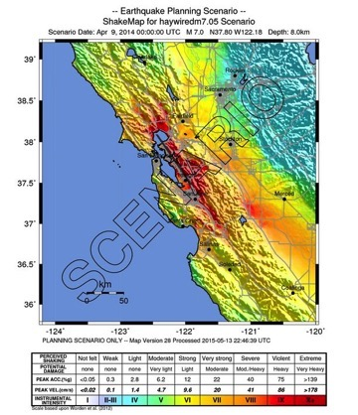
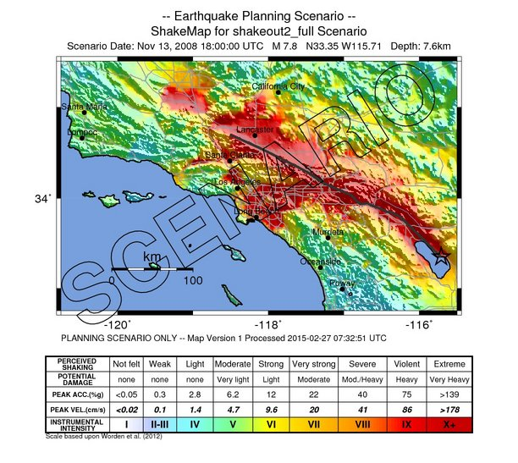
The Exercises
Cascadia Rising was a FEMA National Level Exercise held 7-10 June 2016
  The scenario included a M 9.0 earthquake resulting in the complete rupture of 700-mile Cascadia Subduction Zone that triggered a tsunami and multiple aftershocks
Vigilant Guard 17 was a Full Scale National Guard Exercise hosted by California and Nevada held 10-14 November 2016
  The scenario included a M 6.0 earthquake east of Las Vegas and a M 7.8 earthquake in southern California with multiple aftershocks
Upcoming: Haywired 2017 California Exercise is an earthquake scenario to model and study impacts on the San Francisco Bay area from a Mw 7.05 earthquake on the Hayward fault (planned early 2017)
  Builds upon understanding of the last large earthquake to occur on the Hayward fault in 1868
  Considers that modern urban infrastructures are made vulnerable by multiple layers of interdependencies between lifelines
  Also considers impacts from a sequence of aftershocks following the main earthquake

Slide 3
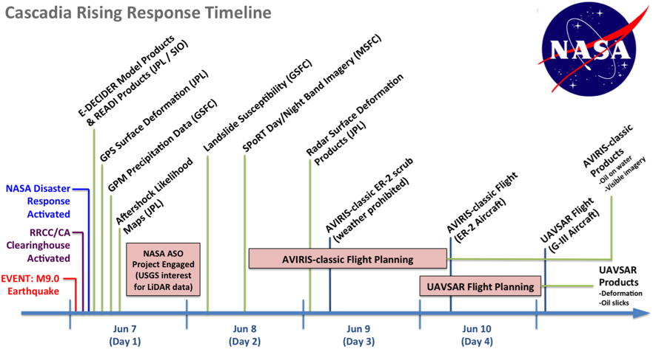
Exercise Timeline & Product Delivery
Notes:
Key information on the nature, magnitude and scope of damage, or Essential Elements of Information (EEI), necessary to achieve situational awareness are often generated from a wide array of organizations and disciplines, using any number of geospatial and non-geospatial technologies.

Slide 4
Master Scenario Event List (MSEL)
Lists in chronological order the events and injects that drive exercise play
Links simulation to action, enhances exercise experience for players, and reflects an incident or activity that will prompt players to implement the policy or procedure being tested
Contains at minimum:
  Designated scenario time
  Event synopsis
  Expected action
  Intended player
  Notes section
Examples:
  Cascadia Rising (CA Earthquake Clearinghouse, NASA)
  May 2015 Capstone (same scenario as VG 17)
http://www.michigan.gov/documents/deq/deq-wb-wws-Binder7_271811_7.pdf
Notes:
Contains at minimum:
Designated scenario time
Event synopsis
Expected action (player response after an MSEL inject is delivered)
Intended player (agency or individual player for whom the MSEL inject is intended)
Notes section (for controllers and evaluators to track actual events against those listed in the MSEL, with special instructions for individual controllers and evaluators)

Slide 5
Thank you for your attention!
Questions?
Maggi Glasscoe
Margaret.T.Glasscoe@jpl.nasa.gov

Slide 6
Value of Clearinghouse Data Sharing Efforts
Time Savings
Information to support your COP
Two-way Information Sharing
Clearinghouse Technology Interoperability
Connect best tools and technologies
Decision Support
Not just for earthquakes
Situational Awareness

Slide 7













Information Sharing Between Multiple State, Federal, Local Organizations through XchangeCore connected applications
N. CA Chapter

