Slide 1
Usability Considerations in Conveying Data Quality Information
Mark Reese
mreese@element84.com

Slide 2
Agenda
Process Overview
A year (and a half) in review
Major themes
Major pain points
A look ahead

Slide 3
Usability

Slide 4
Usability Defined
Quality attribute that assesses how easy user interfaces are to use.
5 components of usability
Learnability
Efficiency
Memorability
Errors
Satisfaction
Notes:
https://www.nngroup.com/articles/usability-101-introduction-to-usability/

Slide 5
Earthdata Search Usability Loop
Feedback and/or Usability Test
Workflow Design
Wireframe
Visual Design
Implementation

Slide 6
A year (and a half) in review

Slide 7
18 Month Review
On-site usability study at LP DAAC
On-site usability study at NSIDC
1-on-1 sessions at ESIP and AGU
Reverb/EDSC Comparison Study
Multiple rounds of workflows, wireframes and visual designs

Slide 8
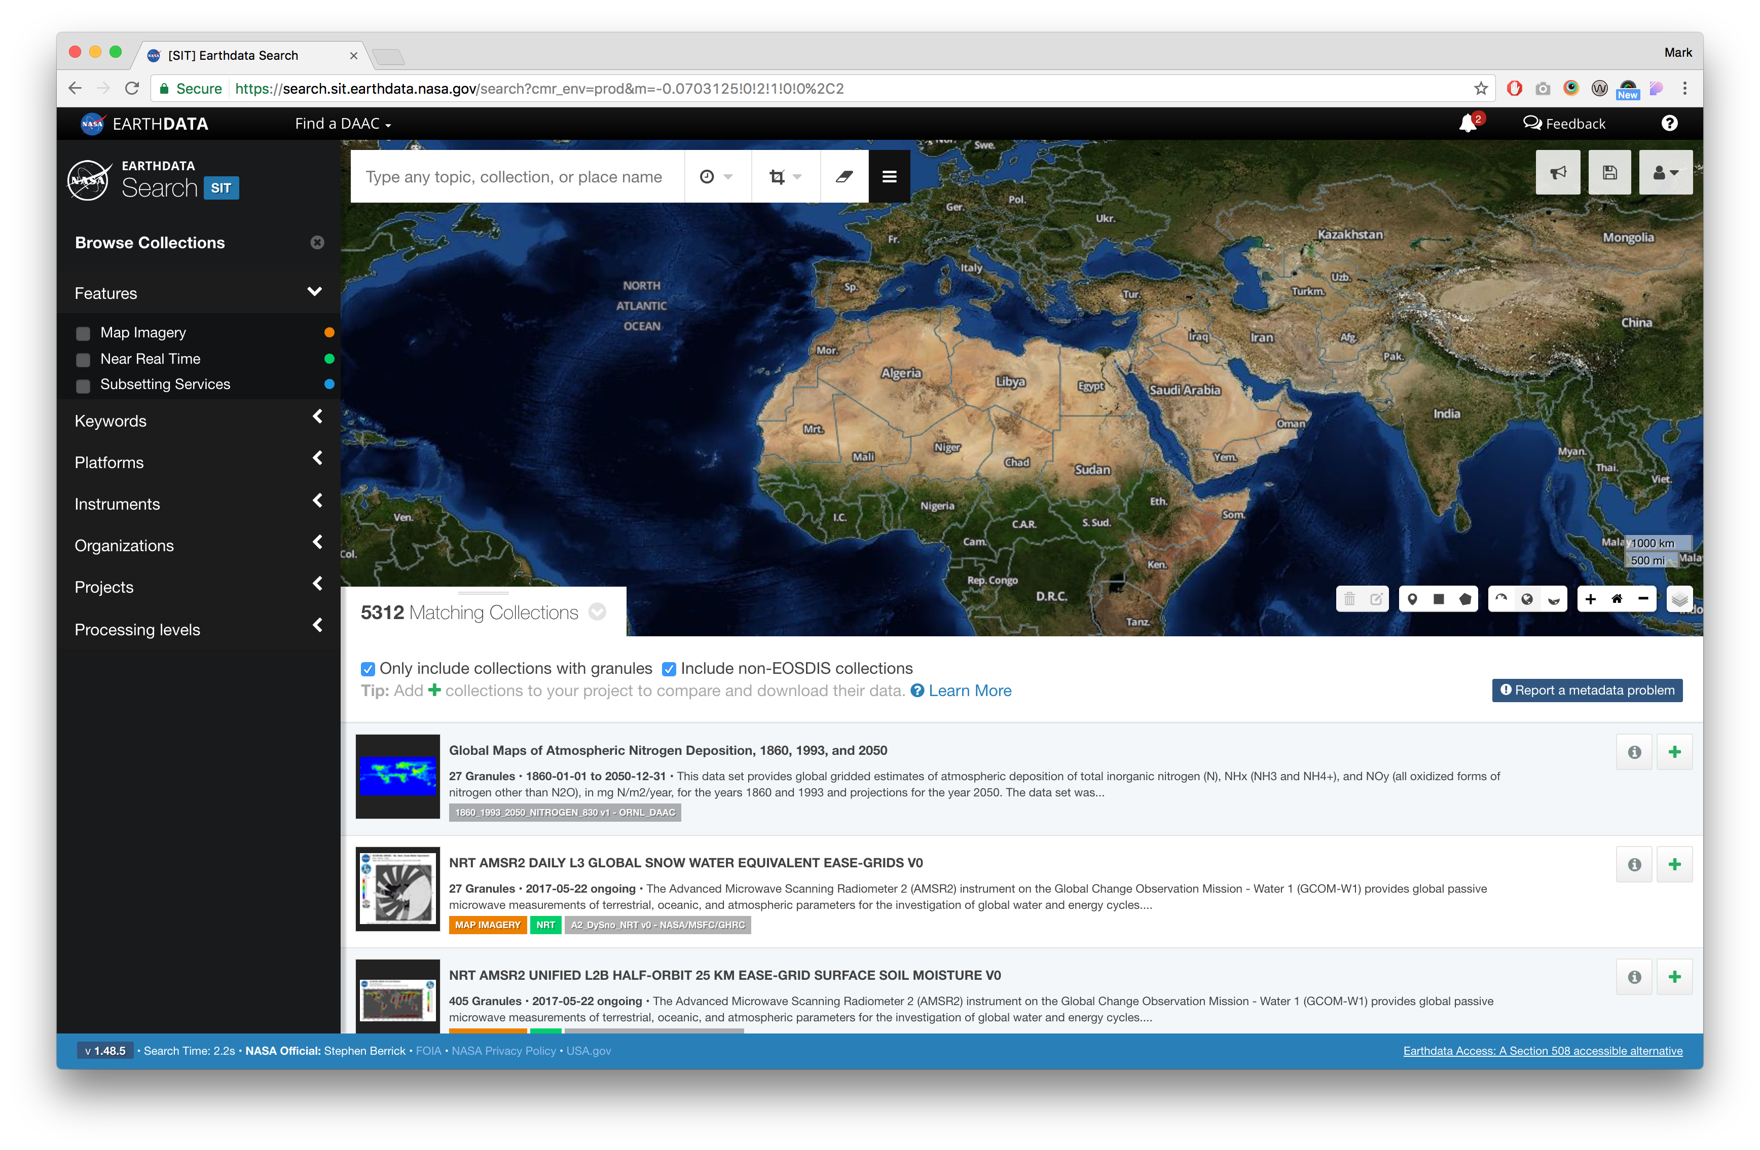

Slide 9
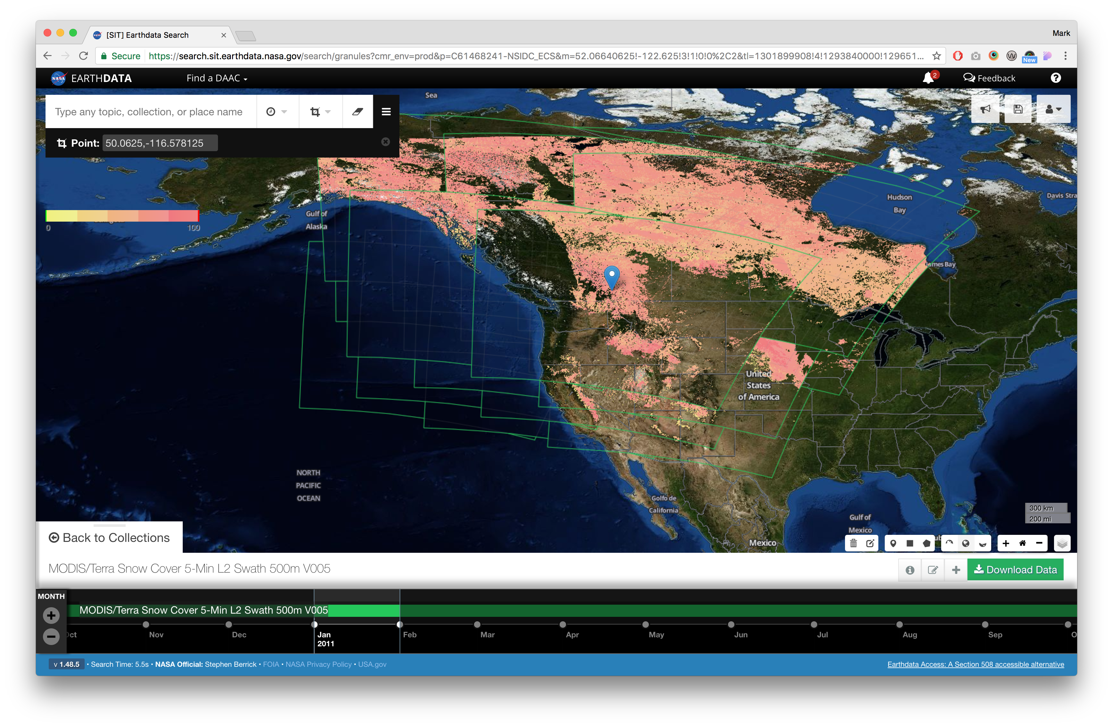

Slide 10
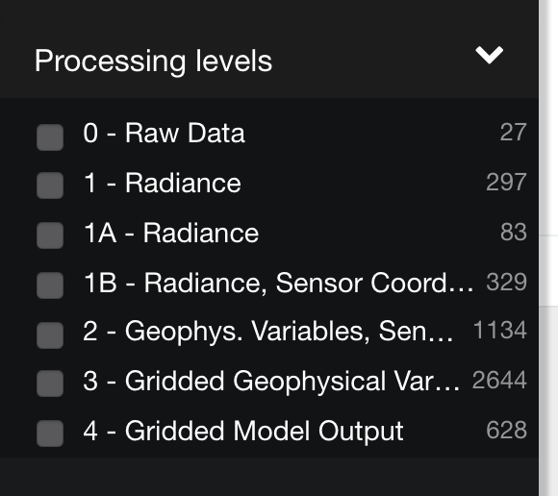
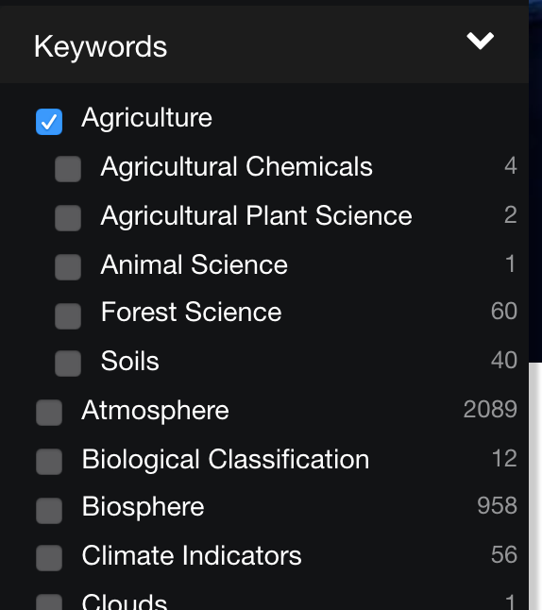

Slide 11
Major themes

Slide 12
The Good
General aesthetic satisfaction
Once features were discovered, users had genuine excitement over their function
High task completion rates

Slide 13
Opportunities for Improvement
Timeline
Lexicon
Relevancy
Services & Customization Discoverability

Slide 14
Major Pain Points

Slide 15
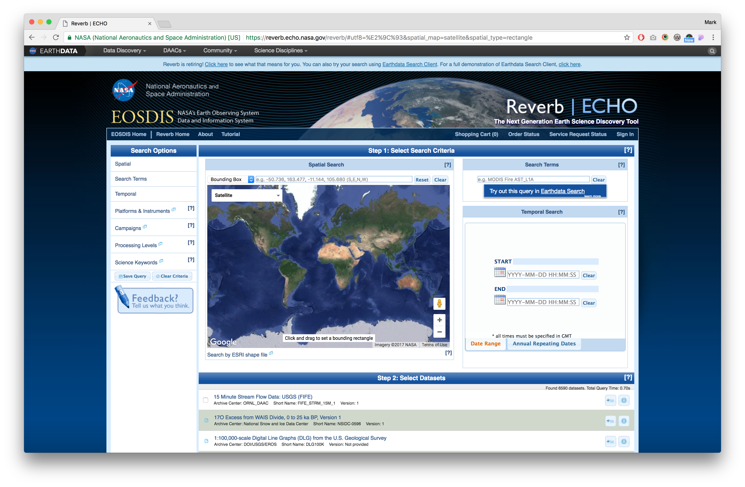

Slide 16
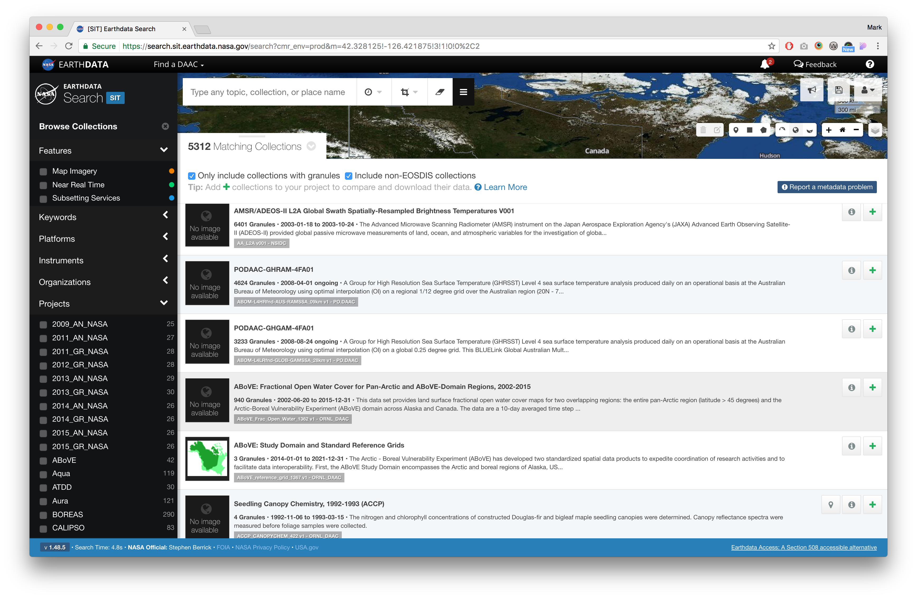

Slide 17
A look ahead

Slide 18
Where We’re Going
Striving for simplicity
Retiring Reverb
Improving Services Workflow

Slide 19
This work was supported by NASA/GSFC under Raytheon Co. contract number NNG10HP02C

