Slide 1


Agency Requirements:
NSF Data Management Plans
Section: The Case for Data Stewardship
Ruth Duerr
National Snow and Ice Data Center
Version 1.0
Review Date
Notes:
Modules should be 3-7 minutes long

Slide 2
Overview
All proposals to NSF must be accompanied by a data management plan
  Plans must be no longer than 2 pages
  Plans should be responsive to NSF’s policy on the dissemination and sharing of research results (see NSF Award and Administration Guide)
  Fastlane will not accept proposals without this supplementary document
Individual directorates may have directorate specific guidance
Individual solicitations may have program specific guidance

Slide 3
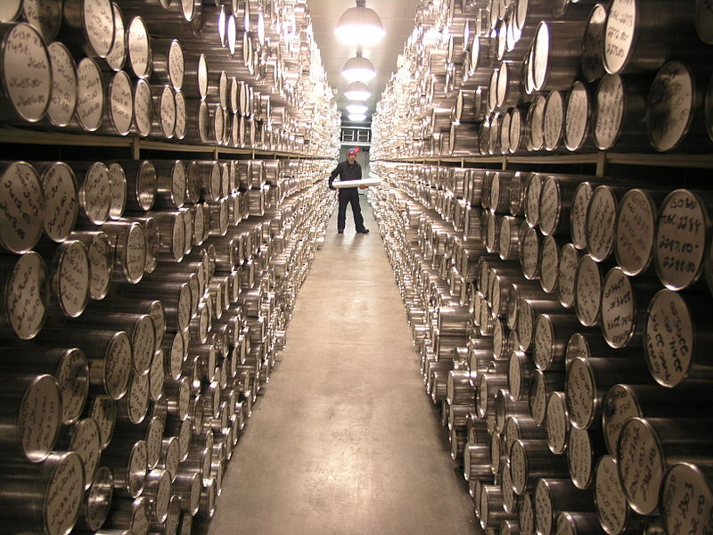
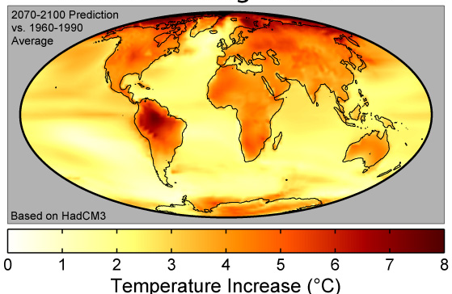

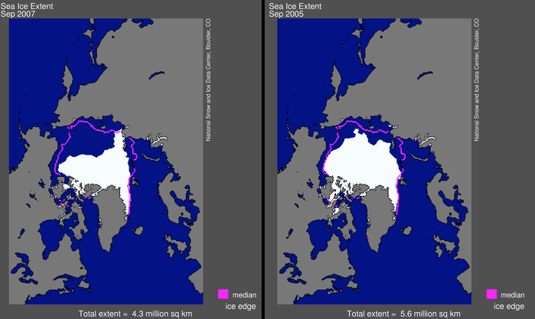
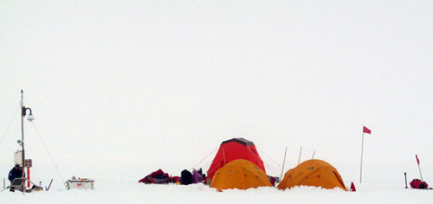
NSF’s Definition of Data
The NSF definition of data is very broad - you may be surprised at what is included!
Obviously
Data!
model output
Photo credit: Erik Cravens, National Ice Core Laboratory, 2006
samples
Photo credit: Robert A. Rohde, Global Warming Art, 2007
Model output
Photo credit: DynV, Open Clip Art Library, 2006
experiment data
Photo credit: National Snow and Ice Data Center, 2006
“in-situ” data
remote sensing data

Slide 4


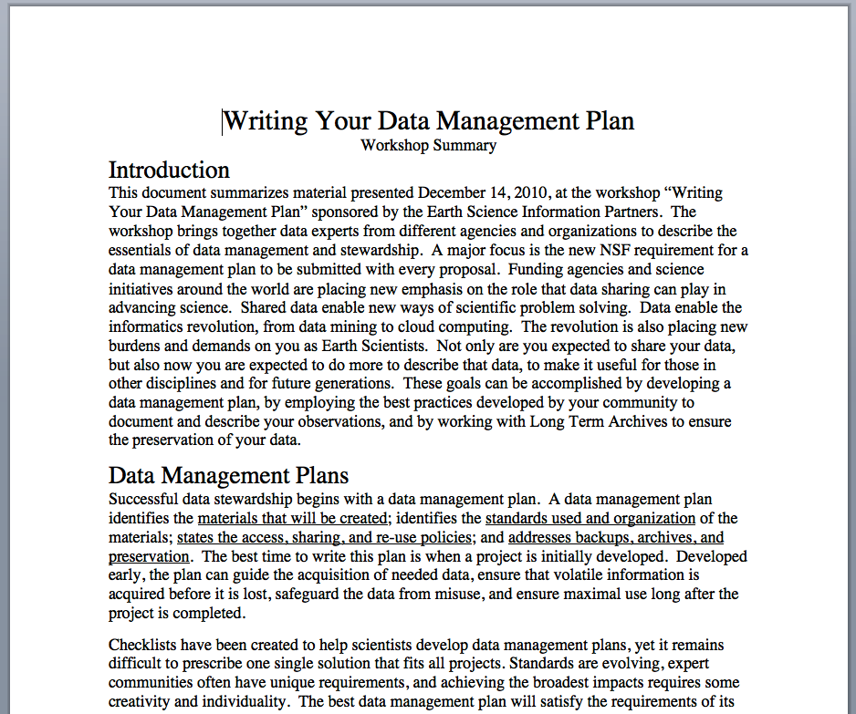
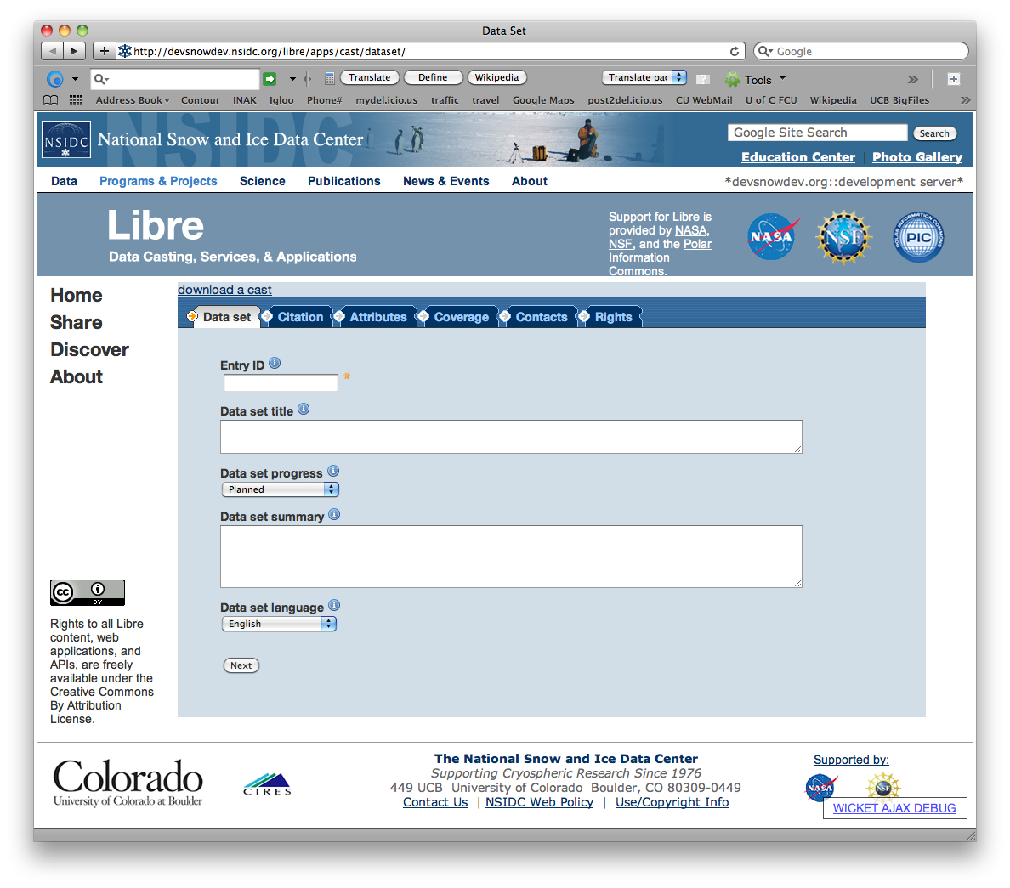
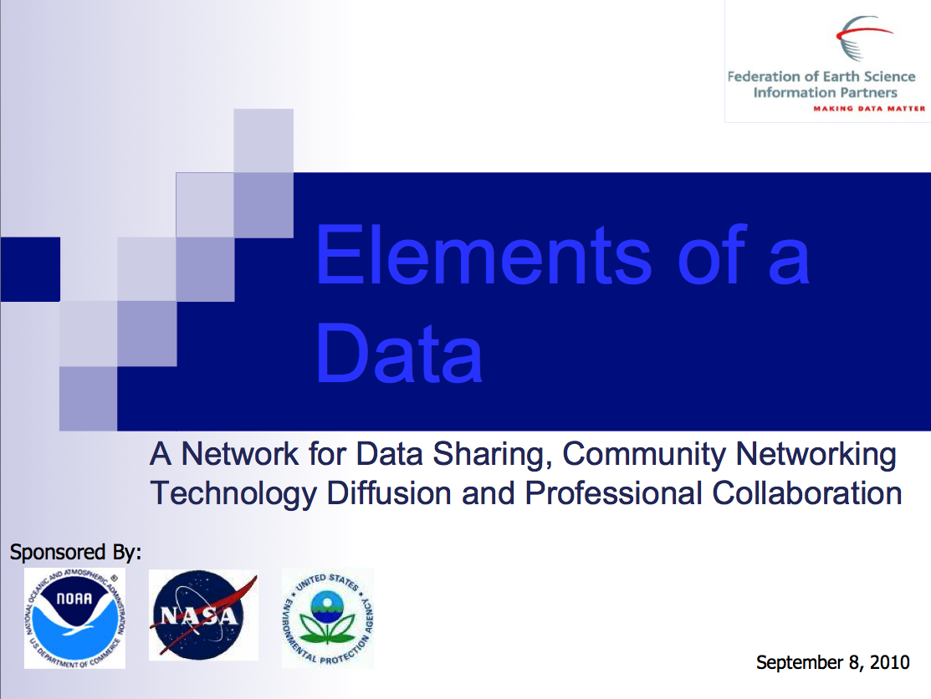
NSF’s Definition of Data
Not so
obviously
Data??
Blueprints
Photo credit: Franklin Jones, Wikimedia Commons, 2005
Photo credit: National Snow and Ice Data Center, 2012
Course Materials
Software

Slide 5
NSF policy on dissemination and sharing
Investigators must promptly publish all significant findings
Investigators are expected to share primary data, samples, etc. created or gathered
  Privacy or sensitive information concerns need to be taken into account
  Exceptions to open sharing may be granted on request to your program officer
Sharing of software or other inventions created as a result of your research is encouraged and some programs may require it

Slide 6
General guidance from NSF on plan content
Description of materials produced as a part of the project
Metadata and data standards and formats to be used
Access and sharing policies
Policies for re-use, re-distribution, and creation of derived products
Plan for preserving materials and access to them

Slide 7
Resources
NSF Data Policy
  NSF. 2011. “Award and Administration Guide.” http://www.nsf.gov/pubs/policydocs/pappguide/nsf11001/aag_6.jsp#VID4.
NSF Data Management Plan Requirement
  NSF. 2011. “Grant Proposal Guide, Chapter II.C.2.j.” http://www.nsf.gov/pubs/policydocs/pappguide/nsf11001/gpg_2.jsp#dmp.
NSF Directorates with specific guidance
  NSF. 2011. “Dissemination and Sharing of Research Results.” http://www.nsf.gov/bfa/dias/policy/dmp.jsp.

Slide 8
Other Relevant Modules
For more information about why data management planning can help you see
  Data Management Plans: Why do a data management plan?
For more information about what to put in your data management plan see
  Elements of a data management plan
For a discussion of agency requirements for publishing metadata about your data see
  Local Data Management: Advertising your data: Agency/Institution requirements for publishing metadata
For more information about agency requirements for preserving your data see
  Preservation strategies: Agency or institution requirements

