Slide 1
Providing Access to Your Data: Access Mechanisms
Local Data Management
Robert R. Downs, PhD
Socioeconomic Data and Applications Center (SEDAC)
Center for International Earth Science Information Network (CIESIN)
Columbia University
Version 1.0
Review Date
Copyright 2012 Robert R. Downs.
Notes:
Modules should be 3-7 minutes long
Voiceover script:
This training module is part of the ESIP Federation's Data Management Course for Scientists. The subject of this module is [name of category / name of subcategory, if any, e.g., "The case for data stewardship / Agency Requirements"]. The title of this module is [Subtitle]authored by [Author Name] from [full Organization Name, no acronyms]. Besides the Earth Science Information Partners (ESIP) Federation, sponsors of this Data Management Course are the Data Conservancyand the United States National Oceanographic and Atmospheric Administration, NOAA.

Slide 2
Overview
Background and context
Relevance to data management
Access providers and mechanisms
Community considerations for access
Resource considerations for access
Access mechanisms offered by data centers
Notes:
Overview Module: Voiceover Script for Slide 2
Just to give you an overview of what this module will cover, we have defined this module as:
We think the following information might be helpful for you to understand as background for the topics covered in this module:
As a high level overview, we'll touch upon these topics in this module:

Slide 3
Background and context
Access mechanisms include ways to foster access and use of your data
Provide your own access mechanisms or utilize services offered by others
Work with your community’s data center to identify possible access means for your data
The selection of access mechanisms should be based on the needs of the user community and the opportunities that are available
Choices among access mechanisms can influence how your data are managed, discovered, accessed, and used
Selection of ideal access mechanisms can foster access to your data
Notes:
Background and context: Voiceover Script for Slide 3
Now that you have an idea of what this module will cover, you might be wondering why these topics are important for data management. To answer that question, please consider the following:
At this point, it might seem that managing your data involves a lot more effort than may be warranted. If so, there are both incentives and warnings to share that might help motivate you to do your part for data management. As incentives, think about these possibilities:
On the other hand, a few warning thoughts might be in order. For instance:

Slide 4
Relevance to data management
Data will have enduring value if they are accessible and usable
Access mechanisms facilitate data discovery, access, and usability by future users
Data services can enable new uses of data and new user communities
Data that continue to be used are recognized as having future value worthy of continuing stewardship
Working with your archive can help identify access mechanisms for your data
Notes:
Relevance to Data Management: Voiceover Script for Slide 4
Now that you have an idea of what this module will cover, you might be wondering why these topics are important for data management. To answer that question, please consider the following:
At this point, it might seem that managing your data involves a lot more effort than may be warranted. If so, there are both incentives and warnings to share that might help motivate you to do your part for data management. As incentives, think about these possibilities:
On the other hand, a few warning thoughts might be in order. For instance:

Slide 5
Access providers and mechanisms
Who provides access: producer (you) or distributor?
Single or multiple distributors (version control, commitment, cited source)
Producer provides access
Producer’s website, project website, blog, Email, portable media
Distributor provides access
Distributor’s website: organized by collections, projects, or producers
What are they providing access to: packaged data?
Data package includes documentation (any information users need to know)
What is the means for providing access?
Free or fee, discovery, user capabilities, user services (help), registration
For how long will they provide access?
Organizational commitment, infrastructure, sustainability
Notes:
Access providers and mechanisms: Voiceover Script for Slide 5
Now that you have an idea of what this module will cover, you might be wondering why these topics are important for data management. To answer that question, please consider the following:
At this point, it might seem that managing your data involves a lot more effort than may be warranted. If so, there are both incentives and warnings to share that might help motivate you to do your part for data management. As incentives, think about these possibilities:
On the other hand, a few warning thoughts might be in order. For instance:

Slide 6
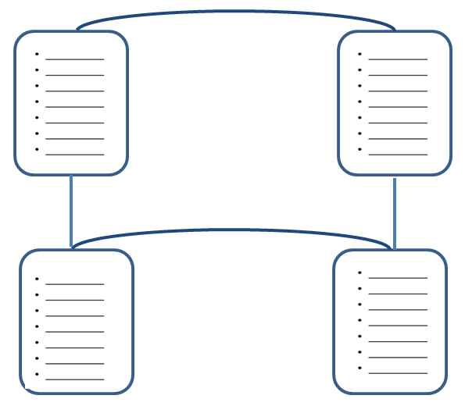
Community considerations for access
Envisioned users and uses
Sites for research (disciplinary, interdisciplinary), education, planning, policy-making
Community expectations
Download, analysis or data integration tools, reference services (help desk, FAQs)
Affiliations (organizational, disciplinary)
Government clearinghouse, institutional repository, disciplinary archive
Notes:
Considerations for access mechanisms: Voiceover Script for Slide 6
Now that you have an idea of what this module will cover, you might be wondering why these topics are important for data management. To answer that question, please consider the following:
At this point, it might seem that managing your data involves a lot more effort than may be warranted. If so, there are both incentives and warnings to share that might help motivate you to do your part for data management. As incentives, think about these possibilities:
On the other hand, a few warning thoughts might be in order. For instance:

Slide 7
Resource considerations for access
Costs for deposit, maintenance, or access
Free deposit, free access, deposit fees, access fees, subscription fees
Discovery opportunities
Inclusion in catalogs, metadata harvesting, search engine optimization, promotion
Facilitating registration, rights, or restrictions
Capabilities to require registration, respect rights, or enforce restrictions
Expertise and resource availability (current and long-term)
Sustainable organization and infrastructure to foster ongoing development and access
Use and impact measures
Download counts, page visits by domain or country, published uses, data product citations
Notes:
Considerations for access mechanisms: Voiceover Script for Slide 6
Now that you have an idea of what this module will cover, you might be wondering why these topics are important for data management. To answer that question, please consider the following:
At this point, it might seem that managing your data involves a lot more effort than may be warranted. If so, there are both incentives and warnings to share that might help motivate you to do your part for data management. As incentives, think about these possibilities:
On the other hand, a few warning thoughts might be in order. For instance:

Slide 8
Access mechanisms offered by data centers
Catalog
Described within searchable catalogs that are relevant to user community
Descriptions provide sufficient information to inform usage decisions
Collection
Many datasets may be accessible through a single collection
Collection may include resources for a topic or for other purposes
Dataset webpage (data page, splash page, landing page)
Page provides access to data, contextual information, and services
Contains dataset title, metadata, related resources, recommended citation
Services
Database, gazetteer, linked data, search, intuitive (smart) interface
Web Coverage Services (WCS), Web Map Services (WMS), Web Processing Services (WPS), Web Feature Services (WFS)
Order system for delivery on portable media
Notes:
Access mechanisms offered by data centers: Voiceover Script for Slide 7
Now that you have an idea of what this module will cover, you might be wondering why these topics are important for data management. To answer that question, please consider the following:
At this point, it might seem that managing your data involves a lot more effort than may be warranted. If so, there are both incentives and warnings to share that might help motivate you to do your part for data management. As incentives, think about these possibilities:
On the other hand, a few warning thoughts might be in order. For instance:

Slide 9
Resources
DataONE Best Practices Database. 2012. DataONE. Available online at http://www.dataone.org/best-practices
Geospatial Data Preservation Resource Center. 2011. CIESIN, Columbia University. Available online at http://geopreservation.org/
GEOSS AIP-2 Demonstration. 2012. Open Geospatial Consortium, Inc. Available online at http://www.ogcnetwork.net/pub/ogcnetwork/GEOSS/AIP2/index.html
Notes:
Resources Module: Voiceover script
We've collected some additional resources that might you might find helpful should you need more information about some of the areas that we've covered briefly. We'd also like to explain why we think they might be useful.

Slide 10
References
Michener, W., Vieglais, D., Vision, T., Kunze, J., Cruse, P., Janée, G.. DataONE: Data Observation Network for Earth — Preserving Data and Enabling Innovation in the Biological and Environmental Sciences. D-Lib Magazine, 17(1/2) [Web]. 2011. Available online at http://dx.doi.org/10.1045/january2011-michener
Percivall, G., Ménard, L., Chung, L., Nativi, S., and Pearlman, J. (2011). Geo-processing in cyberinfrastructure: making the web an easy to use geospatial computational platform. 34th International Symposium on Remote Sensing of Environment, Sydney, Australia. Available online at http://hal.archives-ouvertes.fr/hal-00608573/
Van den Eynden, V., Corti, L., Woollard, M., Bishop, L., and Horton, L.. Managing and Sharing Data: Best Practices for Researchers, 3rd Edition. UK Data Archive, University of Essex, ISBN: 1-904059-78-3 [Web]. 2011. Available online at http://www.data-archive.ac.uk/media/2894/managingsharing.pdf
Notes:
References Module: Voiceover script
Within this module, we've made reference to a number of published information sources that we think you may want to review when you want more in-depth information. The most relevant references are listed here.

Slide 11
Other Relevant Modules
Creating documentation and metadata: Metadata for discovery
Providing descriptive metadata can foster discovery and access
Providing access to your data: Determining your audience
Determine your audience to understand their data needs
Preservation strategies: Options for archiving your data
Choose an archive that will improve access to your data
Providing access to your data: Rights
Sufficient intellectual property rights can enable open access to data
Notes:
Other Relevant Modules Module: Voiceover script
The modules of the ESIP Data Management Course have been designed to complement and supplement each other. In light of this plan, we think you might find the following, related modules relevant to you and why as you gain a better understanding of data management:

