Slide 1


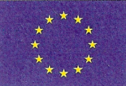


Monitoring Atmospheric
Composition & Climate
Adrian Simmons, MACC coordinator
(Presented by Dominique Marbouty)
European Centre for Medium-Range Weather Forecasts

Slide 2


GMES atmospheric environmental services
A component of Europe’s Global Monitoring
for Environment and Security initiative
  which also provides services for land and ocean
The atmospheric programme comprises
  developing operational space-based observation of constituents
  strengthening the provision of complementary in-situ observations
  developing and operating associated data and information services
MACC is a 48-partner EC-funded project that:
  is implementing the core monitoring and
  forecasting services
  will support downstream services for specific sectors
  follows-up previous GEMS (EC-FP7) and PROMOTE (ESA)

Slide 3
GMES atmospheric environmental services
Services related to the chemical and particulate content of the atmosphere, providing data and information on:
  Climate forcing by greenhouse gases and aerosols
  Long-range pollutant transport
  European air quality
  Dust outbreaks
  Resources for solar power generation
  UV radiation
  …
through global and regional processing based on adapting the data assimilation and forecasting approaches of numerical weather prediction

Slide 4
ECMWF | European Centre for Medium-Range Weather Forecasts | INT
UKMET | Met Office | UK
LMD, LA, LISA, ICARE | Centre National de la Recherche Scientifique | FR
CEA | Commissariat à l’Energie Atomique | FR
DLR | Deutsches Zentrum für Luft- und Raumfahrt e.V. | DE
MPG | Max-Planck-Gesellschaft zur Förderung der Wissenschaften e. V. | DE
KNMI | Royal Netherlands Meteorological Institute | NL
BIRA-IASB | Institut d’aéronomie spatiale de Belgique | BE
FMI | Ilmatieteen Laitos - Finnish Meteorological Institute | FI
DMI | Danish Meteorological Institute | DK
DWD | Deutscher Wetterdienst | DE
IUP-UB | University of Bremen | DE
UPMC-SA | Université Pierre et Marie Curie - Paris 6 | FR
NKUA | National and Kapodistrian University of Athens | GR
MF-CNRM | Météo-France - Centre National de Recherches Météorologiques | FR
NUIG | National University of Ireland, Galway | IE
SMHI | Swedish Meteorological and Hydrological Institute | SU
ARPA ER | ARPA Emilia Romagna | IT
AEMet | Agencia Estatal de Meteorología | ES
MET.NO | Meteorologisk Institutt | NO
FRIUUK | Rheinisches Insti. für Umweltforschung an der Universität zu Köln | DE
JRC | European Commission - Joint Research Centre | JRC
INERIS | Institut National de l’Environnement Industriel et des Risques | FR
CHMI | Czech Hydrometeorological Institute | CZ
NMA | National Meteorological Administration, Romania | RO
PIEP | Institute of Environmental Protection | PL
IMPERIAL | Imperial College of Science, Technology and Medicine | UK
FZJ | Forschungszentrum Jülich GmbH | DE
ARSO | Environmental Agency of the Republic of Slovenia | SV
ARMINES | Association pour la recherche et le développement des méthodes et processus industriels | FR
SRON | Netherlands Institute for Space Research | NL
UNIVLEEDS | University of Leeds | UK
KCL | King’s College London | UK
VUA | Vrije Universiteit, Amsterdam | NL
UBA_AT | Umweltbundesamt GmbH | AT
TNO | Nederlandse Organisatie voor toegepast-natuurwetenschappelijk onderzoek | NL
CERC | Cambridge Environmental Research Consultants Ltd | UK
CGS | Carlo Gavazzi Space S.p.A. | IT
Flyby | Flyby s.r.l. | IT
CERFACS | Centre Européen de Recherche et Formation avancée en Calcul Scientifique | FR
CNES | Centre National d’Etudes Spatiales | FR
NILU | Norsk Institutt for Luftforskning | NO
CNR | National Research Council | IT
NEPA | National Environmental Protection Agency | RO
UWS | University of the West of Scotland | UK
The MACC Consortium
46 national entities (universities, national labs, environment agencies, …) from 18 European States, plus ECMWF and JRC
Partners include 11 National Met Services
Supporting organizations comprise several other national institutes, EUMETSAT and WMO
ECMWF is project coordinator

Slide 5
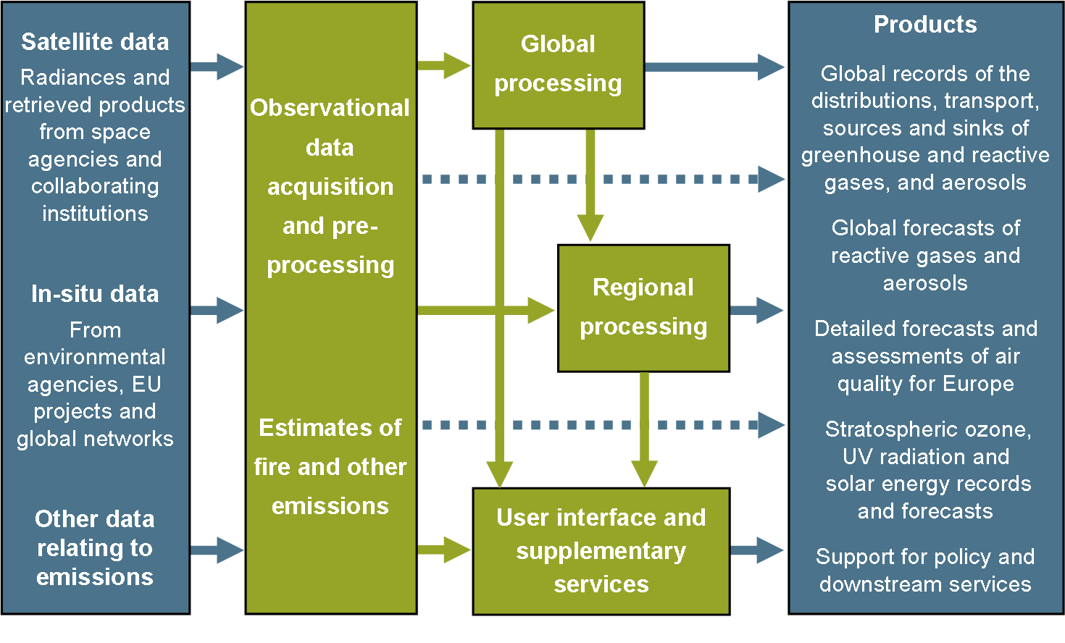
Service structure

Slide 6
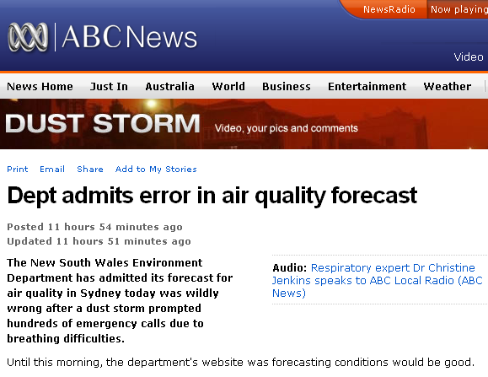
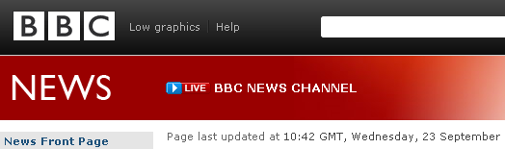
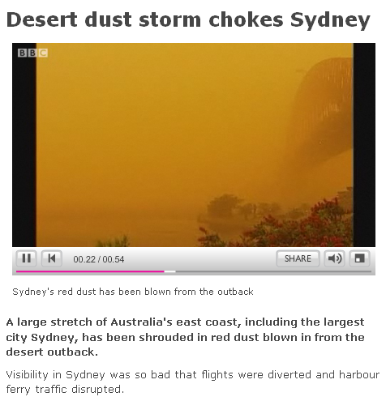
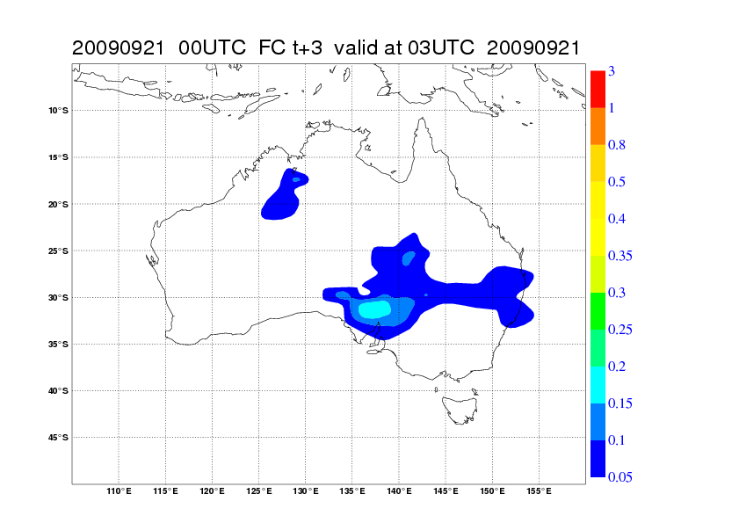
Real-time aerosol forecasts
MACC dust aerosol optical depth

Slide 7
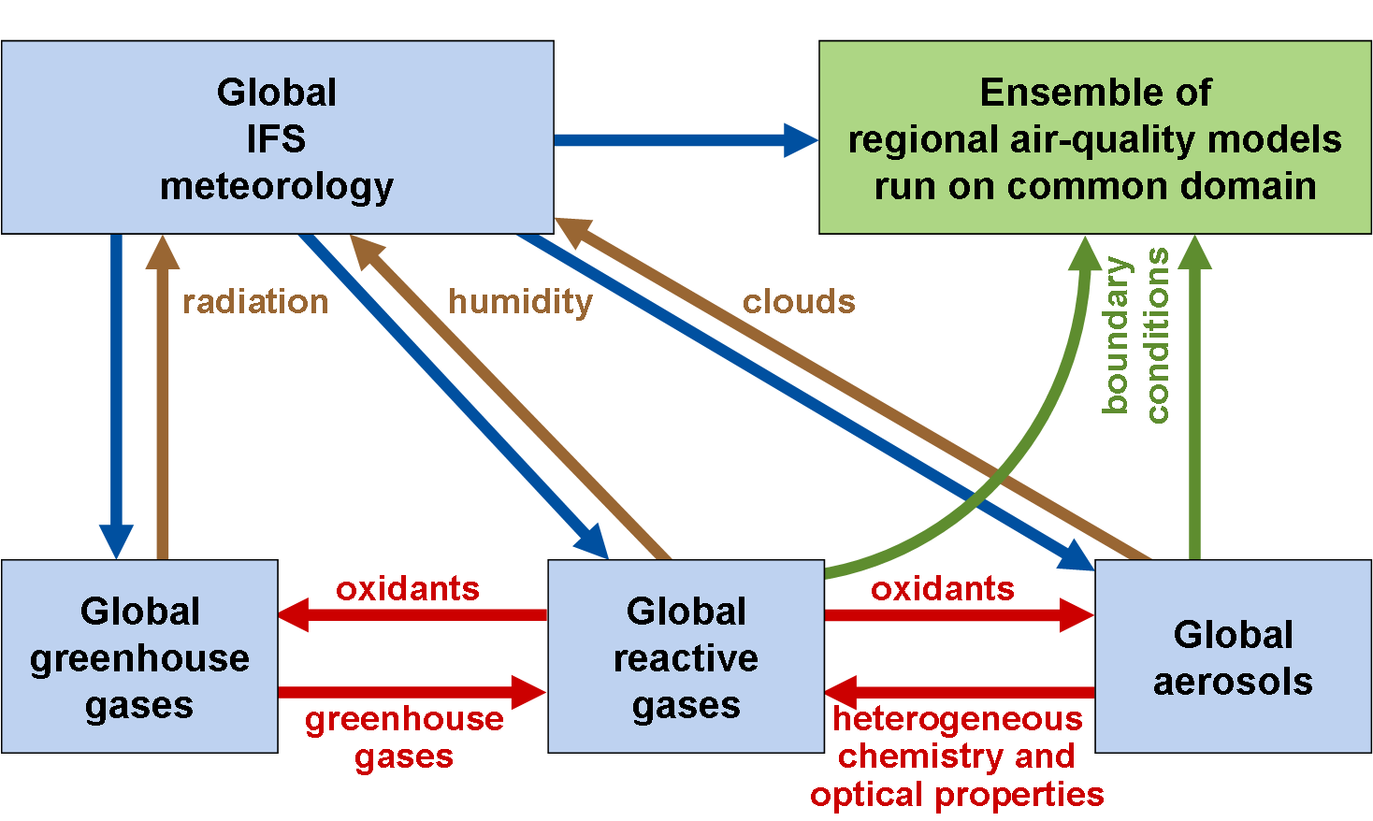
Global/regional system
Global components are incorporated within ECMWF’s core Integrated Forecasting System (IFS)
Regional ensemble comprises a set of nationally developed models run on a common European domain

Slide 8
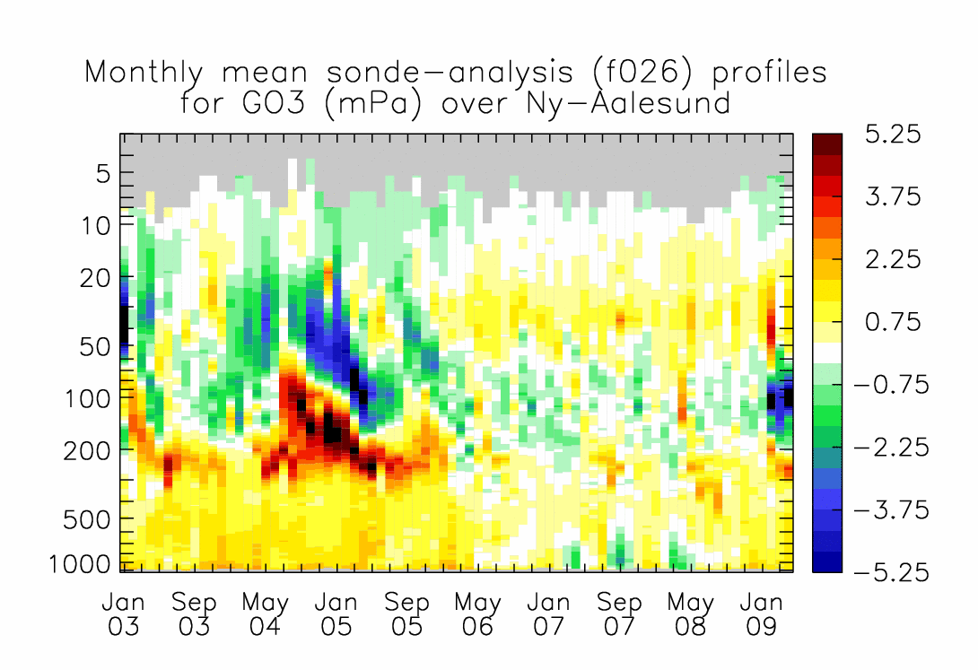
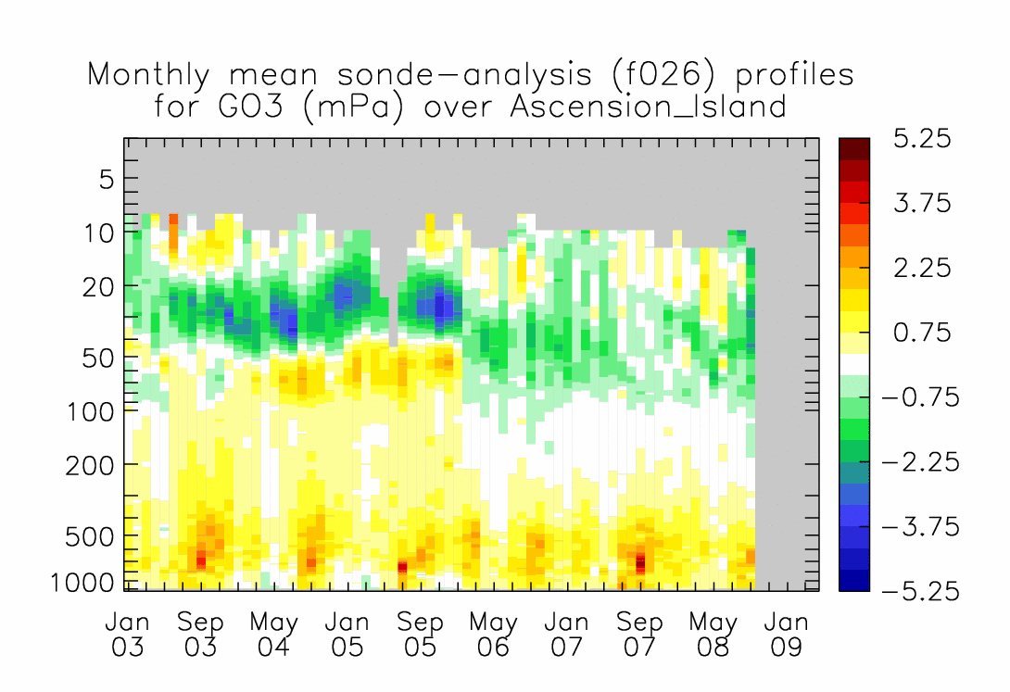
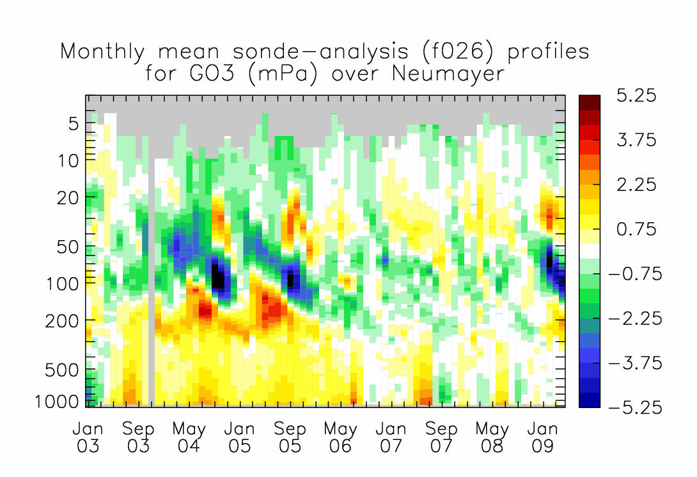
Comparison of ozone reanalysis and ozonesonde data
No LS data
Limb-sounding data assimilated in 2003 (MIPAS) and 2006-2008 (MLS)
These data, especially MLS, are clearly beneficial.
OMI are used from July 2007.

Slide 9
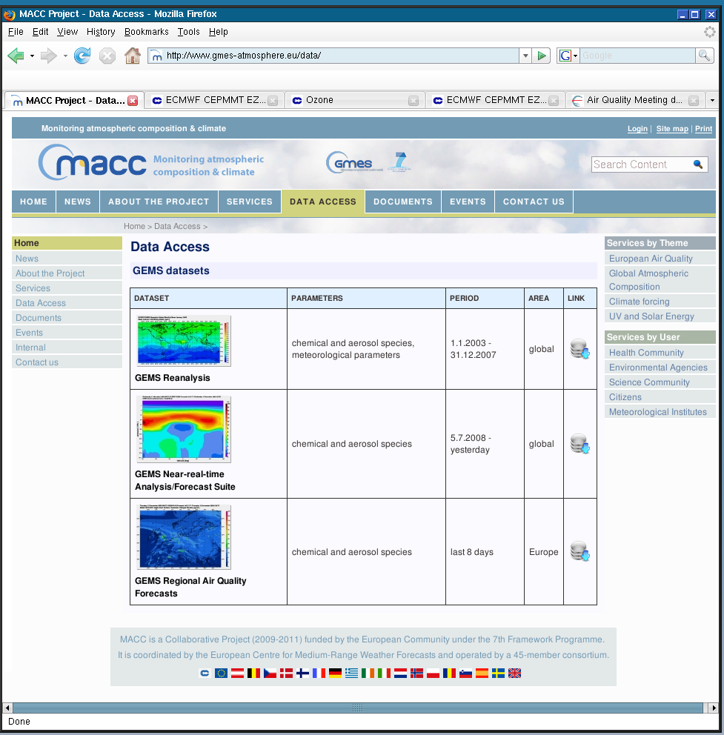
Global availability of products
Global data products on atmospheric composition are publicly available with minimal conditions, from a reanalysis
for 2003-2007 and from daily
near-real-time forecasts
Complementary conventional
global meteorological data
products from the reanalysis
are similarly available
A new reanalysis for 2003-2010
will be produced during MACC
Data dissemination systems
will evolve during MACC
www.gmes-atmosphere.eu

Slide 10
Data use and needs
MACC makes extensive use of satellite data for assimilation
  data access presents few problems; data suppliers have made efforts to support near-real-time delivery
  plans for future provision are progressing reasonably
  continuity of limb-sounding is a concern for reactive-gas component
  OCO replacement ?
Situation for in-situ observational data is more problematic
  needed in near-real-time for validation and increasingly for assimilation
  need is for prompt delivery, common coding standards, integrated global networks and archiving, network monitoring, …
  need is for upper-air (ozonesonde, aircraft, …) as well as surface data
More timely data on emissions are needed
  GEMS used inventories for anthropogenic emissions based on 2003 or earlier

Slide 11
International coordination
MACC builds on heritage of numerical weather prediction
  uses WMO BUFR code for near-real-time transfer of European
  air-quality data for validating forecasts
  converts all input data to WMO BUFR code for assimilation in global system
  uses WMO GRIB code for primary representation of model data fields (with converters to NetCDF)
  will utilize WMO Information System and comply with European INSPIRE directive
A GEO initiative has the potential to address issues related to the needs for observational data and up-to-date inventories
  activity should be harmonized with the activities of WMO/GAW, and support the full implementation of GCOS as the climate observing component of GEOSS

Slide 12
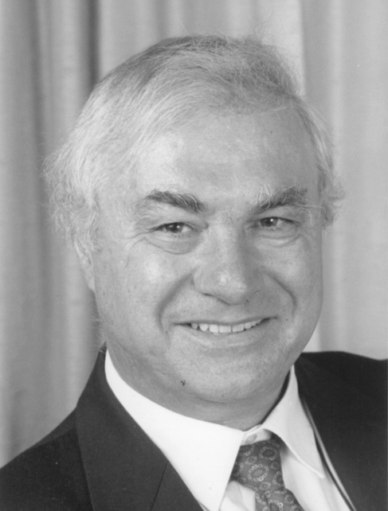
Acknowledgments
GEMS/MACC team at ECMWF
Anna Agusti-Panareda, Angela Benedetti,
Richard Engelen, Johannes Flemming,
Antje Inness, Luke Jones, Johannes Kaiser,
Jean-Jacques Morcrette, Miha Razinger,
Adrian Simmons, Martin Suttie
MACC Management Board members
from partner organizations
Olivier Boucher, Met Office Frédéric Chevallier, CEA
Hendrik Elbern, Univ. Köln Henk Eskes, KNMI
Claire Granier, Service d'Aéronomie Thomas Holzer-Popp, DLR
Øystein Hov, met.no Vincent-Henri Peuch, Météo-France
Laurence Rouïl, INERIS Martin Schultz, FZ Jülich
Leonor Tarrason, NILU
and all other team members
Tony
Hollingsworth
(1943-2007)

