Slide 1
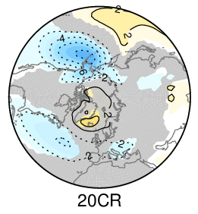
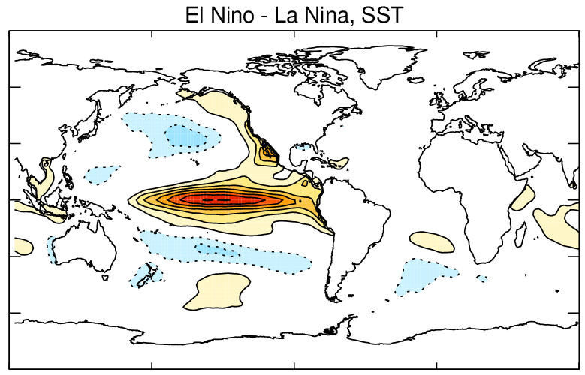


The challenges of evaluating global climate models with the limited observational record.
Isla Simpson
Climate and Global Dynamics Laboratory, NCAR

Slide 2
My Perspective: Typically aiming to evaluate the representation of dynamical processes within the atmospheric component of global climate models

Slide 3
My Perspective: Typically aiming to evaluate the representation of dynamical processes within the atmospheric component of global climate models
Issues

Slide 4
My Perspective: Typically aiming to evaluate the representation of dynamical processes within the atmospheric component of global climate models
Issues
The quality of observation based products.

Slide 5
My Perspective: Typically aiming to evaluate the representation of dynamical processes within the atmospheric component of global climate models
Issues
The quality of observation based products.
The limited sampling of the real world over the short observational record.

Slide 6
My Perspective: Typically aiming to evaluate the representation of dynamical processes within the atmospheric component of global climate models
Issues
The quality of observation based products.
The limited sampling of the real world over the short observational record.
While the impact of natural internal variability and limited sampling has been brought to the forefront recently through the use of large ensembles of model simulations (Hoerling et al 1997, Sardeshmukh and Kumar 2000, Deser et al 2012, Deser et al 2014, Kay et al 2015, Deser et al 2016).

Slide 7
My Perspective: Typically aiming to evaluate the representation of dynamical processes within the atmospheric component of global climate models
Issues
The quality of observation based products.
The limited sampling of the real world over the short observational record.
While the impact of natural internal variability and limited sampling has been brought to the forefront recently through the use of large ensembles of model simulations (Hoerling et al 1997, Sardeshmukh and Kumar 2000, Deser et al 2012, Deser et al 2014, Kay et al 2015, Deser et al 2016).
The impact of limited sampling on our observation based analyses continues to be underappreciated in our field.

Slide 8
How do we deal with this issue?
The combined use of model ensembles and appropriate statistical analysis of the observations can make us aware of the limitations of our observational analysis. Where we can say our models are in error and where we can’t.

Slide 9
How do we deal with this issue?
The combined use of model ensembles and appropriate statistical analysis of the observations can make us aware of the limitations of our observational analysis. Where we can say our models are in error and where we can’t.
A more process based view of model errors e.g., analysis of short term forecast errors can allow us to identify erroneous processes.

Slide 10
How do we deal with this issue?
The combined use of model ensembles and appropriate statistical analysis of the observations can make us aware of the limitations of our observational analysis. Where we can say our models are in error and where we can’t.
A more process based view of model errors e.g., analysis of short term forecast errors can allow us to identify erroneous processes.

Slide 11



An Example: The Northern Hemisphere circulation response to El Nino Southern Oscillation (ENSO)
Deser, Simpson, McKinnon and Phillips (2017) The Northern Hemisphere Extra-tropical Atmospheric Circulation Response to ENSO: How well do we know it and how do we evaluate models accordingly? J. Clim., 30, 5059-5082
Clara Deser
Karen McKinnon
Adam Phillips

Slide 12
An Example: The Northern Hemisphere circulation response to El Nino Southern Oscillation (ENSO)
ENSO: Irregular but quasi-periodic variation in Sea Surface Temperatures in the Eastern Equatorial Pacific. Warm phase = El Nino, Cold phase = La Nina

Slide 13
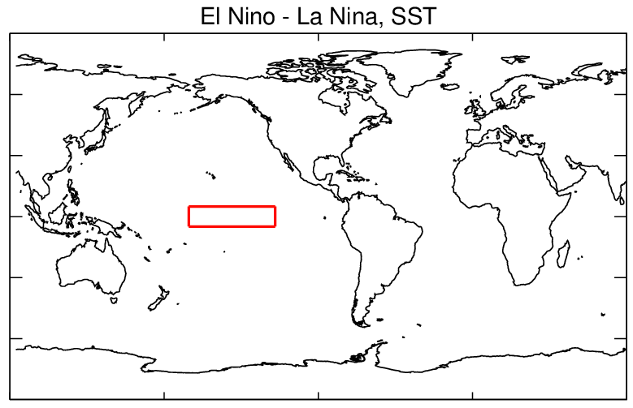
An Example: The Northern Hemisphere circulation response to El Nino Southern Oscillation (ENSO)
ENSO: Irregular but quasi-periodic variation in Sea Surface Temperatures in the Eastern Equatorial Pacific. Warm phase = El Nino, Cold phase = La Nina
Defining Events
Nino 3.4 region
Sea surface temperature of the Nino3.4 region of the equatorial Pacific
Smooth monthly with a 3 point binomial filter, detrend, normalize by σ, calculate November, December, January average.

Slide 14
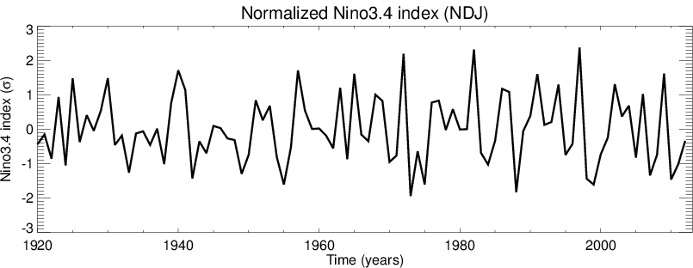
An Example: The Northern Hemisphere circulation response to El Nino Southern Oscillation (ENSO)
ENSO: Irregular but quasi-periodic variation in Sea Surface Temperatures in the Eastern Equatorial Pacific. Warm phase = El Nino, Cold phase = La Nina
Defining Events
Nino 3.4 region
Sea surface temperature of the Nino3.4 region of the equatorial Pacific
Smooth monthly with a 3 point binomial filter, detrend, normalize by σ, calculate November, December, January average.
ERSSTv3B SST dataset back to 1920 (Smith et al 2008)

Slide 15
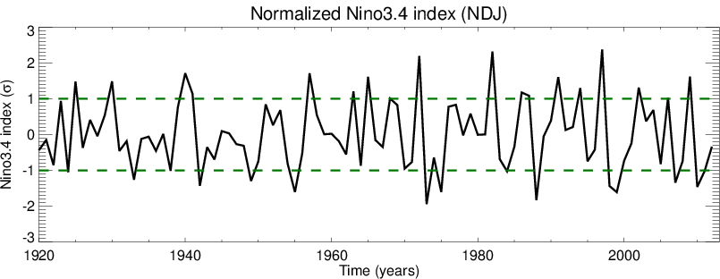
An Example: The Northern Hemisphere circulation response to El Nino Southern Oscillation (ENSO)
ENSO: Irregular but quasi-periodic variation in Sea Surface Temperatures in the Eastern Equatorial Pacific. Warm phase = El Nino, Cold phase = La Nina
Defining Events
Nino 3.4 region
Sea surface temperature of the Nino3.4 region of the equatorial Pacific
Smooth monthly with a 3 point binomial filter, detrend, normalize by σ, calculate November, December, January average.
ERSSTv3B SST dataset back to 1920 (Smith et al 2008)

Slide 16
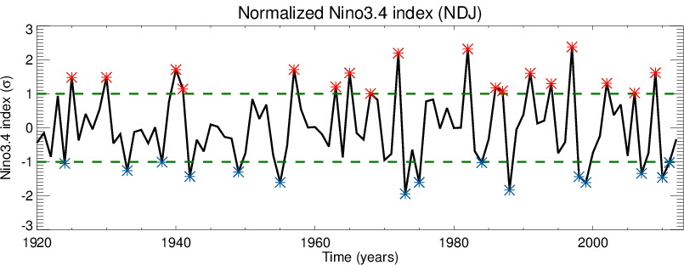
An Example: The Northern Hemisphere circulation response to El Nino Southern Oscillation (ENSO)
ENSO: Irregular but quasi-periodic variation in Sea Surface Temperatures in the Eastern Equatorial Pacific. Warm phase = El Nino, Cold phase = La Nina
Defining Events
Nino 3.4 region
Sea surface temperature of the Nino3.4 region of the equatorial Pacific
Smooth monthly with a 3 point binomial filter, detrend, normalize by σ, calculate November, December, January average.
18 El Nino’s
14 La Nina’s

Slide 17
An Example: The Northern Hemisphere circulation response to El Nino Southern Oscillation (ENSO)
Contour interval = 0.5K
Composite mean difference in Sea Surface Temperature between 18 El Nino and 14 La Nina events.

Slide 18

An Example: The Northern Hemisphere circulation response to El Nino Southern Oscillation (ENSO)
DJF Sea Level Pressure Anomalies (El Nino – La Nina)
Grey = anomaly is not significantly different from zero at the 5% level using a T-test
Contour interval = 0.5K
Composite mean difference in Sea Surface Temperature between 18 El Nino and 14 La Nina events.
Composite mean difference in Sea Level Pressure between 18 El Nino and 14 La Nina events. 20th Century Reanalysis

Slide 19
An Example: The Northern Hemisphere circulation response to El Nino Southern Oscillation (ENSO)
DJF Sea Level Pressure Anomalies (El Nino – La Nina)
Deepening of the Aleutian Low
Grey = anomaly is not significantly different from zero at the 5% level using a T-test
Contour interval = 0.5K
Composite mean difference in Sea Surface Temperature between 18 El Nino and 14 La Nina events.
Composite mean difference in Sea Level Pressure between 18 El Nino and 14 La Nina events. 20th Century Reanalysis

Slide 20
An Example: The Northern Hemisphere circulation response to El Nino Southern Oscillation (ENSO)
DJF Sea Level Pressure Anomalies (El Nino – La Nina)
Deepening of the Aleutian Low
Grey = anomaly is not significantly different from zero at the 5% level using a T-test
Connections to North Atlantic SLP
Contour interval = 0.5K
Composite mean difference in Sea Surface Temperature between 18 El Nino and 14 La Nina events.
Composite mean difference in Sea Level Pressure between 18 El Nino and 14 La Nina events. 20th Century Reanalysis

Slide 21
An Example: The Northern Hemisphere circulation response to El Nino Southern Oscillation (ENSO)
DJF Sea Level Pressure Anomalies (El Nino – La Nina)
Deepening of the Aleutian Low
Grey = anomaly is not significantly different from zero at the 5% level using a T-test
How well do our global climate models capture this connection?
Connections to North Atlantic SLP
Contour interval = 0.5K
Composite mean difference in Sea Surface Temperature between 18 El Nino and 14 La Nina events.
Composite mean difference in Sea Level Pressure between 18 El Nino and 14 La Nina events. 20th Century Reanalysis

Slide 22
Evaluating the ENSO response in NCAR’s Community Earth System Model (CESM)

Slide 23
Evaluating the ENSO response in NCAR’s Community Earth System Model (CESM)
“Pacemaker” Experiments: freely running fully coupled global climate model (atmosphere / ocean /land) but with SST anomalies in the equatorial Pacific nudged toward observations.
(similar conclusions if you run atmosphere only with prescribed SST’s)
Simulations run from 1920 to 2013

Slide 24
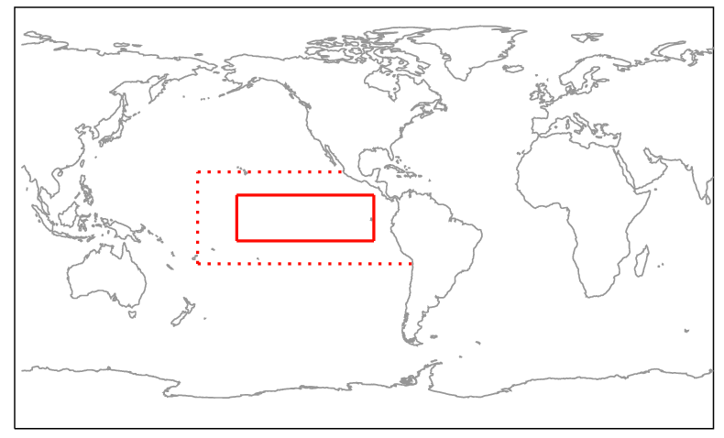
Evaluating the ENSO response in NCAR’s Community Earth System Model (CESM)
“Pacemaker” Experiments: freely running fully coupled global climate model (atmosphere / ocean /land) but with SST anomalies in the equatorial Pacific nudged toward observations.
(similar conclusions if you run atmosphere only with prescribed SST’s)
Sea surface temperatures nudged toward observed anomalies
Ocean freely evolving elsewhere
Simulations run from 1920 to 2013

Slide 25
Evaluating the ENSO response in NCAR’s Community Earth System Model (CESM)
“Pacemaker” Experiments: freely running fully coupled global climate model (atmosphere / ocean /land) but with SST anomalies in the equatorial Pacific nudged toward observations.
(similar conclusions if you run atmosphere only with prescribed SST’s)
18 El Nino’s
14 La Nina’s
Simulations run from 1920 to 2013

Slide 26
Evaluating the ENSO response in NCAR’s Community Earth System Model (CESM)
“Pacemaker” Experiments: freely running fully coupled global climate model (atmosphere / ocean /land) but with SST anomalies in the equatorial Pacific nudged toward observations.
(similar conclusions if you run atmosphere only with prescribed SST’s)
10 Pacemaker ensemble members from 1920 - 2013
Differ only in their initial conditions → differ only in the random weather noise arising from these different initial conditions (butterfly effect).
18 El Nino’s
14 La Nina’s
Simulations run from 1920 to 2013

Slide 27
Does the model captured the observed SLP difference between El Nino and La Nina?
“Observed” DJF Sea Level Pressure (El Nino – La Nina) from 20th Century Reanalysis
Grey = anomaly is not significantly different from zero at the 5% level using a T-test

Slide 28
Does the model captured the observed SLP difference between El Nino and La Nina?
“Observed” DJF Sea Level Pressure (El Nino – La Nina) from 20th Century Reanalysis
El Nino – La Nina SLP anomalies from one Pacemaker ensemble member
Grey = anomaly is not significantly different from zero at the 5% level using a T-test

Slide 29
Does the model captured the observed SLP difference between El Nino and La Nina?
“Observed” DJF Sea Level Pressure (El Nino – La Nina) from 20th Century Reanalysis
Another Pacemaker Ensemble member that differs only from a very small atmospheric temperature perturbation to the initial conditions used to start the simulation.
Grey = anomaly is not significantly different from zero at the 5% level using a T-test

Slide 30
Does the model captured the observed SLP difference between El Nino and La Nina?
“Observed” DJF Sea Level Pressure (El Nino – La Nina) from 20th Century Reanalysis
Grey = anomaly is not significantly different from zero at the 5% level using a T-test

Slide 31
Does the model captured the observed SLP difference between El Nino and La Nina?
“Observed” DJF Sea Level Pressure (El Nino – La Nina) from 20th Century Reanalysis
Grey = anomaly is not significantly different from zero at the 5% level using a T-test

Slide 32
Does the model captured the observed SLP difference between El Nino and La Nina?
“Observed” DJF Sea Level Pressure (El Nino – La Nina) from 20th Century Reanalysis
Grey = anomaly is not significantly different from zero at the 5% level using a T-test

Slide 33
Does the model captured the observed SLP difference between El Nino and La Nina?
“Observed” DJF Sea Level Pressure (El Nino – La Nina) from 20th Century Reanalysis
Grey = anomaly is not significantly different from zero at the 5% level using a T-test

Slide 34
Does the model captured the observed SLP difference between El Nino and La Nina?
“Observed” DJF Sea Level Pressure (El Nino – La Nina) from 20th Century Reanalysis
Grey = anomaly is not significantly different from zero at the 5% level using a T-test

Slide 35
Does the model captured the observed SLP difference between El Nino and La Nina?
“Observed” DJF Sea Level Pressure (El Nino – La Nina) from 20th Century Reanalysis
Grey = anomaly is not significantly different from zero at the 5% level using a T-test

Slide 36
Does the model captured the observed SLP difference between El Nino and La Nina?
“Observed” DJF Sea Level Pressure (El Nino – La Nina) from 20th Century Reanalysis
Grey = anomaly is not significantly different from zero at the 5% level using a T-test

Slide 37
Does the model captured the observed SLP difference between El Nino and La Nina?
“Observed” DJF Sea Level Pressure (El Nino – La Nina) from 20th Century Reanalysis
IF the model has a realistic representation of internal variability (weather noise) then there is substantial uncertainty on the “observed” response to ENSO.
Grey = anomaly is not significantly different from zero at the 5% level using a T-test

Slide 38
Does the model captured the observed SLP difference between El Nino and La Nina?
“Observed” DJF Sea Level Pressure (El Nino – La Nina) from 20th Century Reanalysis
In this case it is realistic -
From various bootstrapping analyses of the observed record
IF the model has a realistic representation of internal variability (weather noise) then there is substantial uncertainty on the “observed” response to ENSO.
Grey = anomaly is not significantly different from zero at the 5% level using a T-test

Slide 39
Does the model captured the observed SLP difference between El Nino and La Nina?
“Observed” DJF Sea Level Pressure (El Nino – La Nina) from 20th Century Reanalysis
Grey = anomaly is not significantly different from zero at the 5% level using a T-test

Slide 40
Summary

Slide 41
Summary
Observations are obviously vital for assessing the fidelity of our climate models

Slide 42
Summary
Observations are obviously vital for assessing the fidelity of our climate models
But, over the limited observational record there can be large uncertainties in aspects of both the observed climatology and variability of the atmosphere.

Slide 43
Summary
Observations are obviously vital for assessing the fidelity of our climate models
But, over the limited observational record there can be large uncertainties in aspects of both the observed climatology and variability of the atmosphere.
Ideally we’d like to have longer observational records.

Slide 44
Summary
Observations are obviously vital for assessing the fidelity of our climate models
But, over the limited observational record there can be large uncertainties in aspects of both the observed climatology and variability of the atmosphere.
Ideally we’d like to have longer observational records.
But, large model ensembles can provide valuable insights into these uncertainties provided that their noise/variability is similar to that of the real world.

Slide 45
Summary
Observations are obviously vital for assessing the fidelity of our climate models
But, over the limited observational record there can be large uncertainties in aspects of both the observed climatology and variability of the atmosphere.
Ideally we’d like to have longer observational records.
But, large model ensembles can provide valuable insights into these uncertainties provided that their noise/variability is similar to that of the real world.
We can identify the limitations of our models from observations and identify the limitations of our observations from models, provided the analysis is done in the correct way and it is ensured that the models representation of the random natural variability is adequate.

Slide 46
Thanks!
Contact: islas@ucar.edu

Slide 47
Extra Slides

