Slide 1

EPA’s Environmental Dataset Gateway (EDG)
Customizations for Geoportal
January 4, 2012

Slide 2

Meeting EPA User Needs
EDG -Open Source Geoportal
Data.Gov &FGDC Standards
REST Feeds & a Widget
Custom Browse Tree
Data Download Area
Data.Gov Inventory
Metrics Dashboard
Quality time for Q&A!

Slide 3
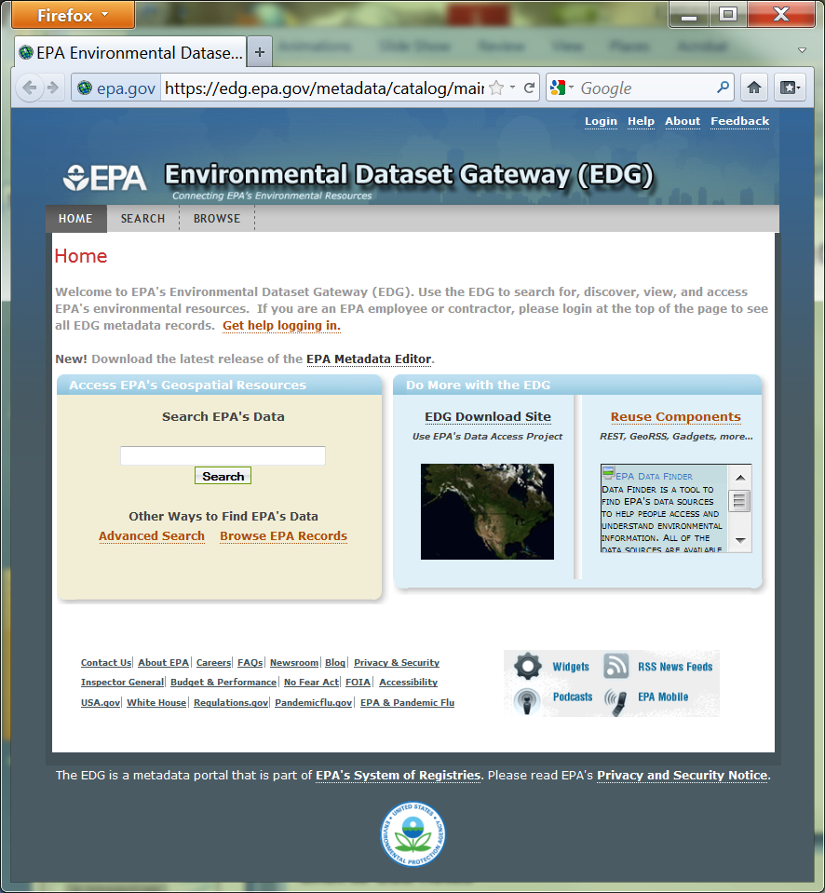
EDG -Open Source Geoportal

Slide 4
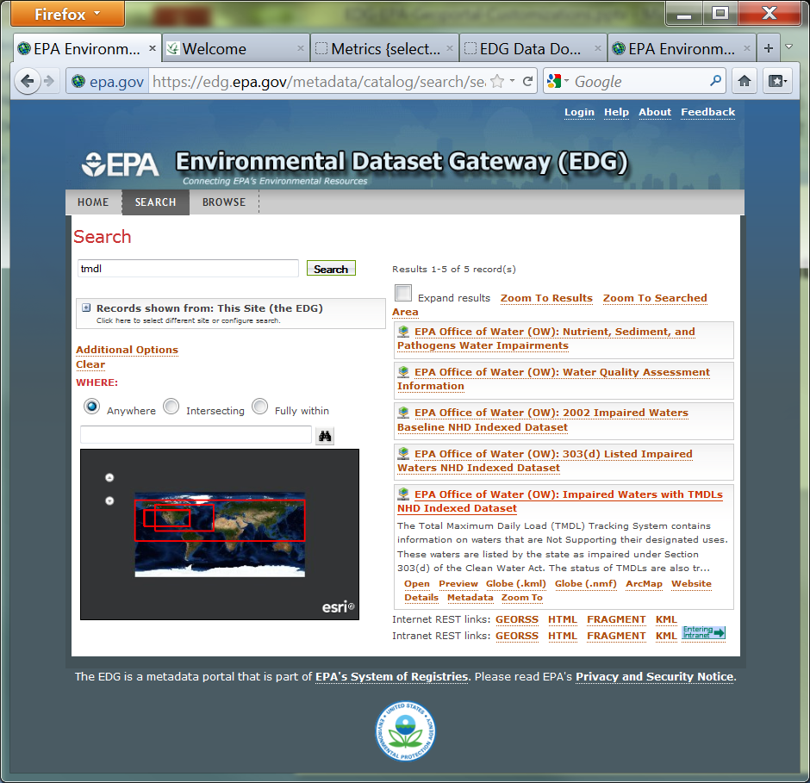
Data.Gov &FGDC Standards

Slide 5
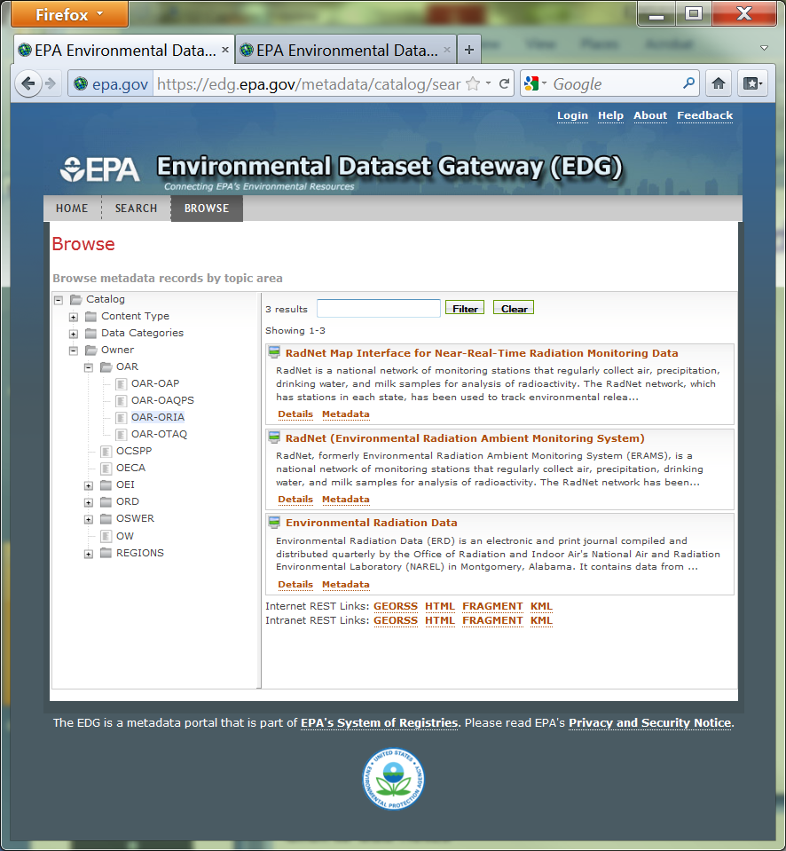
REST Feeds & a Widget

Slide 6
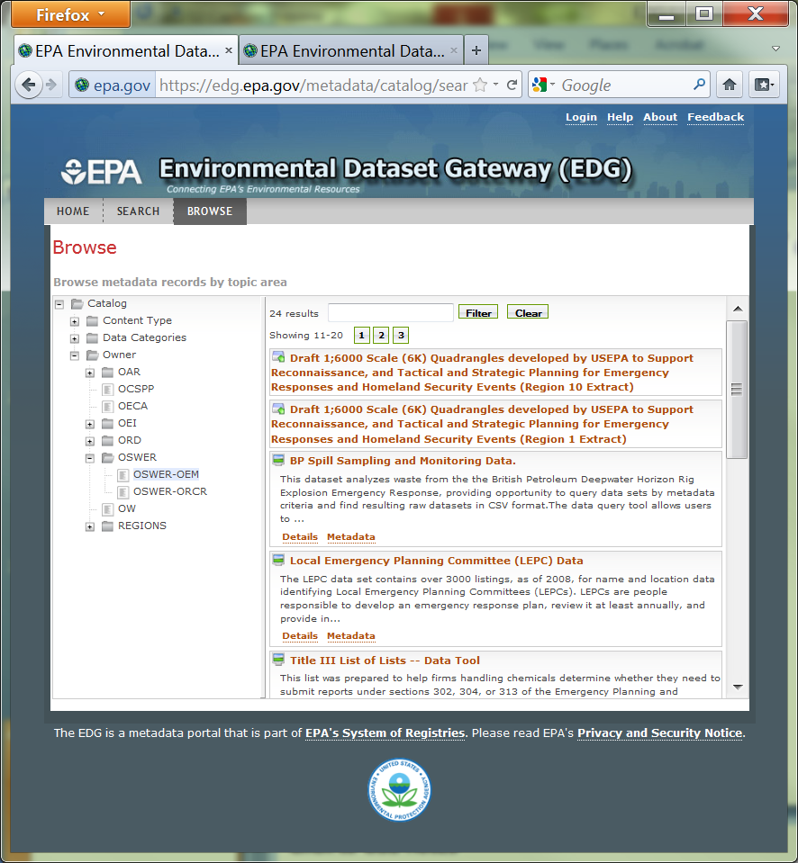
Custom Browse Tree

Slide 7
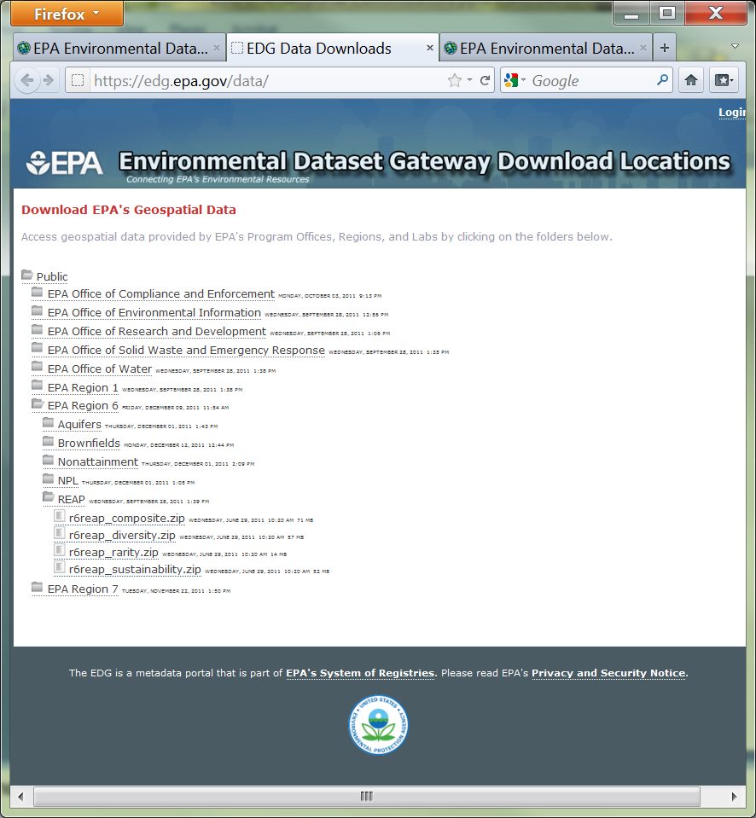
Data Download Area

Slide 8
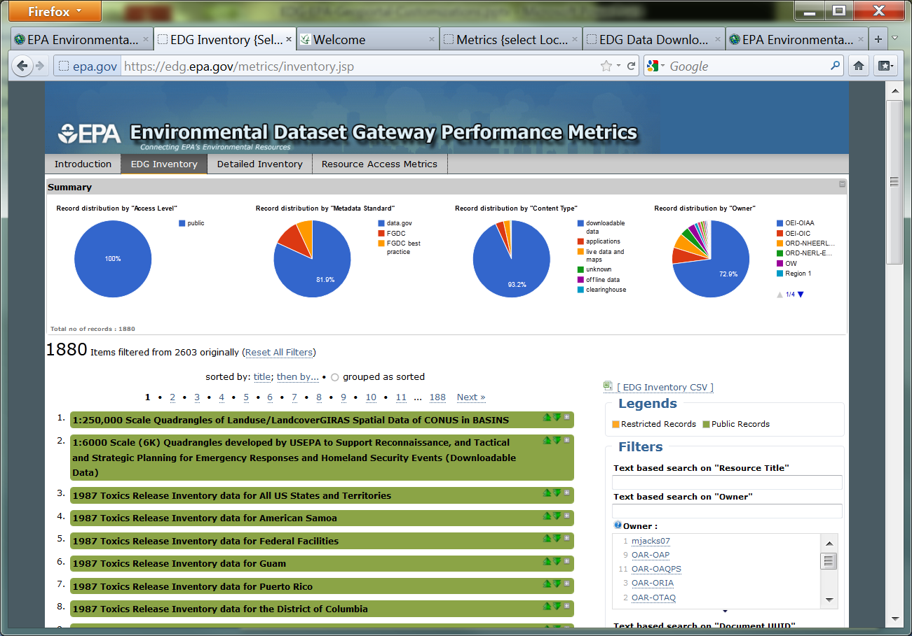
Data.Gov Inventory

Slide 9
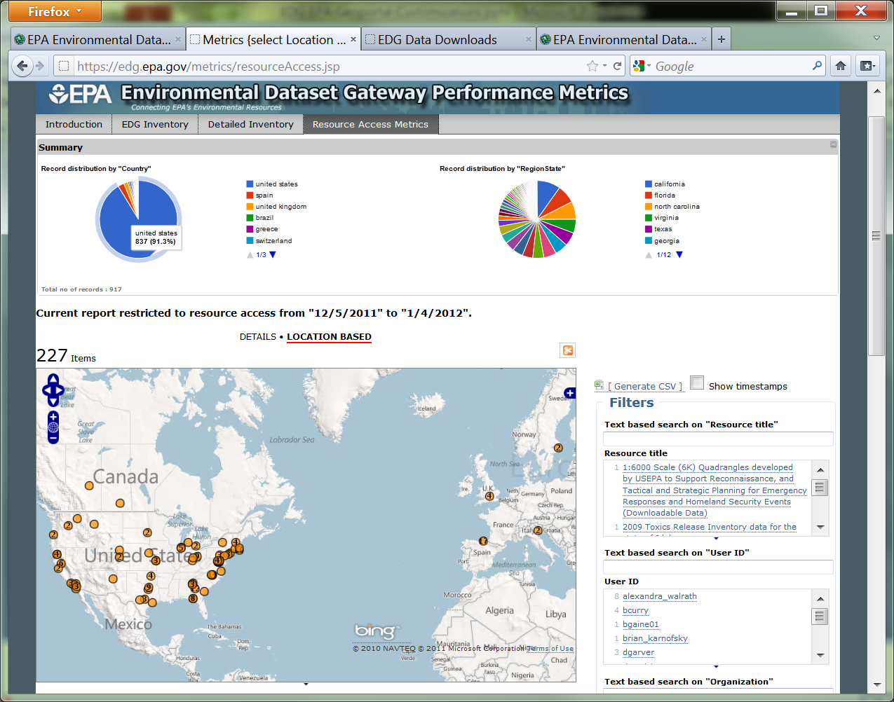
Metrics Dashboard

Slide 10
Creating Metadata for Discovery!
Roles & Responsibilities
Data Owner & their Management
The EDG Steward, our new metadata experts!!!
EDG Administration Team

Slide 11

EDG, What are we doing now?
Clip N Ship (ERS, FME?)
Providing Web Services (& Metadata)
Harvesting among System of Registry components
Enhanced Metrics & Inventory
Automating our feeds to Data.Gov
Sharing our Success
Outreach & Training

Slide 12



Quality time for Q&A!
David A. Parrish, EPA Project Manager
  214/665-8352
  parrish.david@epa.gov
Jessica Zichichi, Innovate! Inc.
  edg@epa.gov
Environmental Dataset Gateway
  http://edg.epa.gov

