Slide 1
Preserving the Scientific Record: Preserving a Record of Scientific Change
Version 1.0
[Review Date]
Matthew Mayernik
National Center for Atmospheric Research
Notes:
Modules should be 3-7 minutes long

Slide 2
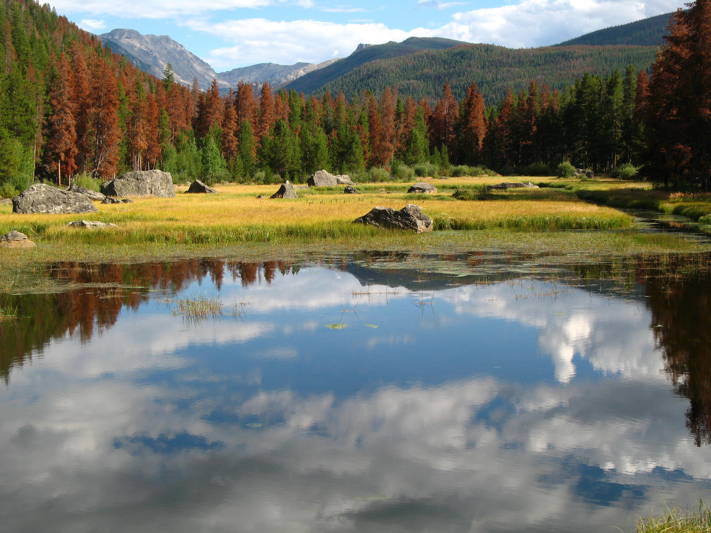
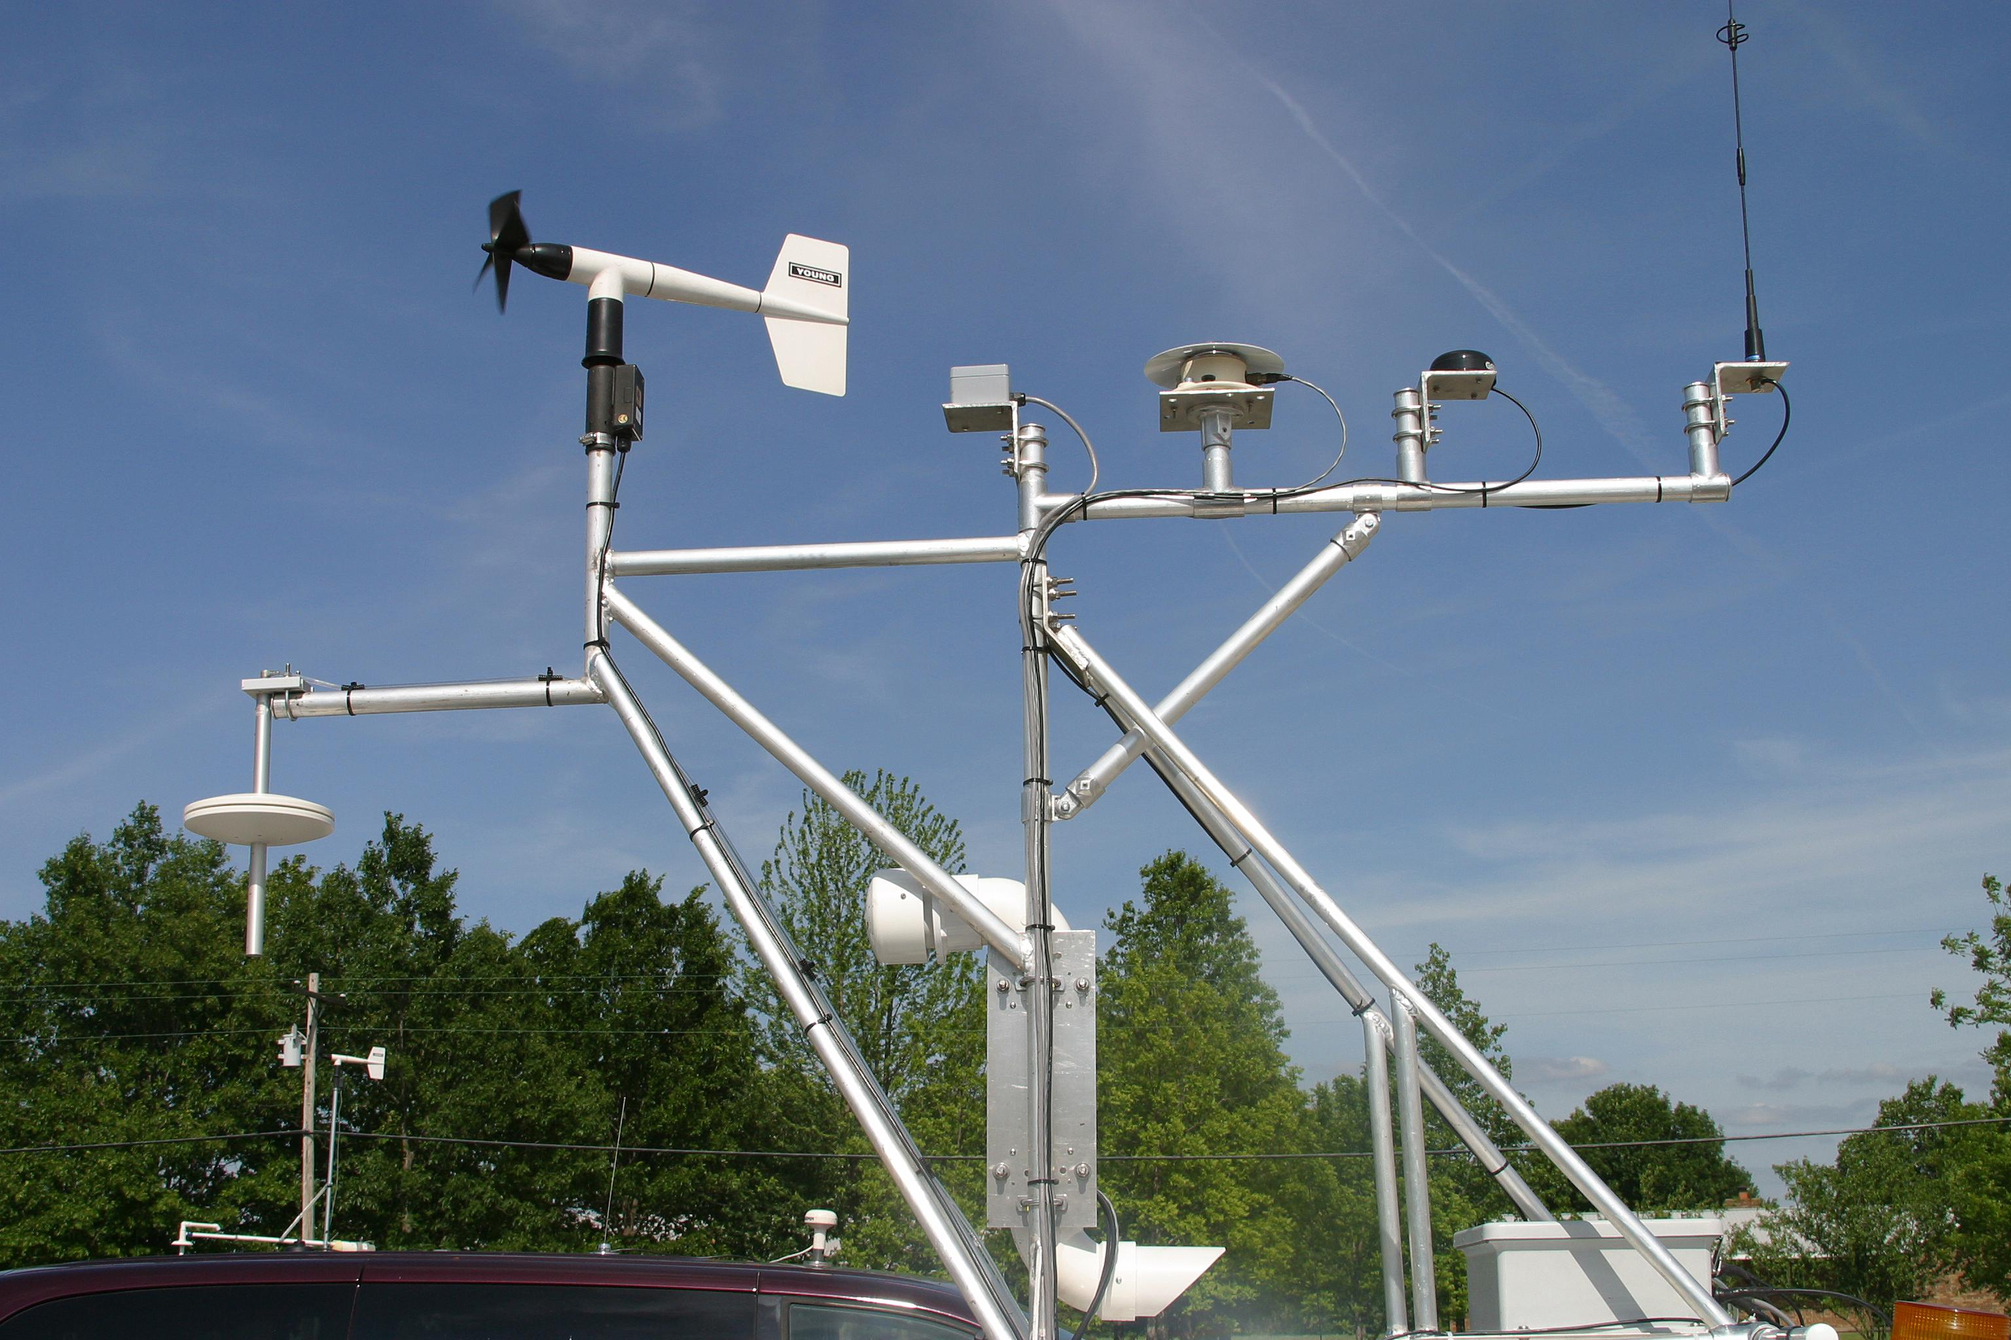
Environmental Change
Environmental change is well documented
Climate observations
Proxy data: ice cores, pollen analysis, tree ring dating
Plant and animal species shifts
Evaluation of biological specimen collections
Etc.
Preserving those records is essential
To understand trends
To prepare for changing conditions
To recommend courses of action
To provide a base for future scientific
work
Images: copyright University Corporation for Atmospheric Research

Slide 3
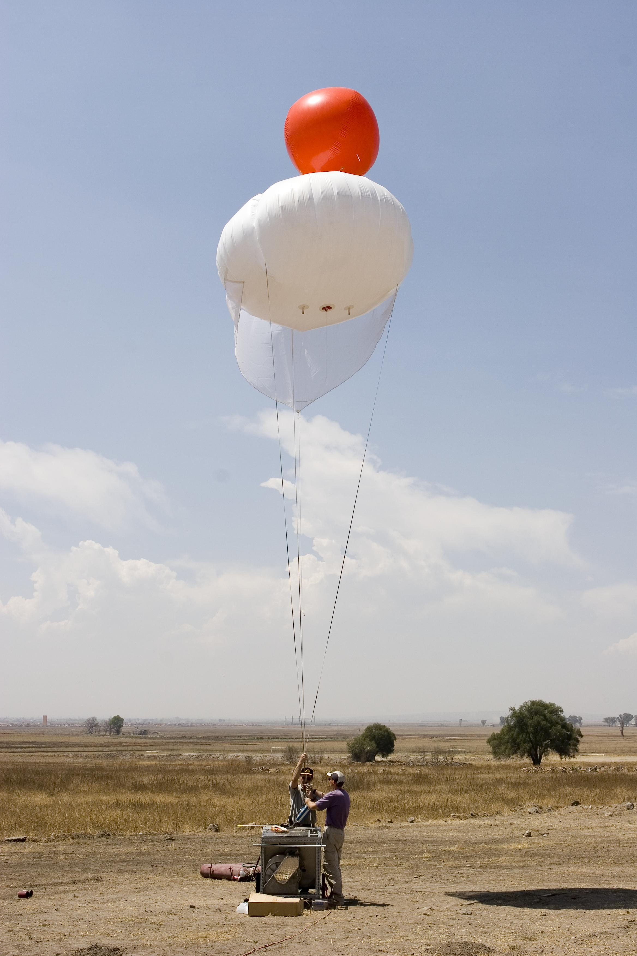
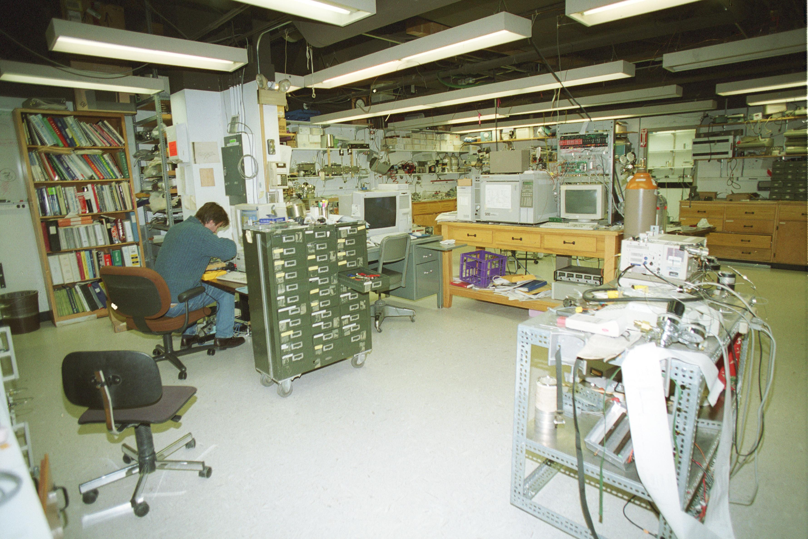
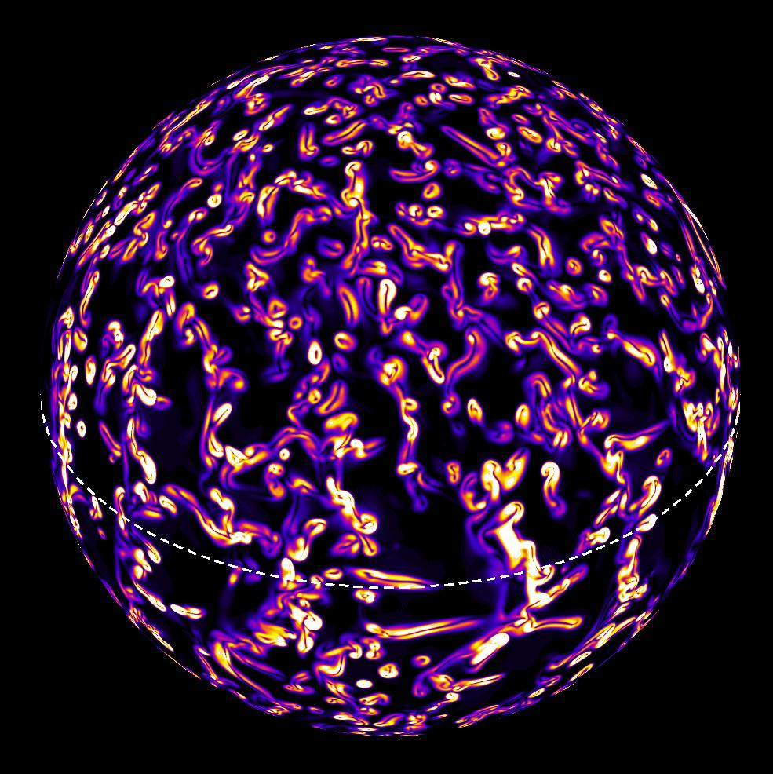
Kinds of Data
Different kinds of data document environmental change in different ways.
Laboratory Experiments
Computational Models
Observations
Images: copyright University Corporation for Atmospheric Research

Slide 4
Observational Data
Observational data are historical records that cannot be recollected
Irreplaceable
Very critical to archive
Documenting data collection methods and equipment is critical to enable:
Understanding
Evaluation
Transparency
Reproducibility
Trust
Secondary use

Slide 5
Computational Models and Simulations
Computational models and simulations produce calculations and predictions of phenomena based on physical theory, algorithms, and observations.
Model outputs may not need to be archived, but…
Archiving of the model itself and of a robust metadata set (description of the hardware, software, and input data) is essential.
Ex. The Metaphor project was created to develop a standard way to describe climate models and the data they produce.
Metafor worked with climate scientists to create a conceptual information model for climate data
Tested, developed, and deployed the model for the CMIP5 project
Metafor: http://metaforclimate.eu/trac
CMIP5: http://cmip-pcmdi.llnl.gov/cmip5/

Slide 6
Laboratory Experimental Data
Experimental data test specific hypotheses in a controlled setting.
In principle, experiments can be accurately reproduced and the data need not be stored indefinitely.
However, reproducibility can be challenging, even with highly controlled lab settings.
Can all of the experimental conditions be precisely reproduced?
Nobody could reliably reproduce cold fusion
Who will reproduce the CERN Large Hadron Collider?
Digital “workflow” systems are available for some types of lab work
Precise step-by-step description of a scientific procedure
Acts as a script for the coordination of research tasks
Can enable automated metadata collection and provenance tracking

Slide 7
Conclusion
Benefits of preservation
Longitudinal studies
Synthesis studies
Additional considerations
Preservation of data in multiple forms - i.e. raw, processed, derived, etc - may be warranted in many circumstances.
Considerations of cost and reproducibility are key in considering policies for preservation of experimental data.

Slide 8
References and Resources
Edwards, P.N. 2010. A vast machine: computer models, climate data, and the politics of global warming. Cambridge, MA: MIT Press.
Goble, C. and De Roure, D. 2009. The impact of workflow tools on data-intensive research. In T. Hey, S. Tansley, & K. Tolle (Eds.), The Fourth Paradigm: Data-Intensive Scientific Discovery (pp. 137-146). Redmond, WA: Microsoft. http://research.microsoft.com/enus/collaboration/fourthparadigm/4th_paradigm_book_part3_goble_deroure.pdf
Long-Lived Digital Data Collections: Enabling Research and Education in the 21st Century. 2005. Washington, D.C.: National Science Foundation, National Science Board. http://www.nsf.gov/pubs/2005/nsb0540/
Michener, W.K, et al. 2009. “Biological Field Stations: Research Legacies and Sites for Serendipity.” BioScience 59 (4): 300–310. http://dx.doi.org/10.1525/bio.2009.59.4.8
Overpeck, J.T., G.A. Meehl, S. Bony, and D.R. Easterling. 2011. “Climate Data Challenges in the 21st Century.” Science 331 (6018): 700–702. http://dx.doi.org/10.1126/science.1197869
Environmental History Resources. 2012. Reconstructing past climate. http://www.eh-resources.org/climate2.html

Slide 9
Other Relevant Modules
Verifiable science
Elements of a data management plan
Managing your data
Creating documentation and metadata
Working with your archive organization
Options for archiving your data

