Slide 1
Semantic Web
Infusion Roadmap V1.0
Gap Analysis 1.6
NASA/ESDSWG/TIWG
April-November 2008
Semantic Web sub-group
Presented to ESIP-STC April 2018
Notes:
Developed during 2008 as part of the NASA Earth Science Data Systems Technology Infusion Working Group, Semantic Web sub-group led by Peter Fox (NCAR), co-lead Rob Raskin (JPL) and members of the sub-group. Material was developed during monthly teleconference calls, by email and after several presentations of draft stages of the roadmap to TIWG, ESDSWG and the ESIP federation. The comments and support of those groups is gratefully acknowledged. Particular thanks to Steve Olding and Karen Moe.

Slide 2
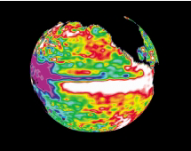
Background: Technology Infusion Process
Established a capability vision for Earth science information systems
Identified Interoperable Information Services as a key capability in the vision
Identified semantic web as one of the primary supporting technologies
Currently defining a roadmap for semantic web technology infusion
Technology Development
Peer Review & Competitive Selection
Technology Infusion
Solicitation Formulation
Operational Systems
Capability Needs
Capability Vision
Identified Gaps
Technology Roadmaps
Technology Projections
Notes:
Slide indicates where the roadmaps fit with the capability vision, technology infusion and the other elements of NASA technology

Slide 3
Infusing Semantic Web Will Help Realize the Vision for all Middleware Services and Assisted Capabilities
Scalable Analysis Portals
Community Modeling Frameworks
Assisted Data & Service Discovery
Assisted Knowledge Building
Interactive Data Analysis
Seamless Data Access
Interoperable Information Services
Responsive Information Delivery
Verifiable Information Quality
Semantic Web Technology
(Languages, Editors, Reasoners, Triple Stores, Tools, Services and Ontologies)
Evolvable Technical Infrastructure
Notes:
Taken from NASA TIWG Capability Vision -the initial view with all blue boxes represents the elements of the Capability Vision. To animate, there are 5 clicks for this slide. The first inserts the Tech. Infusion for SW in the lowetr layer. Next the yellow shaded boxes indicate the present and near future areas where semantic web will be infused. Next clickindicates the upper level capabilities supported..Next click indicates that middle layers contribute to the upper layers.
Final click puts two orange circles around the two remaining areas will eventually benefit from SW but the work is not as advanced and is not covered in this roadmap.

Slide 4
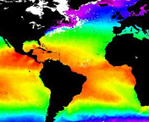

Interactive Data Analysis Inventory
Current technologies
  Visual grammars, shared terminologies for visual properties
Needed
  Semantically-aware visual programming environments and high-level analysis tools
  Tagging data properties with metadata, mapping to non-jargon vocabularies
  Data mediation (units, coordinates)
  Vocabulary translation for machine-to-machine processing
  Semantic support for coordinate systems/ projections/ scale factors/ offsets/ special values
  Support for data quality
  Support for displaying errors
  Understanding of minimum/ maximum, color bars (and relation to data)

Slide 5
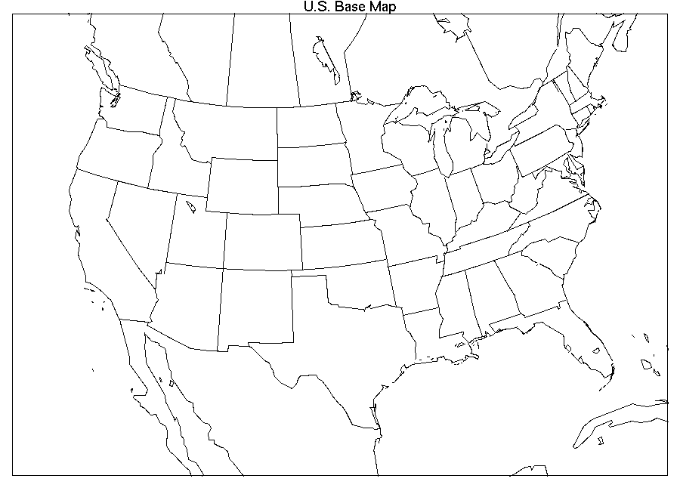
Seamless Data Access Inventory
Current technologies
  Community network data access protocols (OpenDAP, WMS/WCS, WebDAV, GridFTP)
  Established data server tools (MapServer, GDS/LAS, ArcWeb) integrate data analysis in local environment from outside sources
Needed technologies
  Semantic metadata (OWL-S) to enhanced existing hard-coded services (WxS)
  Data-type ontology
  Services ontology (inputs/ outputs) for service chaining
  Semantic markup for sensors and scheduling/ planning
  Tools interoperating with other tools at a semantic level
Topo
Winds
SST

Slide 6
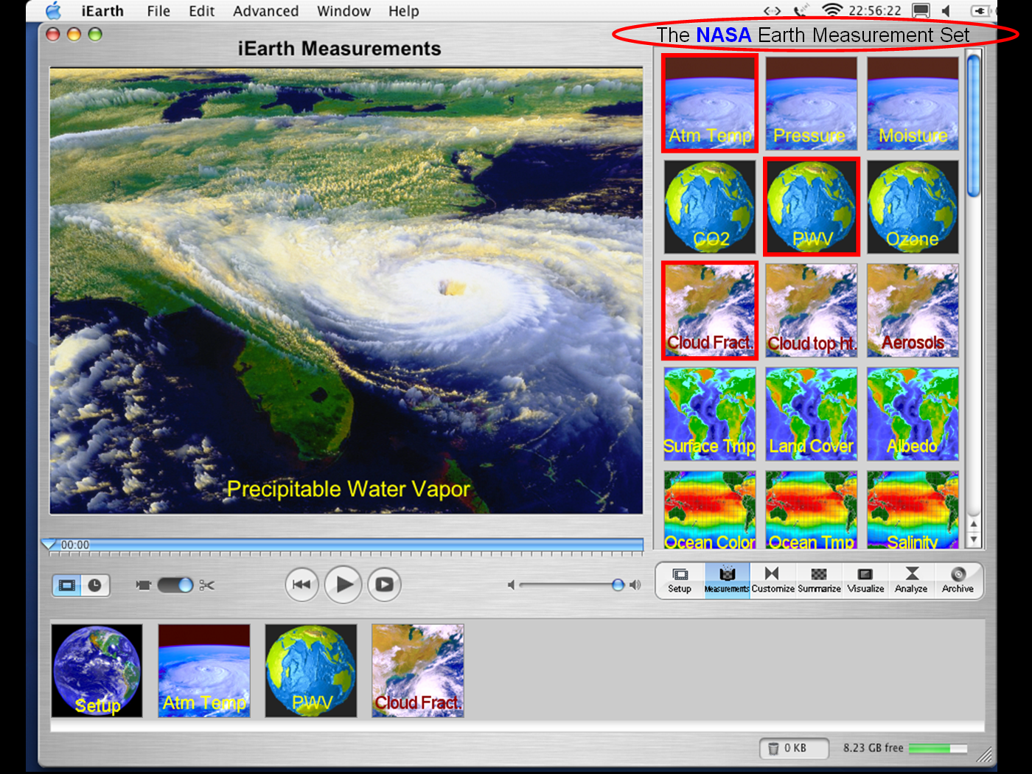
Interoperable Information Services Inventory
Current technologies
  Network service protocols (SOAP, Java RMI, OPeNDAP, CORBA)
  Utility/grid computing protocols & toolkits (Globus)
Needed technologies
  Service and domain ontologies working synergistically
  Services that know about other services, and their levels
  Services understand terms, quantities, units, coordinates
  Semantic service registry
  Smart service chaining
  Smart service gap filling
Alg 1
Alg 3
Alg 2
Notes:
Value-added nature of semantics

Slide 7
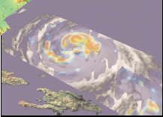
Responsive Information Delivery Inventory
Current technologies
  Optical networks (National LambdaRail)
  Peer-to-peer networks with swarming (Modster)
  Direct downlink (MODIS/AIRS DDL)
  Sensor tasking in response to event/ prediction
Needed technologies
  Semantic service bindings and groundings include resource estimates, priority scheduling, spectrum of data latency in common terms
  Late semantic binding for real-time streams
  Semantic event detection and tagging
Notes:
Value-added nature of semantics

Slide 8
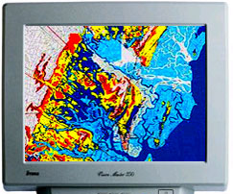
Verifiable Information Quality Inventory
Current technologies
  Data pedigree algorithms (Ellis)
  Machine-readable formats (XML) and common semantic service ontology (OWL-S) including data-types
Needed technologies
  Data quality (all dimensions conveyed in meaningful terms), uncertainty and provenance ontologies
  Domain ontologies include domain and range value restrictions
  Making provenance from two or more services interoperable
  Smart quality propagation from two or more information services
  Rulesets, explanation, trust and proof inferencing
Notes:
Value-added nature of semantics

Slide 9
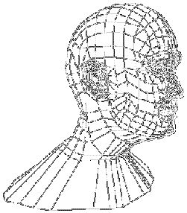
Assisted Data & Service Discovery Inventory
Current technologies
  Smart query with term expansion, narrowing, reasoning, abstracting selection workflows, capturing concepts of discovery, inventory and item/granule -level in finding data
  Data and service description standards, web service directories, syndication services, topic/ concept maps
  Established directory services (GCMD, ECHO, THREDDS)
  Domain ontologies (SWEET, MMI, VSTO, …), rule-based logic, semantic query
Needed technologies
  Community standards are needed to avoid wasted and inconsistent efforts
  Smart mediation among catalogs that are using ontologies and/or standard data model
  Semantic service registry
  Data-type and service ontologies
  Smart discovery of virtual data products (want data but need service to create it for you)
  Smart crawlers to pull
Gazetteer
Product Catalog
Event Catalog
Search Terms
Data Inventory
Content Analysis
Notes:
Traverse each of the Capability Vision component and indicate the value-added nature of semantics:
Query expansion, reasoning, term narrowing, unifying/
abstracting selection workflows, capturing the concepts
of discovery level, inventory level and item/granule-level
in finding data. This requires ontologies that have depth
and breadth in specific domains to enable this capability.
Currently SWEET, MMI, VSTO, and others are emerging
Community standards are needed to avoid wasted and
inconsistent efforts.

Slide 10
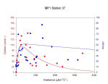
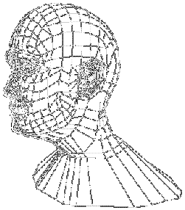
Assisted Knowledge Building Inventory
Current technologies
  Data mining algorithms (Support vector machines, independent component analysis, rule induction) and ontologies
  Data mining toolkits (Adam, D2K, Darwin) and plug-ins (IMAGINE, ENVI, ArcGIS) with semantic annotations
  Data and service description standards, web service directories, syndication services, topic maps
Needed technologies
  Cross-domain data mining and fusion and rule-based smart data mining and fusion
  Ontologies for visualization and analysis, metadata annotation with ontologies
  Conversion of folksonomies to ontologies
  Formalizing the long-term de-facto standards into formal ontologies
Notes:
Value-added nature of semantics

Slide 11
Scalable Analysis Portals Inventory
Current technologies
  JSR168/268 porlets
  Several implementations; Gridsphere, JetSpeed, et c.
Needed technologies
  Ontologies for portal modal functions
  APIs for accessing domain ontologies
  Capabilities to propagate provenance and other key metadata
  Ontology to describe analysis functions and results
Notes:
JSR
API

Slide 12
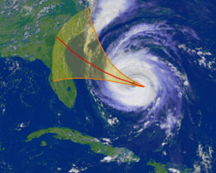
Community Modeling Frameworks Inventory
Current technologies
  Frameworks: ESMF, SPMF, etc.
  Models: WRF, ROM, etc.
  Earth System Curator
Needed technologies
  Ontologies for model component and framework functions
  APIs for accessing domain ontologies
  Capabilities to generate provenance and other key metadata
  Use of data-type ontologies, units (point back to lower layer)
  Semantics of assumptions, especially among models
  Semantics to facilitate data assimilation
Notes:
ESMF
SPMF
WRF
ROM
API

Slide 13






Keys to notations in gap analysis
September 2008
13

Slide 14

Keys to notations in gap analysis
Symbols:
  Warning = gap
Color scheme (unless otherwise noted)
Distance measure:
  NASA =
  Earth science =
  Country = flag
Examples:
  outside US
  in US, outside NASA and ES
  in ES, outside NASA
  within NASA and ES
  Yellow - okay, or some effort, not proven
  Orange - fair, definite gap, effort needed
  Red - none or poor, serious gap, effort required
September 2008
14

Slide 15
Semantic Web Roadmap
⧫ Improved Information Sharing
⧫ Increased Collaboration & Interdisciplinary Science
⧫ Acceleration of Knowledge Production
⧫ Revolutionizing how science is done
Results
Outcome
⧫ Geospatial semantic services established
⧫ Geospatial semantic services proliferate
⧫ Scientific semantic assisted services
⧫ Autonomous inference of science results
Output
⧫ Some common vocabulary based product search and access
⧫ Semantic geospatial search & inference, access
⧫ Semantic agent-based searches
⧫ Semantic agent-based integration
Assisted Discovery & Mediation
Capability
⧫ Local processing + data exchange
⧫ Basic data tailoring services (data as service), verification/ validation
Interoperable geospatial services
(analysis as service), results explanation service
⧫ Metadata-driven data fusion (semantic service chaining), trust
Interoperable Information Infrastructure
⧫ SWEET core 1.0 based on GCMD/CF
⧫ SWEET core 2.0 based on best practices decided from community
⧫ SWEET 3.0 with semantic callable interfaces via standard programming languages
⧫ Reasoners able to utilize SWEET 4.0
Technology
Vocabulary
⧫ RDF, OWL, OWL-S
⧫ Geospatial reasoning, OWL-Time
⧫ Numerical reasoning
⧫ Scientific reasoning
Languages/ Reasoning
Current
Near Term (0-2 yrs)
Mid Term (2-5 yrs)
Long Term (5+ yrs)
15
15
Notes:
15
Eventually a white paper is needed to capture each of the elements in this roadmap with expanded explanations.
Horizontal axis: Time frame
Vertical Axis: three sets of groupings (bottom two from capability vision): Technology split into the domain independent portion (languages/ reasoning) and domain specific (vocabulary). Capability includes ONLY two of the seven capability components from slide 5 as an *example* of the different stages and needs for these capabilities (the NEXT slide expands the Capability axis to cover all seven components). Top rows are the Results in terms of output and outcomes where the advancement of the capability vision in support of science and education using semantic technologies is to be realized.
Note dependence on Tech Infusion Capability Vision
The color graphical representation indicated that as one moves across the horizontal axis, each element builds on TOP of the previous element (I.e. evolve)
In the same way that as one moves up (vertically) within a given timeframe that each element builds upon the former. E.g. vocabulary relies on languages/reasoning, etc.
For Results - we need to determine how to measure progress. Need to establish baseline metrics.
For presentation. Take one or two cells and explain the contents as one goes from left - > right or bottom to top. Noting the ultimate top-right statement!

Slide 16
Semantic Web Roadmap - Gap Analysis
  Yellow - okay, or some effort, not proven
  Orange - fair, definite gap, effort needed
  Red - none or poor, serious gap, effort required
⧫ Improved Information Sharing
⧫ Increased Collaboration & Interdisciplinary Science
⧫ Acceleration of Knowledge Production
⧫ Revolutionizing how science is done
Results
Outcome
⧫ Geospatial semantic services established
⧫ Geospatial semantic services proliferate
⧫ Scientific semantic assisted services
⧫ Autonomous inference of science results
Output
⧫ Some common vocabulary based product search and access
⧫ Semantic geospatial search & inference, access
⧫ Semantic agent-based searches
⧫ Semantic agent-based integration
Assisted Discovery & Mediation
Capability
⧫ Local processing + data exchange
⧫ Basic data tailoring services (data as service), verification/ validation
Interoperable geospatial services
(analysis as service), results explanation service
⧫ Metadata-driven data fusion (semantic service chaining), trust
Interoperable Information Infrastructure
⧫ SWEET core 1.0 based on GCMD/CF
⧫ SWEET core 2.0 based on best practices decided from community
⧫ SWEET 3.0 with semantic callable interfaces via standard programming languages
⧫ Reasoners able to utilize SWEET 4.0
Technology
Vocabulary
⧫ RDF, OWL, OWL-S
⧫ Geospatial reasoning, OWL-Time
⧫ Numerical reasoning
⧫ Scientific reasoning
Languages/ Reasoning
Current
Near Term (0-2 yrs)
Mid Term (2-5 yrs)
Long Term (5+ yrs)
16
16
Notes:
16
Eventually a white paper is needed to capture each of the elements in this roadmap with expanded explanations.
Horizontal axis: Time frame
Vertical Axis: three sets of groupings (bottom two from capability vision): Technology split into the domain independent portion (languages/ reasoning) and domain specific (vocabulary). Capability includes ONLY two of the seven capability components from slide 5 as an *example* of the different stages and needs for these capabilities (the NEXT slide expands the Capability axis to cover all seven components). Top rows are the Results in terms of output and outcomes where the advancement of the capability vision in support of science and education using semantic technologies is to be realized.
Note dependence on Tech Infusion Capability Vision
The color graphical representation indicated that as one moves across the horizontal axis, each element builds on TOP of the previous element (I.e. evolve)
In the same way that as one moves up (vertically) within a given timeframe that each element builds upon the former. E.g. vocabulary relies on languages/reasoning, etc.
For Results - we need to determine how to measure progress. Need to establish baseline metrics.
For presentation. Take one or two cells and explain the contents as one goes from left - > right or bottom to top. Noting the ultimate top-right statement!

Slide 17
Semantic Web Roadmap - Gap Analysis
Distance measure:
NASA =
Earth science =
Country =
⧫ Improved Information Sharing
⧫ Increased Collaboration & Interdisciplinary Science
⧫ Acceleration of Knowledge Production
⧫ Revolutionizing how science is done
Results
Outcome
⧫ Geospatial semantic services established
⧫ Geospatial semantic services proliferate
⧫ Scientific semantic assisted services
⧫ Autonomous inference of science results
Output
⧫ Some common vocabulary based product search and access
⧫ Semantic geospatial search & inference, access
⧫ Semantic agent-based searches
⧫ Semantic agent-based integration
Assisted Discovery & Mediation
Capability
⧫ Local processing + data exchange
⧫ Basic data tailoring services (data as service), verification/ validation
Interoperable geospatial services
(analysis as service), results explanation service
⧫ Metadata-driven data fusion (semantic service chaining), trust
Interoperable Information Infrastructure
⧫ SWEET core 1.0 based on GCMD/CF
⧫ SWEET core 2.0 based on best practices decided from community
⧫ SWEET 3.0 with semantic callable interfaces via standard programming languages
⧫ Reasoners able to utilize SWEET 4.0
Technology
Vocabulary
⧫ RDF, OWL, OWL-S
⧫ Geospatial reasoning, OWL-Time
⧫ Numerical reasoning
⧫ Scientific reasoning
Languages/ Reasoning
Current
Near Term (0-2 yrs)‏
Mid Term (2-5 yrs)‏
Long Term (5+ yrs)‏
Notes:
17
Eventually a white paper is needed to capture each of the elements in this roadmap with expanded explanations.
Horizontal axis: Time frame
Vertical Axis: three sets of groupings (bottom two from capability vision): Technology split into the domain independent portion (languages/ reasoning) and domain specific (vocabulary). Capability includes ONLY two of the seven capability components from slide 5 as an *example* of the different stages and needs for these capabilities (the NEXT slide expands the Capability axis to cover all seven components). Top rows are the Results in terms of output and outcomes where the advancement of the capability vision in support of science and education using semantic technologies is to be realized.
Note dependence on Tech Infusion Capability Vision
The color graphical representation indicated that as one moves across the horizontal axis, each element builds on TOP of the previous element (I.e. evolve)‏
In the same way that as one moves up (vertically) within a given timeframe that each element builds upon the former. E.g. vocabulary relies on languages/reasoning, etc.
For Results - we need to determine how to measure progress. Need to establish baseline metrics.
For presentation. Take one or two cells and explain the contents as one goes from left - > right or bottom to top. Noting the ultimate top-right statement!

Slide 18
Semantic Web Roadmap (expanded capability)
Capability
⧫ Some common vocabulary based product search and access
⧫ Semantic geospatial search & inference, access
⧫ Semantic agent-based searches
⧫ Semantic agent-based integration
Assisted Discovery & Mediation
⧫ Some metadata and limited provenance available
⧫ Ontologies for data mining, visualization and analysis emerging/ maturing
⧫ Common terminology captured in ontologies, crossing domains
⧫ Provenance/ annotation with ontologies in user tools
Assisted Knowledge Building
⧫ Verification is manual with minimal tool support
⧫ Ontologies for information quality developed
⧫ Domain and range properties in ontologies used in tools
⧫ Service ontologies carry quality provenance
Verifiable Information Quality
⧫ Services must be hardwired and service agreements established
⧫ Services annotated with resource descriptions
⧫ Dynamic service discovery and mediation, and data scheduling
⧫ Semantic markup of data latency (time lags) which adapt dynamically
Responsive Information Delivery
⧫ Local processing + data exchange
Basic data tailoring services (data as service), verification /validation
Interoperable geospatial services
(analysis as service), results explanation service
⧫ Metadata-driven data fusion (semantic service chaining), trust
Interoperable Information services
⧫ Limited metadata passed to analysis applications
⧫ Tag properties, non-jargon vocabulary for non-specialist use
⧫ Shared terminology for the visual properties of interface objects and graph types...
⧫ Semantic fields to describe tag key modal functions.
Interactive Data Analysis
⧫ Access mediated by agreed standard vocabularies, hard-wired connections
⧫ Access mediated by common ontologies
⧫ Mediation aided by services with domain/ range properties
⧫ Key data access services are semantically mediated
Seamless Data Access
September 2008
Current
Near Term (0-2 yrs)
Mid Term (2-5 yrs)
Long Term (5+ yrs)
18
Notes:
18
This is an expanded version of the previous slide where the middle capability layers include all seven of the components that semantic web influences, these are the
Same components from slide 5 and slides 6-12.
The roadmap is to be read left to right within a row (building on the previous element).
Capability levels can be assessed by accessibility as well I.e. - available, easily available, widespread
Arrows between boxes to show what it takes to get from one to another…
Education/ outreach, briefing, etc. to NASA and within their available fora

Slide 19
Roadmap - getting from near-term to mid-term
first priority,
second priority,
third priority
Capability
⧫ Semantic geospatial search & inference, access
-> requires agent development and vocabulary for agent characterization
Assisted Discovery & Mediation
⧫ Semantic agent-based searches
⧫ Ontologies for data mining, visualization and analysis emerging/ maturing
-> requires mature (domain and data-type) ontologies with community endorsement and governance and a robust integration framework
⧫ Common terminology captured in ontologies, crossing domains
Assisted Knowledge Building
⧫ Ontologies for information quality developed
-> requires mature quality and uncertainty ontologies with domain and range properties added and populated
Verifiable Information Quality
⧫ Domain and range properties in ontologies used in tools
-> requires semantic service (ontology) registry
⧫ Dynamic service discovery and mediation, and data scheduling
Responsive Information Delivery
⧫ Services annotated with resource descriptions
⧫ Basic data tailoring services (data as service), verification/ validation
-> requires service to implement v/v, new descriptions of analyses, developing explanation
Interoperable geospatial services
(analysis as service), results explanation service
Interoperable Information services
-> requires development of portal modal function vocabulary and ontology, link to domain context and data structure
⧫ Shared terminology for the visual properties of interface objects and graph types...
Interactive Data Analysis
⧫ Tag properties, non-jargon vocabulary for non-specialist use
-> requires adding properties to classes in ontologies and populating instances with expert agreement
⧫ Mediation aided by services with domain/ range properties
Seamless Data Access
⧫ Access mediated by common ontologies
Near Term (0-2 yrs)
Mid Term (2-5 yrs)

Slide 20
Roadmap - getting from near-term to mid-term
first priority,
second priority,
third priority
Capability
⧫ Ontologies for data mining, visualization and analysis emerging/ maturing
-> requires mature (domain and data-type) ontologies with community endorsement and governance and a robust integration framework
⧫ Common terminology captured in ontologies, crossing domains
Assisted Knowledge Building
-> requires semantic service (ontology) registry
⧫ Dynamic service discovery and mediation, and data scheduling
Responsive Information Delivery
⧫ Services annotated with resource descriptions
⧫ Ontologies for information quality developed
-> requires mature quality and uncertainty ontologies with domain and range properties added and populated
Verifiable Information Quality
⧫ Domain and range properties in ontologies used in tools
⧫ Basic data tailoring services (data as service), verification/ validation
-> requires service to implement v/v, new descriptions of analyses, developing explanation
Interoperable geospatial services
(analysis as service), results explanation service
Interoperable Information services
-> requires adding properties to classes in ontologies and populating instances with expert agreement
⧫ Mediation aided by services with domain/ range properties
Seamless Data Access
⧫ Access mediated by common ontologies
-> requires development of portal modal function vocabulary and ontology, link to domain context and data structure
⧫ Shared terminology for the visual properties of interface objects and graph types...
Interactive Data Analysis
⧫ Tag properties, non-jargon vocabulary for non-specialist use
⧫ Semantic geospatial search & inference, access
-> requires agent development and vocabulary for agent characterization
Assisted Discovery & Mediation
⧫ Semantic agent-based searches
Near Term (0-2 yrs)
Mid Term (2-5 yrs)

Slide 21
Semantic Web: Roadmap Details
first priority,
second,
third,
done by others (comp. sci.),
in place
Competing catalog schemas
Common semantic service catalog established
Enhanced semantic search into search engines
Automatic knowledge discovery and mining
Discovery
Standard workflow language (BPEL)
Semantic framework for Web Services
Semantic service chaining
Intelligent algorithm programming chaining
Workflow
Built into code logic and in the head of the user
Basic semantics (DL, FOL)
High degree of semantic understanding
Intelligent message routing (SOL)
Inference
Earth Science Standards
GCMD, CF, ESML, GML, etc.
SWEET Core 1.0
VSTO, MMI, others
SWEET core 2.0 + domain and math plug-in
SWEET 3.0 + science applications plug-in
XML, RDF
OWL-DL, OWL-Full
OWL-S, RIF
PML
Languages
Current
Near Term (0-2 yrs)
Mid Term (2-5 yrs)
Long Term (5+ yrs)
Syntax
Semantics
Explanation/Rules
Proof/Trust
Notes:
Recasting of the roadmap with time axis on the horizontal overlaid with the levels of semantics (cf to the semantic web architecture layers - slide 17)
The vertical axis uses functional elements (languages, vocabulary [similar to the lower rows of slide 13], inference, workflow and discovery as general capabilities that need to be enabled. The elements in each cell then represent a guide to the current (and project) technology or technical capability needed.
DL - description logic
FOL - first order logic
SOL- second order logic
BPEL - Business Process Execution Language
ESML - Earth Science Markup Language
MMI - Marine Metadata Initiative
GML - Geography Markup Language
WSMO - Web Services Modeling Ontology
CF - Climate and Forecast metadata conventions
WSML - Web services modeling Language
SWRL - Semantic Web Rules Language
PML - Proof Markup Language
GCMD- Global Change Master Directory

Slide 22
Semantic Web: Roadmap Details – TRL estimate
Competing catalog schemas
Common semantic service catalog established
Enhanced semantic search into search engines
Automatic knowledge discovery and mining
Discovery
8
6
6
2
Standard workflow language (BPEL)
Semantic framework for Web Services
Semantic service chaining,
Intelligent algorithm programming chaining
Workflow
8
4
4
2
Built into code logic and in the head of the user
Basic semantics (DL, FOL)
High degree of semantic understanding
Intelligent message routing (SOL)
Inference
8
4
2
Earth Science Standards
GCMD, CF, ESML, GML, etc.
SWEET Core 1.0
VSTO, MMI, others
SWEET core 2.0 + domain and math plug-in
SWEET 3.0 + science applications plug-in
8
8
4
2
Languages
XML, RDF
OWL-DL, OWL-Full
OWL-S, RIF
PML
4
9
8
4
Current
Near Term (0-2 yrs)
Mid Term (2-5 yrs)
Long Term (5+ yrs)
Syntax
Semantics
Explanation/Rules
Proof/Trust
Notes:
Recasting of the roadmap with time axis on the horizontal overlaid with the levels of semantics (cf to the semantic web architecture layers - slide 17)
The vertical axis uses functional elements (languages, vocabulary [similar to the lower rows of slide 13], inference, workflow and discovery as general capabilities that need to be enabled. The elements in each cell then represent a guide to the current (and project) technology or technical capability needed.
DL - description logic
FOL - first order logic
SOL- second order logic
BPEL - Business Process Execution Language
ESML - Earth Science Markup Language
MMI - Marine Metadata Initiative
GML - Geography Markup Language
WSMO - Web Services Modeling Ontology
CF - Climate and Forecast metadata conventions
WSML - Web services modeling Language
SWRL - Semantic Web Rules Language
PML - Proof Markup Language
GCMD- Global Change Master Directory

Slide 23
Technology Inventory for Semantic Web
Languages
  OWL - Web Ontology Language (W3C Recommendation), OWL 2 coming soon
  RDF - Resource Description Framework (W3C Recommendation)
  OWL-S/SWSL/SWSM/SAWSDL - Web Services (W3C Submission) – not standard (2018: ***)
  SWRL - Semantic Web Rule Language (W3 Working Draft) – unlikely to be recommended
  Rule Interchange Format (RIF) (W3 Submission)!!! (2018: W3 Recommendation)
  PML - Proof Markup Language – defacto standard (2018: PROV superseded PML and OPM)
  ODM/MOF - Ontology Definition Metamodel/Meta Object Facility (OMG) (2018: Gone)
Editors: Protégé, SWOOP, Medius, SWeDE, CMAP/COE (2018: Most gone)
Reasoners
  Pellet, Racer, Medius KBS, FACT++, fuzzyDL, KAON2, MSPASS, QuOnto
Query Languages
  SPARQL (W3 Recommendation), XQUERY, SeRQL, OWL-QL, RDFQuery
Other Tools for Semantic Web
  Search: SWOOGLE swoogle.umbc.edu
  Collaboration: www.planetont.org
  Ontology repository/ registry: needed (three efforts now: BIOPORTAL, OMV and OOR)
  Other: Jena, SeSAME/SAIL, Mulgara, Eclipse, KOWARI
  Semantic wiki: OntoWiki, SemanticMediaWiki
  Semantic content; Drupal,
  Inference Web (IW; iw.rpi.edu)
Semantic Standards for Earth Science
  SWEET, VSTO, MMI, GeoSciML (all have governance models)
  Need to promote domain and ES-specific service ontology development/ governance
Notes:
Languages:
OWL - http://www.w3.org/TR/owl-features/
RDF - http://www.w3.org/RDF/
OWL-S - http://www.w3.org/Submission/OWL-S/
SWSL - http://www.w3.org/Submission/SWSF-SWSL/
WSMO/WSML - http://www.w3.org/Submission/WSML/
Many other MLs exist, e.g. ESML, GML, but these are not ontolgies
Reasoners - http://www.cs.man.ac.uk/~sattler/reasoners.html
SWRL - Semantic Web Rule Language - http://www.w3.org/Submission/SWRL/
PML - Proof Markup Language - http://iw.stanford.edu/2005/wd-pml-primer/pml-primer-20051128.htm
ODM/MOF - Ontology Definition Metamodel/Meta Object Facility (OMG) - http://www.omg.org/docs/ptc/07-09-09.pdf
Editors: Protégé - protégé.stanford.edu, SWOOP www.mindswap.org/2004/SWOOP, Medius - http://www.sandsoft.com/products.html, SWeDE - http://owl-eclipse.projects.semwebcentral.org/
Reasoners - http://www.cs.man.ac.uk/~sattler/reasoners.html
Pellet, Racer, Medius KBS, FACT++, fuzzyDL, KAON2, MSPASS, QuOnto
Query Languages
SPARQL vs OWL-QL - SPARQL is query for RDF, OWL-QL is query for OWL, , XQUERY is for XML, SeRQL is for the SeSAME triple store, OWL-QL
SPARQL - http://www.w3.org/TR/rdf-sparql-query/
OWL-QL - http://www.ksl.stanford.edu/projects/owl-ql/
XQUERY - http://www.w3.org/XML/Query/
SerQL - http://www.openrdf.org/doc/sesame/users/ch06.html
RDFQuery - http://www.w3.org/TandS/QL/QL98/pp/rdfquery.html
Other Tools for Semantic Web
Search: SWOOGLE swoogle.umbc.edu - helps to find ontologies (in OWL, RDF) harvested (google-like) from the web
Collaboration: www.planetont.org - site where one can compare, download, upload, annotate ontologies.
Other: Jena - http://jena.sourceforge.net/, SeSAME/SAIL - http://openrdf.org/doc/sesame2/2.0/users/index.html, Storage and Inference Layer - http://www.openrdf.org/doc/sesame/api/org/openrdf/sesame/sail/package-summary.html, Mulgara - http://www.mulgara.org/, KOWARI - http://kowari.org are triple stores,
Eclipse is a java software development environment - http://www.eclipse.org/
Semantic wiki: OntoWiki - http://ontowiki.net/Projects/OntoWiki, SemanticMediaWiki - http://meta.wikimedia.org/wiki/Semantic_MediaWiki
SWEET sweet.jpl.nasa.gov - mid-level earth science ontology framework and domain encodings
VSTO vsto.hao.ucar.edu, www.vsto.org - for solar-terrestrial includes instruments and parameters, data products, etc.
MMI www.marinemetadata.org - ontologies for marine and related sciences, include devices and platforms.
GeoSciML - schema language for solid-earth with possible applications to geosciences/ earth sciences. - https://www.seegrid.csiro.au/twiki/bin/view/CGIModel/GeoSciML

Slide 24
What NASA could fund now – priorities
first priority,
second priority,
third priority
⧫ Semantic agent-based searches
⧫ Common terminology captured in ontologies, crossing domains
⧫ Semantic geospatial search & inference, access
⧫ Ontologies for data mining, visualization and analysis emerging/ maturing
⧫ Domain and range properties in ontologies used in tools
⧫ Basic data tailoring services (data as service), verification/ validation
⧫ Ontologies for information quality developed
Interoperable geospatial services
(analysis as service), results explanation service
⧫ Tag properties, non-jargon vocabulary for non-specialist use
⧫ Dynamic service discovery and mediation, and data scheduling
⧫ Shared terminology for the visual properties of interface objects and graph types...
⧫ Access mediated by common ontologies
⧫ Services annotated with resource descriptions
⧫ Mediation aided by services with domain/ range properties

Slide 25
What NASA could fund now – priorities
first priority,
second priority,
third priority
Semantic geospatial search & inference, access
Semantic agent-based searches
Ontologies for data mining, visualization and analysis emerging/ maturing
Common terminology captured in ontologies, crossing domains
Basic data tailoring services (data as service), verification/ validation
Domain and range properties in ontologies used in tools
Ontologies for information quality developed
Interoperable geospatial services
(analysis as service), results explanation service
Tag properties, non-jargon vocabulary for non-specialist use
Dynamic service discovery and mediation, and data scheduling
Shared terminology for the visual properties of interface objects and graph types...
Access mediated by common ontologies
Services annotated with resource descriptions
Mediation aided by services with domain/ range properties
September 2008
25

Slide 26
What NASA could fund now – priorities
first priority,
second priority,
third priority
Basic data tailoring services (data as service), verification/ validation
Ontologies for information quality developed
Services annotated with resource descriptions
Mediation aided by services with domain/ range properties
Access mediated by common ontologies
Ontologies for data mining, visualization and analysis emerging/ maturing
Domain and range properties in ontologies used in tools
Common terminology captured in ontologies, crossing domains
Semantic geospatial search & inference, access
Semantic agent-based searches
Shared terminology for the visual properties of interface objects and graph types...
Interoperable geospatial services (analysis as service), results explanation service
Dynamic service discovery and mediation, and data scheduling
Tag properties, non-jargon vocabulary for non-specialist use
September 2008
26

Slide 27
Ongoing Steps
Baseline metrics for current capabilities
  TRLs, number of implementations, effort to add new data/ service, development time, new results
  How to measure? TRL in/out, Technology Readiness Assessment, project-defined metrics, impacts/ nuggets
Communicate findings to NASA
  awareness of gaps - need to communicate where there are gaps and the implications for NASA
  recommendations for solicitation wording that would encourage research to fill gaps
Recommendations
  NASA to ensure coverage in domain application areas of semantics
  Identify ways to encourage technical/ vocabulary progress to support capability progress
  Leverage non-NASA, non-ES, and non-US efforts
Notes:
TRL-technology readiness level
In the future perhaps use IRL=Interoperability and RRL=Re-use (software/ service)
TRA= technology readiness assessment
xRL (x=T, I, R)

