Slide 1
Data & infrastructure to understand changing ecosystems
Janae Csavina
Manager/QA
Calibration, Validation, and Audit Laboratory
2018-04-10
A project sponsored by the National Science Foundation and proudly operated by Battelle

Slide 2
What is the National Ecological Observatory Network (NEON)?
  NEON is a continental-scale ecological observatory funded by the National Science Foundation as a large science facility. NEON provides:
    Free and open data on the drivers of and responses to ecological change
    A standardized and reliable framework for research and experiments
    Data interoperability for integration with other national and international network science projects

Slide 3
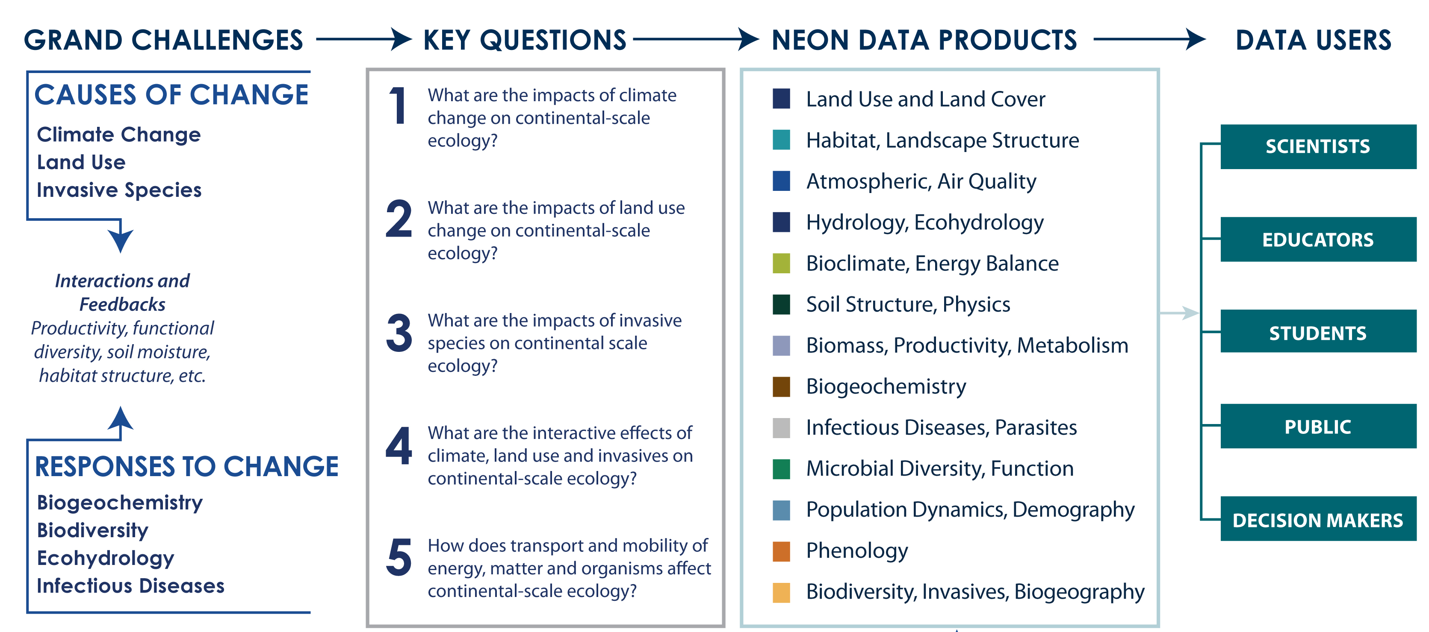
The NEON Project:
Addressing Science Challenges

Slide 4
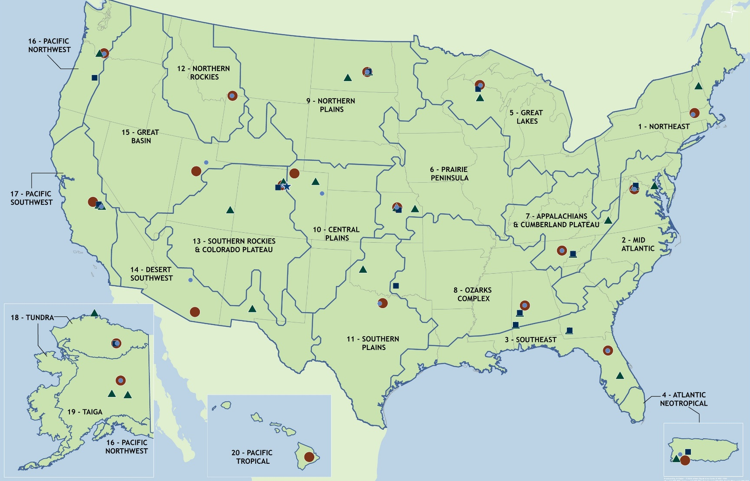

NEON’s field sites and data products
81
FIELD SITES
47 terrestrial
34 aquatic
Approximately
180
DATA PRODUCTS

Slide 5



NEON’s data collection methods
Automated instruments
These three systems collect data within close proximity of each other at each site
Standardized methods are used across all sites
Observational sampling
Airborne remote sensing

Slide 6
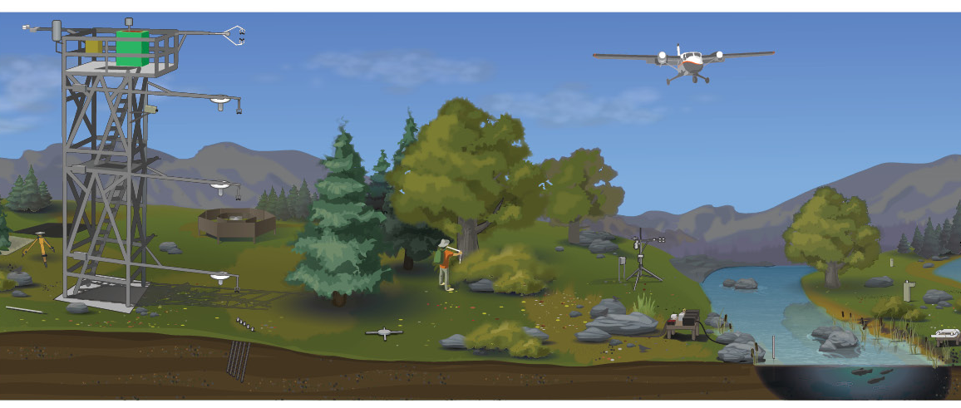
Data collection at colocated sites
Aquatic site
Terrestrial site

Slide 7
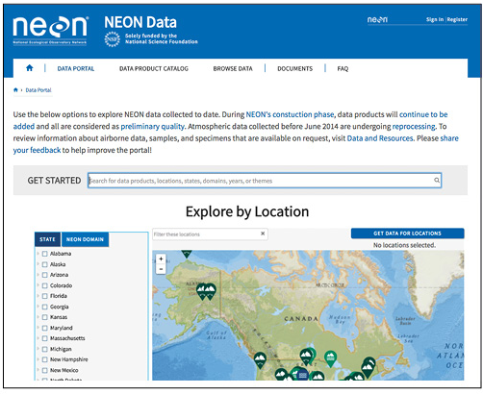
Data portal
Download data
View the Data Product Catalog
API
Read protocols
Register a free account

Slide 8
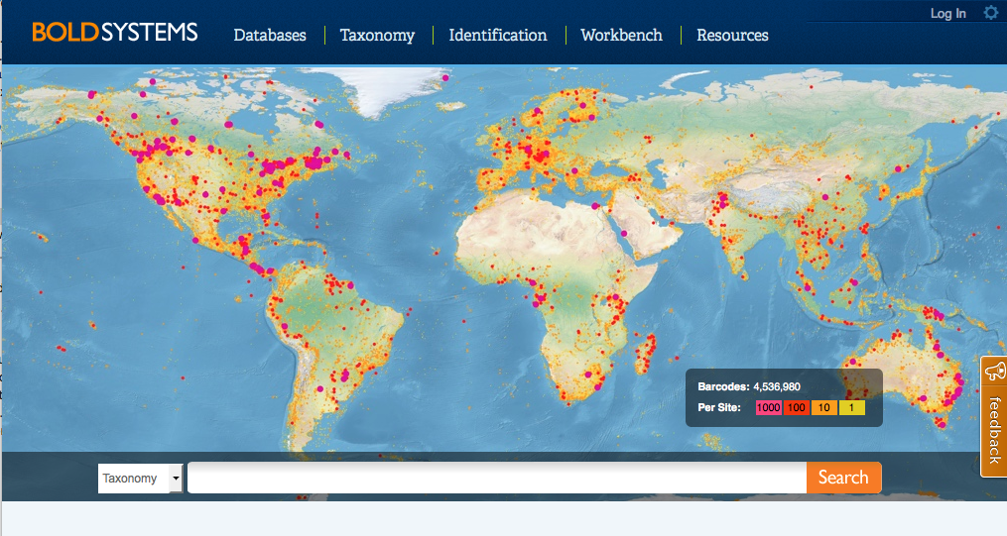
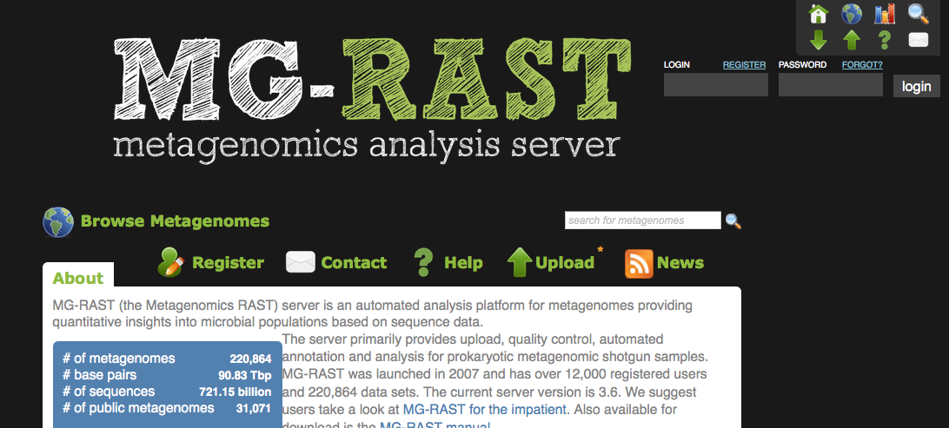
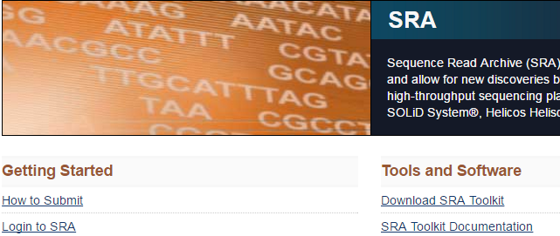
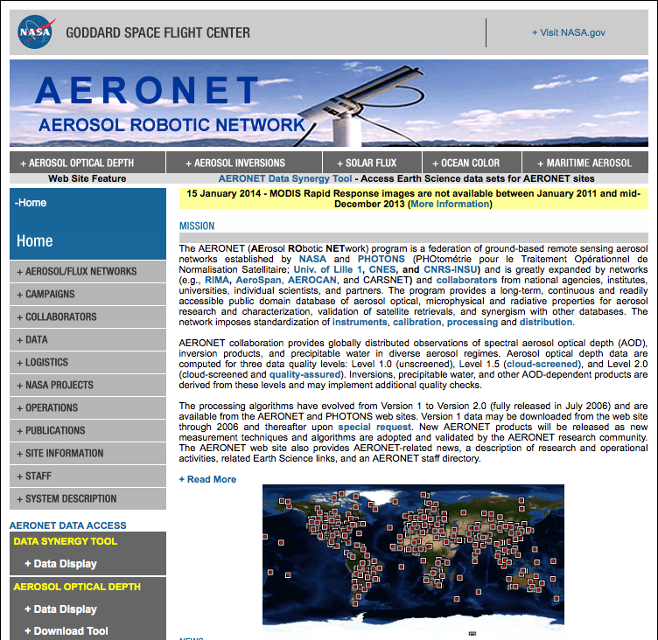
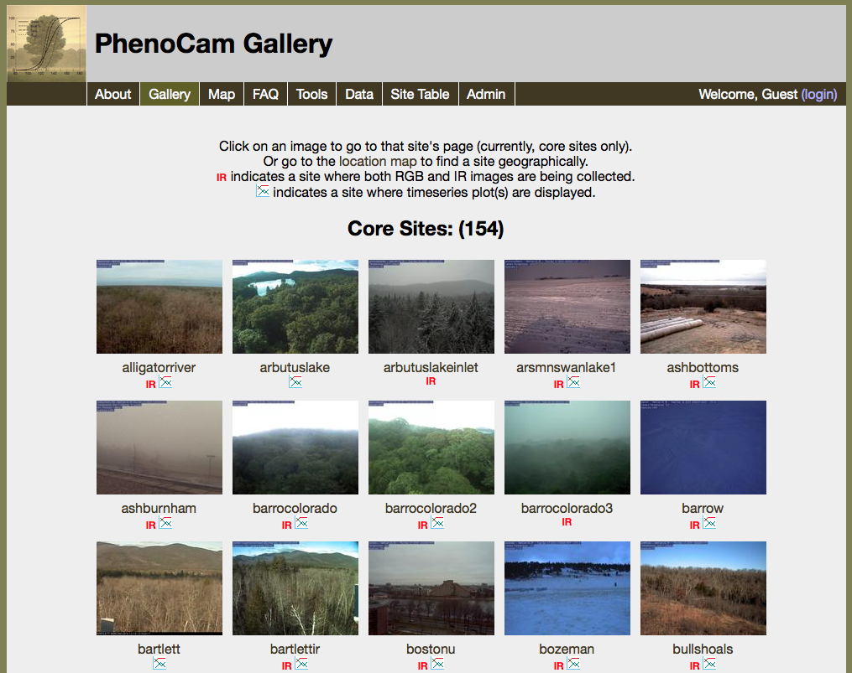
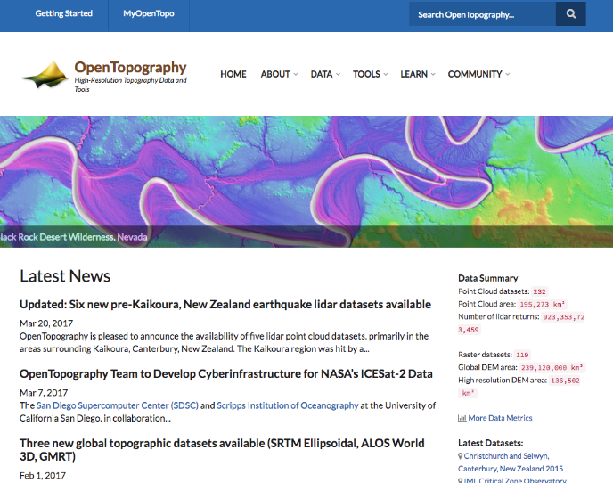
External repositories
Barcode of Life (BOLD)
MG-RAST
Sequence Read Archive (SRA)
AERONET
OpenTopography
PhenoCam Network

Slide 9
NEON’s data collection methods
Automated instruments
This presentation will focus on this component of NEON
Observational sampling
Standardized Framework
Traceable
Reliable
Transparent
Airborne remote sensing

Slide 10
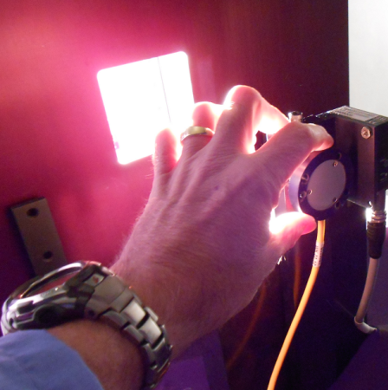
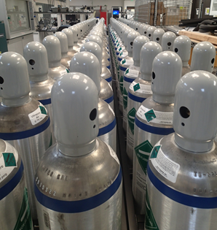
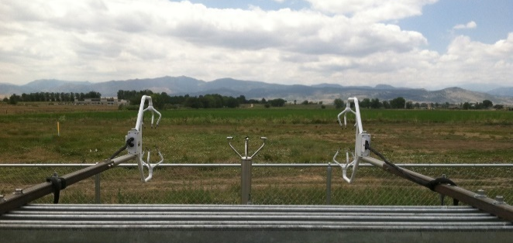
Standardized Framework
Standardized Framework
NEON’s in-house metrology lab – Calibration, Validation, and Audit Laboratory (CVAL)
  Provides regular calibrations for sensors and data acquisitions systems (DAS).
    Traceable to the same standards and methods.
    Control over quality by ensuring performance of sensors and DAS’s meet project requirements.
    Provides internal assessment of measurement uncertainty.
  Informs drift in measurements
    Compare years of calibrations to understand field use
    impacts to sensors and sensor life
  Creates aquatic standards, isotopic carbon dioxide gas standards, and isotopic water standards
    Used in the field for traceable calibrations and validations.
  Technology Changes
    Compare old to new with same standards to understand changes in the 30 years of the project.
Traceable
Reliable
Transparent

Slide 11
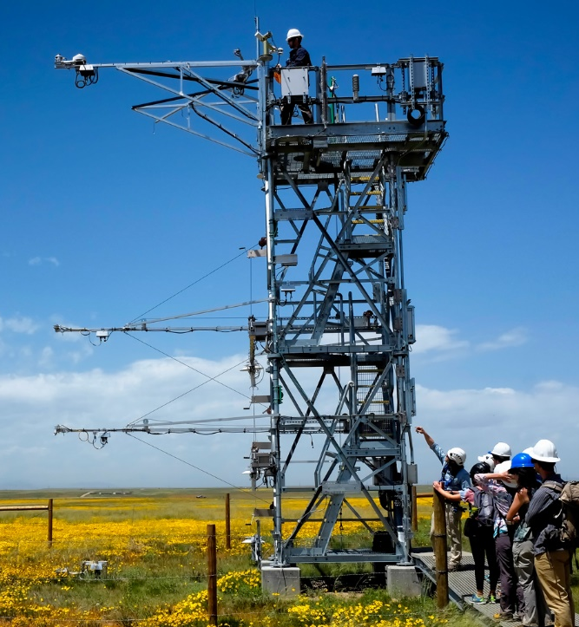
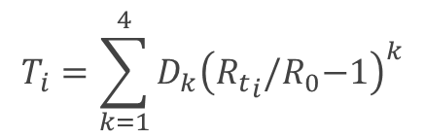
Standardized Framework
Standardized Framework
Algorithm Theoretical Basis Documents (ATBDs)
http://data.neonscience.org/documents
Theory of measurement
Theory of algorithms
    converting from raw data to calibrated data
QA/QC
Temporal averaging (Level 1 data products)
    One- and thirty-minute averages
Uncertainty estimates
    Measurement uncertainty published with data products
Traceable
Reliable
Transparent
$$T_{i}=\sum_{k=1}^{4}{D_{k}{\left({R_{t}}_{i}{/R}_{0}−1\right)}^{k}}$$

Slide 12
Standardized Framework
Standardized Framework
Traceable
Reliable
Transparent

Slide 13
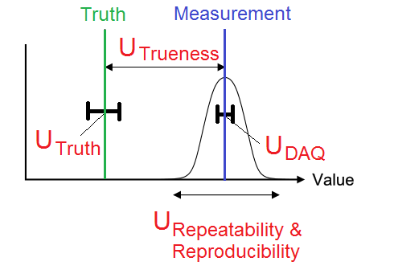
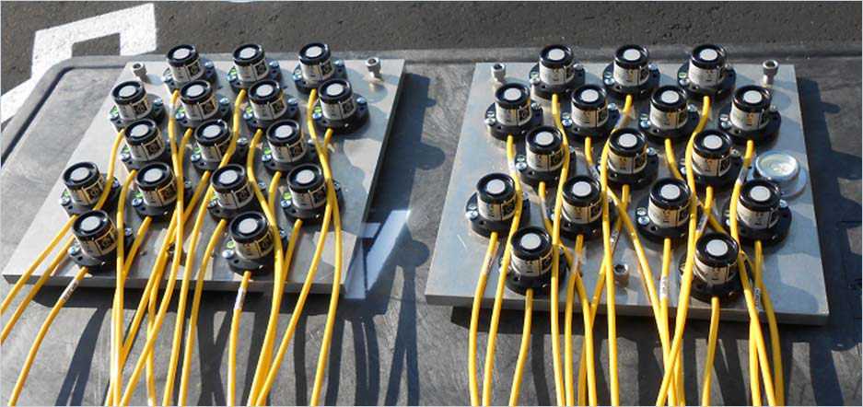
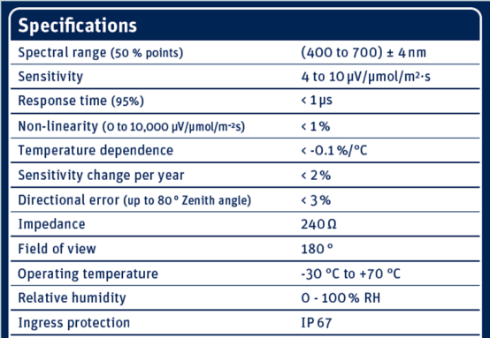
Calibration Uncertainty
Uncertainty: informing the quality of measurement
  Assessment Standard: JCGM, 2008, Evaluation of measurement data – Guide to the expression of uncertainty in measurement (GUM), JCGM 100:2008.
Type A: evaluated by statistical methods.
Experimental variance of independent observations which differ in value because of random variations.
  Calibration with uncertainties
  DAQ: Data Acquisition System
Type B: evaluated by other means. Estimates obtained using available published knowledge such as manufacturer’s specs, calibration certificates, reference data from handbooks, etc.

Slide 14
Calibration Uncertainty
Truth
Type B: Primary Standard
Type A: Calibration Variation
Type A: Algorithm Accuracy
Type B: Other
e.g., DAS
Secondary Standard Calibration
+
+
+
=
u(x_{i})
Sources
+
+
+
Standard Drift,
Temperature
Drift, DAS
Calibration
Certificate, etc.
➔
Standard
Calibration
Certificate:
Uncertainty,
Tolerance,
Accuracy
Reproducibility
Trueness
=
u_{c}(y)
Secondary
Standard
Calibration
Truth
Type B: Secondary Standard
Type A: Calibration Variation
Type A: Algorithm Accuracy
Type B: Other
e.g., DAS
Sensor Calibration
+
+
+
=
u(x_{i})
Sources
+
+
+
Standard Drift,
Temperature
Drift, DAS
Calibration
Certificate, etc.
=
➔
u_{c}(y)
Secondary
Standard
Calibration
Reproducibility
Trueness
u_{c}(y)
Sensor
Calibration

Slide 15
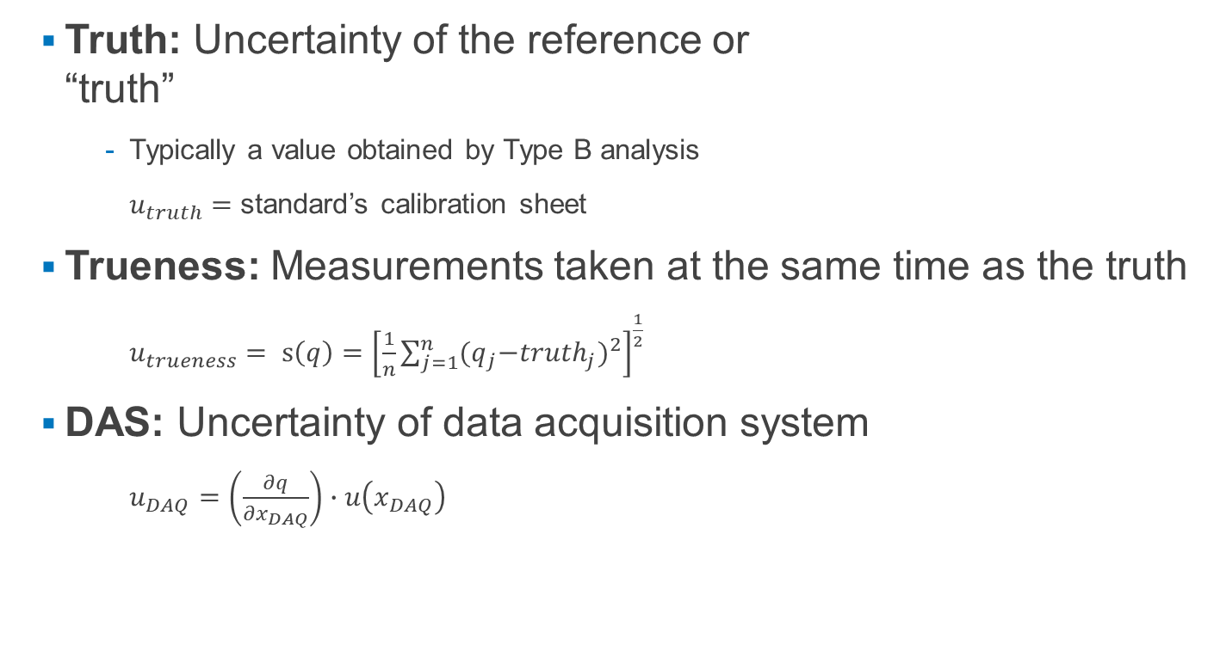
Calibration Uncertainty
  Truth: Uncertainty of the reference or
  “truth”
      Typically a value obtained by Type B analysis
      $u_{truth}=$ standard’s calibration sheet
  Trueness: Measurements taken at the same time as the truth
  $u_{trueness}= s\left(q\right)={\left[\frac{1}{n}\sum_{j=1}^{n}{{{(q}_{j}−{truth}_{j})}^{2}}\right]}^{\frac{1}{2}}$
  DAS: Uncertainty of data acquisition system
      $u_{DAQ}=\left(\frac{∂q}{∂x_{DAQ}}\right)∙u\left(x_{DAQ}\right)$

Slide 16
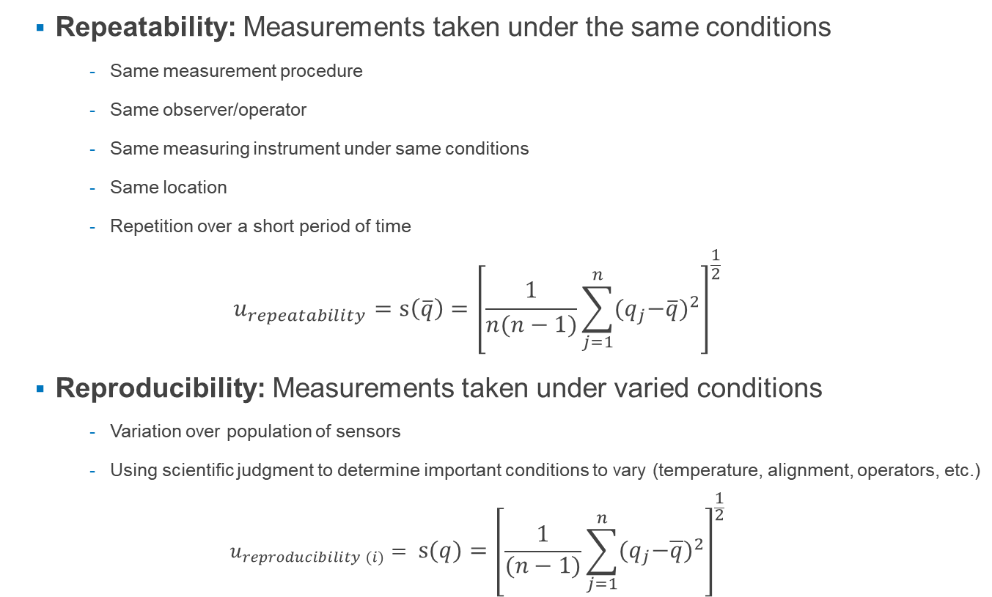
Calibration Uncertainty
  Repeatability: Measurements taken under the same conditions
      Same measurement procedure
      Same observer/operator
      Same measuring instrument under same conditions
      Same location
      Repetition over a short period of time
  $$u_{repeatability}=s\left(\overline{q}\right)={\left[\frac{1}{n(n−1)}\sum_{j=1}^{n}{{{(q}_{j}−\overline{q})}^{2}}\right]}^{\frac{1}{2}}$$
  Reproducibility: Measurements taken under varied conditions
      Variation over population of sensors
      Using scientific judgment to determine important conditions to vary (temperature, alignment, operators, etc.)
  $$u_{reproducibility (i)}= s\left(q\right)={\left[\frac{1}{(n−1)}\sum_{j=1}^{n}{{{(q}_{j}−\overline{q})}^{2}}\right]}^{\frac{1}{2}}$$

Slide 17
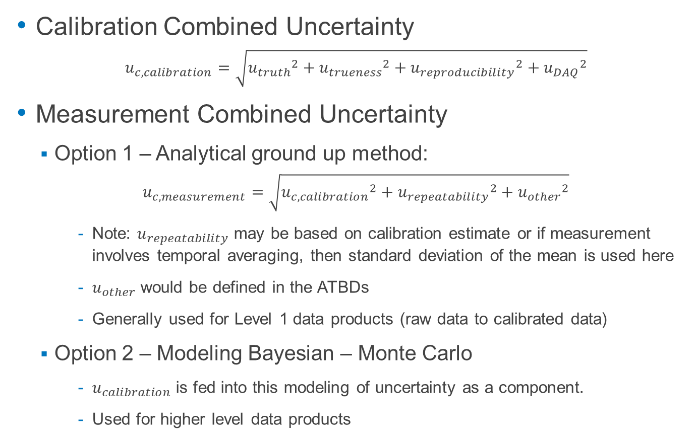
Traceable Calibrations to Measurement Uncertainty
Calibration Combined Uncertainty
$$u_{c,calibration}=\sqrt{{u_{truth}}^{2}+{u_{trueness}}^{2}+{u_{reproducibility}}^{2}+{u_{DAQ}}^{2}}$$
Measurement Combined Uncertainty
  Option 1 – Analytical ground up method:
$$u_{c,measurement}=\sqrt{{u_{c,calibration}}^{2}+{u_{repeatability}}^{2}+{u_{other}}^{2}}$$
      Note: $u_{repeatability}$ may be based on calibration estimate or if measurement involves temporal averaging, then standard deviation of the mean is used here
      $u_{other}$ would be defined in the ATBDs
      Generally used for Level 1 data products (raw data to calibrated data)
  Option 2 – Modeling Bayesian – Monte Carlo
      $u_{calibration}$ is fed into this modeling of uncertainty as a component.
      Used for higher level data products

Slide 18

Measurement Uncertainty
Expanded uncertainty (95% CL) provided as output with data products.
$$u_{95\%}=k_{p}∗u_{c}$$
startDateTime | endDateTime | tempTripleMean | tempTripleMinimum | tempTripleMaximum | tempTripleVariance | tempTripleNumPts | tempTripleExpUncert | tempTripleStdErMean | finalQF
2018-01-01T21:30:00Z | 2018-01-01T22:00:00Z | -6.8852 | -7.5285 | -6.2477 | 0.0434 | 1800 | 0.0225 | 0.0049 | 0
2018-01-01T22:00:00Z | 2018-01-01T22:30:00Z | -6.3504 | -6.8992 | -5.9652 | 0.0458 | 1800 | 0.0227 | 0.005 | 0
2018-01-01T22:30:00Z | 2018-01-01T23:00:00Z | -6.3603 | -6.6458 | -6.0367 | 0.0113 | 1800 | 0.019 | 0.0025 | 0
2018-01-01T23:00:00Z | 2018-01-01T23:30:00Z | -7.2451 | -7.9455 | -6.6443 | 0.0923 | 1800 | 0.0269 | 0.0072 | 0
2018-01-01T23:30:00Z | 2018-01-02T00:00:00Z | -8.5638 | -9.1642 | -7.9429 | 0.1361 | 1800 | 0.0195 | 0.0087 | 0
2018-01-02T00:00:00Z | 2018-01-02T00:30:00Z | -8.8873 | -9.4052 | -8.7115 | 0.0105 | 1800 | 0.0188 | 0.0024 | 0
2018-01-02T00:30:00Z | 2018-01-02T01:00:00Z | -9.4548 | -9.8138 | -9.2061 | 0.0199 | 1800 | 0.0199 | 0.0033 | 0
2018-01-02T01:00:00Z | 2018-01-02T01:30:00Z | -10.0574 | -12.0896 | -9.1353 | 0.5932 | 1800 | 0.0542 | 0.0182 | 0
2018-01-02T01:30:00Z | 2018-01-02T02:00:00Z | -10.3771 | -11.4278 | -9.9939 | 0.1414 | 1800 | 0.0197 | 0.0089 | 0
2018-01-02T02:00:00Z | 2018-01-02T02:30:00Z | -11.0717 | -11.8375 | -10.3517 | 0.2132 | 1800 | 0.0354 | 0.0109 | 0
2018-01-02T02:30:00Z | 2018-01-02T03:00:00Z | -10.9954 | -11.4976 | -10.3317 | 0.0604 | 1800 | 0.0239 | 0.0058 | 0
2018-01-02T03:00:00Z | 2018-01-02T03:30:00Z | -11.3477 | -11.7524 | -10.9252 | 0.0649 | 1800 | 0.0161 | 0.006 | 0
2018-01-02T03:30:00Z | 2018-01-02T04:00:00Z | -11.599 | -12.104 | -10.9418 | 0.0783 | 1800 | 0.0168 | 0.0066 | 0
2018-01-02T04:00:00Z | 2018-01-02T04:30:00Z | -11.6209 | -12.1554 | -10.5556 | 0.1482 | 1800 | 0.02 | 0.0091 | 0
2018-01-02T04:30:00Z | 2018-01-02T05:00:00Z | -10.1807 | -10.834 | -9.4249 | 0.1358 | 1800 | 0.0302 | 0.0087 | 0
2018-01-02T05:00:00Z | 2018-01-02T05:30:00Z | -10.0644 | -10.4079 | -9.6853 | 0.0481 | 1800 | 0.0228 | 0.0052 | 0
2018-01-02T05:30:00Z | 2018-01-02T06:00:00Z | -9.7592 | -10.905 | -8.7137 | 0.3067 | 1800 | 0.0409 | 0.0131 | 0
2018-01-02T06:00:00Z | 2018-01-02T06:30:00Z | -8.8099 | -9.201 | -8.5386 | 0.024 | 1800 | 0.0204 | 0.0037 | 0
2018-01-02T06:30:00Z | 2018-01-02T07:00:00Z | -8.7845 | -10.3254 | -7.6421 | 0.8494 | 1800 | 0.0639 | 0.0217 | 0

Slide 19
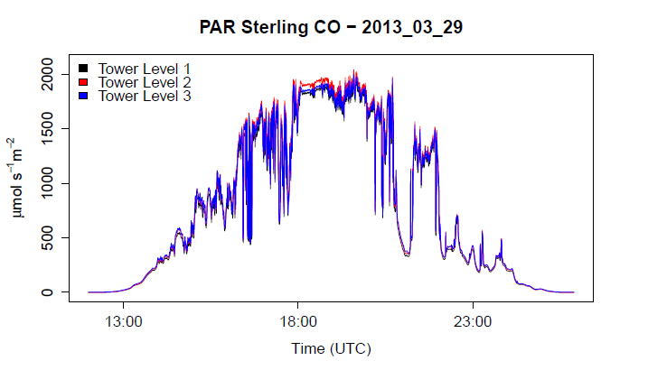
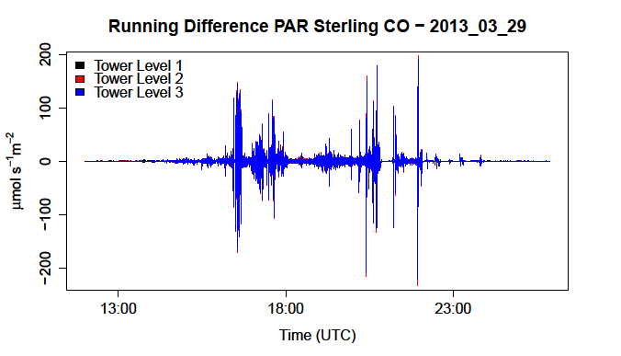
Automated QAQC of the data products
QA/QC Flags:
Range – realistic data range
Persistence – realistic data variability
Null –missing data points
Gap –large data gaps
Step –large changes between consecutive data points
De-spiking –spikes in the data set
Consistency – comparable measurements
Sensor Flags:
Identify problem areas, e.g., consistency checks
Assist algorithm refinement and development

Slide 20
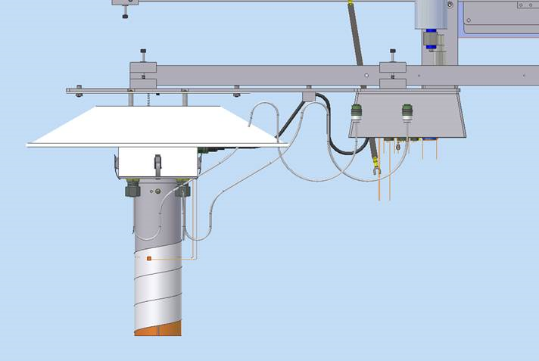
Example
Convert [Ω] to [°C]
Sensor flags
A. Heater (ON/OFF)
B. Turbine (flow > threshold)
3. QA /QC testing
4. Calculate temporally averaged data product
5. Publish data
1 Hz Tem. (Ω)
Traceable uncertainty estimates
Uncertainty informs thresholds for certain QA/QC tests (e.g., persistence)
Make confident inferences between signal (environmental phenomenon)-to-noise

Slide 21
Current and Future work
Data commissioning
Threshold refinement
Drift analysis and corrections

Slide 22
Learn more at neonscience.org
Contact Info: jcsavina@battelleecology.org

Slide 24
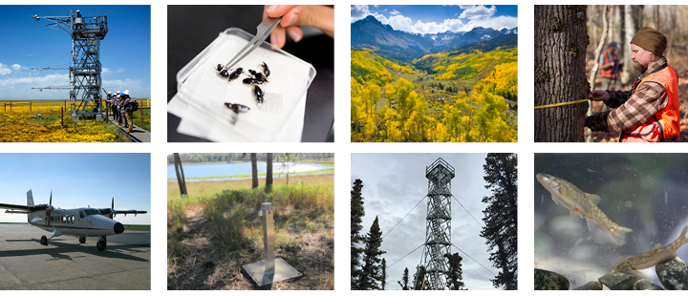
Why is NEON important?
NEON provides a highly coordinated national system for monitoring a number of critical ecological and environmental properties at multiple spatial and temporal scales.
Notes:
NEON provides a highly coordinated national system for monitoring a number of critical ecological and environmental properties at multiple spatial and temporal scales.

Slide 25
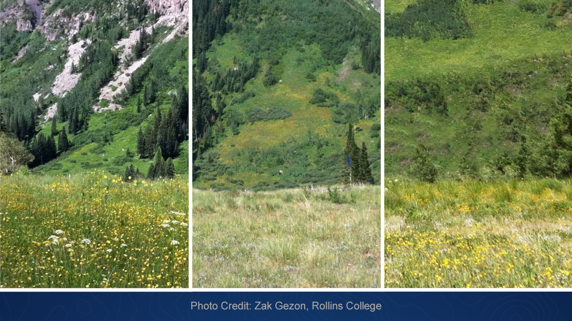
NEON can be used to:
Detect changes in how our ecosystems function over time
2011
2012
2013
Notes:
NEON data can be used to detect changes in how our ecosystems function over time.
These photos were all taken at peak flower of Potentilla pulcherrima in 2011, 2012, and 2013. 2011 was a record breaking high snowfall year with very late phenology, and very high floral abundance. 2012 was a record breaking low snowfall year with very early phenology and extreme frost events, and basically no flowers at all because they all got hit by frost and then drought. 2013 was more average, and had intermediate floral abundance. This photo does a great job of representing climate change because the phenology in this area is advancing by almost a week a decade, and the frequency of hard frost events is increasing with the advanced phenology. Thus that photo of 2011 represents what the meadow has been like more often in the past, and the 2012 photo represents what we might be expecting more in the future. The plants basically failed to flower in 2012, and of the ones that did flower, failed to reproduce.
Ecologists have developed and tested theories to describe species function, species interactions, and ecosystem development after discrete disturbances, such as floods, fires, and insect outbreaks (e.g., intermediate disturbance hypothesis [Wilkinson 1999] and succession [Odum 1969]). However, increasing demand for natural resources (Hardin 1968) and other anthropogenic activities (e.g., increasing nitrogen deposition and atmospheric CO₂ concentrations) have created “new more chronic disturbance regimes” (Smith et al. 2009, Schimel and Keller 2015). In addition, it is now more common for multiple disturbances to act simultaneously (NRC 2007, Aber at el. 2001). Overall, these new disturbance regimes challenge traditional assumptions of stability, resiliency, and adaptability in ecosystem properties (Chapin et al. 2009), and will require new data to support our capability to make informed decisions about sustainable management of our ecosystems.

Slide 26
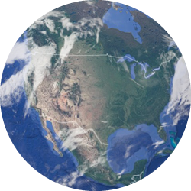
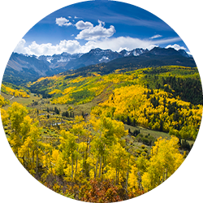

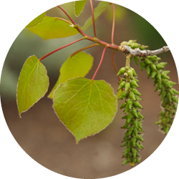
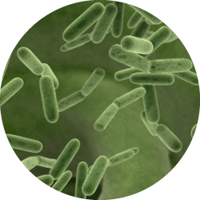
NEON can be used to:
Integrate ecological observations across multiple scales
Biogeochemical cycles
SPATIAL SCALE
Community Dynamics
Phenology
Metabolic regulation
Energy transfer
TEMPORAL SCALE
Modified after Schaepman, et al. 2009
Notes:
NEON data can be used to address research questions across temporal and spatial scales. NEON data sampling is designed to scale within a single field site and across field sites to enable researchers to ask questions at the continental scale ecology. The long term operations of NEON will allow researchers to answer questions on scales from seconds to decades.
Our environment includes numerous physical, biotic, and abiotic processes that functionally connect the biosphere, geosphere, hydrosphere, and atmosphere in the critical zone that fosters life. Our current knowledge is insufficient to establish an integrative theory that can link the Earth’s systems across ecologically relevant scales of time and space, from seconds to decades and square meters to continents (Chabbi and Loescher 2017). Current ecological research programs lack the consistent, standardized design and operational infrastructure to adequately address the complexity associated with these scales.
Macrosystems ecology (MSE) is an emerging field that is coincident with this era of “big data” and new techniques to study broad-scaled regional processes.

Slide 27
NEON can be used to:
Integrate ecological observations across multiple scales
Biogeochemical cycles
Community Dynamics
Phenology
Metabolic regulation
Ecosystem diversity, process diversity,
landscape diversity
Energy transfer
Individual – Population – Community – Ecosystem – Landscape
Species diversity, functional diversity,
interaction diversity
Genetic diversity
Modified after Schaepman, et al. 2009
Notes:
For example, biodiversity can be studied at several different scales from the genetic diversity within and between individuals to ecosystem and process diversity across large regional or continental scales.

Slide 28
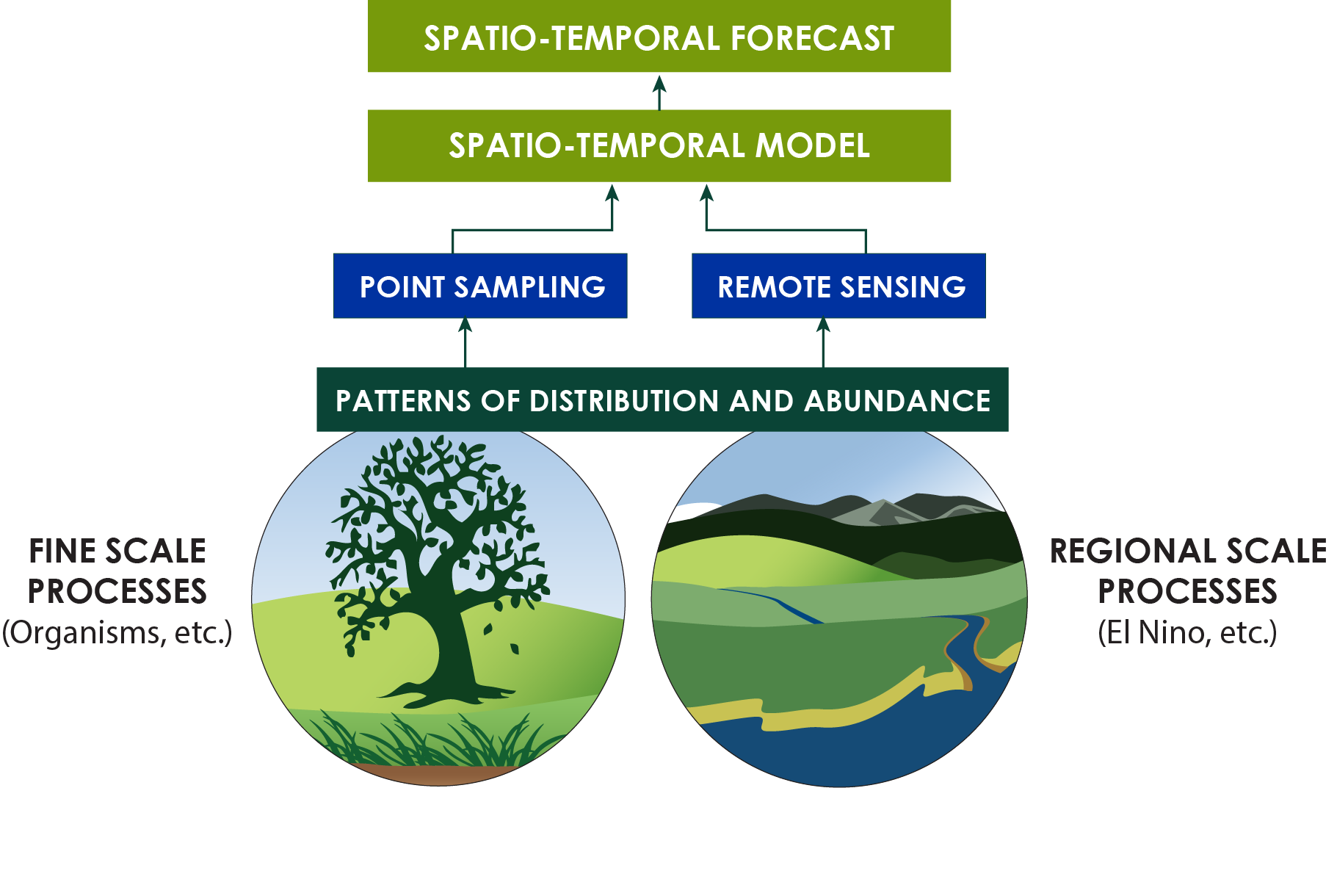
NEON can be used to:
Enable environmental forecasting
Notes:
NEON data can be used to enable environmental forecasting
Ecology is limited by its inability to predict the trajectory of ecological processes or ecosystem functions into the future (Clark et al. 2001). The Intergovernmental Panel on Climate Change (IPCC 2013) highlighted the necessity for more advanced and broader attempts at ecological forecasting. To enable and support ecological forecasting, we need to better understand:
(1) What are the key attributes of an ecological process that allow them to be scaled in time and space?
(2) What are the possible trajectories of these processes?
(3) What is the recognized degree of uncertainty (Schimel and Keller 2015)?
The ecosystem services that our environment provides are under stress from environmental change and the increasing demands of industrialized society. Therefore, science has a new mandate to determine how to preserve the key components of our planet’s ecosystems to ensure our future economic and societal well-being.

Slide 29
How does NEON work?
NEON’s data collection methods

Slide 30
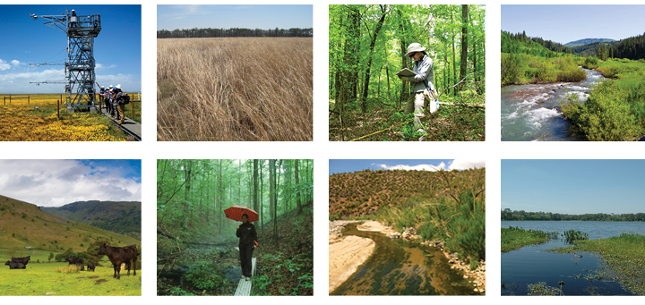
NEON’s ecoclimatic domain design
Notes:
NEON statistically partitioned the continental US, Hawaii and Puerto Rico into 20 ecoclimatic domains that represent distinct regions of vegetation, landforms and ecosystem dynamics to capture the full range of US ecological and climatic diversity. NEON selected ecologically representative core sites within each domain considering logistical convenience and site accessibility. Relocatable sites may be moved and are selected to capture environmental gradients not captured at core sites; these sites are intended to support the study of key continental areas of study. (note the slide in the Detailed Slide section explaining core & relocatable sites, if desired for your audience).
How were domains decided on?
NEON’s domains were defined with a statistically rigorous analysis using national data sets for ecoclimatic variables. The statistical design is based upon algorithms for multivariate geographic clustering (MGC) (Hargrove and Hoffman, 1999, 2004).
Clusters are formed so that each cluster contains roughly the same fraction of the total ecoclimatic variance, and so that the centroids of the clusters lie roughly equally far apart in ecoclimatic space. S
Selecting one core site per domain allows NEON to sample within the ecoclimatic variability of the U.S. in a roughly uniform way. Put another way, each site represents roughly the same fraction of total ecoclimatic variability, providing an equal-variance design.
For more details see the 2011 Science Strategy design document: http://www.neonscience.org/sites/default/files/basic-page-files/NEON_Strategy_2011u2_0.pdf
Jen Smith suggested that one of the “core” NEON concepts that outside scientists and NEON staff didn’t understand was the core sites represented “wildlands” and that relocatable sites were specific to different types of questions. This could be built in here, but I feel that in what I’ve read recently this has been significantly downplayed. Include or not?

Slide 31



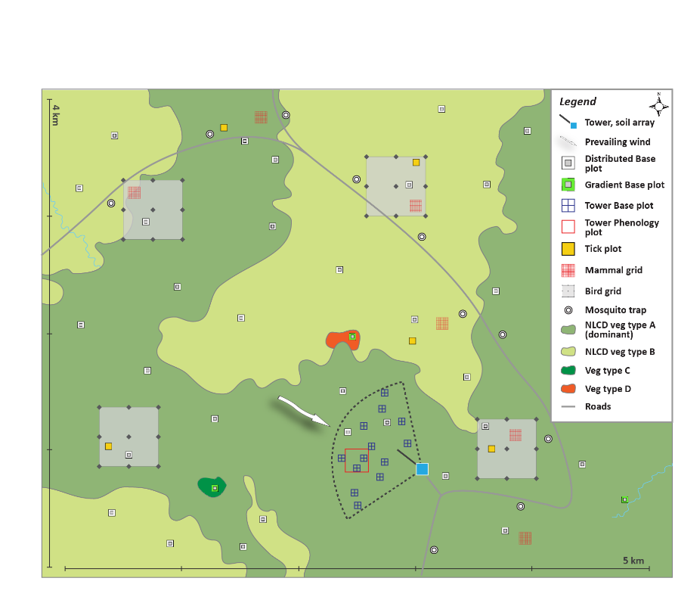
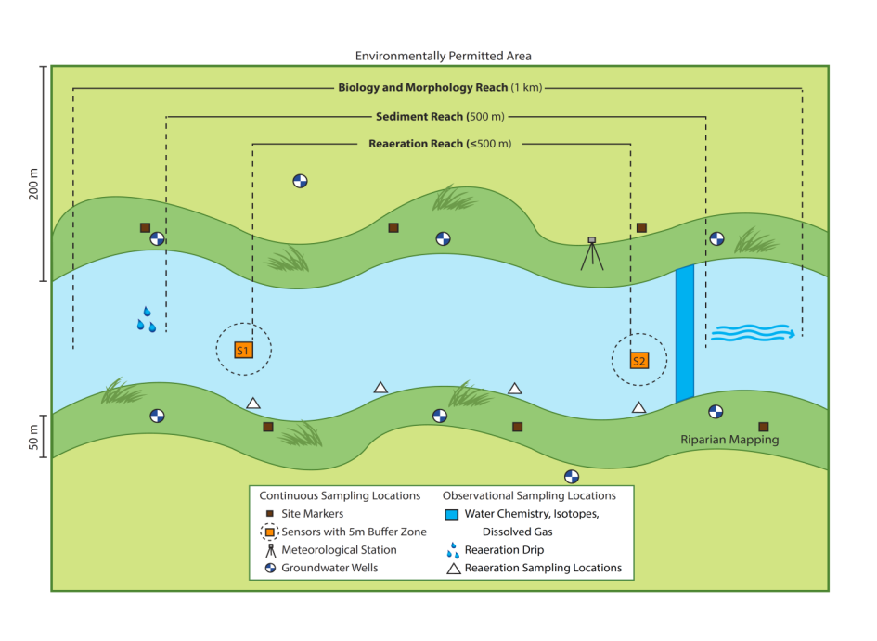
Collection systems at a site
Both aquatic and terrestrial field sites have all three collection systems
Terrestrial site
Aquatic wadeable site
Notes:
The data collected through these three systems may be studied in conjunction with each other since they are collected in close proximity at each field site. The data are also comparable across ecosystems and field sites which means researchers can study connections and patterns and develop models to forecast environmental trends locally, regionally and even at the continental scale.

Slide 32
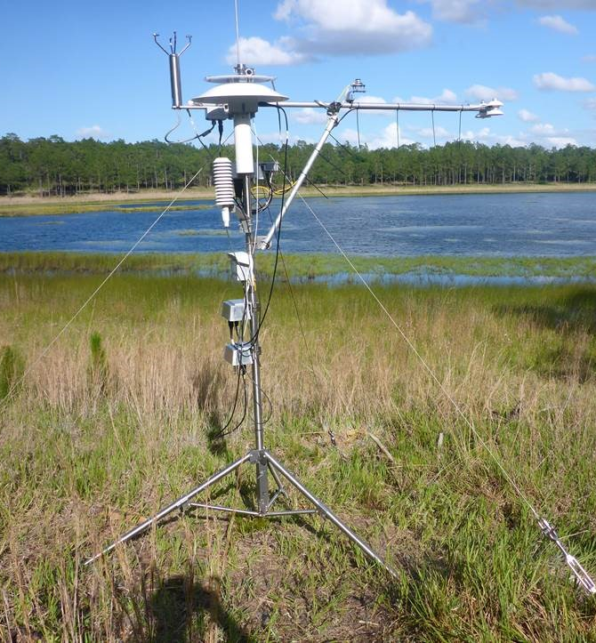
Automated instruments: atmospheric data
Flux tower at terrestrial sites
Micrometeorology station at aquatic sites
Notes:
NEON collect atmospheric data at all field sites – terrestrial and aquatic. Core measurements at all sites include air temperature, wind speed, precipitation, barometric pressure, and visible light or Photosynthetically Active Radiation (PAR).
In addition, the towers at terrestrial sites allow for these measurements at multiple levels and for eddy covariance measurements to estimate gas exchange at the site.
Tower height is determined by the height of the surrounding vegetation. The Wind River site in Washington is the tallest tower in the NEON network.
(note the slide in the Detailed Slide section comparing tower & met stations similarities & differences if desired for your audience).

Slide 33
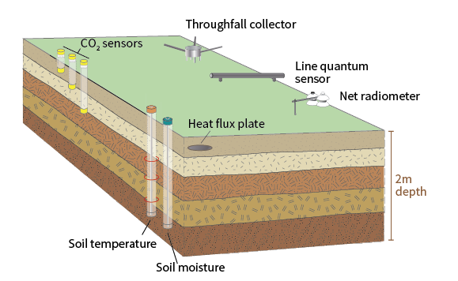
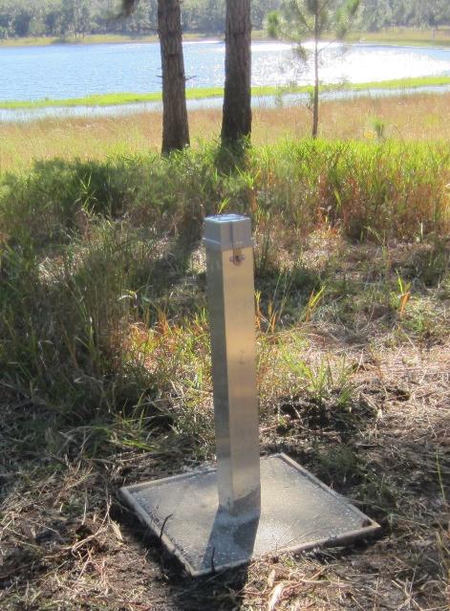
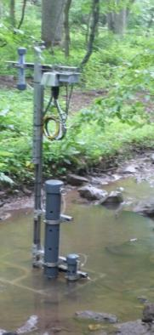
Automated instruments:
soil and water
An array of soil plots near the flux tower at terrestrial sites collect soil health data
Instruments in the ground, lakes and streams at aquatic sites monitor indicators of water quality
Notes:
Water: The project uses suites of aquatic sensors in streams, lakes and rivers featured at NEON sites to collect data ranging from water quality measurements to localized atmospheric measurements.
Soil: Soil arrays and in situ samples provide estimates of soil moisture, soil organic carbon, root growth and phenology, temperature and heat flux.

Slide 34
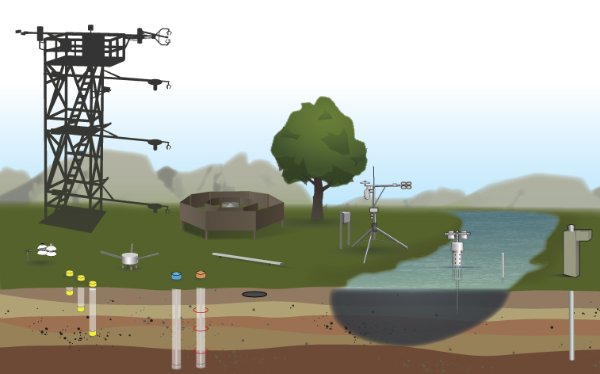
Linking measurements
Temperature
PAR
CO₂
Notes:
The NEON instrument & spatial design allows for measurements to be linked within and across field sites. Here we show a hypothetical, colocated terrestrial and aquatic site. Here we should Temperature, Photosynthetically Active Radiation (PAR), and CO2 measurements.
For example, temperature measurements are taken at multiple levels in both terrestrial and aquatic sites and can be used to look at independent or co-varying changes in temperature over time.
Temperature measurement specifics:
Tower: Air temperature, single (NEON.DP1.00002) & triple aspirated (NEON.DP1.00003); IR biological temperature (NEON.DP1.00005), at the top and at the levels along the tower.
Soil Array: soil temperature at multiple depths (NEON.DP1.00041)
Aquatic met station: Air temperature, single (NEON.DP1.00002) & triple aspirated (NEON.DP1.00003)
Aquatic water bodies: surface temperature (NEON.DP1.20053), temperature at depth (NEON.DP1.20264) & air temperature at buoys (NEON.DP1.20046; not shown in diagram)
Groundwater wells: ground water temperature (NEON.DP1.20217)

Slide 35
Linking measurements
Precipitation
Water content
Water quality and elevation
Notes:
(If using slide after other Linking Measurements slide) Likewise the several moisture related measurements are similarly linked across and between field sites. (see DP details below)
(If using slide alone) The NEON instrument & spatial design allows for measurements to be linked within and across field sites. Here we show a hypothetical, colocated terrestrial and aquatic site. Here we should Precipitation, Soil Moisture, and Water Quality & Elevation measurements.
For example, temperature measurements are taken at multiple levels in both terrestrial and aquatic sites and can be used to look at independent or co-varying changes in temperature over time.
Precipitation measurements:
All precipitation measures are NEON.DP1.00006. But collected in several ways
Double Fence Intercomparison Reference station (DFIR): weight gauge (within 0.5 km of tower).
Tower/Met station Top: tipping bucket
Soil array (3 of 5 stations) - “through fall” or ground level precipitation: tipping bucket
Note: aquatic sites have DFIR or Metstation Precipitation gauge, not both. No through fall precipitation.
Wet deposition chemical analysis: NEON.DP1.00013.
Top of tower and met station
Total dissolved chemical ion concentrations of SO42_, NO3_, Cl_, Br-, NH4+, PO43_, Ca2+, Mg2+, K+, Na+, and pH/conductivity
Moisture measurement specifics:
Soil Water Content (and salinity):NEON.DP1.00094
recorded at several soil depths from 2-200cm (300cm in permafrost areas).
Soil array
Canopy Water Content: NEON.DP2.30019 (Remote Sensing/AOP)
Water Quality/Elevation measurements
Surface water quality: NEON.DP1.20288
in surface water of lakes, wadeable streams, and non-wadeable streams.
specific conductivity, concentration of chlorophyll a, dissolved oxygen content, fluorescent dissolved organic matter (fDOM) concentration, pH, and turbidity.
Surface water: chemical properties NEON.DP1.20093
Surface water: elevation NEON.DP1.20016
Ground water: chemical properties NEON.DP1.20092
general chemistry, anions, cations, and nutrients.
Ground water: elevation NEON.DP1.20100
Ground water: specific conductivity NEON.DP1.20015
(Not on diagram but related) Relative humidity NEON.DP1.00098
top of the tower infrastructure, in the soil array, and on the aquatic meteorological station.

Slide 36

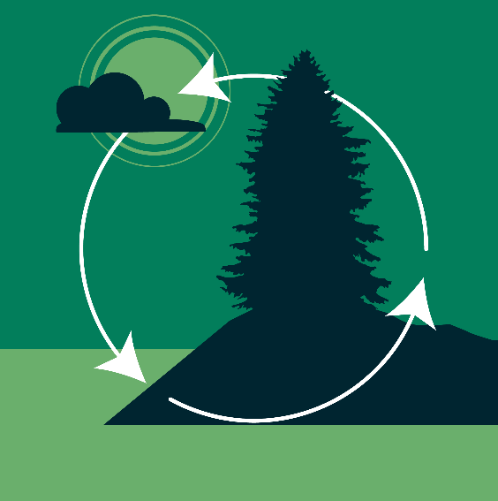

Observational sampling
Terrestrial & aquatic organisms
Biogeochemical data
Geomorphology/hydrology
Notes:
Observational sampling collects data on biogeochemical cycles, infectious diseases, and a suite of focal taxa to characterize local patterns, dynamics, and linkages within ecosystems. The selected taxa are designed to be widespread, capture a wide range of turnover time, and diverse evolutionary histories.

Slide 37
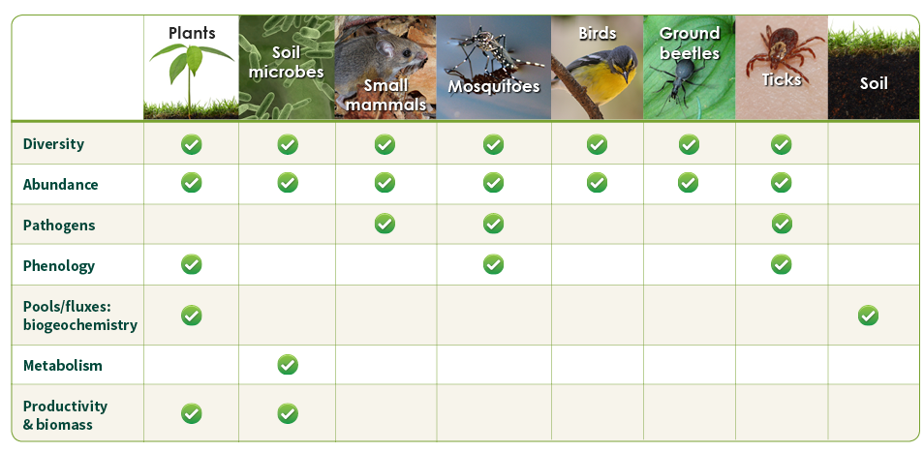
Terrestrial organisms & biogeochemical data
Notes:
At all terrestrial sites, NEON measures and observes animals, plants and microbes in situ and collects data such as species abundance and diversity, infectious diseases, population dynamics, plant chemistry and biomass.

Slide 38
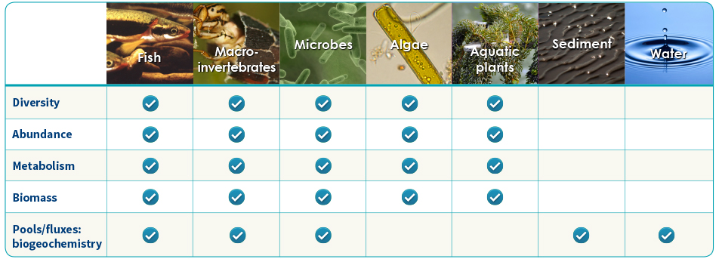
Aquatic organisms & biogeochemical data
Notes:
NEON captures in situ data related to stream and lake organisms, as well as hydrologic and climatic conditions. The project samples key organisms (e.g., fish), macroinvertebrates and riparian phenology based on temperature, water flow and peak greenness.

Slide 39
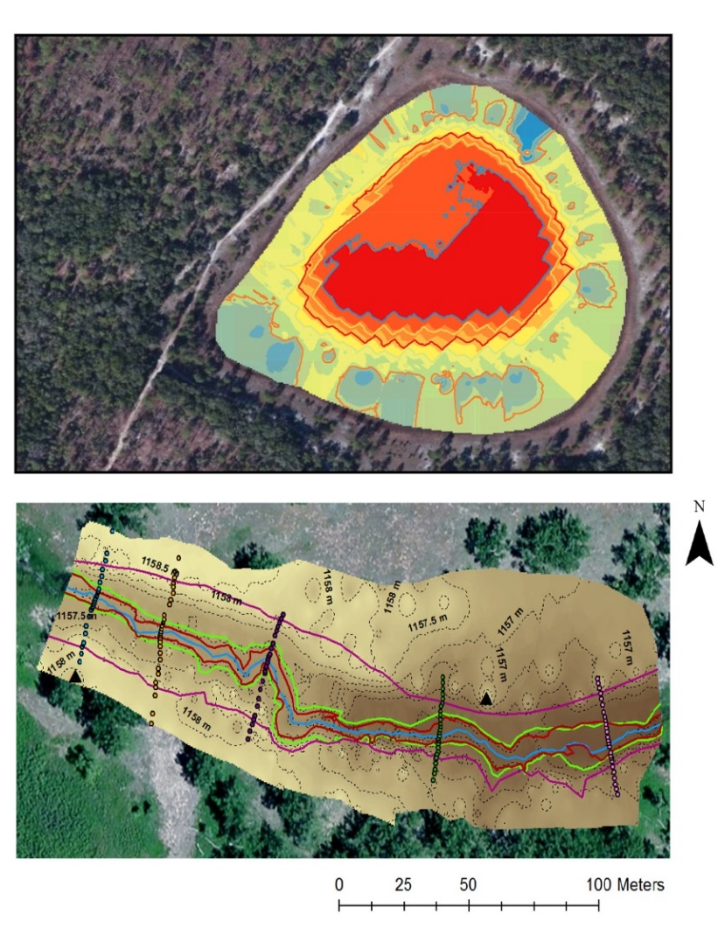
Bathymetry & morphology
Lake bathymetry
Stream geomorphology
Riparian assessment
Notes:
NEON captures in situ data related to stream and lake morphology.

Slide 40
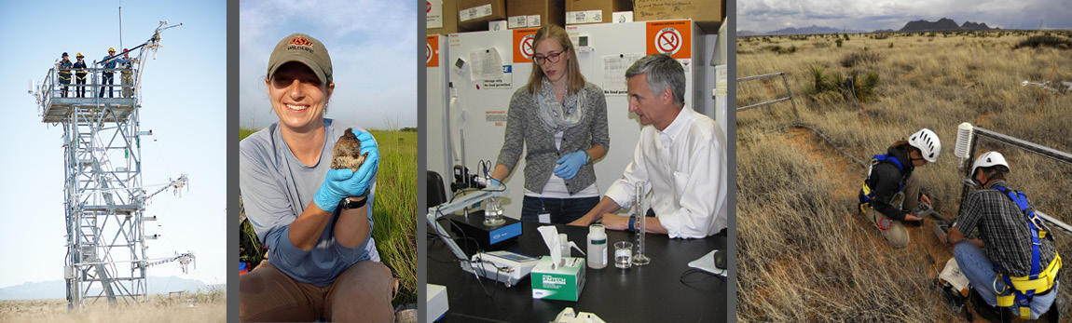
Field operations
Field operations staff are critical for
  Collecting all the observational data
  Care & maintenance with instruments
  Cooperation with site hosts & local communities
Notes:
The field staff make up the largest personnel component of the NEON project and are critical for the collection of all the observational data sampling and maintenance of instruments in the field. Located at domain offices throughout the US, the field staff include year-round technicians and managers and a large number of seasonal employees.

Slide 41
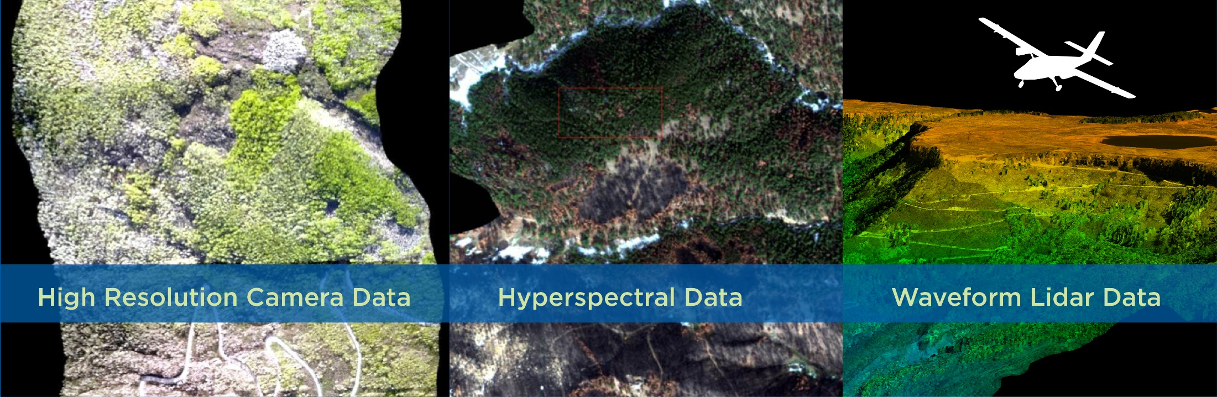
Airborne remote sensing
The Airborne Observation Platform (AOP)
Surveys are conducted at peak greenness over each site
Notes:
Airborne remote sensing data collected at all terrestrial sites and most aquatic sites provides site-wide data about ecological conditions, such as 1) vegetation composition, structure, health; 2) hydrology and drainage patterns; and 3) land cover. Each field site is flown over annually at peak greenness for that location.

Slide 42

Data processing example
Air Temperature
Data are collected at a frequency of 1 Hz, in Ohms
NEON converts this to 1- and 30-min averages, in Degrees
Data QA/QC typically includes:
Raw data are calibrated
Physical units are converted into standard scientific units
Data quality control occurs
Data are temporally averaged
Notes:
Data processing is essential for two main reasons:
* The creation of data products used in research. For example the air temperature measurements are recorded at a frequency of 1 Hz and in the unit Ohms. However, those are not measurements most would readily recognize for temperature. NEON converts the data into air temperature in degrees Celsius and is available at intervals of 1 and 30 minute averages.
* The implementation of Quality Assurance and Quality Control checks to ensure the reliability of NEON data used by scientists in their research.

Slide 43
Using NEON
Notes:
Get data, samples and assignable assets

Slide 44
Data portal
Download data
View the Data Product Catalog
API
Read protocols
Register a free account
Notes:
A primary product of NEON is freely available, open access data for use by the scientific research community. These data are also intended to be used by policy makers, natural resource managers, educators, students, citizen scientists, and others who will explore the petabytes of information that will be available during the lifetime of the Observatory.
Other ways to get the data:
Airborne remote sensing data is currently (spring 2017) only available by a request form on NEONScience.org
NEON Terrestrial Insect DNA Barcoding data is available through the Barcode of Life Datasystem (BOLD).
Data collected during NEON’s development is available on the Prototype Data Search in the data portal.
(Note detailed slide on other repositories, if appropriate for your audience).

Slide 45
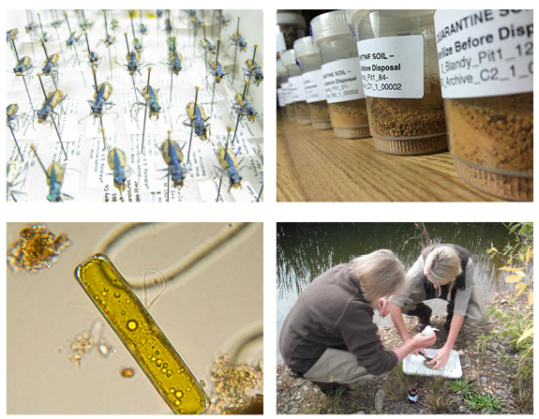
Sample archive
Small mammals*
Fish*
Ground beetles* & bycatch
Mosquitos*
Ticks*
Zooplankton
Benthic macroinvertebrates*
Vascular plants, algae, bryophytes and lichens
Soil microbes*
Soil
Dust
Wet deposition
*including genomic extracts
Notes:
Physical resources, such as bioarchived samples and research infrastructure, are available to support Principal Investigator-driven research and educational activities.

Slide 46
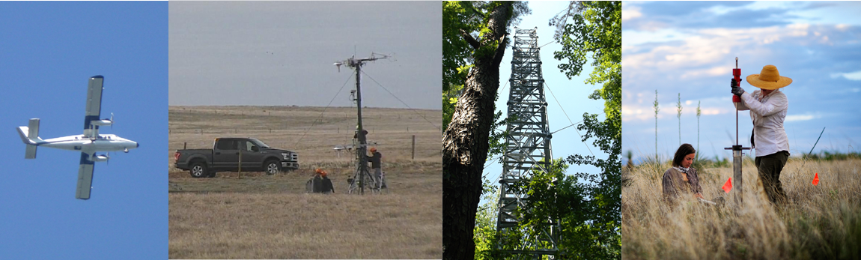
Assignable assets program
A formal request process to:
use an AOP
use a Mobile Deployment Platform (MDP)
add instruments to towers and other site infrastructure
access field sites for observational sampling purposes
Notes:
Specific NEON infrastructure assets (referred to as Assignable Assets) are available upon request for PI-driven research and environmental studies. Scientists and educators interested in requesting Assignable Assets must submit a formal request that includes in detail the proposed use of these assets. Standard requests may be submitted at any time. However, they will typically be evaluated on a quarterly basis.
Specifics:
AOP – contract the NEON AOP to fly over a site of your choice.
MDP – The MDP is a self-contained suite of sensors, power systems and data logging capabilities for capturing atmospheric, soil, and aquatic based measurements. Central to the concept of the MDP is the ability for rapid deployment to capture stochastic ecological events (e.g. fires, flood events, pest outbreaks) across the landscape.

Slide 47
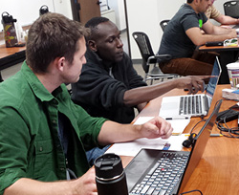
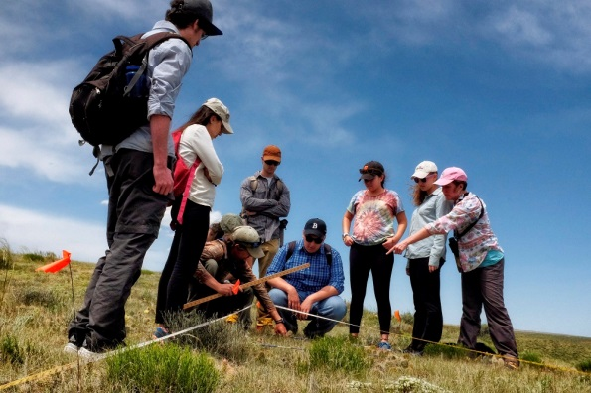

Learn & Experience
NEON
Teaching Modules
Data Skills Workshops
Science Videos
Research Internships
Seasonal Fieldwork
Self-paced Tutorials
47
Notes:
The future workforce in ecology, and many other science, technology, engineering, and mathematics (STEM) disciplines, will need to have robust data skills, whether working to support data collection, handling, curation, sharing, analysis, visualization, or presentation. To support development of data skills and macrosystems ecology research experience,
NEON provides
an intensive summer research internship program targeting undergraduates from traditionally underrepresented groups,
Seasonal field work opportunities for early career scientists,
a suite of online tutorials to learn at your own pace,
Workshop and Data Institutes that provide direct instruction on specific topics and a chance to network with NEON scientists & data users,
science videos that explain important ecological concepts and techniques, and
Classroom teaching modules & curated data sets focused on data skills for using NEON data.

Slide 48

NEON enables a broad user community to do more
Notes:
NEON provides open, continental-scale data that characterize and quantify complex, rapidly changing ecological processes. The Observatory supports greater understanding of ecological change and enables forecasting of future ecological conditions. Researchers at all stages of their careers and across geographic locations can use NEON data to answer pressing research questions. NEON also provides ongoing education & training resources to improve the research experience.

Slide 49
Supplemental/Detail slides

Slide 50


Core & Relocatable Sites
Core Sites
  Wildlands sites
  Representative of domain
  Baseline ecological processes
Relocatable Sites
  Question-drive gradients & comparisons
  Land use change
    Agriculture
    Forest management
    Climate change
    Invasive species
Notes:
Core Sites
a long-term baseline of observation in minimally managed, wildland systems.
primary locations for studies of climate impacts and reference sites for studies of other causes of change and stressors. Site selection:
1) suggested by the scientific community,
2) evaluated by calculating the ecological distance in ecoclimatic space between the centroid of the domain and each potential site.
ensure that the site selected was the one most representative of the domain, based on quantitative comparison.
Relocatable Sites
create question-driven gradient or comparison studies.
Relocatable sites must preserve the “cause and effect” paradigm that is at the heart of NEON. This means that each relocatable site should include the same suite of sampling and monitoring as at the core sites, such as organism collection (terrestrial and aquatic biological measurements), automated measurements (terrestrial and aquatic instrument measurements), and remote sensing (the Airborne Observation Platform).
land use and its effects cannot be studied at the core sites because these are located in wildland areas. As a result, land use is often the first priority for relocatable deployments.
In order to study interactive effects with replication, regional NEON designs also focus on a few land use types across ecoclimatic gradients
Agriculture
Forest management
Climate change
Invasive species
Connectivity: The overarching theoretical question of connectivity is– the linkage of ecological processes across space – is relevant to all of the NEON questions. A number of relocatable deployments should address connectivity, sampling hydrological and atmospheric transport (of dust and air pollution) flowpaths. They should address not only the sources and sinks of materials, but also the way these sources and sinks may change with land use and other disturbances.

Slide 51

Undergraduate research internships
Work with NEON mentors on individualized projects
An 11-week paid summer research internship earning a competitive wage
Round-trip airfare, regional bus pass, and furnished apartments provided at no cost
Applications are due early Feb. each year
www.neonscience.org/research-internships
Notes:
NEON offers a variety of research internships for undergraduates each summer, from helping to design sensor assemblies to testing sampling protocols and analyzing data. Interns work alongside staff mentors; and explore career options in weekly professional development seminars and networking events with interns from other scientific programs based in Boulder, CO. Interns work 40 hours a week and are paid a competitive salary. Airfare and housing are also covered by the program.
Eligibility: Must be able to legally work in the US & must be currently enrolled in a university/college (they cannot graduate in May before the program starts).

Slide 52

Seasonal Field Work
Benefits of becoming a temporary field technician
  Get complete training of protocols and procedures
  Gain experience with wide variety of field ecology protocols
  Live and work in some of the most beautiful places in the nation
  Work alongside other early career ecologists/scientists; get great networking opportunities for your future
Notes:
Each year, NEON hires hundreds of temporary field technicians to assist our full-time field operations staff with observational sampling. NEON field sites are located in 24 states across the U.S plus Puerto Rico; and the sites are located in some of the nation’s most pristine and wild areas. These opportunities are perfect for up-and-coming scientists who want valuable fieldwork experience collecting data for a continental-scale ecology project.
These positions typically run from May to September. Some locations require an early start date and later end date, exact dates vary by location.

Slide 53










Notes:
Alternate slide for diversity of ecosystems that NEON is in or stock photos for sites.

Slide 54
Colocated LTER and NEON sites
LTER | NEON
Andrews | McRae Creek (D16 relocatable aquatic)
Arctic | Toolik (D18 core terrestrial) Oksrukuyik Creek (D18 core aquatic) Toolik Lake (D18 relocatable aquatic)
Bonanza Creek | Caribou Creek – Poker Flats (D19 core terrestrial) Caribou Creek at Poker Flats (D18 core aquatic)
Harvard Forest | Harvard (D01 core terrestrial) Lower Hop Brook (D01 core aquatic)*
Jornada Basin | Jornada LTER (D14 relocatable terrestrial)
Konza Prairie | Konza Prairie Biological Station (D06 core terrestrial) Kings Creek (D06 core aquatic)
Niwot Ridge | Niwot Ridge (D13 core terrestrial) Como Creek (D13 core aquatic)
Notes:
*Hop Brook is on Quabbin Reservoir property, part of the NEON Harvard Forest site and nearby, but not part of the Harvard Forest LTER site.

Slide 55
Colocated LTER & NEON sites
Notes:
Map of colocated LTER & NEON sites.
LTER -> NEON
Andrews - > McRae Creek (D16 relocatable aquatic)
Arctic -> Toolik (D18 core terrestrial)
-> Oksrukuyik Creek (D18 core aquatic)
->Toolik Lake (D18 relocatable aquatic)
Bonanza Creek-> Caribou Creek – Poker Flats (D19 core terrestrial)
->Caribou Creek at Poker Flats (D18 core aquatic)
Harvard Forest->Harvard (D01 core terrestrial)
->Lower Hop Brook (D01 core aquatic)**on Quabbin Reservoir property, part of the NEON Harvard Forest site and nearby, but not part of the Harvard Forest LTER site.
Jornada Basin->Jornada LTER (D14 relocatable terrestrial)
Konza Prairie->Konza Prairie Biological Station (D06 core terrestrial)
-> Kings Creek (D06 core aquatic)
Niwot Ridge ->Niwot Ridge Mountain Research Station (D13 core terrestrial)
-> Como Creek (D13 core aquatic)

Slide 56

Comparison of Met. Station Measurements
Terrestrial site
Aquatic site
Notes:
Meteorological stations are used at both NEON terrestrial and aquatic sites.
Towers at terrestrial sites have instruments at the tower top, along the height of the tower, and near the ground to collect different types of data. The height of towers is determined by the vegetation canopy height at each site.
Meteorological stations at aquatic sites collect similar data.

Slide 57

Terrestrial Field Sites

Slide 58
Aquatic Field Sites – wadable

Slide 59

Aquatic Field Sites - lakes

Slide 60

Soil Array

Slide 61

Niwot Ridge Field Site (NIWO)
Notes:
Provided as an example, non-generalized terrestrial field site.
NIWO is a core terrestrial site within Domain 13 and is co-located with the aquatic site Como Creek (COMO) -- not visible on map. NIWO is also the highest elevation NEON field site.

Slide 62
NEON Advisory Groups
  Science Technology Education Advisory Committee (STEAC)
    Provides high-level strategic advice to NEON, on the planning, construction and operation of NEON Project, Observatory, and other relevant programs
  Technical Working Groups (TWGs)
    Comprise science, education and engineering experts. TWGs provide input to the Observatory’s data collection and processing methods.

Slide 63
2017 Macrosystems Biology Awards
The future of US forest function under changing climate, disturbance, and forest management: Christina Staudhammer, University of Alabama; Gregory Glass, University of Florida; Courtney Schultz, Colorado State University; Paul Stoy, Montana State University
Testing abiotic drivers of activity, abundance, and diversity of ground-dwelling arthropod communities at a continental scale: Michael Kaspari, University of Oklahoma
Causes, consequences, and cross-scale linkages of climate-driven phenological mismatch across three trophic levels: Morgan Tingley, University of Connecticut; Allen Hurlbert, University of North Carolina-Chapel Hill; Leslie Ries, Georgetown University
A multi-scale framework to quantify and forecast population changes and associated uncertainties: Elise Zipkin, Michigan State University; Leslie Ries, Georgetown University
Linking thermal tolerance to invasion dynamics: Climate and physiological capacity as regulators of geographical spread: Kristine Grayson, University of Richmond; Salvatore Agosta, Virginia Commonwealth University; Dylan Parry, State University of New York
Grassroots global network science: a macrosystems model: Kathleen Weathers, Cary Institute of Ecosystem Studies
Improved Understanding of Feedbacks between Ecosystem Phenology and the Weather-Climate Nexus at Local-to-Continental Scales: Andrew Richardson, Northern Arizona University; Steve Frolking, University of New Hampshire; Mark Friedl, Boston University; Toby Ault, Cornell University
Ecosystems in four dimensions: Measuring changes to forest structure and function in the Anthropocene: Kyla Dahlin, Michigan State University
Leveraging NEON data to investigate remote sensing of biodiversity variables and scaling implications: Jessica Mitchell, Appalachian State University
A macrosystems science training program: developing undergraduates' simulation modeling, distributed computing, and collaborative skills: Cayelan Carey, Virginia Tech
Notes:
Full Research Award (FRA), which supports macrosystems biology research or innovative training to conduct such research; Early Career Track (ECA), for early career scientists; and Early NEON Science Track (ENS), which allows for the innovative use of NEON samples and infrastructure.
FRA: The future of US forest function under changing climate, disturbance, and forest management: Christina Staudhammer, University of Alabama; Gregory Glass, University of Florida; Courtney Schultz, Colorado State University; Paul Stoy, Montana State University
FRA: Testing abiotic drivers of activity, abundance, and diversity of ground-dwelling arthropod communities at a continental scale: Michael Kaspari, University of Oklahoma
FRA: Causes, consequences, and cross-scale linkages of climate-driven phenological mismatch across three trophic levels: Morgan Tingley, University of Connecticut; Allen Hurlbert, University of North Carolina-Chapel Hill; Leslie Ries, Georgetown University
ECA: A multi-scale framework to quantify and forecast population changes and associated uncertainties: Elise Zipkin, Michigan State University; Leslie Ries, Georgetown University
ECA: Linking thermal tolerance to invasion dynamics: Climate and physiological capacity as regulators of geographical spread: Kristine Grayson, University of Richmond; Salvatore Agosta, Virginia Commonwealth University; Dylan Parry, State University of New York
FRA: Grassroots global network science: a macrosystems model: Kathleen Weathers, Cary Institute of Ecosystem Studies
FRA: Improved Understanding of Feedbacks between Ecosystem Phenology and the Weather-Climate Nexus at Local-to-Continental Scales: Andrew Richardson, Northern Arizona University; Steve Frolking, University of New Hampshire; Mark Friedl, Boston University; Toby Ault, Cornell University
ECA: Ecosystems in four dimensions: Measuring changes to forest structure and function in the Anthropocene: Kyla Dahlin, Michigan State University
ECA: Leveraging NEON data to investigate remote sensing of biodiversity variables and scaling implications: Jessica Mitchell, Appalachian State University
ECA: A macrosystems science training program: developing undergraduates' simulation modeling, distributed computing, and collaborative skills: Cayelan Carey, Virginia Tech

Slide 64
NEON Technical Working Groups
Airborne Sampling Design Technical Working Group
Aquatic Instrument Technical Working Group
Aquatic Observational Sampling Technical Working Group
Aquatic Technical Working Group
Atmospheric Chemistry Technical Working Group
Biorepository Technical Working Group
Breeding Birds Technical Working Group
Data Standards Technical Working Group
Fish Technical Working Group
Foliar Sampling Technical Working Group
Ground Beetle Technical Working Group
LiDAR Technical Working Group
Microbial Technical Working Group
Mobile Deployment Platform Technical Working Group
Mosquito Technical Working Group
Small Mammals Technical Working Group
Soil Sensor Technical Working Group
Spatial Sampling Technical Working Group
Surface Atmosphere Exchange Technical Working Group
Terrestrial Biogeochemistry Technical Working Group
Terrestrial Instrument Data QA/QC Technical Working Group
Terrestrial Observational Sampling Technical Working Group
Terrestrial Plant Diversity and Phenology Technical Working Group
Terrestrial Plant Productivity and Biomass Technical Working Group
Notes:
http://www.neonscience.org/observatory/advisory-groups
Airborne Sampling Design Technical Working Group
The Airborne Sampling Design Technical Working Group provides expert input and advice regarding the NEON airborne remote sensing flight sampling design and campaign scheduling.
Aquatic Instrument Technical Working Group
The Aquatic Instrument Technical Working Group supports activities related to aquatic instruments and sensors.
Aquatic Observational Sampling Technical Working Group
This Rapid Response group will be utilized if needed to provide recommendations to realize budget constraints related to Aquatic Observation System scope and sampling designs.
Aquatic Technical Working Group
The Aquatic Technical Working Group provides expert knowledge across the fields of Aquatic Ecology, Biogeochemistry and Ecohydrology.
Atmospheric Chemistry Technical Working Group
The Atmospheric Chemistry Technical Working Group provides expert input, insight, experience and advice regarding the senor assembly design, integrated function, critical parts and materials, flow consideration, as well as the field and lab procedures.
Biorepository Technical Working Group
The Biorepository Technical Working Group is comprised of curation, archival and museum collections experts who advise NEON’s procedures and protocols regarding scientific research collections, such as organismal and soil samples.
Breeding Birds Technical Working Group
The Breeding Landbirds Technical Working Group provides expert input and advice regarding the science design and protocols related to NEON breeding landbirds sampling.
Data Standards Technical Working Group
The Data Standards Technical Working Group is tasked with making recommendations to NEON about effective ways to provide NEON's data products to the broader scientific, educational, and policy communities.
Fish Technical Working Group
The Fish Technical Working Group provides expert knowledge and support for the development of field-based protocols and strategies for standardization of sampling across NEON aquatic sites.
Foliar Sampling Technical Working Group
The Foliar Sampling Technical Working Group provides expert input and advice related to sampling sun-lit plant foliage, with the goal of linking field measurements to remotely sensed observations of vegetation chemical and physical properties.
Ground Beetle Technical Working Group
The ground beetle Technical Working Group provides expert input and advice regarding the science design and protocols related to NEON ground beetle sampling.
LiDAR Technical Working Group
The LiDAR Technical Working Group assesses and recommends strategies for developing and implementing techniques for instrument calibration and data validation, operational instrument testing, and product data formatting for vegetation remote sensing.
Microbial Technical Working Group
The Microbial Technical Working Group provides expert input and advice regarding the science design and protocols related to NEON measurements of microbial diversity in terrestrial environments.
Mobile Deployment Platform Technical Working Group
This group supports activities related to the development of Mobile Deployment Platforms by assisting our scientists with sensor integration, optimizing designs for maximum scientific utility, and collaborating on data product and document generation.
Mosquito Technical Working Group
The Mosquito Technical Working Group provides expert input and advice regarding the science design and protocols related to NEON mosquito sampling.
Small Mammals Technical Working Group
The Small Mammal Technical Working Group provides expert input and advice regarding the science design and protocols related to NEON small mammal abundance, diversity and pathogen sampling.
Soil Sensor Technical Working Group
The Soil Technical Working Group supports activities related to soil sensor data collection, such as optimizing sampling designs and providing feedback on algorithms to process the data.
Spatial Sampling Technical Working Group
The Spatial Sampling Technical Working Group provides expert input and advice regarding the spatial sampling design for the NEON Terrestrial Observation System.
Surface Atmosphere Exchange Technical Working Group
The Surface Atmosphere Exchange Technical Working Group recommends, develops and revises data processing techniques that allow (i) testing to which degree these assumptions are fulfilled, and (ii) quantifying residual uncertainty terms
Terrestrial Biogeochemistry Technical Working Group
The Terrestrial Biogeochemistry Technical Working Group provides expert input and advice regarding the science design and protocols related to NEON biogeochemistry sampling.
Terrestrial Instrument Data QA/QC Technical Working Group
The Terrestrial Instrument Data QA/QC Technical Working Group supports activities related to assuring the quality of Terrestrial Instrument data products, as well as presenting quality summaries to the user community.
Terrestrial Observational Sampling Technical Working Group
This Rapid Response group will be utilized if needed to provide recommendations to realize budget constraints related to the Terrestrial Observation System scope and sampling designs.
Terrestrial Plant Diversity and Phenology Technical Working Group
The Terrestrial Plant Diversity and Phenology Technical Working Group provides expert input and advice regarding the science design and protocols related to NEON plant diversity and phenology sampling.
Terrestrial Plant Productivity and Biomass Technical Working Group
The Terrestrial Plant Productivity Technical Working Group provides input into how the NEON Terrestrial Observation System allocates sampling effort for plant biomass, productivity, and leaf area index measurements.

