Slide 1
Data Stewardship Maturity Matrix
-- Update and Future Plans
G. Peng¹, C.Y. Hou², R. Duerr³, R. Downs⁴, M. Austin⁵, N. Ritchey⁶,
D. Kowal⁶, and H. Ramapriyan⁷
¹NOAA’s Cooperative Institute for Climate and Satellites, North Carolina (CICS-NC)
and NOAA’s National Centers for Environmental Information (NCEI);
²University of Illinois at Urbana-Champaign; ³Ronin Institute for Independent Scholarship;
⁴NASA Socioeconomic Data and Applications Center;
⁵NOAA’s National Environmental Satellite, Data, and Information Service;
⁶NOAA’s National Centers for Environmental Information; ⁷Science Systems and Applications, Inc.
8 January 2016 ESIP Winter Meeting

Slide 2
What Is the NCEI/CICS-NC DSMM?
A Unified Framework for
Measuring Stewardship Practices Applied to
Individual Digital Earth Sciences Data Products
(http://www.tinyurl.com/DSMMintro)

Slide 3
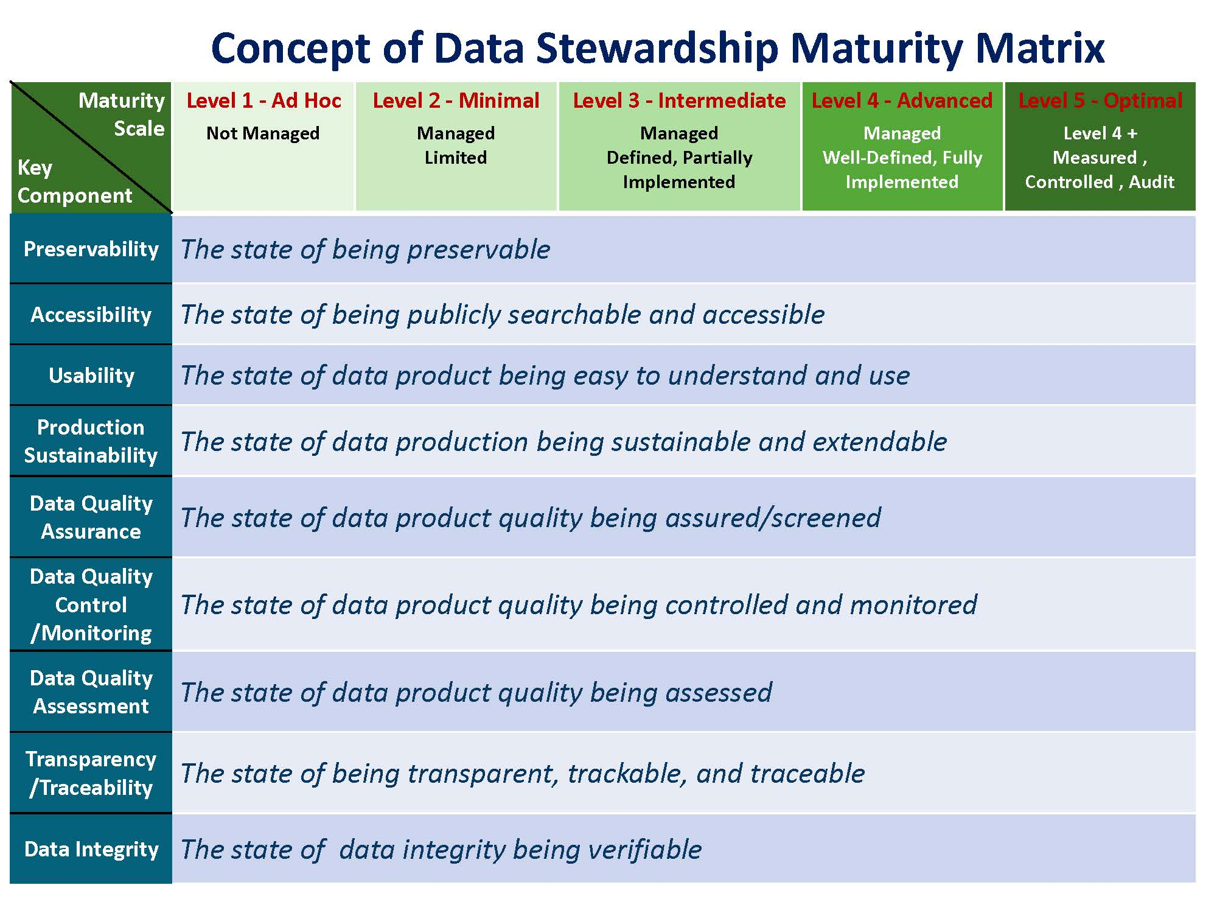
DSMM Defines Measureable, Five-Level Progressive Practices
in Nine Quasi-Independent Key Components
Level 2 -> collection-level searchable and data files on ftp
Level 4 -> verifying checksum at ingest, archive, access (retrieve/stage/disseminate)

Slide 4
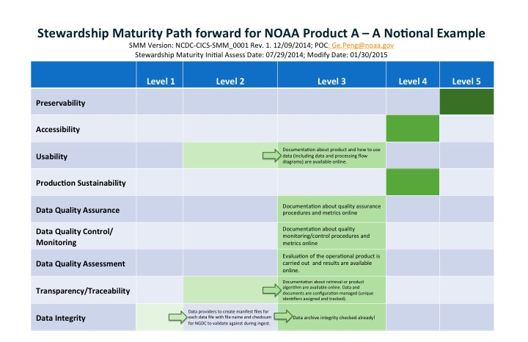
Ways to Utilize DSMM & Assessment Results
To know the current state of your dataset(s) – maturity assessment (stewardship maturity scoreboard)
Need to Be
To know where you want or need to be – stewardship requirements
Current
To know how to get there – roadmap forward (informed, actionable steps)
Stewardship Maturity Scoreboard and Roadmap Forward
A reference model for stewardship planning and resource allocation – informed decision-making support
A consolidate source for information about stewardship practices – assessment with detailed justifications
Context-rich quality metadata for enhanced discoverability and usability

Slide 5
Looking Back - 2015 Activities
ESIP Data Stewardship Committee/Information Quality Cluster DSMM Use Case Studies – Evaluating, improving, and generalizing the utility of DSMM and its self-assessment template
NCAR Global Climate Reanalysis – initial assessment (Sophie Hou)
DataOne Member Node SBC LTER – initial assessment (Sophie Hou)
NSF ACADIS – preliminary assessment; subset (Ruth Duerr and A. Rosati)
NASA Socioeconomic Data – preliminary assessment (Bob Downs)
NOAA’s NCEI Data Stewardship Division/Climate Data Record Program DSMM Use Case Studies – Ensuring consistent application to & establishing baselines for various data types of NCEI core datasets
NOAA/NSIDC Sea Ice Concentration CDR – baselined (G. Peng and D. Scott)
NCEI Global Historical Climatology Monthly (GHCN-M) – baselined (G. Peng and IPT members)
NCEI Digital Elevation Models – initial assessment (D. Kowal and G. Peng)
Global Local Climatological Data – preliminary assessment (Jason Cooper)

Slide 6
2015 Activities – Cont.
NOAA Data Stewardship Division & NESDIS Content-Rich Quality Information Integration – enhancing discoverability and decision-making support
Asset and Investment Portfolio Management Tool – initial exploration (M. Austin and G. Peng)
NCEI Collection-Level Metadata and NOAA Catalog – initial exploration (G. Peng, P. Jones, Jeff DLB, and M. Austin )
Graph Database – initial exploration (G. Peng and J. Biard)

Slide 7
2015 Outcomes
Break-out session in the 2015 summer ESIP meeting on DSMM use case study
One talk and two posters at the AGU 2015 Fall meeting
One presentation to stakeholders on the results and lessons learned from the NCEI GHCN-M DSMM use case study
One paper in draft form on defining roles and responsibilities of stewards

Slide 8
Looking Forward - 2016 Activities
ESIP Data Stewardship Committee/Information Quality Cluster DSMM Use Case Studies
Continue the existing use case studies; baseline stewardship ratings
Evaluate completeness, appropriateness, and usefulness of DSMM
Start new case studies? (e.g., another DataOne Member node LTER site (Dan Henshaw); Borehole data (Anu Devaraju), ..etc.)
NOAA’s NCEI Data Stewardship Division/Climate Data Record Program DSMM Use Case Studies
Continue to assess stewardship maturity of NCEI core datasets; baseline the ratings
Evaluate completeness, appropriateness, and usefulness of DSMM

Slide 9
2016 Activities – Cont.
NOAA OneStop Project, NESDIS, and ESIP Information Quality Cluster: Content-Rich Quality Information Integration
Continue to explore or make progress
User Feedback Tool – initial exploration (A. Devaraju and G. Peng)
Papers
Submit the roles and responsibilities paper to a peer-reviewed journal (Peng et al.)
Start on the paper of lessons learned based on ESIP DSMM Use case studies (Hou et al.?)

Slide 10
Acknowledgement
Members of the Integration Product Teams and Product Stewards have participated or provided information necessary for data stewardship maturity assessments. Feedbacks on interoperability of stewardship maturity rating metadata are beneficial.
Special THANKS goes to
Matthew Mayernik, NCAR,
Antonia Rosati, NSIDC,
Grace Peng, NCAR,
Margaret O’Brien, UCSB,
Donna Scott, NSIDC,
Christina Lief, NCEI,
Jay Lawrimore, NCEI,
Valerie Toner, ERT, Inc./NCEI,
Richard Baldwin, NCEI,
Philip Jones, STG, Inc./NCEI,
Jim Biard, CICS-NC/NCEI,
Jeff DLB, NOAA

