Slide 1
Why Create a Data Management Plan?
Section: Data Management Plans
Ruth Duerr
National Snow and Ice Data Center
Version 1.0
Review Date
Notes:
This training module is part of the ESIP Federation's Data Management Course for Scientists. The subject of this module is Data Management Plans: Why Create a Data Management Plan. The module was authored by Ruth Duerr from the National Snow and Ice Data Center at the University of Colorado in Boulder. Besides the Earth Science Information Partners (ESIP) Federation, sponsors of this Data Management Course are the Data Conservancy and the United States National Oceanographic and Atmospheric Administration, NOAA.

Slide 2
Outline
Data Management Plans: Why Do a Data Management Plan?; Version 1.0, Reviewed September 2012
What is a Data Management Plan?
The top 3 reasons why you should create one:
To make your research easier and cheaper
To enhance your reputation
Because many funding agencies require it
Notes:
Here is a brief outline of what I plan to talk about. First, I’ll very briefly review what a Data Management Plan is, followed by a discussion of my top three reasons for creating a data management plan. These are first, that proper data management planning actually should make your work easier and possibly even cheaper than if you had handled your data in an ad-hoc fashion throughout your project. Second, properly handling your data, documenting it well, etc. can actually improve your standing with your users and most importantly your colleagues, and last and in my mind least, because your funding agency says that you have to.
Hopefully, by the end of this module you will have been convinced that while funding agency requirements may be the stick making you create data management plans now, actually it has been in your own best interest all along.

Slide 3
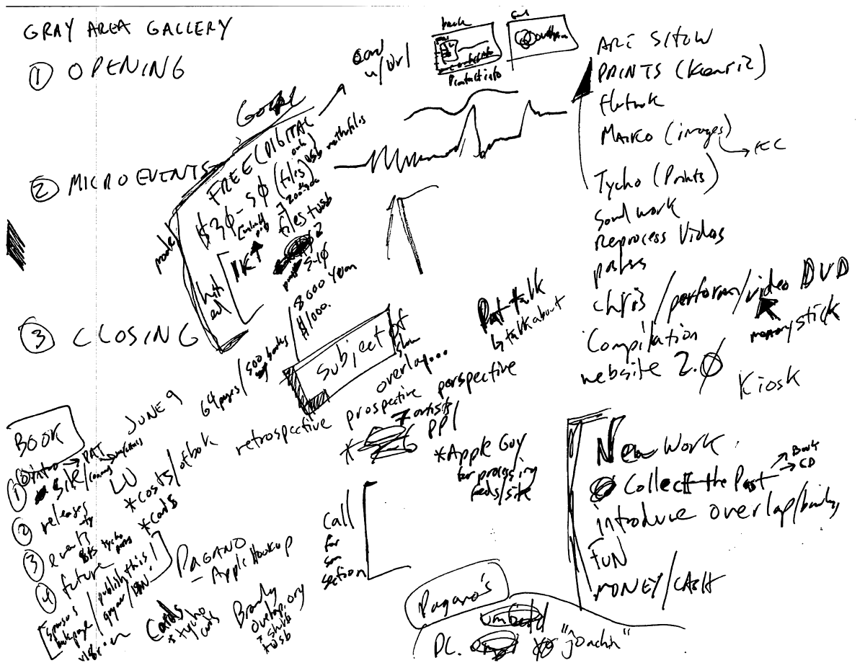
What is a Data Management Plan?
Data Management Plans: Why Do a Data Management Plan?; Version 1.0, Reviewed September 2012
A document describing what you are going to do with your data both during your project and after it is over
Image by Jon Phillips, Open Clip Art Library 3/29/2010
Notes:
So, what is a Data Management Plan? Simply a document describing what you are going to do with your data both during your project and after the project is over. Hopefully a document that is a bit more legible than the plan illustrated here.
Like any planning activity the important thing to remember is that plans can and should change over the course of a project as the situation changes. A data management plan that exists solely at the time a proposal is written and is never updated thereafter, will probably be worthless. It certainly is unlikely to reflect reality.

Slide 4
Making Your Research Easier and Cheaper
Data Management Plans: Why Do a Data Management Plan?; Version 1.0, Reviewed September 2012
The 5 P’s matter!
Prior Planning Prevents Poor Performance!
Notes:
So onto convincing you that data management planning will make your research easier and cheaper. But first, have you ever heard of the 5 P’s? Perhaps you’ve heard of them as the 6 P’s or maybe 7? Well, as in any large project whether building a house, preparing for an extensive field campaign or nearly any kind of complex or time-consuming activity, the 5 P’s matter! Simply put Prior Planning Prevents Poor Performance!

Slide 5
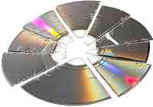
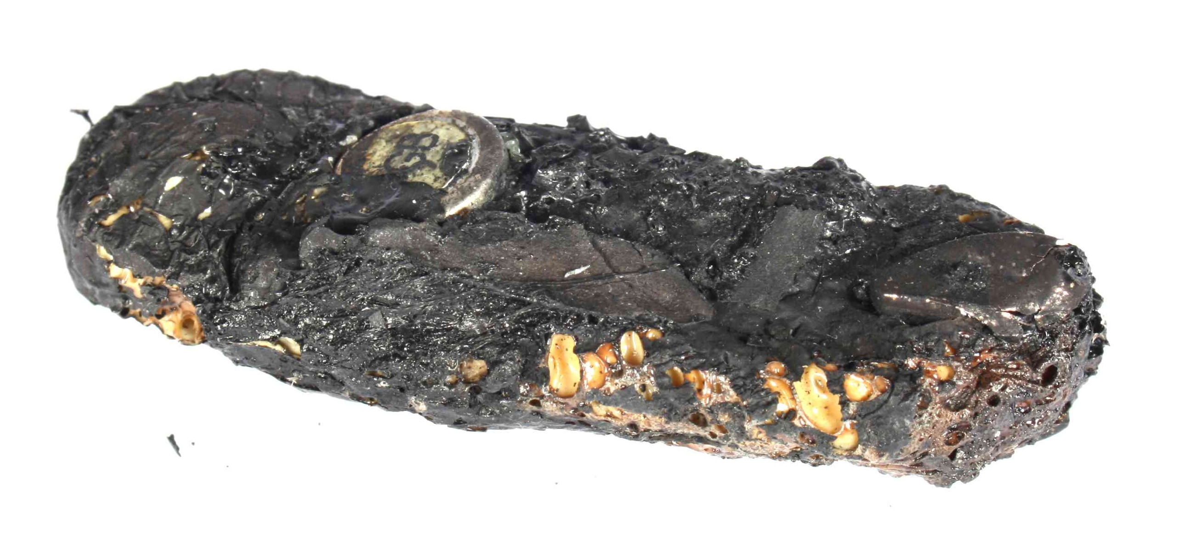
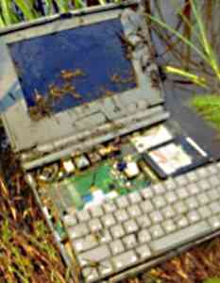
Making Your Research Easier and Cheaper
Data Management Plans: Why Do a Data Management Plan?; Version 1.0, Reviewed September 2012
Accidents do happen!
Notes:
Accidents do happen;
CD’s and DVD’s really can get broken
Fire, floods, earthquakes, hurricanes or other natural disasters really can destroy your memory sticks or other hardware
You really might drop that laptop on a field trip (in this case into a swamp)
And who hasn’t had their personal computer decide to fry itself often for no apparent reason?
What would the impact of an event like this be on your project?
Yes, there are companies out there making good money recovering data from situations like these; but they aren’t cheap and they can’t always recover everything; but if you’ve thought about data protection in advance, thought about having multiple copies of your data on multiple kinds of media in multiple places so that no single event can destroy your work, none of this has to be a tragedy.

Slide 6
Don't you think it would be more efficient
Data Management Plans: Why Do a Data Management Plan?; Version 1.0, Reviewed September 2012
If you didn't have to remember
the name of that file?
and the directory where you put it?
the units those measurements were taken in?
which sample site was which?
etc.
Notes:
Also, on the topic of efficiency… don’t you think it would be more efficient if you didn’t have to remember:
The name of that file, the one that had the correct calibration details, the one you based your conclusions on?
If you didn’t have to remember exactly where you put it?
And what units those measurements were in?
Or which sample site was which?
Or any of the myriad of details needed to really understand the meaning of your data?

Slide 7
Making Your Research Easier and Cheaper
Data Management Plans: Why Do a Data Management Plan?; Version 1.0, Reviewed September 2012
Write it down!
Notes:
Do you have a perfect memory? I don’t. Even if I remember something extremely well today, I know that odds are in a few years I am not likely to remember the details of whatever project I was working on way back then. But you probably are going to want to use and understand your data for many years. Soo… if it is important, plan to…

Slide 8
Poor data practice results in loss of information
Data Management Plans: Why Do a Data Management Plan?; Version 1.0, Reviewed September 2012
Time of publication
Specific details
General details
Retirement or
career change
Information Content
Accident
Death
Time
(Michener et al. 1997)
Notes:
This diagram comes from a paper by Bill Michener 15 years or so ago. It talks about how during the course of a project the time at which the most information is known and understood about a project’s data is right at the time of publication and then slowly or more rapidly due to time and life events, what you know about the data declines eventually to zero.
Well I submit, that the same diagram holds true for details about any proposed project. You will have spent considerable time and energy thinking through the details when writing your proposal. Doesn’t it just make sense to document those details thoroughly when writing your proposal? If you had, you wouldn’t have to reinvent all of those details when the proposal is actually funded.

Slide 9
Enhancing Your Reputation
Data Management Plans: Why Do a Data Management Plan?; Version 1.0, Reviewed September 2012
Sloppy, unorganized and undocumented data is hard to share
What does sloppy, unorganized, and not well documented data say about the rest of your work?
What if you get hit by a bus?
Your data may well be your most important legacy!
Notes:
On to the second reason why data management planning is in your best interests.
Enhancing your reputation:
These days there are increasing calls for you to share your data. Many arguments for this are used – ranging from ethical arguments about publicly funded research needing to be available to those who funded it; to studies which have shown economic benefits of open data; to arguments about the scientific process itself. Yet sloppy, unorganized and undocumented data is hard to share. Either you are going to have to answer lots of questions by any user or the number of users will be small and then there is always the risk of misuse. Whereas well documented, clean and organized data may lead to new collaborations and funding opportunities.
Also, what are people going to think about the rest of your work if your data is a mess? Is that good for your reputation?
Lastly, what if you get hit by a bus? Particularly in the Earth sciences where data lost is often impossible to recreate, your data may well be your most important legacy!

Slide 10
Many funding agencies require data management plans
Data Management Plans: Why Do a Data Management Plan?; Version 1.0, Reviewed September 2012
NSF now requires a two page data management plan submitted with every proposal
NASA Earth Sciences requires a data management plan for its Earth science missions, projects, grants and cooperative agreements.
NOAA and USGS also require data management plans.
NIH requires that projects with budgets greater than $500k/yr include a data sharing plan in their proposals.
Notes:
But if neither of those two arguments have convinced you, the last main reason for creating data management plans is that many if not all funding agencies now require them:
You probably have heard that NSF requires a 2 page data management plan with every proposal and that their FastLane system won’t even accept a proposal without one; but
You may not be aware that NASA, NOAA, and USGS all require data management plans for their grant funded work; and
Even NIH requires that large projects produce a data sharing plan
Hopefully I’ve convinced you that data management planning can save you time and money and enhance your reputation in your field. If not, well odds are your are going to have to do it anyway as most funding agencies require it.

Slide 11
References
Data Management Plans: Why Do a Data Management Plan?; Version 1.0, Reviewed September 2012
Michener, W.K., Brunt, J.W., Helly, J.J., Kirchner, T.B. and S. G. Stafford. 1997. “Nongeospatial metadata for the ecological sciences.” Ecological Applications 7(1):330-342.
Notes:
If you are interested in reading that paper by Bill Michener, here is its reference

Slide 12
Resources
Data Management Plans: Why Do a Data Management Plan?; Version 1.0, Reviewed September 2012
NSF Guidance: http://www.nsf.gov/bfa/dias/policy/dmp.jsp
NASA Data Policy: http://science1.nasa.gov/earth-science/earth-science-data/data-information-policy/
NOAA Administrative Order 212-15: http://www.corporateservices.noaa.gov/ames/administrative_orders/chapter_212/212-15.html
USGS National Climate Change and Wildlife Science Center guidance: https://nccwsc.usgs.gov/?q=content/data-policies-and-guidance
NIH Data Sharing Policy and Implementation Guidance: http://grants1.nih.gov/grants/policy/data_sharing/data_sharing_guidance.htm
Notes:
I’ve included links to data management planning guidance by each of the agencies I mentioned earlier on this slide.

Slide 13
Other Relevant Modules
Data Management Plans: Why Do a Data Management Plan?; Version 1.0, Reviewed September 2012
For more details on why Data Management is important, see any of the modules in The Case for Data Stewardship section
For information on how to create a Data Management Plan see the other the modules in the Data Management Plans section:
Elements of a Data management Plan
Identify materials to be created
Organization and standards
Roles and responsibilities
Data access, sharing, and re-use policies
Backups, archives, and preservation strategy

