Slide 1





Data Management 101 for Earth Scientists
Metadata for your Data
Nancy J. Hoebelheinrich
Notes:
Modules should be 3-7 minutes long

Slide 2
Roadmap
Definition of Metadata
Relevance to Data Management
Distinction b/w Metadata and Documentation
Metadata Types & Functions
Best Practices for Metadata Creation

Slide 3
Definition of Metadata
Information to let you & others find, understand, use and archive your data
  descriptions
  descriptors aka keywords
  documentation
Notes:
Provide some background on metadata before getting into the main part of the presentation.

Slide 4
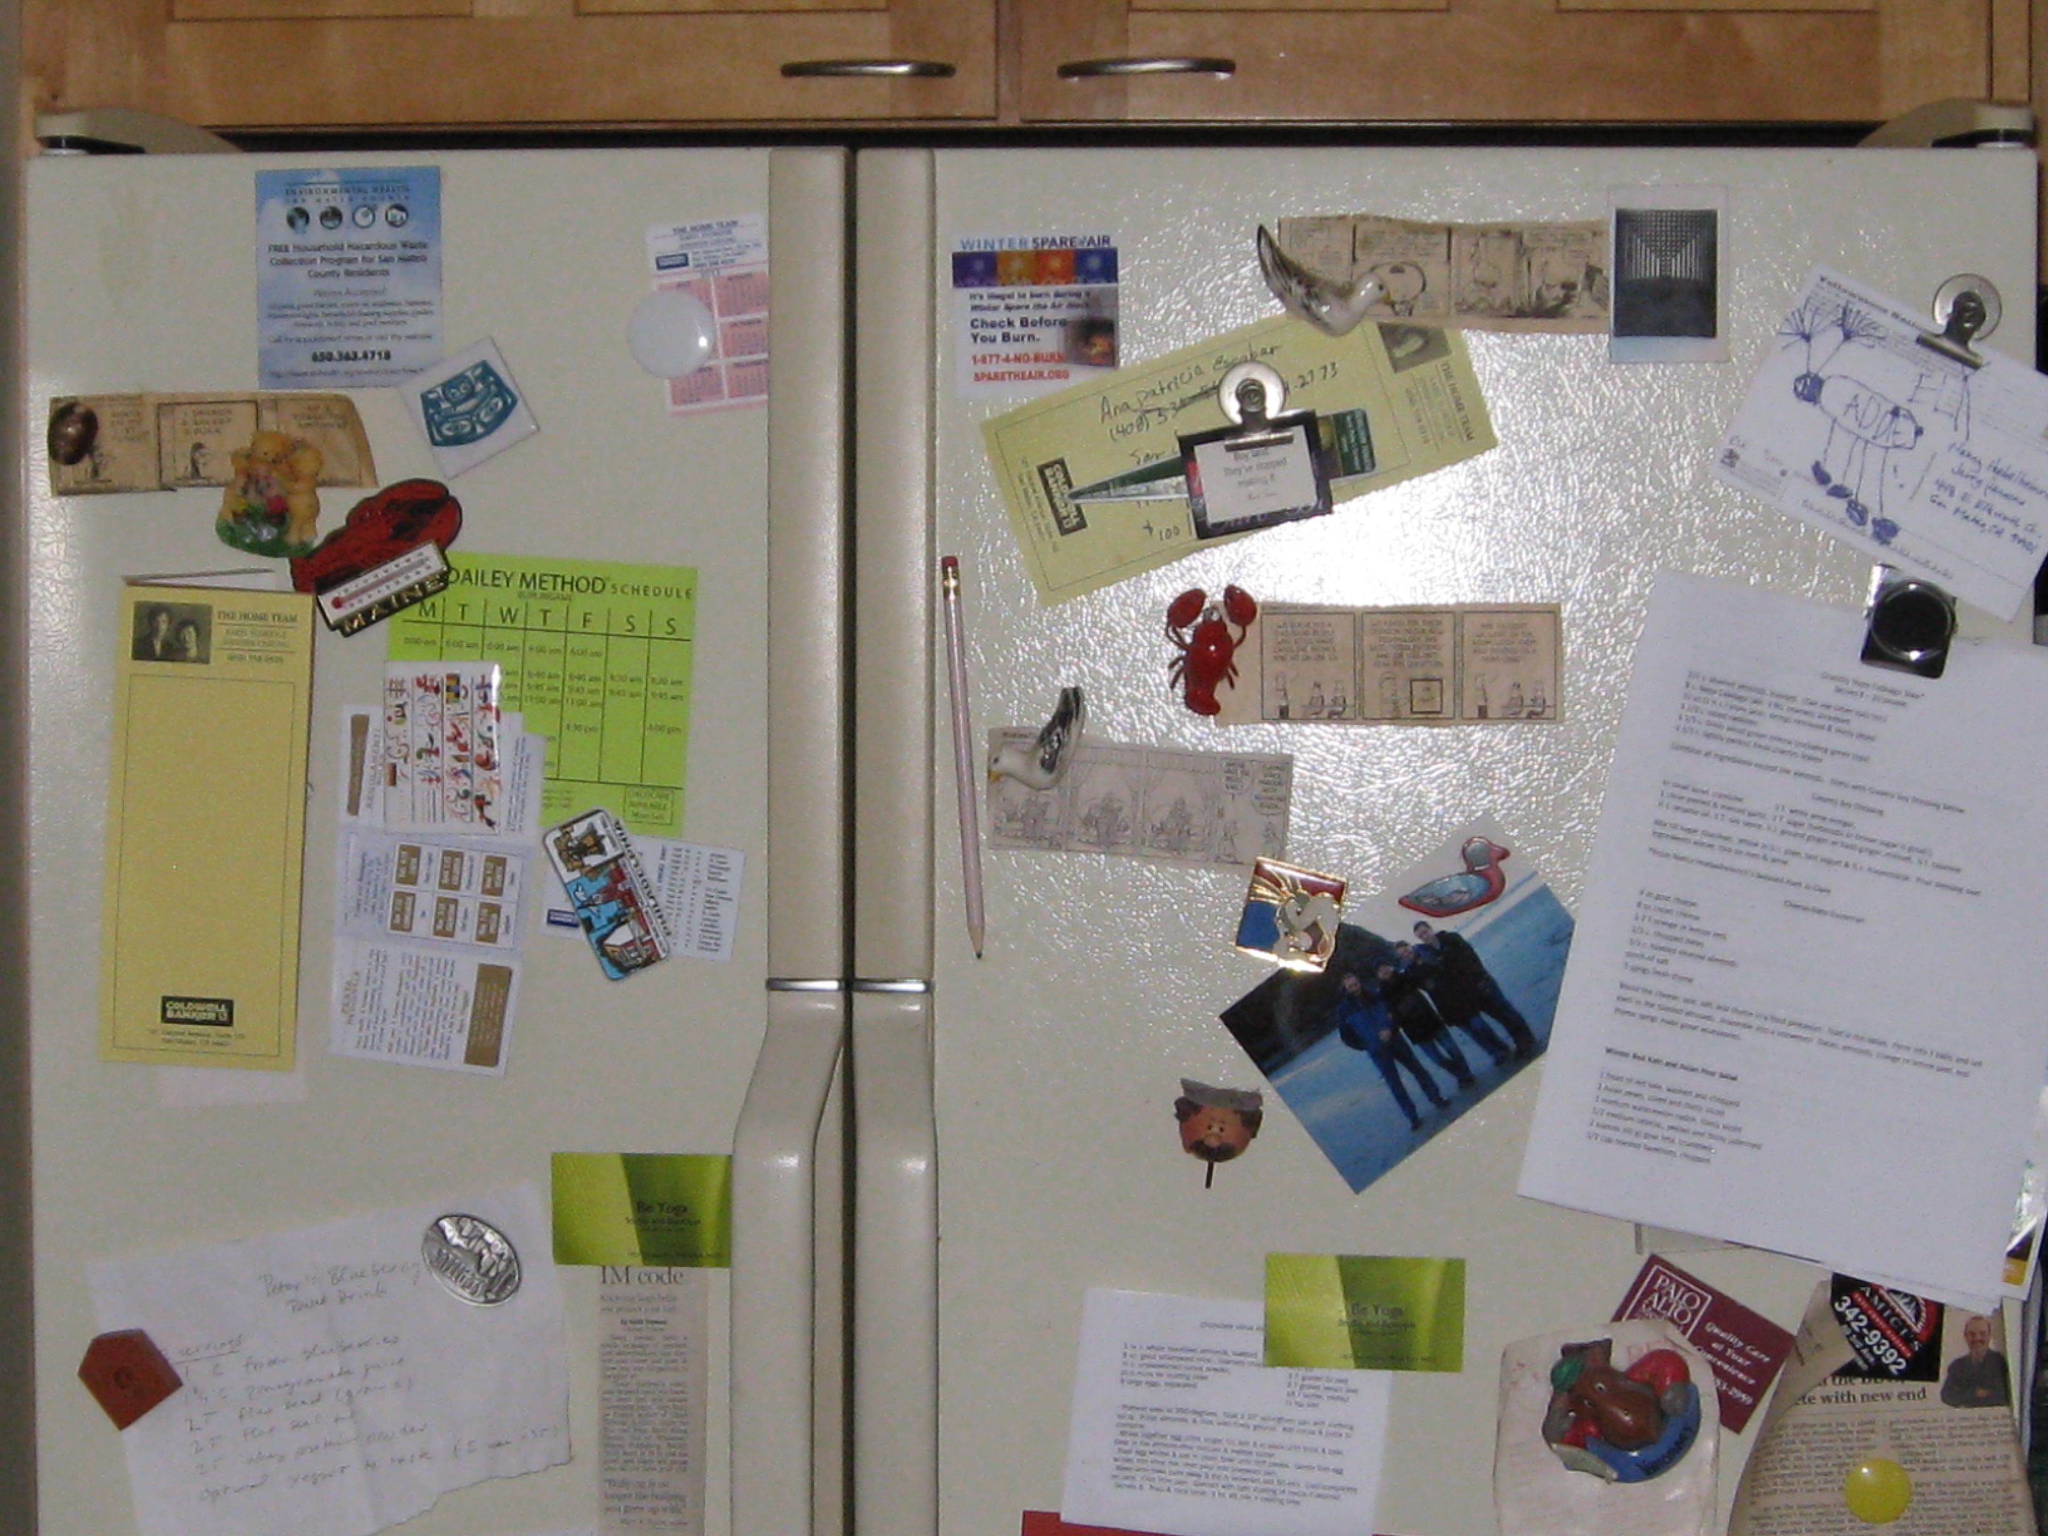
Relevance to Data Management
Documentation for My Latest Research Project
To Data Manager:
Don’t worry, the connections are all there [– in my head!]

Slide 5
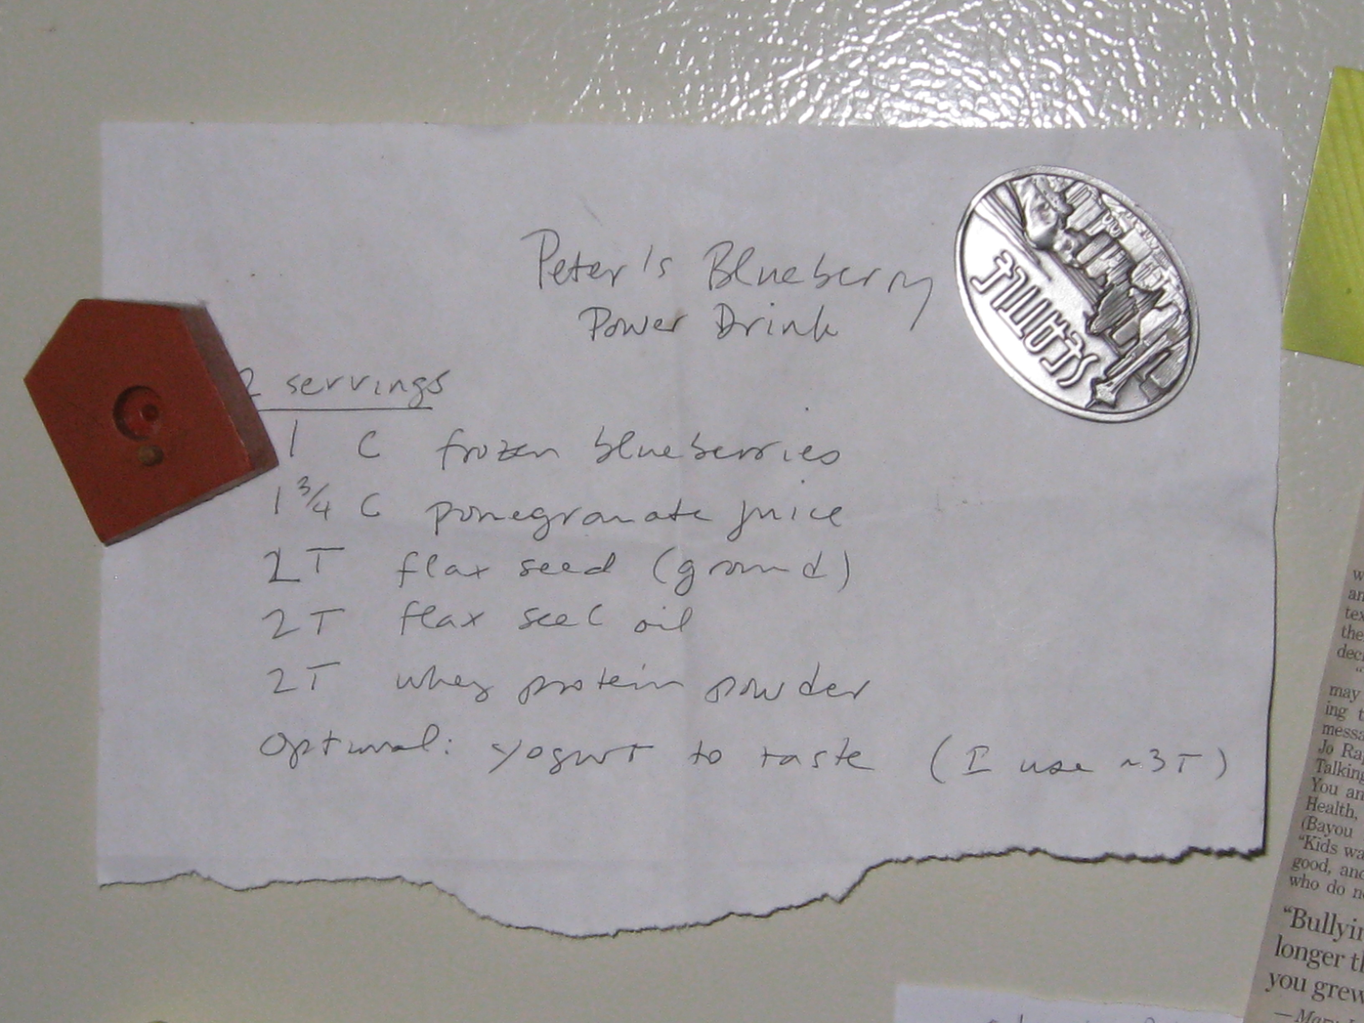
Relevance to Data Management
Documentation for My Latest Research Project
To Data Manager:
See, here’s the primary algorithm I used…oops, where’s the process?

Slide 6
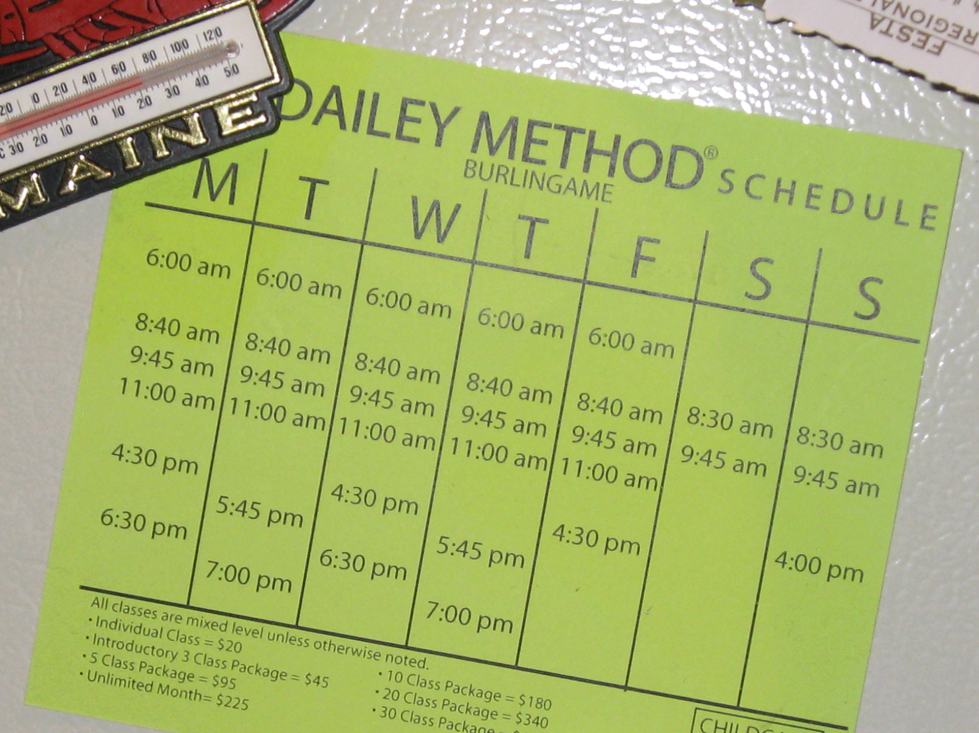
Relevance to Data Management
Documentation for My Latest Research Project
To Data Manager:
Here’s the schedule we used to gather the data – although some months it was a little different…

Slide 7
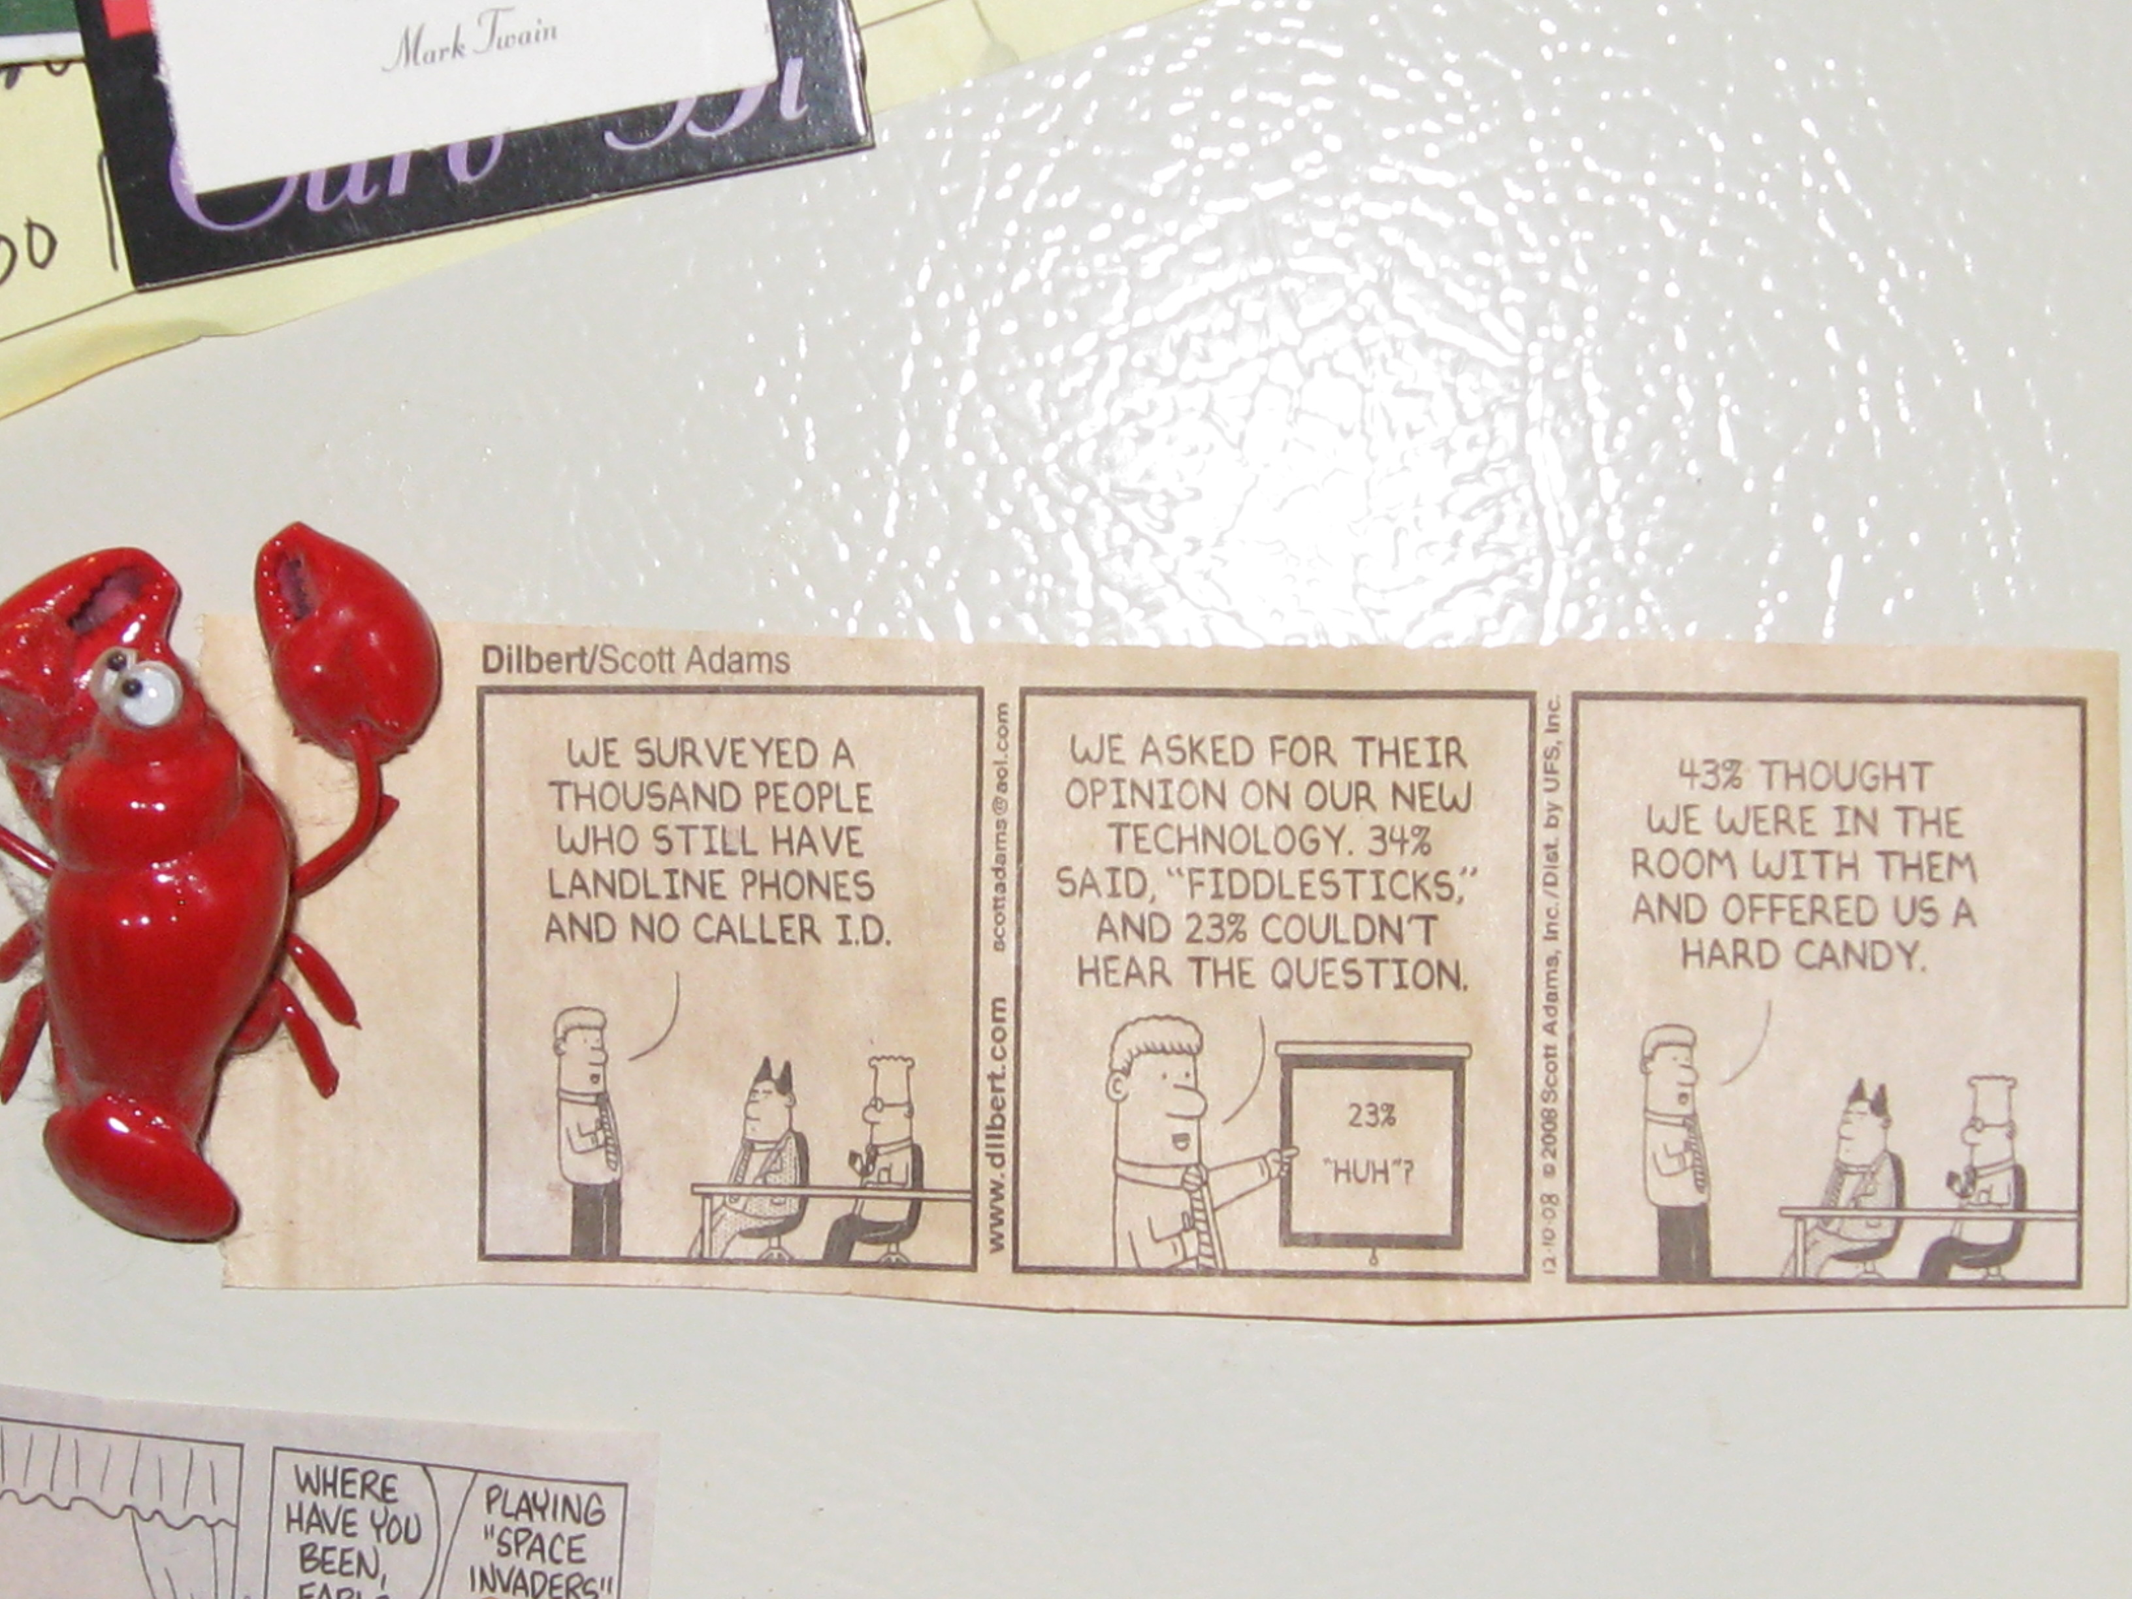
Relevance to Data Management
Documentation for My Latest Research Project
To Data Manager:
Here’s the research methodology we used – more or less…

Slide 8
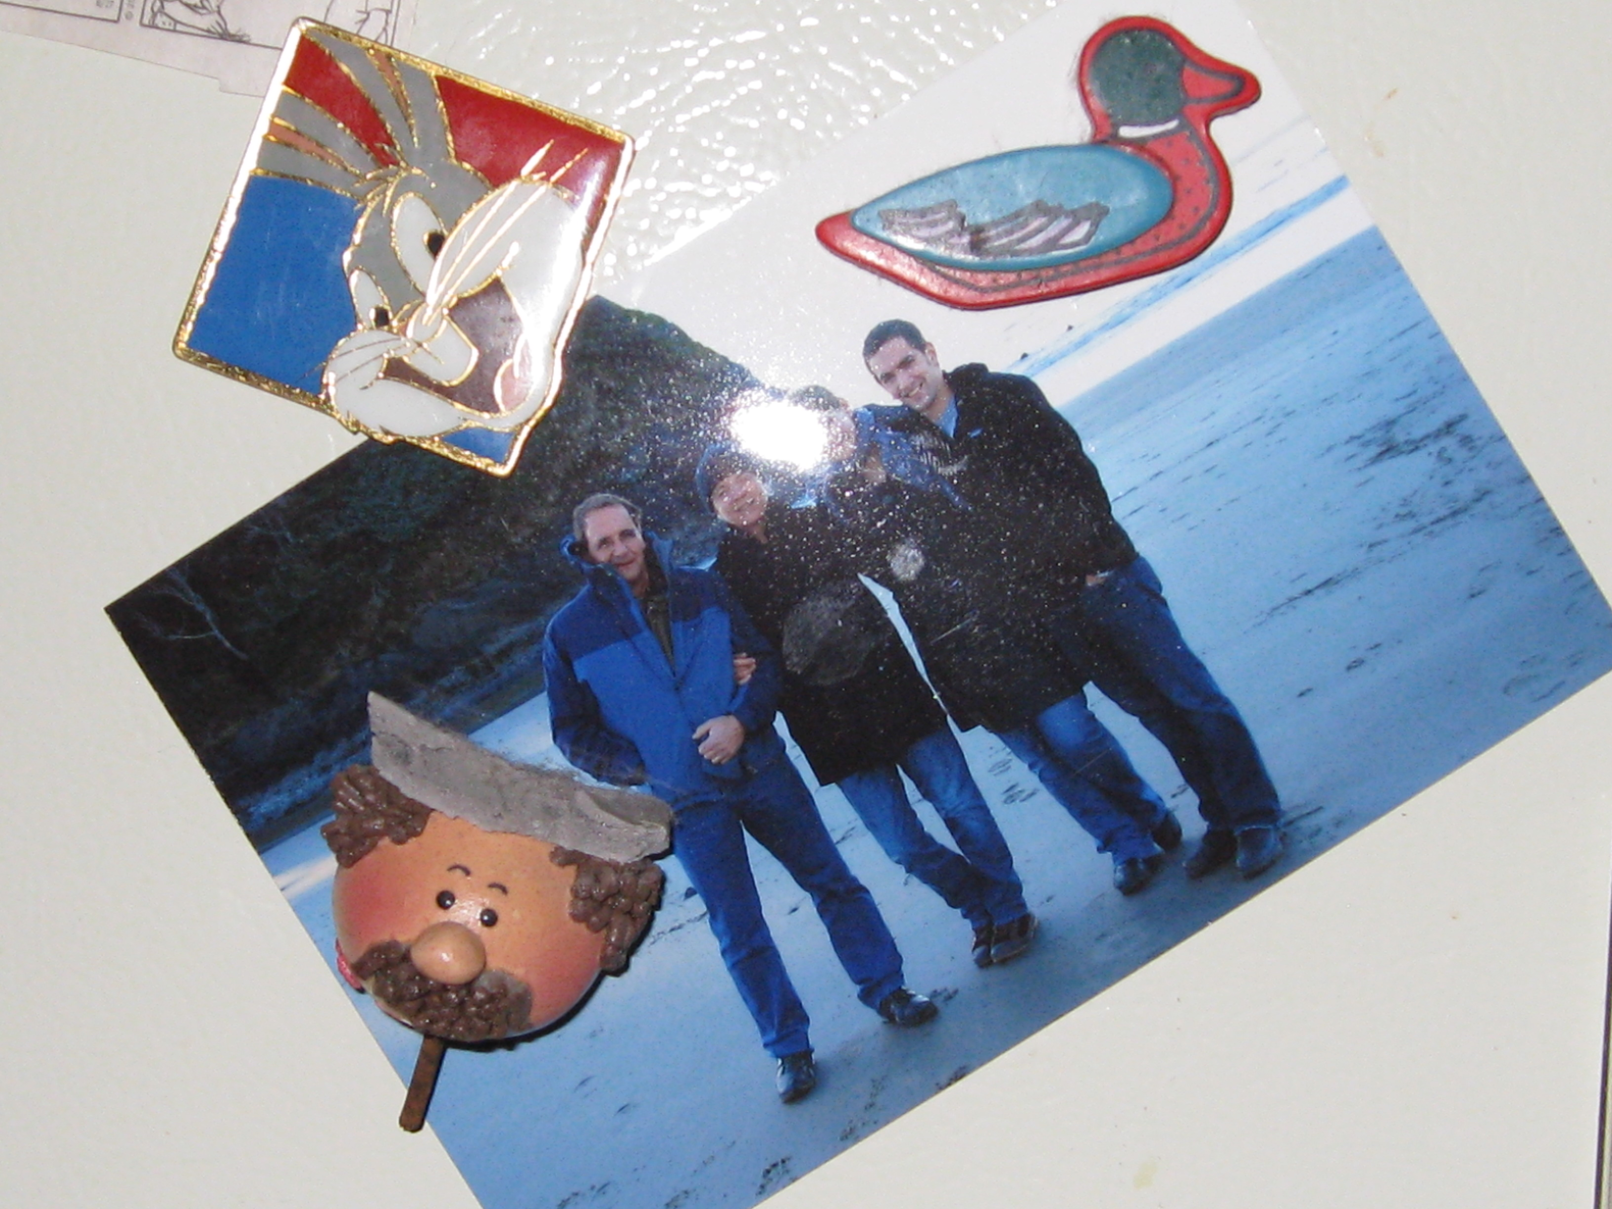
Relevance to Data Management
Documentation for My Latest Research Project
To Data Manager:
Oh, and here’s the team – our PI wasn’t there for the photo, so his placeholder is the guy with the mustache on the stick… And the project manager has the long ears…what was her name???

Slide 9
You get the idea … so, what’s needed?
Negotiated b/w you & your team (data producers), data developers and the data archive
Created / collected as part of workflows associated with lifecycle of the data
Based on key questions, e.g., :
  How will I and others find my data?
  What will future scientists need to know to understand and re-use the data?
  What will data (product) developers need to create data services and products that use my data?
  What does the data archive team need from the data producer team (as the ones who know the data best) in order to preserve it for the long term?

Slide 10
The 20-Year Rule (NRC 1991)
The metadata accompanying a data set should be written for a user 20 years into the future--what does that investigator need to know to use the data?
Prepare the data and metadata / documentation for a user who is unfamiliar with the details of your project, methods, and observations
  In short: the WHO, WHAT, WHEN, WHERE, HOW, WHY about your data

Slide 11
Distinction b/w “metadata” & “documentation”
Metadata:
  Question & Answer Game
  Using standards (other people’s questions based on community agreement),
    the data archive asks you & your project team questions
    you & your project team (try to) answer them as best you can
Documentation:
  Sometimes called “content” specifications
  Addresses key question of what
  Representation will change from discipline to discipline and project to project (i.e., what form the documentation will take)
There may be overlap b/w these two depending upon who is speaking

Slide 12
How can I (the scientist) help?
Besides me, who’s going to care?
  Sponsor mandates to archive
  Specific requirements from sponsor
    e.g., NASA, NOAA, USGS
  Data archive requirements & desirements
    Negotiated & documented in Submission Information Package (OAIS SIP)
  Future scientists who want to use/re-use your data!!
What kind of metadata & documentation should be kept?
  Look for existing formulae for decisionmaking, e.g.,
    NOAA National Climatic Data Center’s Climate Data Record Maturity Matrix; factors include software readiness, existence / state of metadata & (other) documentation, utility of data, validity of product (based on certainty estimates), desire for / restrictions upon public access
Framework Questions:

Slide 13
Specific ?’s from different perspectives:
When submitting data:
Why was the data was created?
What limitations, if any, do the data have?
What does the data mean?
Who should be cited if someone publishes something that utilized your data?
When receiving data:
What are the data gaps?
What processes were used for creating the current data?
Are there any fees associated with the data?
In what scale were the data created?
What do the values in the tables mean?
What software do I need in order to read the data?
What projection is the data in?
Can I give this data to someone else?

Slide 14



Metadata Types and Functions
Provenance & Context
Physical & conceptual environment needed to understand data
  Important for use & re-use
Discovery including:
  Citation to enable proper credit, authority & identification
  Access & use restrictions
Preservation / Archiving
  Facilitating utility of data over time
Project Documentation
  Accumulation of important facts, guidelines, explanations about the project

Slide 15
Provenance & Context
“Don’t touch that! You don’t know where it’s been.”
In law, the chain of custody follows a piece of evidence from collection through presentation and helps document its authenticity and reliability
For the user community to confidently determine the suitability of your data for specific applications, you must adequately describe “where” it has been.

Slide 16
More about Provenance & Context
Part of the WHO, WHAT, WHEN, WHERE, WHY and HOW details that apply to your data during its lifecycle –
  from collection
  through processing
  to final analysis
Comparing & combining data
Citing sources
Identifying what’s needed to understand your data
Process steps
When & how to document
Discipline specific example

Slide 17
Comparing and combining data
Purposes:
  When selecting amongst available data, the user must determine which data sets most closely align with the intended purpose
  Understanding the reason data were collected in the first place lends insight into possible biases
Advantages to combining data sets and tools from heterogeneous sources:
  expands coverage
  extends content
  provides validity checks

Slide 18
Why cite data sources?
Simply using existing data from an archive or portal does not guarantee repeatable results.
  Data may be updated or corrected
  Issues with data delivery systems could affect the data received
To ensure your results are repeatable, or that potential differences are accounted for, it’s best to cite not only the source and its accompanying metadata record, but also
  The dataset version or similar designator
  The specific date(s) on which you acquired the data
  The specific URL, request process or other method(s) through which you acquired the data
  Any special subsetting logic or cross-reference information used to restrict the data received

Slide 19
What’s needed to Understand my data?
The details of the data ….
Parameter
name
Measurement
date
Sample ID
location
Notes:
An investigator and their team need only a small amount of metadata. They know that the steamwater sample was collected at the weir near the orchard and was analyzed by the ion chromatograph in Room 220. But for others outside the team, more information is needed.

Slide 20
Down to the nitty-gritty?
units
method
Parameter def.
lab
field
Method def.
Units def.
method
parameter
name
Units
media
date
words, words.
QA def.
QA
flag
Measurement
Record
system
records
generator
date
sample
ID
location
org.type
name
custodian
address, etc.
coord.
elev. type
depth
GIS
Sample def.
type
date
location
generator
20
Notes:
To share the data more broadly more information is needed:
analytical method, uncertainty, and units
Geocoordinates, elevation, datum

Slide 21
Why describe process steps?
Each time data are transformed, unintentional changes may also be introduced
Documenting each processing step helps isolate changes and the potential for errors
Such documentation may be general, or quite specific. More detail is usually better than less, so when in doubt, spell it out.
If standard algorithms, libraries or other tools are used, they should be clearly referenced. In the case of libraries, GIS shape files and the like, be sure to document the source, version and date

Slide 22
Where and how to document
Standards-based metadata records (ISO 19115-2, FGDC, and others) include areas in which various aspects of provenance and lineage may be documented, including
  Data Quality
  Source
  Process steps
  External citations and references
Do not let a lack of familiarity with standards put you off!
  It is relatively easy to get assistance in creating standards-based metadata records from a comprehensive set of details captured during your research
  It is very difficult to recreate details that were not recorded fully

Slide 23
Provenance & Context
A Discipline Specific Example
Preflight/Pre-Operations Calibration
- 3.1.2 Preflight/Pre-operational Calibration Data
  Item Description: Numeric (digital data) files of Instrument/sensor characteristics
    including pre-flight or pre-operational performance measurements (e.g., spectral response, instrument geometric calibration (geo-location offsets), noise characteristics, etc.).
  Rationale: Measurements made before deploying instruments in space (or in situ) will help establish a baseline

Slide 24
Provenance & Context
A Discipline Specific Example
NASA Earth Science Data Preservation Content Specification (published Nov 2011)
  Focused upon earth science data resulting from NASA’s missions
  Includes reference to a separate Metadata Requirements document for NASA Earth Science data products
  Categorizes content into 8 areas:
    Preflight/Pre-Operations Calibration, Science Data Products, Science Data Product Documentation, Mission Data Calibration, Science Data Product Software, Science Data Product Algorithm Input, Science Data Product Validation & Science Data Software Tools
    Describes rationale for each, see example

Slide 25
Discovery & Citation Metadata
Why is it needed?
  To convey to the user the nature and content of the data
  To help the user determine if a particular data set meets the users’ needs
  To provide the information necessary to create a citation for the data set
  Used to “feed” data catalogs / libraries, information portals, citation systems
  Can be used to describe or trigger restriction on access to data, and on use of the data
What is it?
  Descriptive information that provides essential information to meet the key first question (primarily, finding)
    Can be applied at / describe different levels, i.e., “collection”, data set, and item level
    Will usually contain less information than other types of metadata (i.e. use metadata, granule metadata)
    Contains a set of quantitative and/or qualitative measurements and distinguishes that set from other similar measurement sets
    Should use a controlled keyword vocabulary to provide normalized discovery of data (expressed in various ways, e.g., thesauri, ontologies, etc.)

Slide 26
Categories of Discovery Level
Metadata
What: Title of Data Set and Keywords Describing the Data Set
Why: Description and Purpose of the Data Set
When: Temporal Coverage of the Data Set
Who: Data Set Creator and Contact
Where: Geographic Extent and Location of Data Set Coverage
How: How the Data Set was Created and How to Access the Data

Slide 27
What does a metadata record look like?
Human readable, e.g., as result from your favorite search tool (full record example of following screen shot at: http://mercury.ornl.gov/ornldaac/send/xsltText2;jsessionid=477B8A0DB8D7F17CBFFCD04CB0FB528F?fileURL=d%3A\mercury_instances\ornldaac\daac\harvested\record810.xml&full_datasource=DAAC+Datasets&full_queryString=+text+%3A+randerson+AND+%28+datasource+%3A%28+daac+daac++%29+%29+&ds_id=849)
Machine readable: behind the scenes
  As Text
  As HTML
  As XML

Slide 28
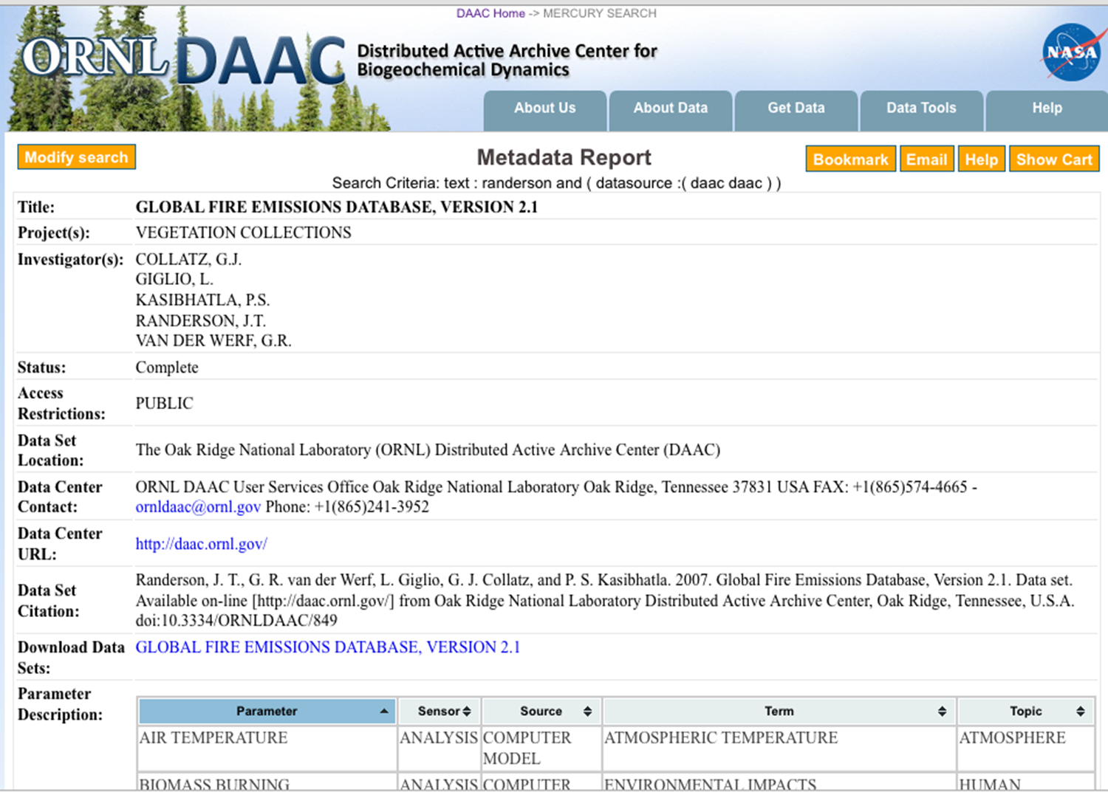
Human readable:
A Sample Search Result
DAAC-recommended Citation

Slide 29
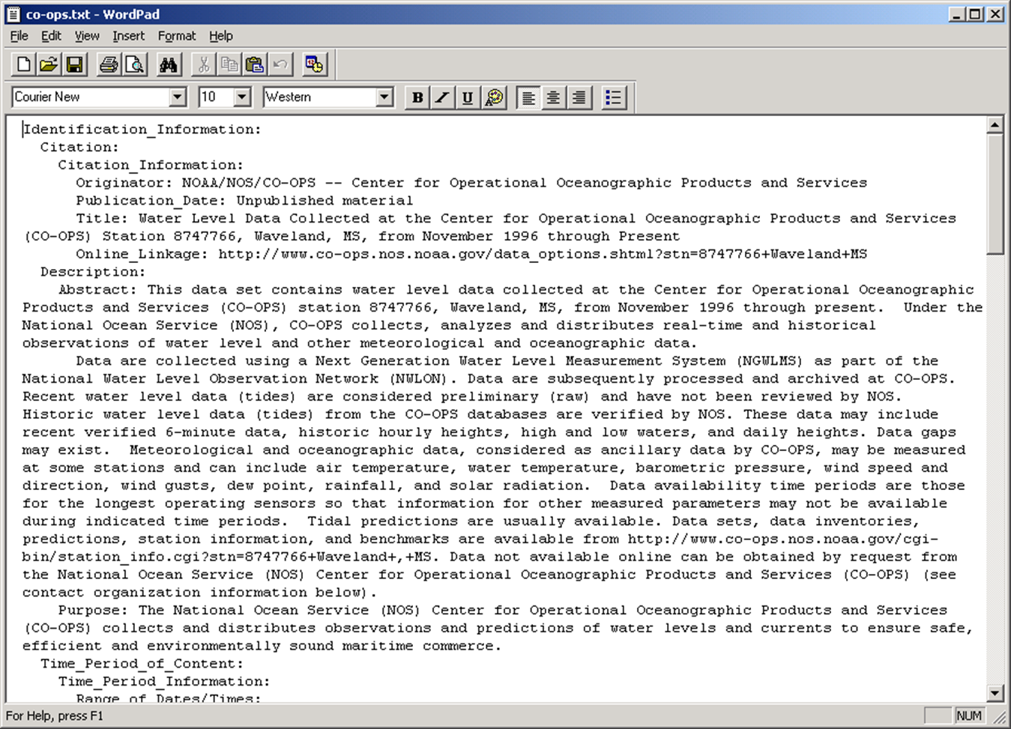
Machine readable:
A Sample Metadata Record – as text

Slide 30
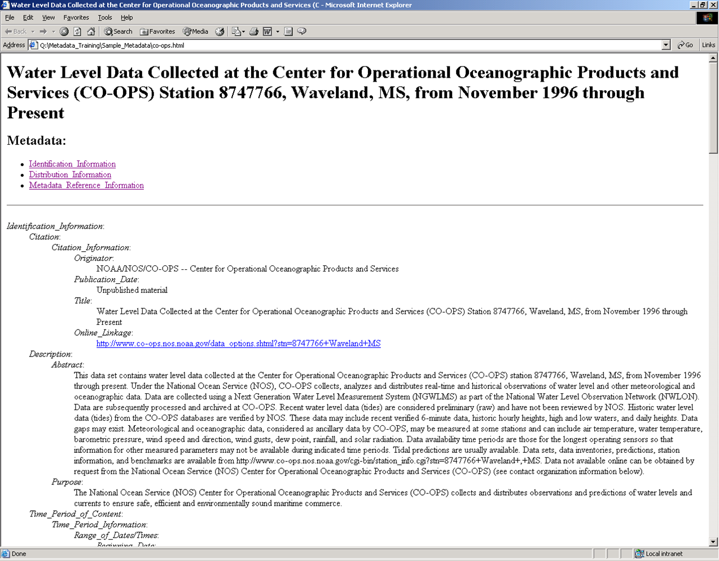
Machine readable:
A Sample Metadata Record – as HTML

Slide 31
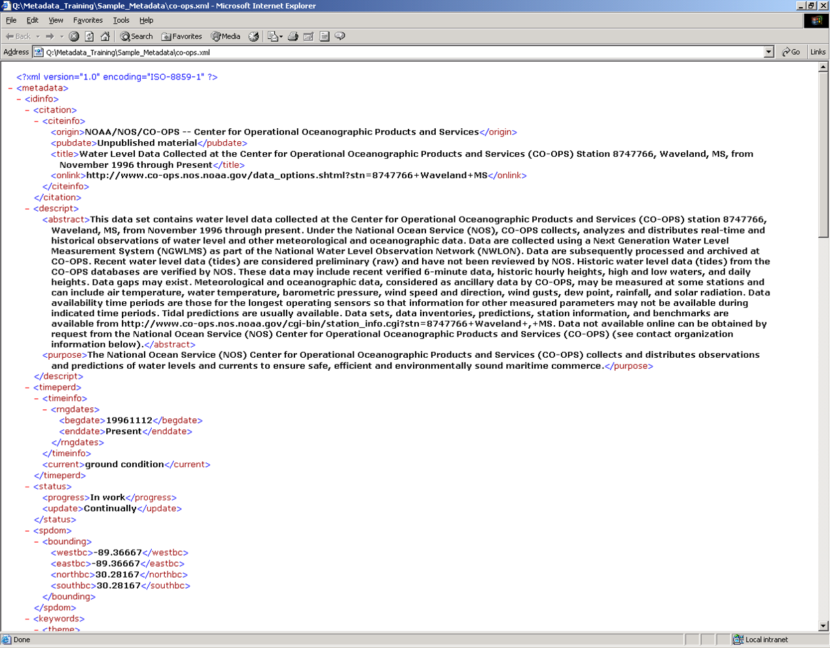
Machine readable:
A Sample Metadata Record – as XML

Slide 32
Preservation / Archiving metadata
Why is it needed?
  To support the long-term usability of digital data
  To support the digital preservation process of a data archive or repository
  To record information not covered by other metadata schemes that are useful for and/or collected by a data archive
What is it? A work in process!
  Many international and interdisciplinary efforts to define what is required in terms of metadata schemes from abstract to concrete:
    OAIS Reference Model (OAIS RM) – generic
    PREMIS: A generic approach coming from digital archives & libraries (based on OAIS RM)
    FGDC & ISO 19115-2 (includes more than “preservation” metadata, but applied more directly to spatial & earth science data)

Slide 33
Categories of Preservation / Archiving
Metadata based on OAIS RM
For “content information” -- a set of information to be preserved over time –” aka “digital object” (DO)
For a “designated community” or knowledge base
  This is where content specifications and application profiles of metadata schemes come into play, e.g., NASA Content Specification for Earth Science data
Preservation Description Information (PDI)
  What is needed to efficiently manage & preserve a DO over time
Representative Information (RI)
  Best guesses as to what will be needed to be able to view or “render” the DO in future technical environments
  Best guesses as to what will be needed for correct semantic interpretation of data
Packaging Information
  Means for binding DO including its MD into an identifiable unit for transfer and/or exchange
Descriptive Information
  Needed to facilitate efficient discovery & accessibility of preserved DO

Slide 34
Preservation / Archiving metadata – a work in progress!!
Options for incorporating preservation MD into data set metadata
  Analyses of existing metadata schemes to see if enough preservation MD is included
  Analyses of whether / how data repository infrastructures accommodate preservation / archiving
  Need to TEST whether what is called for is truly needed, e.g.,
    IMPORTANT NOT JUST TO BACKUP, BUT ALSO TO RESTORE!
Recent analysis of what preservation MD is needed beyond ISO 19115-2
  Shaon & Wolfe, D-Lib Magazine, Sept/Oct 2011.
Comparison of PREMIS v1, FGDC & CIESIN’s Geospatial Electronic Records for the Library of Congress’ NGDA Project
  Hoebelheinrich & Banning. 2008.
Broad discussion of MD needs for preservation,
  Duerr, et al
See CIESIN’s Geospatial Data Preservation Clearinghouse for more information (e.g., topic search on Preservation metadata for geospatial data)

Slide 35
Project Documentation
Will vary by discipline and project
  Chance to use your
  about what could be useful to know in the future -- allowing for
  & cyclical nature of
  scientific data
Example from NASA Earth Science Data Preservation Content Specification (Nov 2011)
  3.3. Science Data Product Documentation content area
Imagination
serendipity

Slide 36
Project Documentation
A Discipline Specific Example
Science Data Product Documentation
Categories of information that should be included with rationales for each:
  Product Team 3.3.1
  Product Requirements & Designs 3.3.2
  Processing & Algorithm Version History 3.3.3
  Product Generation Algorithms 3.3.4
  Product Quality 3.3.5
  Product Application 3.3.6

Slide 37
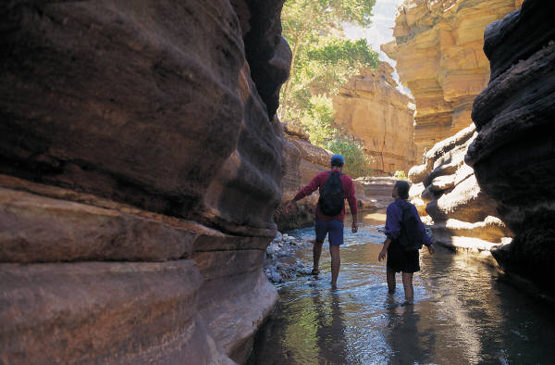
Best Practices for Metadata Creation
Use Metadata Guides!
  Metadata Standards
  Clearinghouses
  Creation Tools
  Controlled Vocabularies for
    Keywords

Slide 38
What is a Metadata Standard?
A Community agreed upon declaration that provides a structure to describe data with:
Common terms to allow consistency between records
Common definitions for easier interpretation
Common language for ease of communication
Common structure to quickly locate information
In search and retrieval, standards provide:
A reliable and predictable format for computer interpretation
A uniform summary description of the data set

Slide 39
Many metadata standards exist
ISO 19115 Geographic information: Metadata
–Emphasis on geospatial data and services
World Meteorological Organization Core Metadata Profile (WMO) – a profile of ISO 19115
–Emphasis on meteorological data
Content Standard for Digital Geospatial Metadata (CSDGM)
Federal Geographic Data Committee (FGDC)
–Emphasis on geospatial data
Directory Interchange Format (DIF)
–Emphasis on Earth science data
Dublin Core Element Set
–Emphasis on web resources, publications

Slide 40
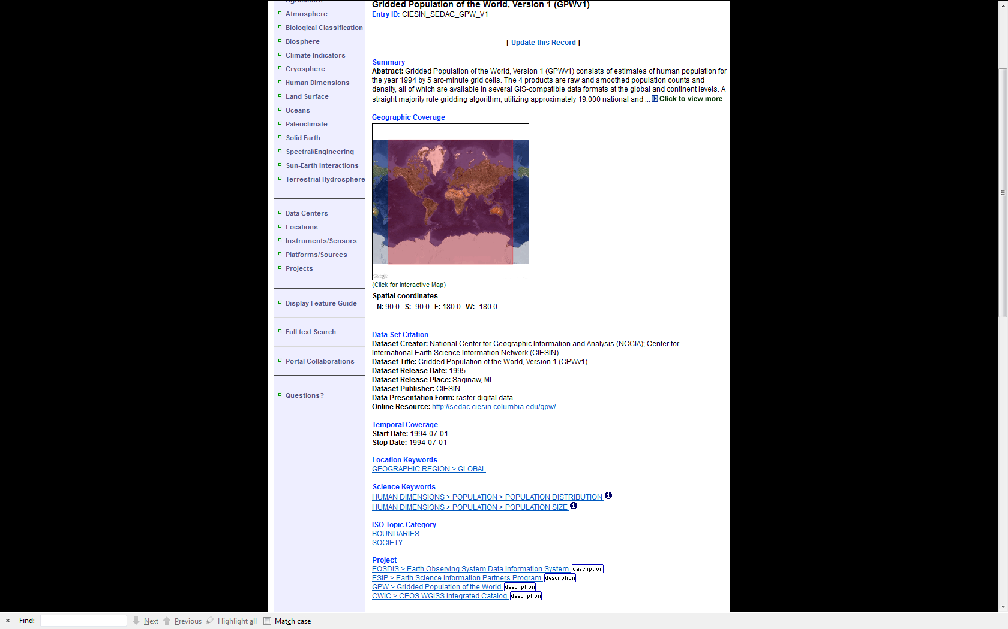
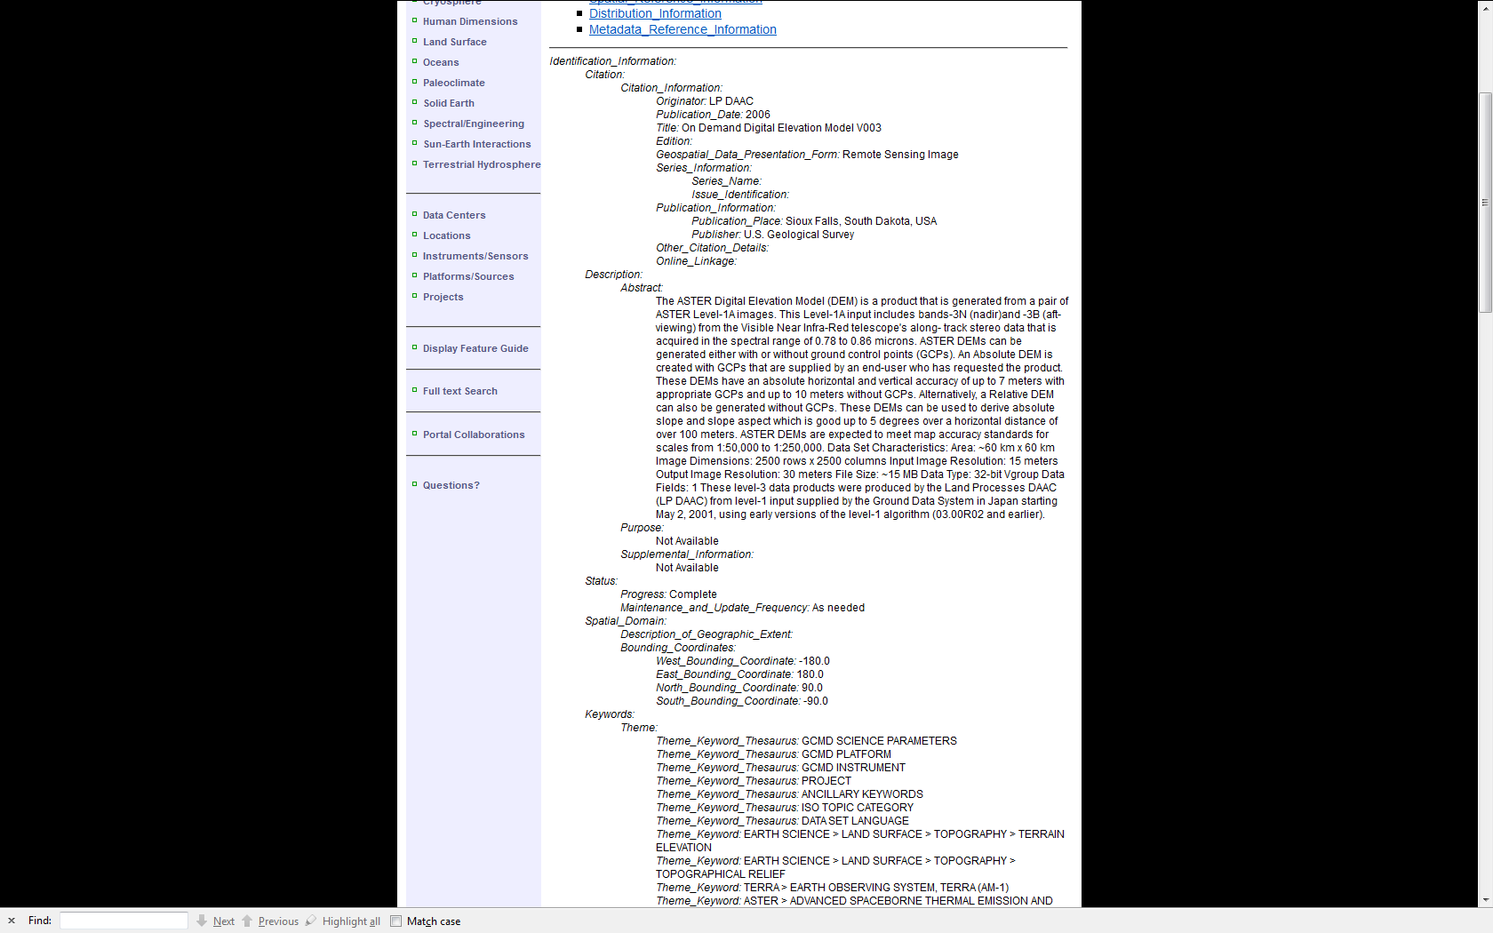
Two Standards: Two Sample Records
Directory Interchange Format (DIF)
Federal Geographic Data Committee

Slide 41
What is a Metadata Clearinghouse?
A metadata clearinghouse is a location —typically accessed through the Internet —to search for spatial data sets
Clearinghouses make metadata records easy to find
Example of Clearinghouse:
  Geospatial One-Stop / Data.gov (http://www.data.gov/)
  Climate Change Database Clearinghouse (http://ccrm.vims.edu/climate_change/index.html)

Slide 42
Metadata Creation Tools:
Some commercial & open source options
  MERMAid - Metadata Enterprise Resource Management Aid (National Coastal Data Development Center)
  ESRI ArcGIS tools
  EPA Metadata Editor (Environmental Protection Agency)
  FGDC Metadata Editor for ArcGIS (USGS)
  INSPIRE Geoportal Metadata Editor (European Commission)
  Find out more from: http://www.fgdc.gov/metadata/geospatial-metadata-tools

Slide 43
For example, NOAA MERMAid

Slide 44
More about MERMAid
Capabilities
  Generates FGDC Standard, Biological, Shoreline, Remote Sensing Profile Records
  Supports Ecological Metadata Language (EML)
  Imports existing FGDC records in XML or .txt format
  Exports records in XML, TXT, HTML or MARC XML via “save as”
  Robust “Help” functions
Technical Elements
  Developed at National Coastal Data Development Center (NCDDC), uses the framework of the Z-Object Publishing Environment (ZOPE) as its web application server
  Open source
  Platform independent
  Uses an object oriented dbase
  Offers secure, remote access through a web browser
Find out more at: http://www.ncddc.noaa.gov/metadata-standards/mermaid/

Slide 45
Controlled Vocabularies for Keywords
Keywords used to facilitate the identification & organization of descriptive information within and across different search systems
Most useful to systems & searchers when they are:
  Unambiguous
  Specifically descriptive
  Come from an established, published source based on continually updated use of discipline-specific language from formal & informal publications such as
  taxonomies, thesauri & ontologies

Slide 46
Useful sources for keywords
Global Change Master Directory (GCMD)
  Developed & maintained by National Aeronautics and Space Administration (NASA)
  Focused upon Earth Science data sets & services
  http://gcmd.nasa.gov/
Getty Thesaurus of Geographic Names
  Developed & maintained by The Getty Research Institute
  Focused upon art, architecture & material culture, but definitive for established names of geographic names and places
  http://www.getty.edu/research/tools/vocabularies/tgn/
INSPIRE Feature Concept Dictionary
  Developed & maintained by the European Environment Agency
  Focused upon Spatial Data Themes
  http://www.eionet.europa.eu/gemet/inspire_themes

Slide 47

Acknowledgements
Robert Cook
  Environmental Sciences Division, Oak Ridge National Laboratory
Jeff Arnfield
  National Climate Data Center, NOAA
Viv Hutchison
  US Geological Survey – NBII program
Jackie Wize
  National Coastal Data Development Center, NOAA
Tyler Stevens
  Wyle Information Systems (NASA Contractor)
Ron Weaver
  Nationao Snow & Ice Data Center (NSIDC)

Slide 48

Questions?
48
Notes:
http://www.flickr.com/photos/thecuriousoysters/4458657148/

Slide 49
References and Resources
Ball, C. A., G. Sherlock, and A. Brazma. 2004. Funding high-throughput data sharing. Nature Biotechnology 22:1179-1183. doi:10.1038/nbt0904-1179.
Borer, ET., EW. Seabloom, M.B. Jones, and M. Schildhauer. 2009. Some Simple Guidelines for Effective Data Management ,Bulletin of the Ecological Society of America. 90(2): 205- 214.
Christensen, S. W. and L. A. Hook. 2007. NARSTO Data and Metadata Reporting Guidance. Provides reference tables of chemical, physical, and metadata variable names for atmospheric measurements. Available on-line at: http://cdiac.ornl.gov/programs/NARSTO/
Cook, Robert B, Richard J. Olson, Paul Kanciruk, and Leslie A. Hook. 2001. Best Practices for Preparing Ecological Data Sets to Share and Archive. Bulletin of the Ecological Society of America, Vol. 82, No. 2, April 2001.
Duerr et al. “Challenges in Long-Term Data Stewardship”,http://storageconference.org/2004/Papers/05-Duerr-a.pdf
Federal Geographic Data Committee (FGDC). Geospatial Metadata. http://www.fgdc.gov/metadata
Geospatial Data Preservation Clearinghouse. CIESEN at Columbia University. Search for Preservation Metadata: http://geopreservation.org/topicResults.jsp?types=8
  Getty Thesaurus of Geographic Names. http://www.getty.edu/research/tools/vocabularies/tgn/
Hoebelheinrich & Banning. “An Investigation into Metadata for Long-Lived Geospatial Data Formats”, 2008. http://www.ngda.org/reports/InvestigateGeoDataFinal_v2.pdf
Hook, L. A., T. W. Beaty, S. Santhana-Vannan, L. Baskaran, and R. B. Cook. June 2007. Best Practices for Preparing Environmental Data Sets to Share and Archive. http://daac.ornl.gov/PI/pi_info.shtml
INSPIRE Feature Concept Dictionary. http://www.eionet.europa.eu/gemet/inspire_themes

Slide 50
References and Resources (continued)
Kanciruk, P., R.J. Olson, and R.A. McCord. 1986. Quality Control in Research Databases: The US Environmental Protection Agency National Surface Water Survey Experience. In: W.K. Michener (ed.). Research Data Management in the Ecological Sciences. The Belle W. Baruch Library in Marine Science, No. 16, 193-207.
Management in the Ecological Sciences. The Belle W. Baruch Library in Marine Science, No. 16, 193-207.
Michener, W K. 2006. Meta-information concepts for ecological data management. Ecological Informatics. 1:3-7.
Michener, W.K. and J.W. Brunt (ed.). 2000. Ecological Data: Design, Management and Processing, Methods in Ecology, Blackwell Science. 180p.
Michener, W. K., J. W. Brunt, J. Helly, T. B. Kirchner, and S. G. Stafford. 1997. Non-Geospatial Metadata for Ecology. Ecological Applications. 7:330-342.
NASA Earth Science Data Preservation Content Specification (Nov 2011). http://earthdata.nasa.gov/sites/default/files/field/document/NASA_ESD_Preservation_Spec.pdf
NASA, 2011: Metadata Requirements – Base Reference for NASA Earth Science Data Products, (Nov 2011). http://earthdata.nasa.gov/sites/default/files/field/document/NASA%20ESD%20Base%20Metadata%20Requirements_V1_20110922_0.pdf
National Aeronautics and Space Administration (NASA). Global Change Master Directory. http://gcmd.nasa.gov.
50

Slide 51
References and Resources (continued)
National Research Council (NRC). 1991. Solving the Global Change Puzzle: A U.S. Strategy for Managing Data and Information. Report by the Committee on Geophysical Data of the National Research Council Commission on Geosciences, Environment and Resources. National Academy Press, Washington, D.C.
NOAA GEO-IDE best practices wiki. https://geo-ide.noaa.gov/wiki/index.php?title=ISO_Lineage
Preservation Metadata (PREMIS). http://www.loc.gov/standards/premis/
Shaon & Woolfe. “Long-term Preservation for Spatial Data Infrastructures: a Metadata Framework and Geo-portal Implementation”, D-Lib Magazine, September/October 2011. doi:10.1045/september2011-shaon. http://www.dlib.org/dlib/september11/shaon/09shaon.print.html
Taylor, Mark. 2000. “Developing Spatial Data Infrastructures – The SDI Cookbook”. Global Spatial Data Infrastructure Association. http://www.gsdi.org/pubs/cookbook/chapter03a.html
U.S. EPA. 2007. Environmental Protection Agency Substance Registry System (SRS). SRS provides information on substances and organisms and how they are represented in the EPA information systems. Available on-line at: http://www.epa.gov/srs/
USGS. 2000. Metadata in plain language. Available on-line at: http://geology.usgs.gov/tools/metadata/tools/doc/ctc/
51

