Slide 1
Preserving the Scientific Record: Case Study 1 – National Snow & Ice Data Center (NSIDC) Glacier Photos
Matthew Mayernik
National Center for Atmospheric Research
Version 1.0
Review Date
Notes:
Modules should be 3-7 minutes long

Slide 2
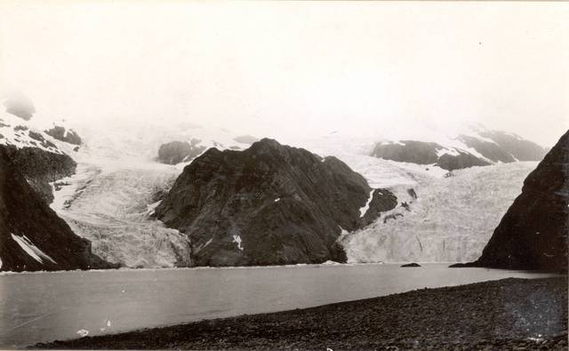
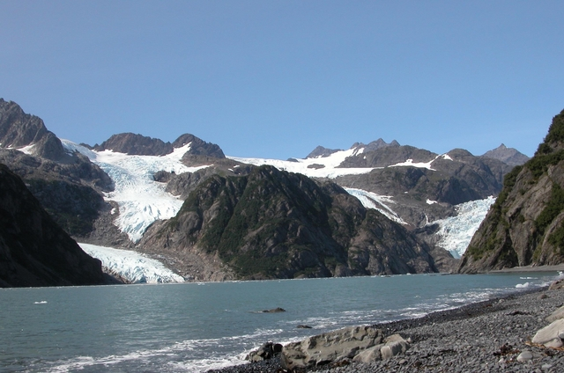
Overview
Glacier photos provide vivid demonstrations of climate change and can be used in photogrammetric studies to determine how the physical properties of glaciers (e.g. mass and extent) change over time
1909¹
2004²
1. Grant, Ulysses Sherman. 1909. Holgate Glacier: http://nsidc.org/cgi-bin/gpd_deliver_jpg.pl?holgate1909072401
2. Molnia, Bruce F. 2004. Holgate Glacier: http://nsidc.org/cgi-bin/gpd_deliver_jpg.pl?holgate2004081301
From the Glacier Photograph Collection. Boulder, Colorado USA:
National Snow and Ice Data Center/World Data Center for Glaciology. Digital Media.

Slide 3
NSIDC Glacier Photo Collection
NSIDC curates and provides online access to more than 13,000 glacier photographs
Photos from 130+ photographers, U.S. government, military, and scientific agencies
Photographs date from the mid 1800s to the present
Collection has been growing since 1950’s
Full analog archive contains more than 15,000 glacier photograph prints, ~100,000 glacier images on microfilm, and many slides and negatives
Digitization was a partnership with the National Oceanic and Atmospheric Administration (NOAA) Climate Database Modernization Program, National Climatic Data Center (NCDC), and private industry

Slide 4
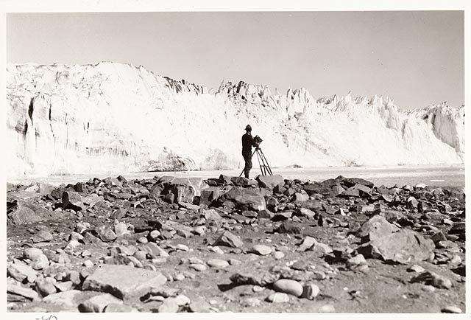
NSIDC Glacier Photo Documentation
Documentation for discovery
Background information
Spatial and temporal coverage
Collection organization
Location, science, and other topical keywords
How to cite the collection (and individual images)
References and related publications
Image: Field, William Osgood. 1931 Columbia Glacier: From the Glacier Photograph Collection. Boulder, Colorado USA: National Snow and Ice Data Center/World Data Center for Glaciology. Digital media.
http://nsidc.org/cgi-bin/gpd_deliver_jpg.pl?columbia1931090612

Slide 5
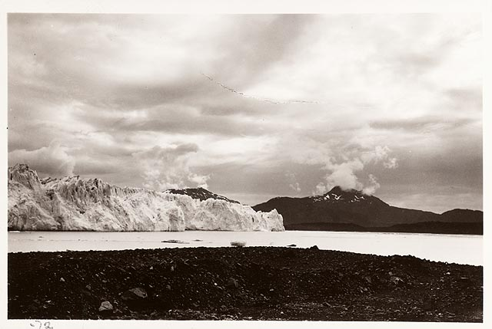
NSIDC Glacier Photo Documentation
Documentation for long-term curation
Contact information
Background information
Formats and file sizes
File naming conventions
Error sources and quality assessment
Collection organization
Access mechanisms
Acknowledgments
Image: Field, William Osgood. 1931 Columbia Glacier: From the Glacier Photograph Collection. Boulder, Colorado USA: National Snow and Ice Data Center/World Data Center for Glaciology. Digital media.
http://nsidc.org/cgi-bin/gpd_deliver_jpg.pl?columbia1931090101

Slide 6
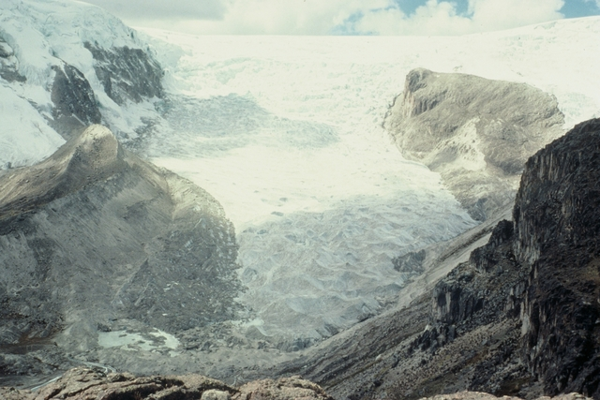
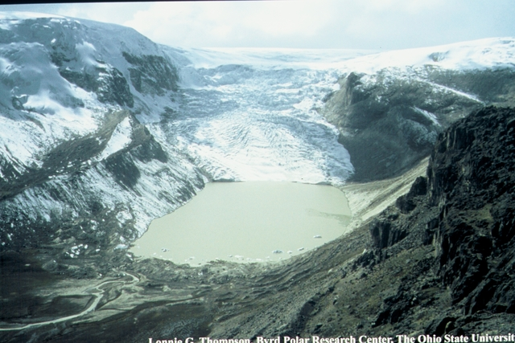
Conclusion
These photos are an invaluable scientific resource.
NSIDC’s active curation makes this collection available to scientific and public communities for research and policy uses
1978¹
2004²
1. http://nsidc.org/cgi-bin/gpd_deliver_jpg.pl?qorikalis1978070001
2. http://nsidc.org/cgi-bin/gpd_deliver_jpg.pl?qorikalis2004070001
Qori Kalis Glacier in Peru: From the Glacier Photograph Collection. Boulder, Colorado USA:
National Snow and Ice Data Center/World Data Center for Glaciology. Digital media.
Both photos by: Lonnie G. Thompson, Byrd Polar Research Center, the Ohio State University

Slide 7
References and Resources
Links:
NSIDC Glacier Photo Collection Home Page: http://nsidc.org/data/glacier_photo/
NSIDC Glacier Photo Collection Documentation: http://nsidc.org/data/docs/noaa/g00472_glacier_photos/index.html
Photogrammetry:
http://en.wikipedia.org/wiki/Photogrammetry
Additional Information:
Beitler, J. The Dry Valleys of Antarctica: Data for Big Science. Data Conservancy press release, June 28, 2011. http://dataconservancy.org/the-dry-valleys-of-antarctica-data-for-big-science/
Molnia, B.F. 2010. Repeat photography of Alaskan glaciers and landscapes from ground-based photo stations and airborne platforms. In R.H. Webb, D.E. Boyer, R.M. Turner (eds.), Repeat Photography: Methods and Applications in the Natural Sciences, Washington, DC : Island Press, (pp. 59-76).

Slide 8
Other Relevant Modules
For more discussion of why data preservation is important, see:
The case for data stewardship: Preserving the Scientific Record
Preservation strategies: Options for archiving your data
For data management recommendations, see:
Local Data Management: Managing Your Data
Local Data Management: Creating documentation and metadata
Local Data Management: Working with your archive organization
Responsible Data Use: Citation and Credit

