Slide 1
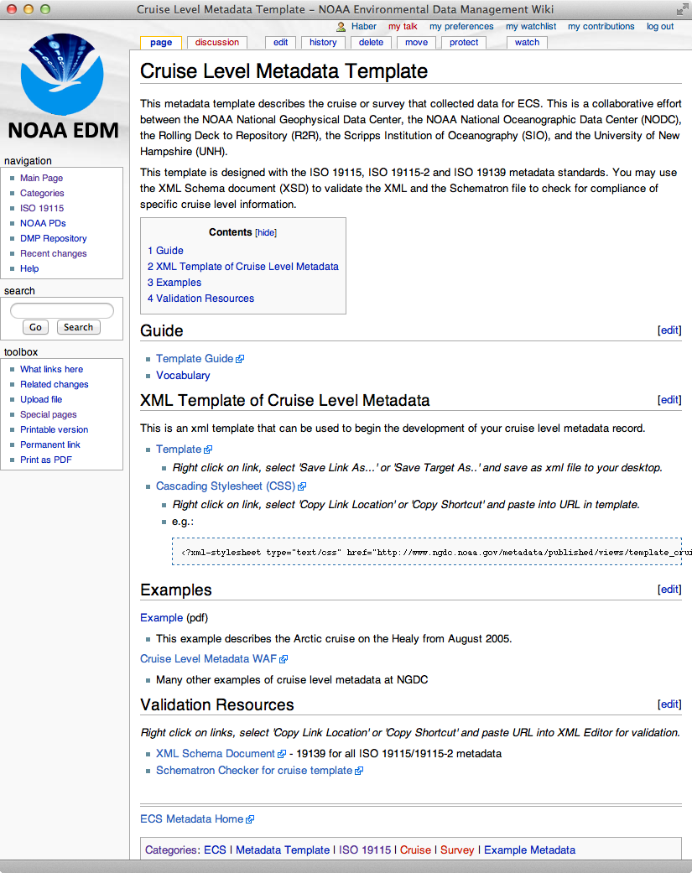
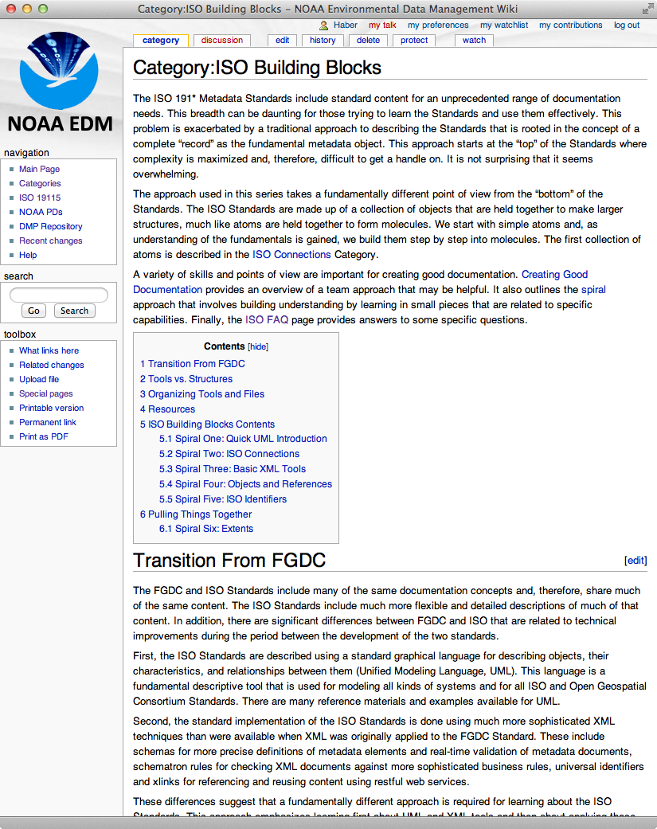
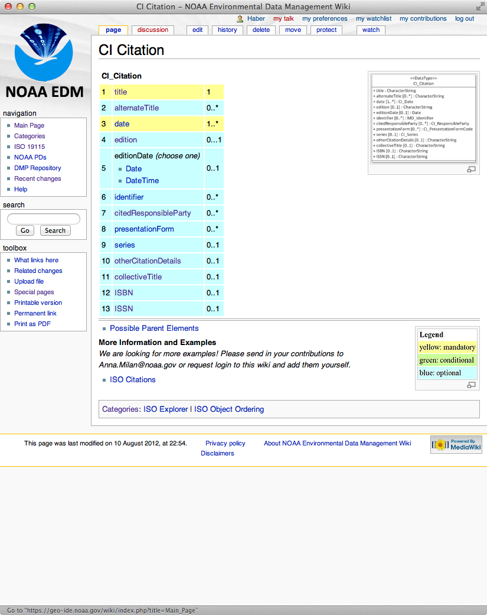
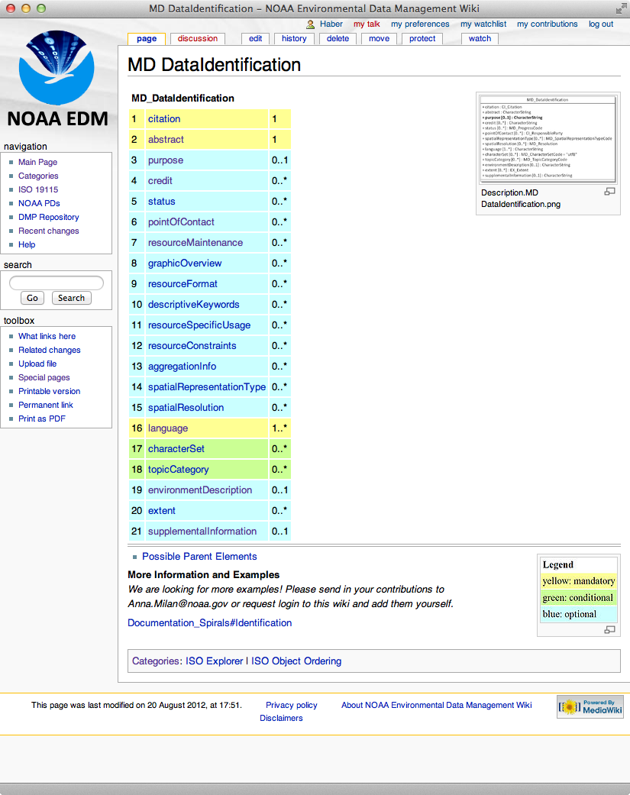
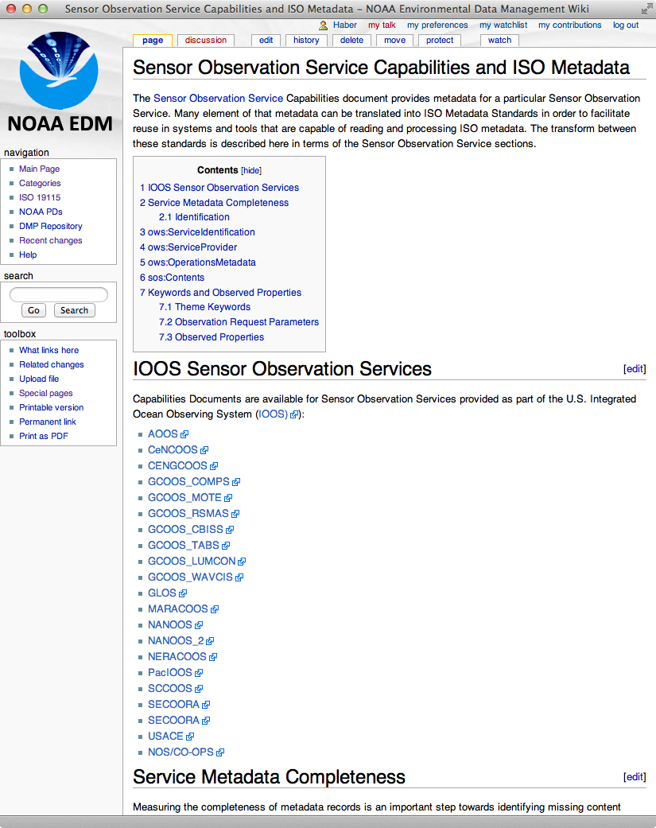
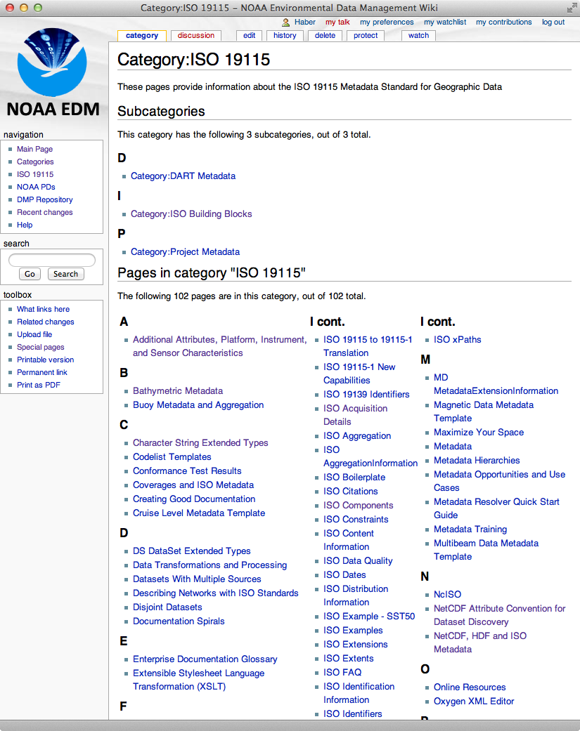
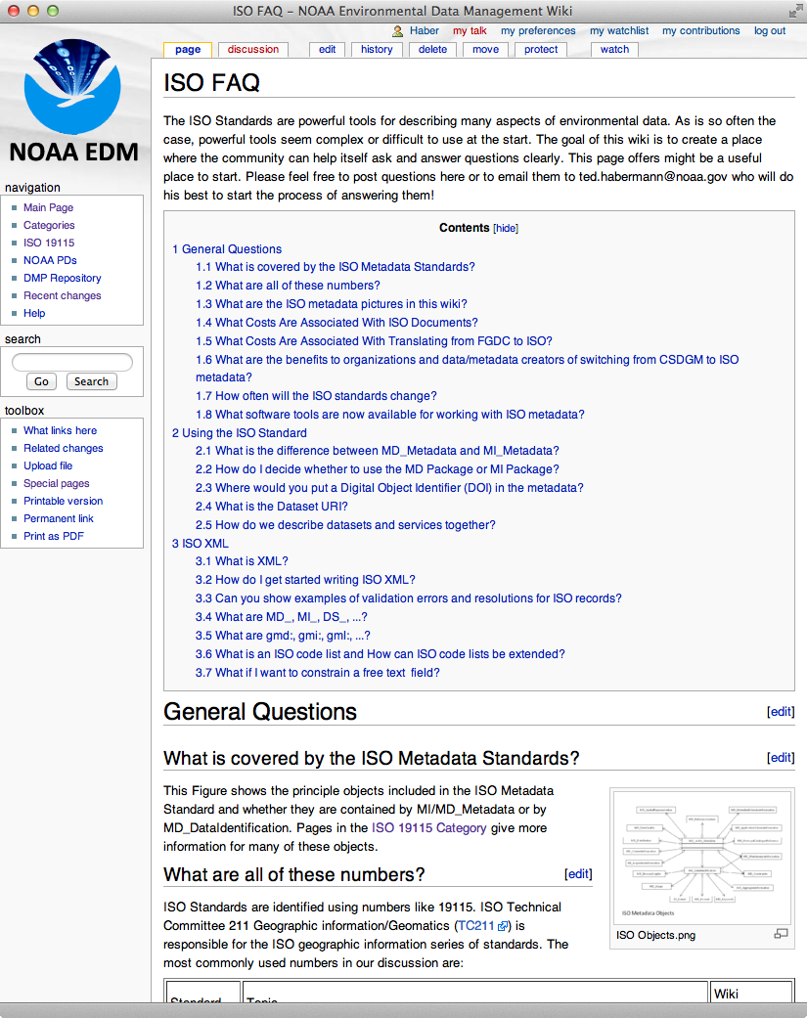
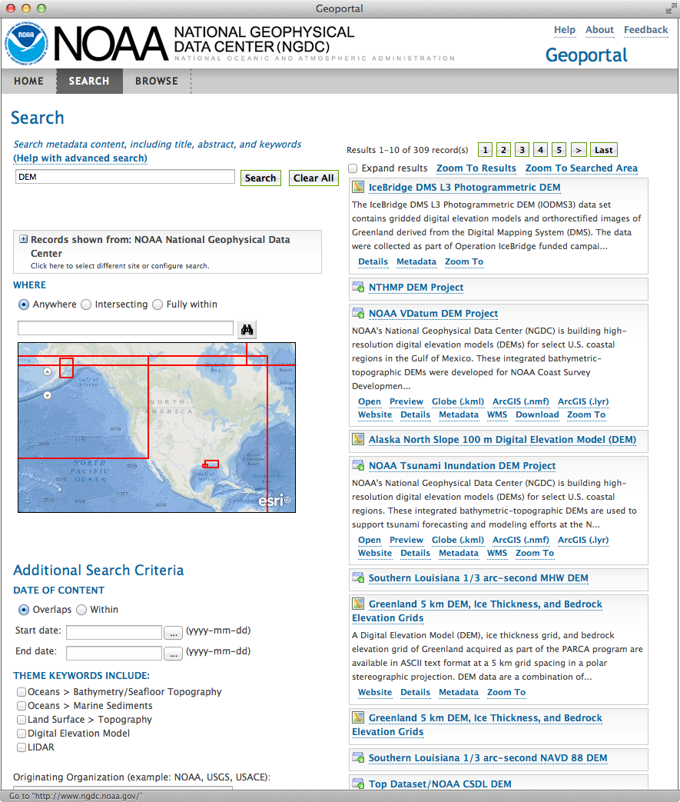
Wikis, Rubrics, Views and Connections: An Integrated Approach to Improving Documentation Ted Habermann, Anna Milan, NOAA/NESDIS/NGDC
Wiki
Wiki
Rubrics
Views
Connections
Web Accessible Folder
Web Accessible Folder
Portals

Slide 2
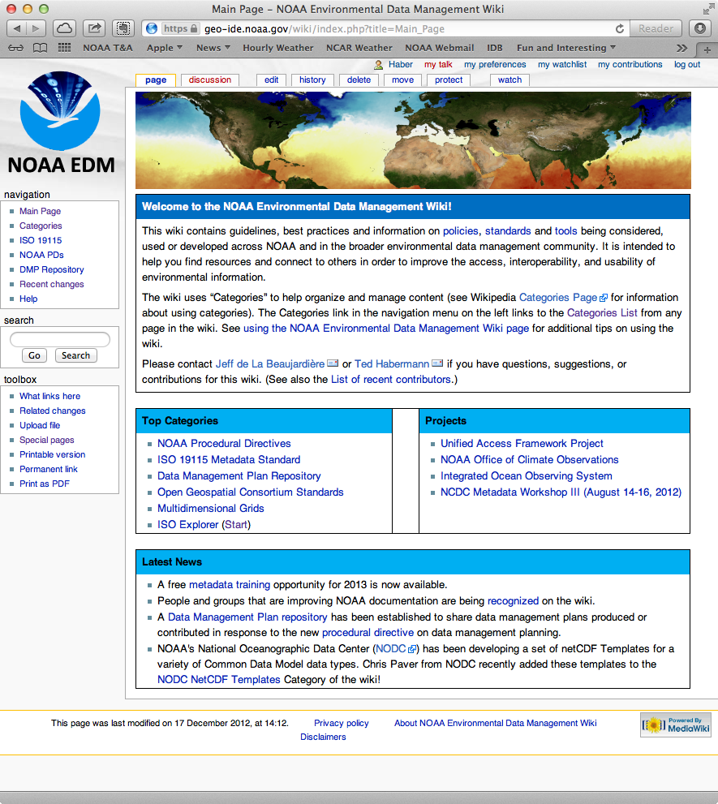
The Data Management Wiki
Wiki
Wiki
The NOAA Data Management wiki is a community knowledge resource developed and maintained by a small group in NOAA and available to all.
It is the heart of the tools.
https://geo-ide.noaa.gov/wiki

Slide 3
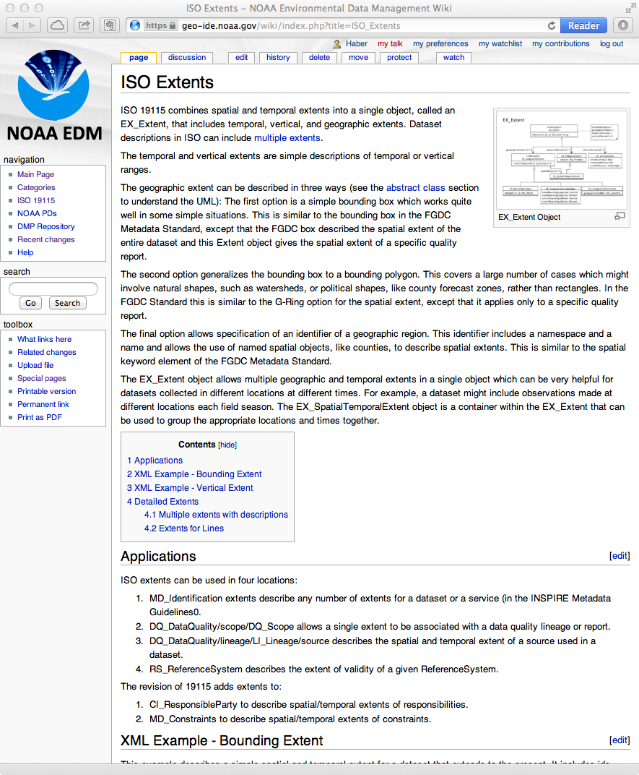
Wiki Pages
Discussion
Explanation, guidance, rationale, examples
Developed first – organic evolution in response to community needs
Class / Element
Structure, order, alternatives
Came later for specific support of metadata editing
Training
Part of structured paths through wiki content
Notes:
Links:
https://geo-ide.noaa.gov/wiki/index.php?title=ISO_Extents
https://geo-ide.noaa.gov/wiki/index.php?title=Category:ISO_Building_Blocks
https://geo-ide.noaa.gov/wiki/index.php?title=MD_DataIdentification

Slide 4
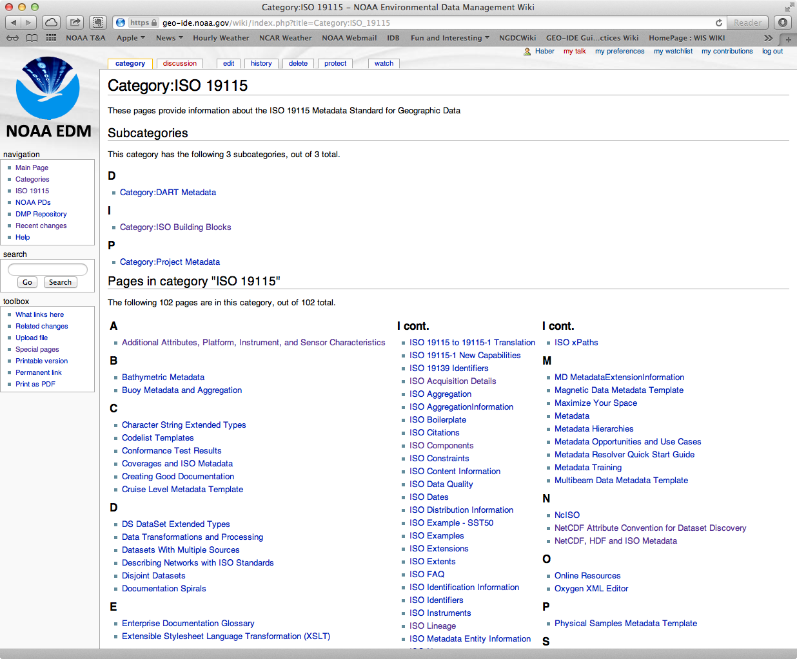
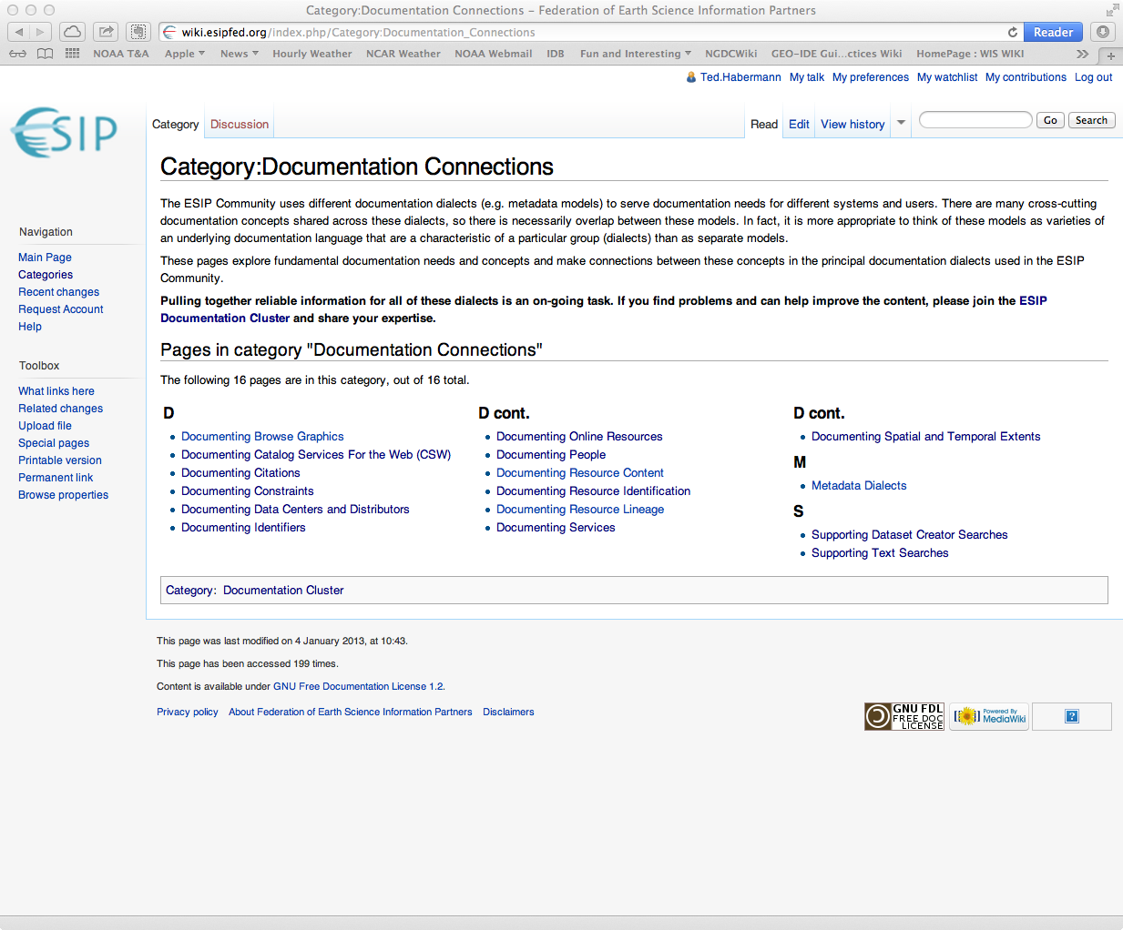
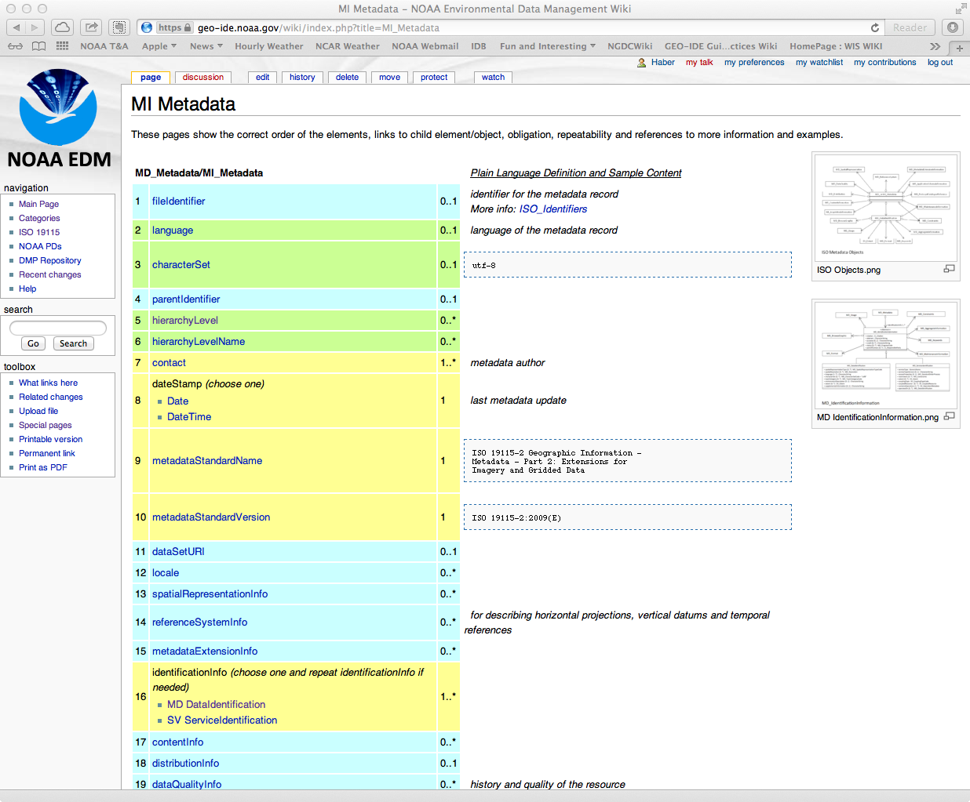
Wiki Navigation
Categories
Automatic mediaWiki Capability
Many-to-Many, Sub-Categories
Categories as “Home Pages”
Automatic page lists
Simplifies navigation and maintenance
ISO Explorer
Consistent presentation (templates)
Follows structure of standard
Notes:
https://geo-ide.noaa.gov/wiki/index.php?title=Category:ISO_19115
https://geo-ide.noaa.gov/wiki/index.php?title=MI_Metadata

Slide 5
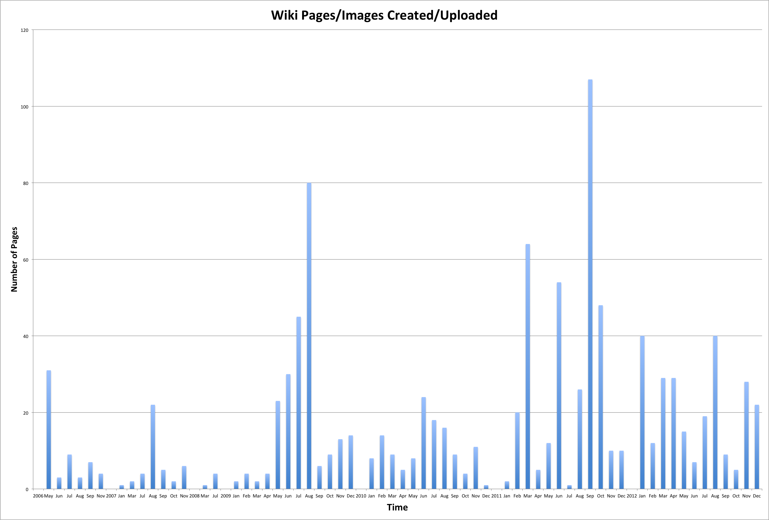
Content Creation
359
255
232
127
52
42
5
Notes:
6 52 17.3816156
7 42 14.03899721
8 5 1.671309192
9 232 77.54874652
10 127 42.45125348
11 359 120
12 255 85.2367688

Slide 6
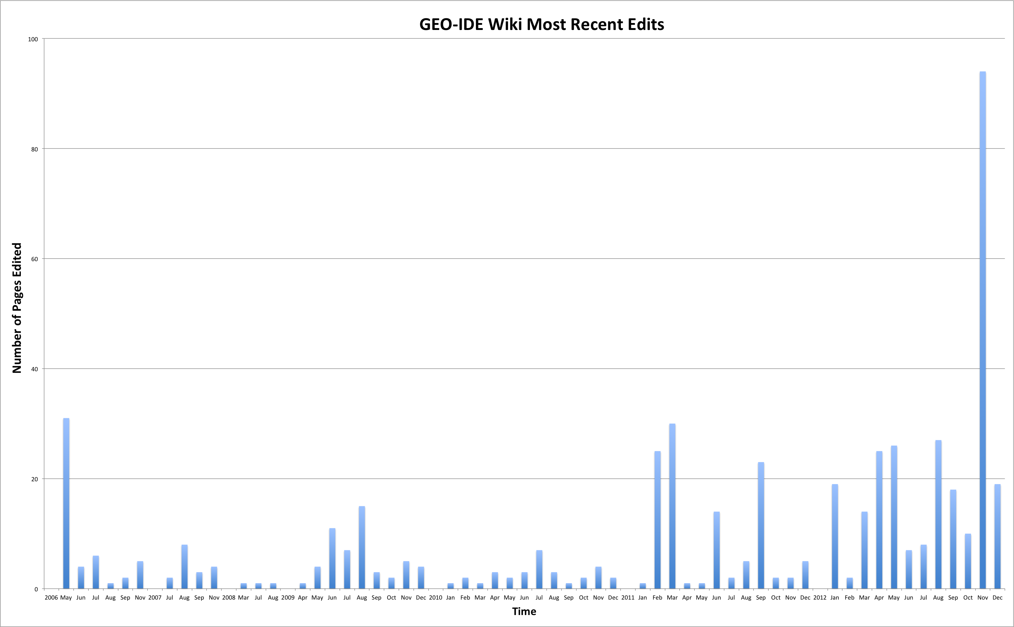
Content Updates
269
111
49
52
17
31
3
Notes:
6 52 17.3816156
7 42 14.03899721
8 5 1.671309192
9 232 77.54874652
10 127 42.45125348
11 359 120
12 255 85.2367688

Slide 7
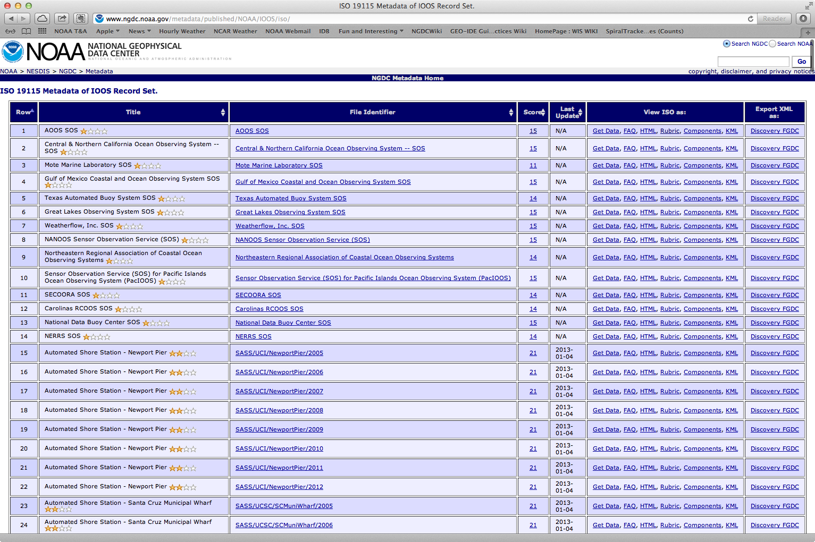
Web Accessible Folders
Web Accessible Folder
Web Accessible Folder
Titles
Links
Scores
Dates
Views
Notes:
http://www.ngdc.noaa.gov/metadata/published/NOAA/IOOS/iso/

Slide 8
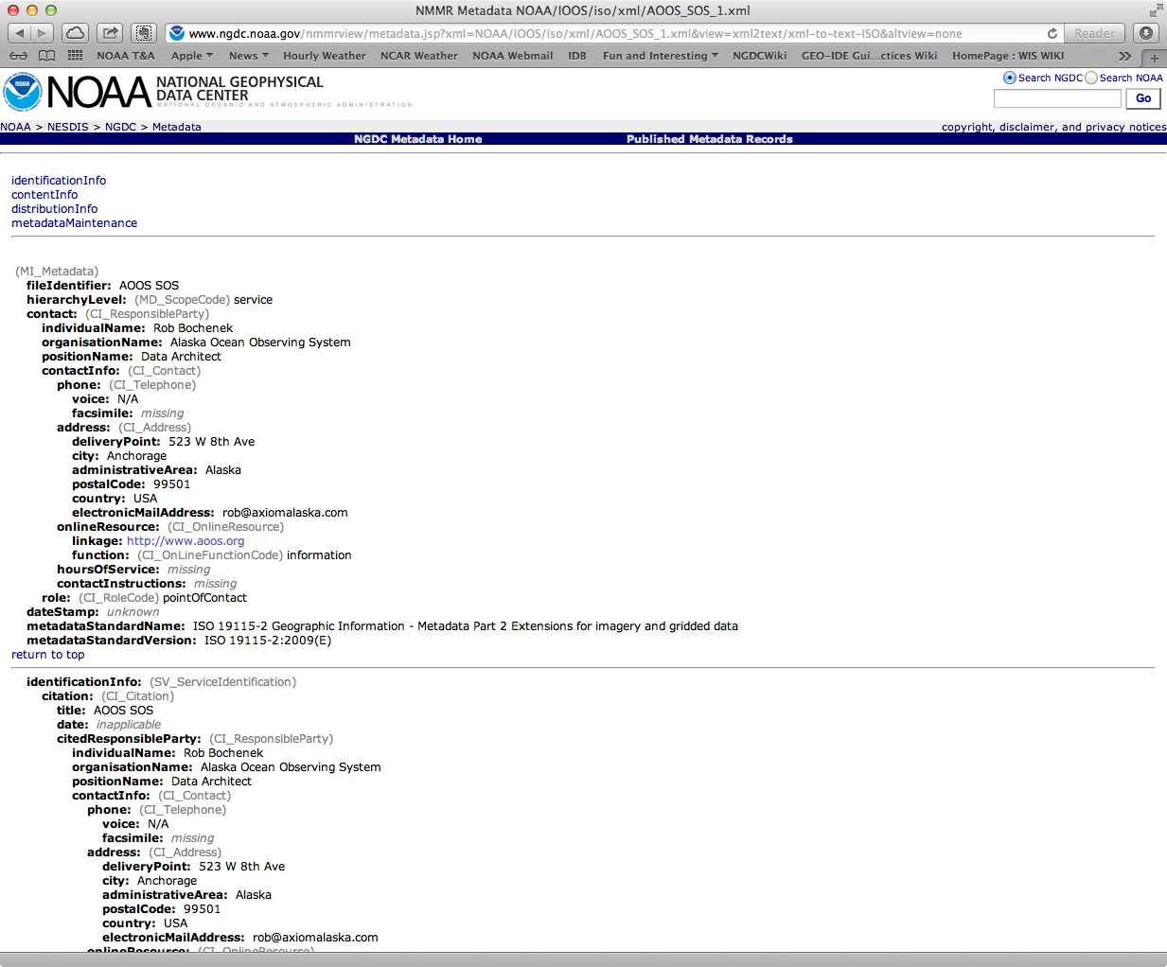
Guide View (HTML)
Wiki
Wiki
Notes:
http://www.ngdc.noaa.gov/nmmrview/metadata.jsp?xml=NOAA/IOOS/iso/xml/AOOS_SOS_1.xml&view=xml2text/xml-to-text-ISO&altview=none

Slide 9
Metadata Evaluation
Requires conventions or model that can be used for evaluation (a set of suggested fields and practices)
Oriented towards use cases (text search, spatial/temporal search, lineage, …)
Evaluates completeness, not quality
Designated Community Representatives (OAIS) = gold standard

Slide 10
Rubrics are made of Spirals made of Fields
Rubric
Spiral
Spiral
Field
Field
Field
Field
Field
Field
Wiki
Wiki
Notes:
Documentation needs are common across many scientific disciplines and data types. Spirals address these needs outside of the context of a particular discipline or data type. Each spiral includes a number of items and these items can usually be expressed using multiple standards. We choose to emphasize commonality between these standards by calling them dialects.

Slide 11
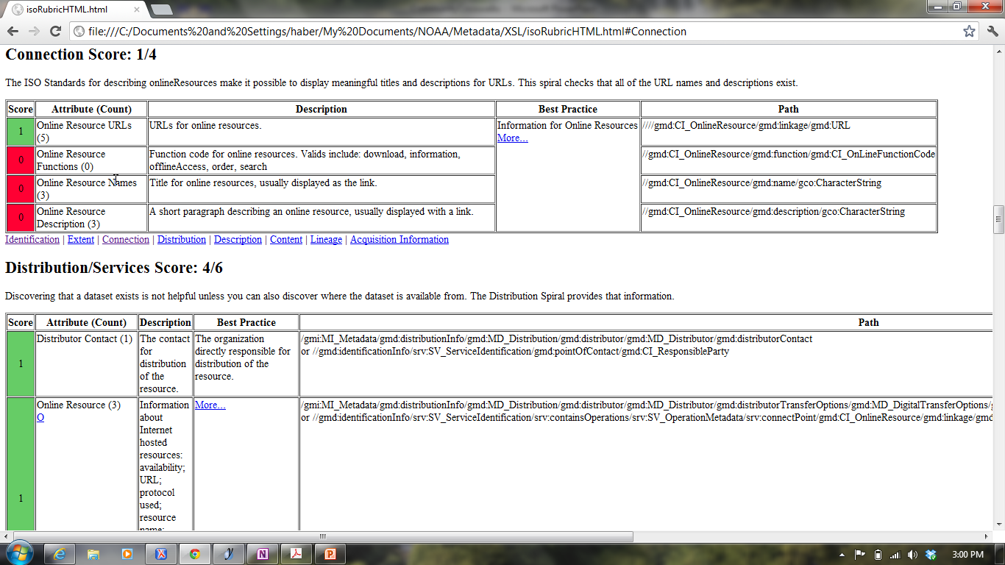
Spiral = Concepts To Address Documentation Need
Opportunities for improvement
Notes:
This slide shows the elements in the Connection Spiral. These elements are used to connect web resources to the metadata record. The ISO Standard allows metadata managers to add information that helps users understand and use online resources. The spiral requires functions, names, and descriptions for each online resource in order to be considered complete.

Slide 12
Spirals and Rubrics
Spiral | None | 0-33% | 34-66% | 67-99% | All
Identification
Connection
Extent
Distribution
Description
Content
Lineage
Acquisition Information
G
O
A
L
S
Progress
Metadata Evaluation for Dataset X
Date: 2012/08/14
Each record has a score that can be calculated using a consistent, standard tool

Slide 13
Spiral = Concepts That Address Documentation Need
WikiLinks
Notes:
This slide shows the elements in the Connection Spiral. These elements are used to connect web resources to the metadata record. The ISO Standard allows metadata managers to add information that helps users understand and use online resources. The spiral requires functions, names, and descriptions for each online resource in order to be considered complete.

Slide 14
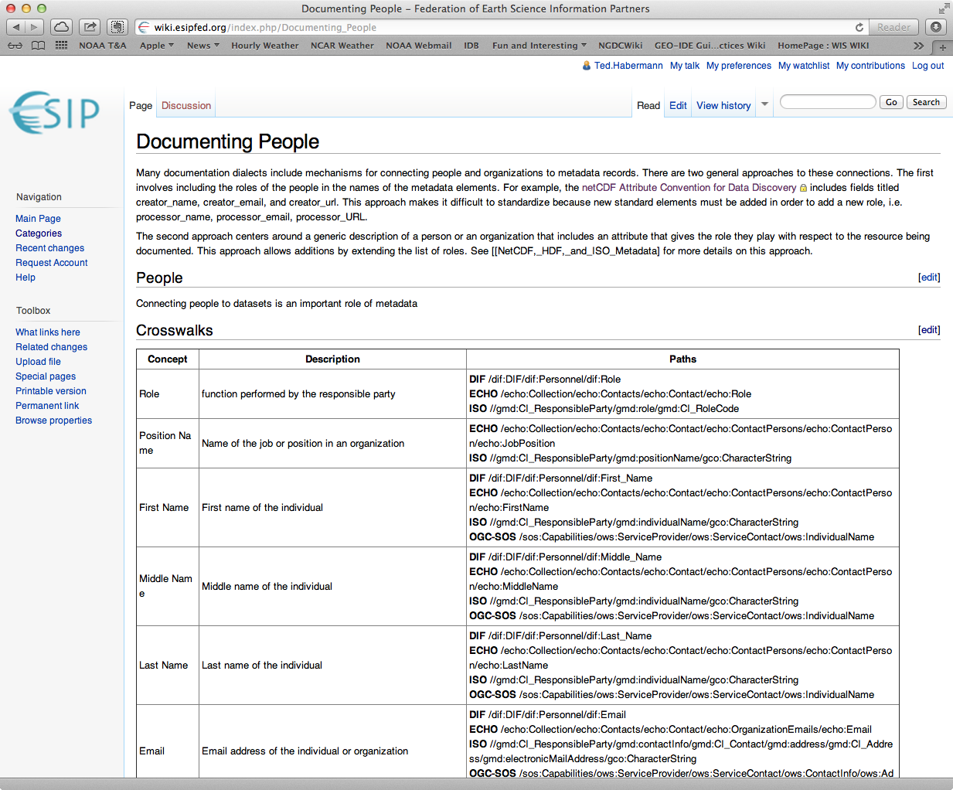
Connections

Slide 15
An Integrated Approach to Improving Documentation
Wiki
Wiki
Rubrics
Views
Connections
Web Accessible Folder
Web Accessible Folder
Portals

