Slide 1
NGDC Geoportal
ISO-2 and more
david.neufeld@noaa.gov
January 4th, 2012

Slide 2
Highlights
Progress
Current workflow
Common property meanings eases multiple dialects
Improving metadata content
Federated searches
ISO DS_Series Support
Collaboration
Wiki
Locator services
Google code shared repository?
Next steps
Integrating ontology services for ocean communities
Keywords tag cloud

Slide 3
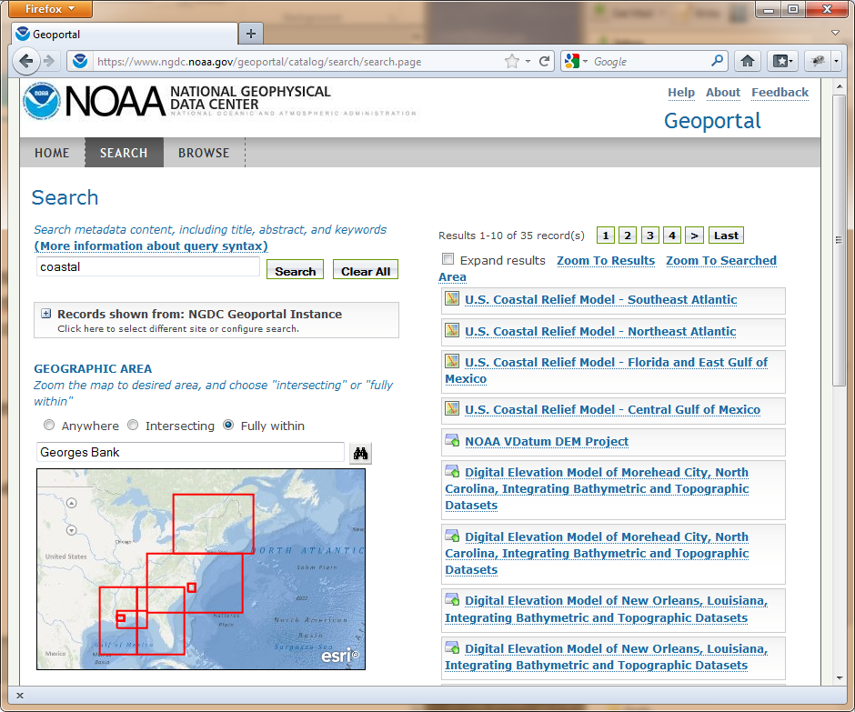
Current Workflow
NGDC Geoportal went ‘live’ on December 22nd, 2011
Over 15,000 records
Mixed content RDF, FGDC,
and ISO-2
Web Accessible Folder
(WAF) centric model
F
WAFs
FGDC
ncISO
ISO-2

Slide 4
Common Property Meanings
Expanding the shared conceptual model
property-meanings.xml
Simplifies modifications to search page
Enhances customized links in results
keywords
startDate
endDate
title
Service
Types
distributionLinks
geometry

Slide 5
Common Property Meanings
Example startDate / endDate:
FGDC
<property meaning="startDate"
xpath="/metadata/idinfo/timeperd/timeinfo/rngdates/begdate"/>
<property meaning="endDate"
xpath="/metadata/idinfo/timeperd/timeinfo/rngdates/enddate"/>
ISO-2
<property meaning="startDate"
xpath="/gmi:MI_Metadata/../gmd:extent/gml:TimePeriod/gml:beginPosition"/>
<property meaning="endDate"
xpath="/gmi:MI_Metadata/../gmd:extent/gml:TimePeriod/gml:endPosition"/>

Slide 6
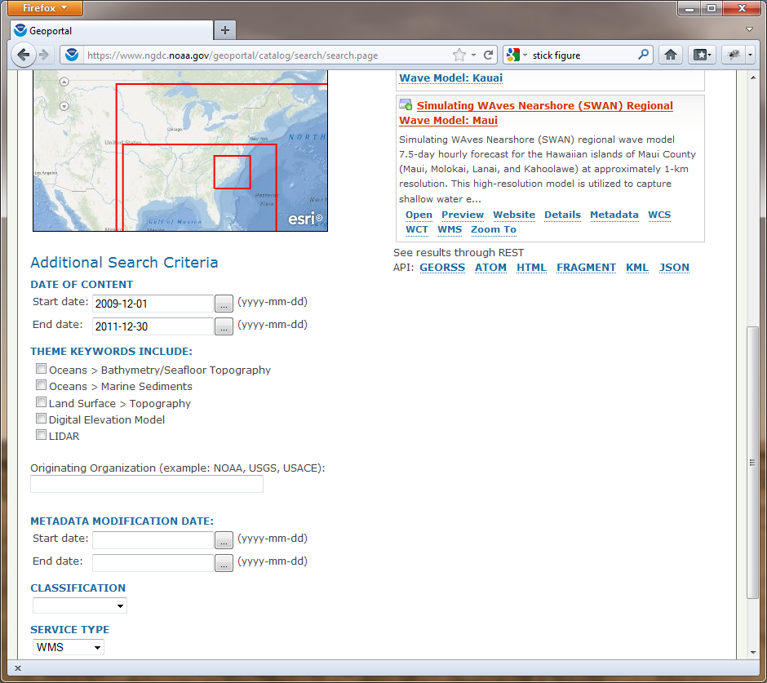
Common Property Meanings

Slide 7
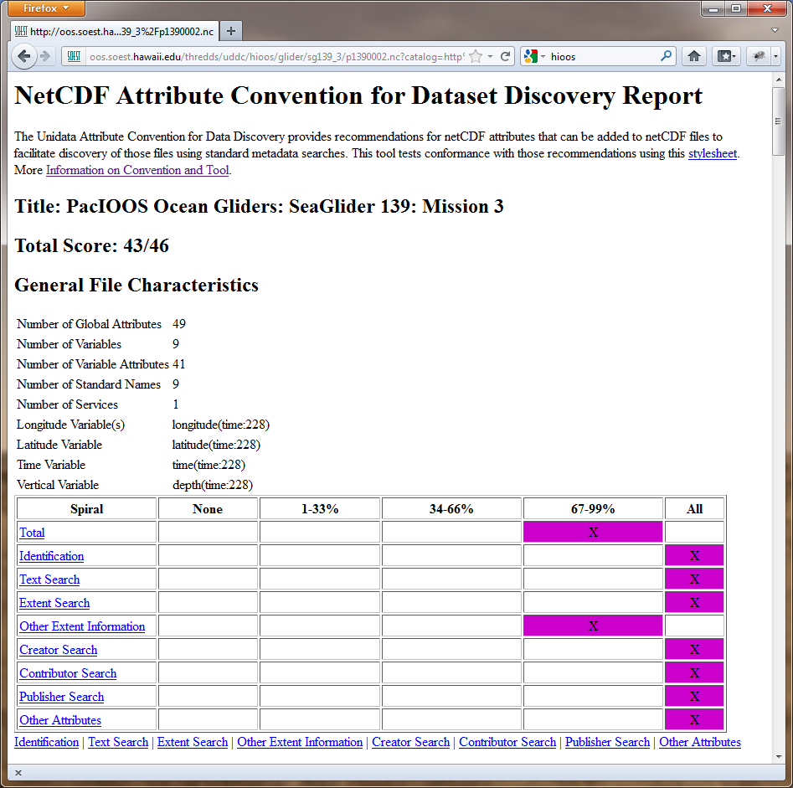
Metadata Improvements
Working with data
providers key
to success!
IOOS
OceanSITES
UAF

Slide 8
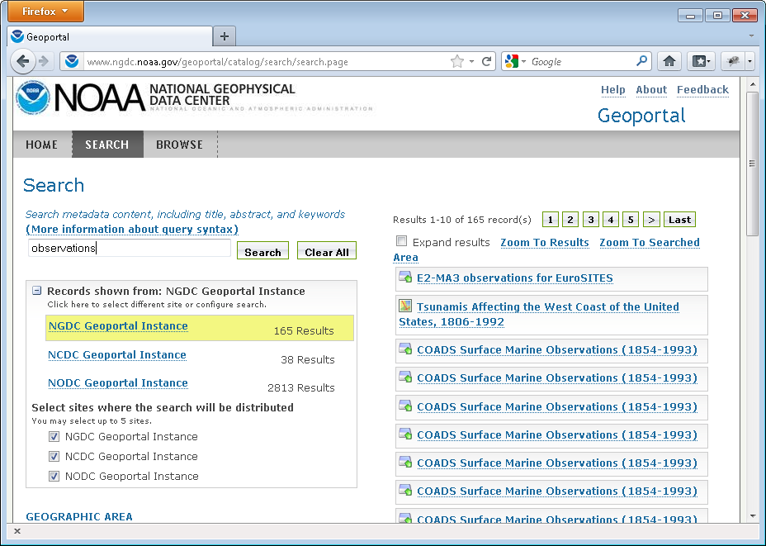
Federated Searches

Slide 9
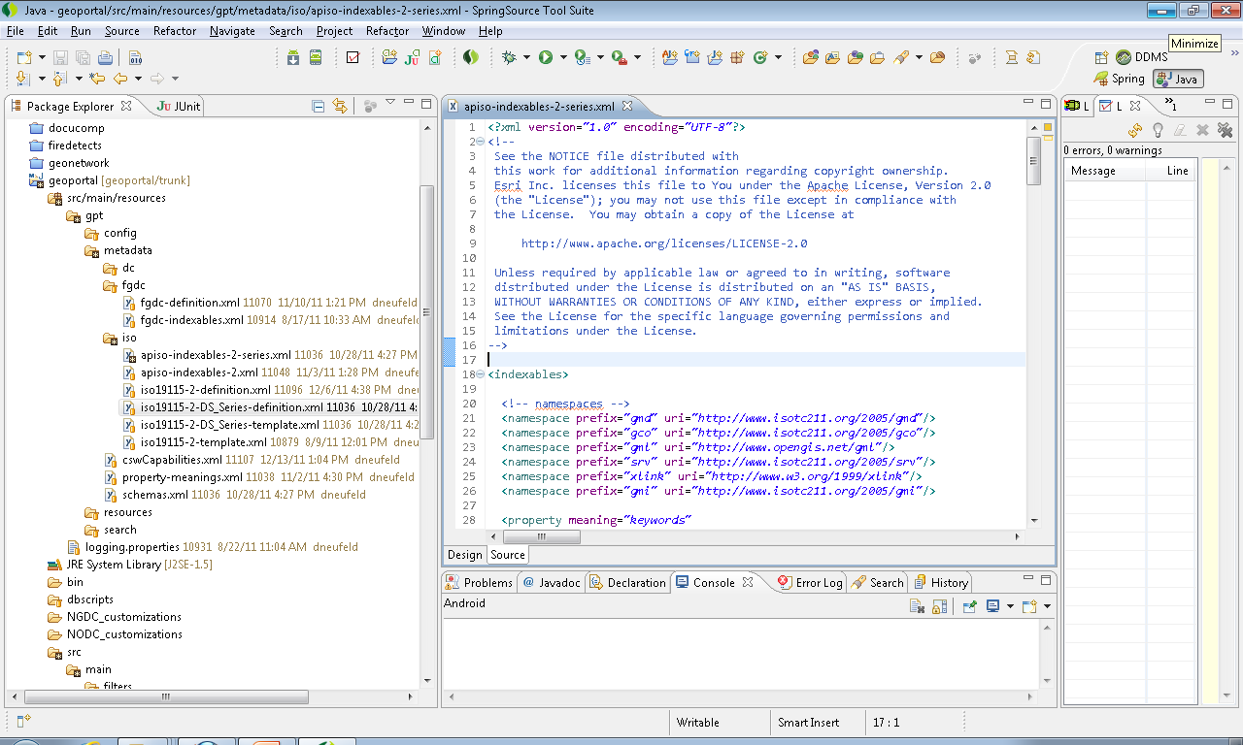
DS_Series – (indexables/definition xml)
Network/Collection Level Metadata

Slide 10
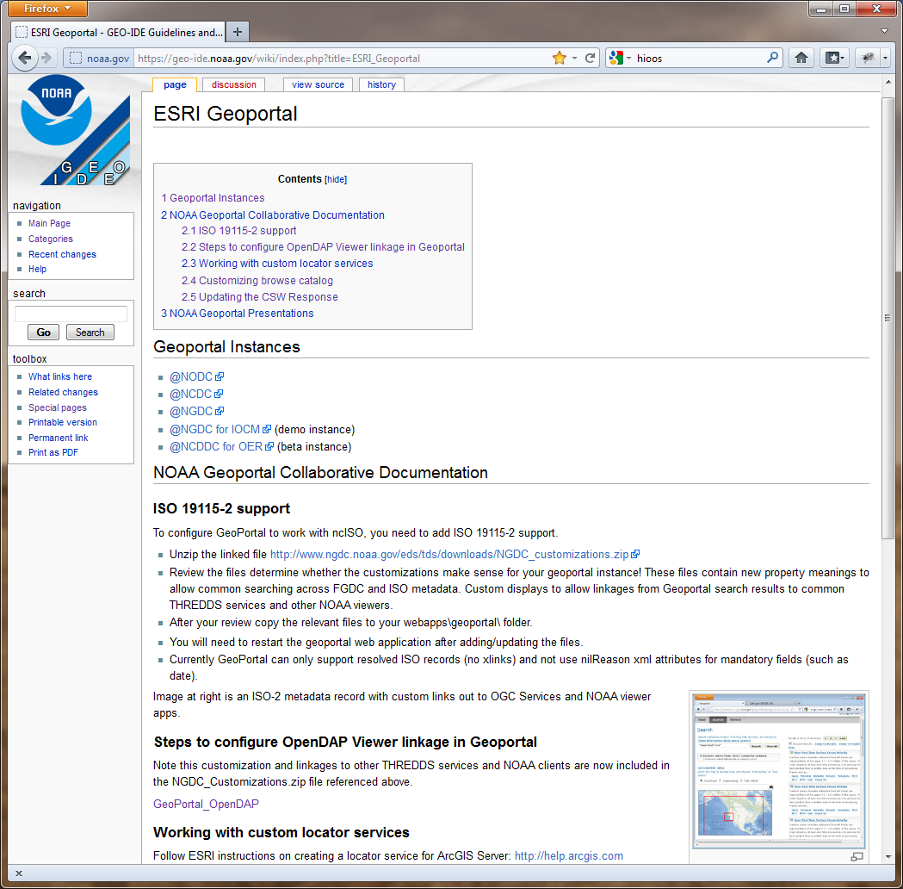
Collaboration
http://geo-ide.noaa.gov/wiki/
Information sharing
with NODC speed
deployment process
Working with ESRI/USGS
on ISO-2 and THREDDs
GEO-IDE wiki to share
Progress
Improved locator services
Google code base

Slide 11
Next steps
Collaborate with OOI for ocean ontology services
Continue work with ESRI on improved THREDDs
harvesting
Integrating metadata tag clouds
Focus on lineage and sensor metadata

Slide 12
Questions / Demo

