Slide 1
Deploying Federal Geospatial Services in the Cloud:
Federal Geographic Data Committee (FGDC) and the GeoCloud Sandbox Initiative
Doug Nebert
USGS/FGDC
June 18, 2012 - ESIP
Draft – For Official Use Only
Notes:
Abstract:
Platform as a Service (PaaS) enables cloud savings and benefits for a large pool of existing applications as well as new development. Our presentation will show a layered architectural framework to understand the fundamental dimensions and components of Geospatial PaaS, including the key distinction between user and provider-composed platforms. We feature a case study based on a multiagency Geospatial Community Platform as a framework to present critical issues and techniques for platform construction and multi-tier platform management in a secure environment.

Slide 2
Background on GeoCloud Sandbox Initiative
Initiated as an Architecture and Technology Working Group activity in December 2009 with a call to federal agencies to nominate geospatial applications for testing in the Cloud environment for a one-year prototyping process coordinated by FGDC and GSA
Eleven projects have been nominated by federal agencies as existing projects with existing software suites to be deployed in commercial- or government-hosted Cloud environments
Two deployment environments (platforms) were abstracted from the nominated projects: Open source service stack on Linux64 and a Commercial service stack on Windows 2008 Server

Slide 3
Deploying Federal Geospatial Services in the Cloud GeoCloud Goals and Activities
Year-long project cycles to incubate and monitor externally-hosted Cloud data and service solutions for the geospatial domain, to support the Geospatial Platform activity
Activities, Outcomes
Acquire, compose, document, and deploy reference platform cloud that support Geospatial Platform standards
Monitor costs, loads, issues and options in support of OMB IT project document guidance
Certify Geospatial Solution Packages to facilitate re-use
Document Best Practices and guides to agencies on adoption of geospatial Cloud infrastructure

Slide 4
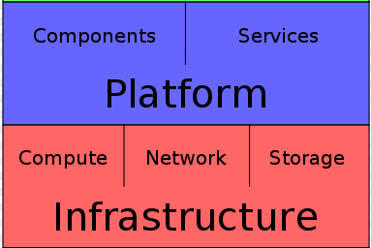
Platform as a Service (PaaS)
“A cloud platform (PaaS) delivers a computing platform and/or solution stack as a service, generally consuming cloud infrastructure and supporting cloud applications. It facilitates deployment of applications without the cost and complexity of buying and managing the underlying hardware and software layers.”*
The GeoCloud is piloting the deployment of candidate services via geospatial solution architectures (suites of software) by composing reference platforms on top of secure IaaS to provide common geospatial capabilities.
(PaaS)
(IaaS)
* http://en.wikipedia.org/wiki/Cloud_computing

Slide 5
Platform as a Service
Geospatial Platform agency data services for OMB Circular A-16 (Nationally Significant Data Sets) are predicated on high-availability Web services providing query-level access into terabyte to petabyte geospatial databases
Platform (PaaS) complements other types of data hosting in the Cloud environment by providing Web services for standardized data access and processing
Part of the Geospatial Platform that will facilitate geospatial data lifecycle management and agile publishing

Slide 6
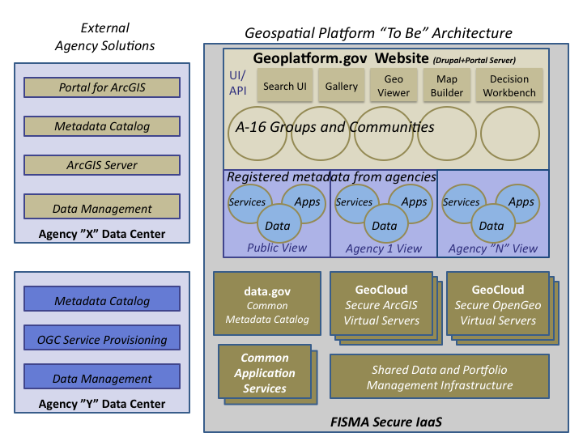

Slide 7
Platform as a Service Architectural Framework Distinguishing Application, Platform and Infrastructure
Application Servers: Provide the deployment environment for actual business applications with access to enablers, frameworks and runtimes, including interfaces and payload standards endorsed by the FGDC.
Applications
10 identified GeoSpatial Applications + more agency apps…
Platform as
a Service
(PaaS)
Platform Enablers: Platform enablers provide core supporting capabilities for developing , testing and deploying code, including DBMS, Directory, Queue, Service Bus, etc. A relational database is the most common enabler example but is not present in all platforms
Platform
Application Servers
Platform Enablers (DB’s, etc)
App Frameworks / Libraries
Frameworks provide bundled access to common behaviors and services, which applications can rely upon.
Libraries are reusable code modules which can be called directly from an application.
Frameworks and Libraries save time and expense freeing developers from having to build common code and behaviors.
Runtime Systems
Infrastructure
(IaaS)
Operating System
Virtual Machines / CPU
Runtimes: provide the execution support for developing and running the code. Examples include Java, Python, Microsoft Common Language Runtime, etc.
Storage
DRAFT - GSA OCIO INTERNAL USE ONLY
Notes:
Focus on the large chunks of functionality in PaaS
App Servers: that provide key services to applications. Like JEE and .NET, PHP
Enablers: Like air. The crucial invisible service glue that give apps the Platform Environment that they need
Libs that you call, and frameworks that call your app and provide core services
Runtimes that enable code to operate in the operating system

Slide 8
GeoCloud Sandbox The Basics
The sandbox is a shared Amazon AWS account with access to:
Common platform images and artifacts
A common provisioning mechanism for launching applications on platforms
Projects load data and customize interfaces on existing Geospatial Cloud Platforms. There is a preference for Cloud-enabling pre-existing Web solutions.
Platform images are periodically updated and enhanced by the community
After a platform update, projects re-test their provisioning in sandbox
Once tested, projects re-launch on the new platform
After sandbox, projects operate in a project-specific account
At the end of the year, projects take over the funding of their account using Departmental or government-wide Cloud acquisition mechanisms

Slide 9
Overview GeoCloud Platform Description
Single centrally maintained platform on Amazon AWS Infrastructure
OpenSource (OSS) based on CentOS, in full operation, Secure AMI from Census. In 2012, adding OSGeo Geospatial application server suite.
ArcGIS based on Windows 2008 R2 with local security policies, in process (Versions 10.0 and 10.1)
“Born anew” with every launch
Provisioning mechanism
Each platform launch has a persistent (EBS) volume that is specific to each project, not the platform
The persistent volume must contain all data and customizations, including Esri software license (from each project)
The persistent volume survives platform (software) changes

Slide 10
GeoCloud-II Instance Architecture
Geospatial App Server
Persistent Volume
ArcGIS
Server,
SQLServer,
Script envt.
Win 2008 R2.
Data Storage
(Virtual
Hard Disk)
Mounted Project-specific
Data, configuration files,
Elastic Block Store (EBS),
could host files behind DB
mounts
GIS Server,
Web Services,
Software,
64-bit Operating
System, on EC2
OR
OpenGeo
Server,
PostgreSQL,
Script envt.
CentOS 5.X
Other
System Image,
incl OS
(Optional)
accesses
Amazon Machine Image of other apps
(Oracle, GeoNode, etc.)_
or clone of secure system
from agency
Each of these boxes represents a Virtual Machine
A typical project will use two instances – one for software (non-persistent), one for data

Slide 11
GeoCloud-II Kick-Off
Selected ten+ projects that will be deploying either ArcGIS Server or OpenGeo Suite using secure Amazon Web Services in partnership with HHS and eGlobalTech
Focus this year is on deployment of common software ‘platforms’ for shared security certification and Web Services for geospatial data to be registered with the Geospatial Platform

Slide 12
GeoCloud Projects, 2012
Inland Electronic Navigation Chart (IENC) data set (USACE)
Wildlife Data and Mapping, Joint Services (FWS/USGS)
Civil Applications Center Global Fiducials (USGS)
GeoMine Project (OSM)
GeoNode (NOAA)
General Land Office Proposal (BLM)
Arctic SDI (USGS)
Web-Based Vector Feature Editing of the NHD (USGS)
School District Demographic Data System (Dept of Education)
Administrative Forest Boundary Data (USDA USFS)
Farm Service Agency Imagery - NAIP (USDA FSA)
TIGERWeb (Census)
StreamStats (USGS)

Slide 13
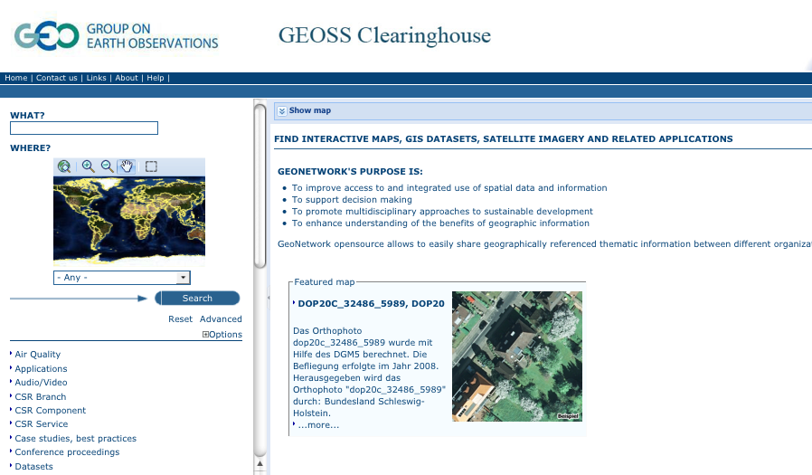

Slide 14
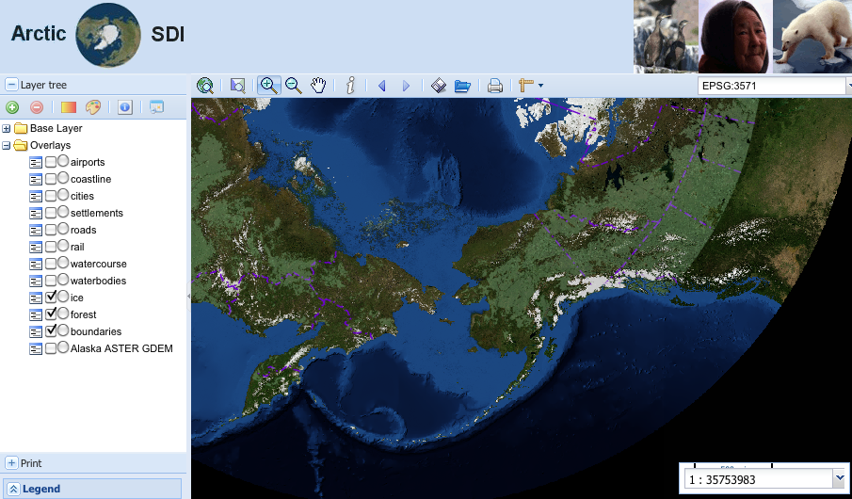

Slide 15
