Slide 1
Actualizing an Effective, Sustainable Science Data Infrastructure
Session on Sustaining Data Centers
for Sustainable Research
Anne Wilson¹, Robert R. Downs², Peter Fox³, W. Christopher Lenhardt⁴, William Michener⁵, Hampapuram Ramapriyan⁶, Erin Robinson⁷
SciDataCon 2014, New Dehli
November 4, 2014
¹Laboratory for Atmospheric and Space Physics, 1234 Innovation Drive, Boulder, CO, 80303, USA.
²Center for International Earth Science Information Network, Columbia University, Palisades, New York.
³Renssalaer Polytechnic Institute, Troy, NY, USA.
⁴Renaissance Computing Institute, UNC Chapel Hill, NC, USA.
⁵University of New Mexico, Albuquerque, NM, USA.
⁶NASA Goddard Space Flight Center, Greenbelt, MD, USA.
⁷Foundation for Earth Science, Boulder, CO, USA.
Email: anne.wilson@lasp.colorado.edu
Notes:
I manage a data center that provides solar irradiance data…
When SORCE ends, I’ll go begging…
But that is not topic of my tlak
I’m here to represent ESIP.

Slide 2
Contents
Introduction to ESIP
The Problem
Introduction to U.S. scientific institutions
National Academy of Sciences (NAS)
National Research Council (NRC)
Board on Research Data and Information (BRDI)
Towards solutions: A overarching study and guiding plan for research data

Slide 3
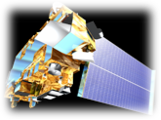
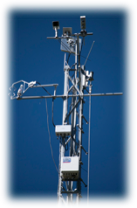
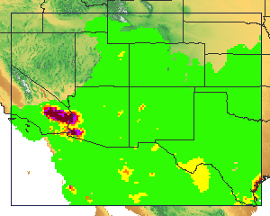
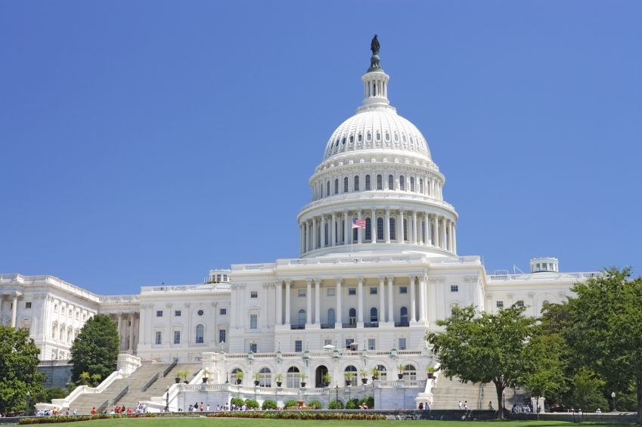
ESIP Vision
Introduction to ESIP
The Federation of Earth Science Information Partners
To be a community of leaders promoting the collection, stewardship and use of Earth science data, information and knowledge that is responsive to societal needs.
Notes:
Motto: Makng data matter

Slide 4
ESIP Community
Multiple Science Domains
Data Providers
Cross-Agency
Users
Data Archives
Application
Developers
Tool & System
Developers
Academia
Corporate
Notes:
Benefits of Engaging with Community:
Enhance staff knowledge through peer knowledge exchange
Take away new technologies
Identify new collaborations
Leverage scarce resources through reuse, repurpose
Help define community best practices

Slide 5
ESIP Core Values
Agility
Collaborative
Collegial
Community-driven
Innovative
Neutral
Open
Participatory
Voluntary

Slide 6
Membership count
Type I: data centers (23)
NASA DAACs
NOAA (NGDC, NODC, NCDC)
Type II: researchers and tool developers (72)
Academia
Government labs
Type III: application developers (61)
Commercial
Nonprofit
Educational
Type IV: strategic partners (2)
NASA
NOAA
Not just U.S. - International membership is growing fast!
Completely free to participate or contribute!

Slide 7
Collaboration Area Structure
Clusters
Working
Groups
Committees
Least
Formality
Most
A bottom up, grassroots organization
Notes:
To form a cluster: send the VP an email

Slide 8
ESIP Groups
Standing Committees
Data Stewardship
Education
Information Technology and Interoperability
Products and Services
Administrative Committees
Constitution and Bylaws
Finance and Appropriations
Partnership
Working groups
Data Study
Air Quality
Climate Education
Energy & Climate
Visioneers
Clusters
Cloud Computing
Decisions
Discovery
Documentation
Drupal
Earth Science Collaboratory
Geospatial
Open Source
Semantic Web
Visualization
Student Fellows

Slide 9
Things ESIP Does
Community-generated Best Practices (e.g. Citation)
Testbed (e.g. Identifiers, Ontology)
Community Conventions (e.g. Discovery)
Professional Development
Technical Workshops
Non-technical Workshops (e.g. Evaluation, Communication)
Data Management Short Course/Workshops
Outreach
Education (e.g. annual teacher workshop on climate change)
Professional Societies (e.g. AGU, GSA)
International Efforts (e.g. GEO, ISRSE)
Provide Venue for Collaboration and Connections
Both virtual and in-person
Support with suite of collaboration tools
Provide mini-grants to make stuff happen
Notes:
Testbed activities:
Digital Identifiers Evaluation
Deploy a Testbed Portal
Esri Geoportal Server: Discovery Services and Clients: Interoperability Testing, Advertisement, and Assessment of Data to Service Broker
A Classification and Annotation Scheme for Data and Service Quality
Drupal Metadata Editing Tool Suite
Data Stewardship: Metadata and Identifier Mapping
ESIP Ontologies in the Cloud: Semantic Web Focus
ESIP DOES not build infrastructure – it enables other to leverage the work across the community to build better infrastructure

Slide 10
Save the Date – ESIP Winter Meeting!
When: January 6-8, 2015
Where: Renaissance Dupont Circle, Washington, D.C.
Theme: Earth Science and Data in Support of Food Resilience: Climate, Energy, Water Nexus
Details: http://commons.esipfed.org/2015WinterMeeting
Early Registration ends December 15, 2014

Slide 11
Data Study Working Group
Cluster formed January 2013
Became a Working Group Fall 2013
Goal: a unified vision and plan for research data

Slide 12
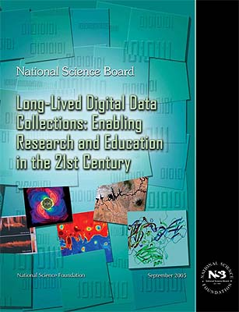
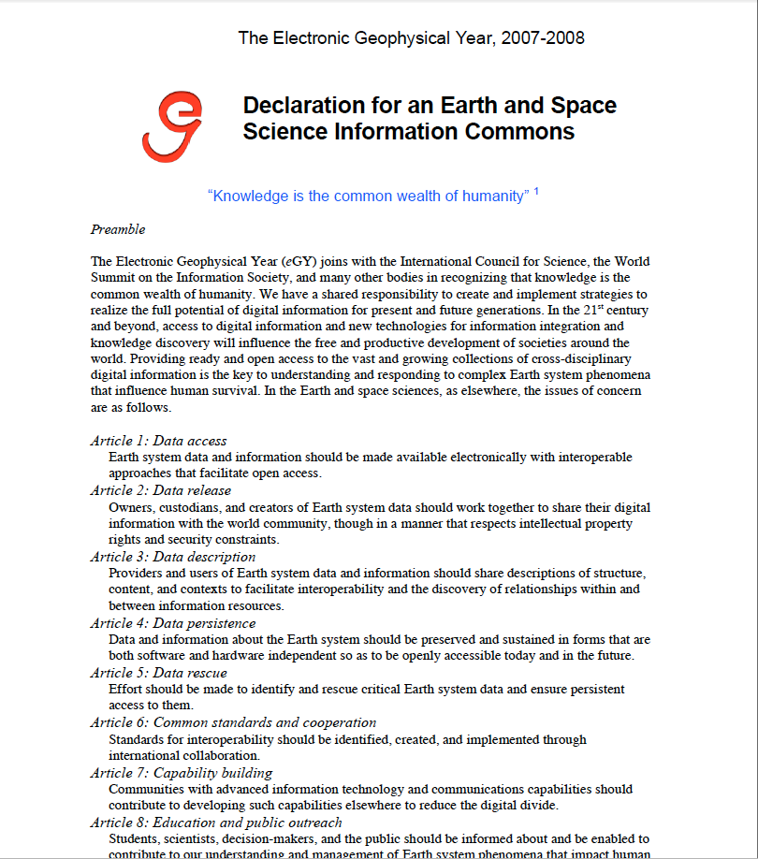
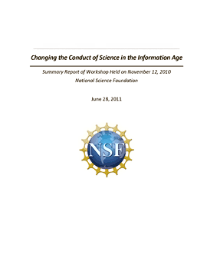
National Research Council. Geoscience Data and Collections: National Resources in Peril. Washington, DC: The National Academies Press, 2002
We’ve been talking about ‘the data problem’ for years!
"Priority Area Assessment on Scientific Data and Information", International Council for Science, 2004
NSB Report: “Long-lived Data Collections: Enabling Research and Education in the 21st Century,” Sept 2005
“We have a shared responsibility to create and implement strategies to realize the full potential of digital information for present and future generations.” –eGY Declaration, 2007
"Report from the ad hoc Strategic Committee on Information and Data", International Council for Science, June 2008
“Sustainable economics for a digital planet: Ensuring long term access to digital information”, The Blue Ribbon Task Force on Sustainable Digital Preservation and Access, 2010
"Harnessing the Power of Digital Data for Science and Society", Report of the Interagency Working Group on Digital Data to the Committee on Science of the National Science and Technology Council, January 2009
NSF: “Changing the Conduct of Science in the Information Age” 2011
"Harnessing the Power of Digital Data: Taking the Next Step", Scientific Data Management (SDM) for Government Agencies: Report from the Workshop to Improve SDM, July 2010
"Report of the Ad-hoc Strategic Coordinating Committee on Information and Data (SCCID Report)", International Council for Science, April 2011
Notes:
Much brain power, ink, electrons

Slide 13
We’re working on it:
Current Declarations, Efforts, and Reports
●The Blue Ribbon Task Force on Sustainable Digital Preservation and Access
●Data.gov
●EarthCube
ESIP
eGy Declaration
●National Research Council
●NASA’s Earth Science Data System Working Groups
●National Consortium for Data Science
NOAA’s Environmental Data Management Committee
●OSTP declaration
Research Data Alliance
●DataNet and its funded projects, such as DataONE and Terra Populus
CODATA
World Data System
and others!

Slide 14
With all this effort, why are we here?
Why are we worried?
Notes:
So, what’s the problem?

Slide 15
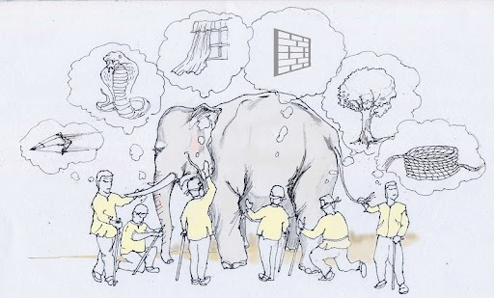
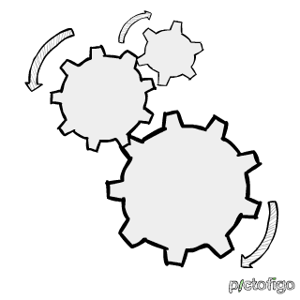
Stakeholders in the Science Data Enterprise
Scientific
Technical
Organizational/Institutional
Economic/financial
Policy/legal
Socio-cultural
Publishing
Information science
Library science
Range of stakeholders is very broad, but groups and organizations are addressing the problems piecemeal and from limited perspectives, which can negatively impact coherence and effectiveness.
Notes:
Start using term SDE
Stakeholders from many arenas also care: legal, etc...
Extremely difficult to work across these stakeholder boundaries.
Duplicative, non-aligned efforts.

Slide 16
No Sustainable Economic Model
“There is no general agreement, however, about who is responsible and who should pay for the access to, preservation of, valuable present and future digital information. Creating sustainable economic models for digital access and preservation is a major challenge for all all sectors, ...”
[Blue Ribbon Task Force on Sustainable Digital Preservation and Access Interim Report, 2008]
Agencies are being asked to do more and better data management with less funding.
Notes:
Today funding issues are arguably worse than in 2008.

Slide 17
The needs are greater than the scope of any single agency or organization
Agencies are not tasked to address
Inconsistent, short term funding
Cross organizational infrastructure: e.g. “Establish federally funded platforms for data and code sharing that are independent of institutions and individual researchers” [CCSIA]
“Develop pilot projects that compare different technical solutions for developing and maintaining open data platforms, fostering the replication of research, and ensuring attribution for intellectual contributions.” [CCSIA]

Slide 18
Agencies are not tasked to address (continued):
“Develop an Open Research License (ORL) to resolve conflicts between reproducibility and copyright law [CCSIA]
“Confusion, lack of alignment between stakeholders, roles, and responsibilities” [BRTF]
Uneven appreciation of issues, goals: “the urgency of the matter is not uniformly appreciated” [BRTF]
Creation of a system of persistent ids for both researchers and their outputs, usable by publishers. “This involves creating taxonomies of data and other entities, incentives for changing, …the development, implementation, and use of standardized identification systems to facilitate attribution by requiring system registration as a prerequisite for agency funding.” [CCSIA]
Connecting data to publications
The role of the private sector
Inadequate incentives
The issue of attribution and reward for data
Workforce training
“The fear that it’s all too big to take on.” [BRTF]

Slide 19
Technology is changing science and producing more data faster than we are responding.

Slide 20
The National Academies of Science
Provide advice to the United States on science, engineering, and medicine
Non-profit, private, not part of U.S. government
Comprised of four academies
National Academy of Science (NAS)
Created by law signed by Lincoln in 1863 to provide independent advice on scientific matters
1916 established National Research Council (NRC)
1964 established National Academy of Engineering (NAE)
1970 established Institute of Medicine (IOM)

Slide 21
The National Research Council
and its Studies
The NRC is the “operating arm” of the National Academies of Science
“Each year, more than 6,000 experts, including members of the National Academy of Sciences, the National Academy of Engineering, and the Institute of Medicine, volunteer their time to serve on hundreds of NRC and IOM study committees that examine some of society's most pressing issues.”
“The reports that result from their efforts frequently form the basis of public policy for decades to come. In addition, members of standing committees and roundtables provide ongoing advice and guidance on a range of issues.”
Input is provided by the community.
These reports can have major impact.
Notes:
Volunteers give time, community provides input.
E.g. heliophysics decadal survey steers heliophysics community for 10 years.

Slide 22
Spearheading an NRC Data Study
Working in partnership with the community, the NRC BRDI, and with support from the Moore Foundation and the National Consortium for Data Science, ESIP is leading efforts to define and scope an NRC data study to provide a consensus view on research priorities for the science data enterprise
Under Policy and Global Affairs, rather than one of the science Boards
ESIP is cross agency, community-led, neutral
Study initiation is a community-led effort
Organizations, agencies would fund the study
Notes:
1) ESIP: “Making data matter.” Cross agency, ...
2) NRC reports examine some of society's most pressing issues.
Independent, authoritative reports frequently form the basis of public policy for decades to come.
Under NRC division on Policy and Global Affairs is the BRDI (not tied to a science board, which tend to be domain specific)
3) Data study effort
Orgs would use study results in planning, prioritizing, and execution of their mission.

Slide 23
Data Study Working Group Activities to Date
Fall 2013 presentation to NRC BRDI
January, 2014 workshop:
Press release: http://esipfed.org/node/2638
Workshop report: http://commons.esipfed.org/node/2635
American Geophysical Union (AGU) EOS article to appear before Fall meeting (December)
Provide input to NITRD Big Data Initiative

Slide 24
Workshop Conclusions
Vision: A Science Data Infrastructure (SDI)
Ubiquitous, reliable, easy to use system for publishing, finding, understanding, using, and accrediting scientific data, including all relevant management and stewardship aspects throughout the data lifecycle
Identified five major challenge areas
Economics of research data
Cultural values and awareness
Data science research, goals
Education Challenges
Legal, ethical and policy challenges

Slide 25
Economics of Research Data
The top challenge: Develop an economic model for sustained infrastructure without competing for research dollars
Treat as infrastructure, like highway or utility?
Interest in economic models, cost models, and return on investment of research data is growing
Efforts to measure impact and generative potential
JISC report: qualitative and quantitative analysis
“A very significant increase in research efficiency was reported by users as a result of their using the data centres. These estimated efficiency gains ranged from 2 and up to 20 times the costs…”
[Jisc 2014] The Value and Impact of Data Sharing and Curation, A synthesis of three recent studies of UK research data centres”, March 2014, http://repository.jisc.ac.uk/5568/1/iDF308_-_Digital_Infrastructure_Dire....

Slide 26
Cultural Values and Awareness
New academic values must be set for data management and stewardship
Cultural incentive and reward structures do not reflect the importance of quality data management
E.g., attribution, rewards for producing, managing data
Attractive, rewarding career paths must be established for system builders in science
Data stewardship must be integrated into ways that science is taught

Slide 27
Data Science Research, Goals
What information, best practices, and tools are needed along the stages of the data lifecycle?
How to measure the value and impact of a data set?
How to identify which data sets to throw away? Which to keep? For how long? At what cost? At what resolution? In what format?
What information about the data should be kept and for how long?
What attribution, provenance tracking, citation and curation tools and practices are needed and at what points in the data lifecycle?
What new practices and tools are need to be developed? How can they be infused?
What cultural and social changes are needed?
How to facilitate future access to current data?
Is there a set of essential SDI components or functionality that can be identified?
Is there a fundamental common data model that could aid in data interoperability and fusion? Is there a mathematics of data?
Notes:
Not just scientific questions, but social, cultural, …

Slide 28
Education Challenges
Technology, eScience is changing the nature of science
Development of current and next-generation workers
Access to science data in classrooms, including K-12
Providing data to educators in ways they can use easily

Slide 29
Legal, Ethical, and Policy Challenges
Licensing
Transparency, verifiability, repeatability
Ethical use of data
Establishment of an agency, council, or office?

Slide 30
Identification of Stakeholders
Data Lifecycle
Consumers or end-users
Long-term curators
Data Providers
Data Producers/Analyzers - Data Scientist/Informaticist
Social Scientist
Data Infrastructure
Economic Sector
IT Industry (for and not-for profit)
University Operations
Education (K-20)
Government Funders and Advisors
Foundation Funders
Science Policy
Adjacent Organizations
Data-related Collaborative Initiatives
Professional Societies and Publishers

Slide 31
What a NRC Data Study Could Accomplish
Overarching, independent, authoritative, expert-derived scientific advice from the highest U.S. authority
Establishment of an economic model
Integration of disparate experience: What lessons have we learned already? What can we learn from libraries and publication efforts? What can we learn from domain-specific successes? [CCSIA]
Planning that spans Administrations and Congressional turnover
Influence, the possibility to impact public policy, including Congress, who controls the purse
Long term visioning for future technological changes, trends
Advice on social constructs: What incentives are necessary to engage scientists in making data accessible and shared? What are the appropriate business models necessary to promote connecting publications to data? How might the private sector be engaged? What are the social barriers to adopting and using [unique identifiers for researchers]? [CCSIA]
Guiding principles and approaches that can help inform organizations that fund research, scientific research organizations, and publishing houses. [CCSIA]
Notes:
Focus not on science, but on research/scientific data per se
Independent, authoritative, overarching
Long term horizon, spanning Administrations, Congress, technological trends
Include the private sector
Could be ongoing, consistent
Note: review existing reports – what worked, what didn’t and why not?

Slide 32
What a NRC Data Study Could Accomplish
(cont)
Advice on technical constructs: what are the most important digital technologies that could be used to facilitate data and knowledge access? To what extent is progress already being made and how can progress be accelerated? [CCSIA]
A coherent vision across all stakeholder roles
Inclusion of the private sector: What role might the private sector play in bringing about change? [CCSIA]
The possibility for ongoing advice, guidance
[CCSIA] Changing the Conduct of Science in the Information Age, June 2011 [http://www.nsf.gov/pubs/2011/oise11003/index.jsp]
Notes:
IF we don’t know where we’re going, any road will do.

Slide 33
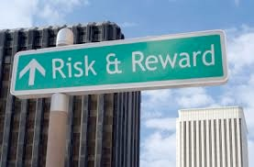
Data Study Risks
Producing a costly, ignored report
Need for sufficient specifics to be useful
Either too broad or too narrow is not helpful
Handling commonalities vs. domain specific needs
Alignment of solutions for U.S. or global network
What scope? Earth science or beyond?

Slide 34
Info
me: anne.wilson@lasp.colorado.edu
ESIP: http://esipfed.org
ESIP wiki: http://wiki.esipfed.org
Thank you to the ESIP Data Study Working Group for assistance and support in this project!
Thank you, LASP, for providing support for this effort!

Slide 35
ESIP Online
Home page
http://esipfed.org
Wiki
http://wiki.esipfed.org
Commons
http://commons.esipfed.org
GitHub
https://github.com/ESIPFed
Facebook
http://tinyurl.com/esip-facebook
Twitter
#esipfed, @ESIPFed, @ESIPPres

Slide 37
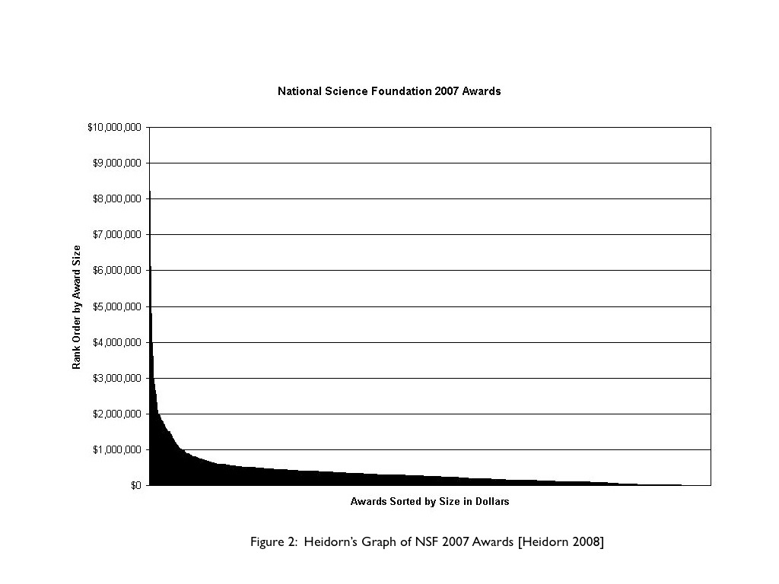
The importance of long tail science, dark data
“The majority of the work being done by scientists is conducted in relatively small projects“
“There may only be a few scientists worldwide that would want to see a particular boutique data set but there are many thousands of these data sets. Access to these data sets can have a very substantial impact on science. It seems likely that transformative science is more likely to come from the tail than the head.”
A parallel can be seen in bibliometrics where high impact articles are not necessarily found in high impact journals (Seglen, 1997; Sun & Giles, 2007).
Questions are generally clear for large-scale projects, while the long tail is a breeding ground for new ideas and never before attempted science.
Improbably, risky projects less like to be funded.
[Heidorn, “Shedding Light on the Dark Data in the Long Tail of Science”, 2008.]

Slide 38
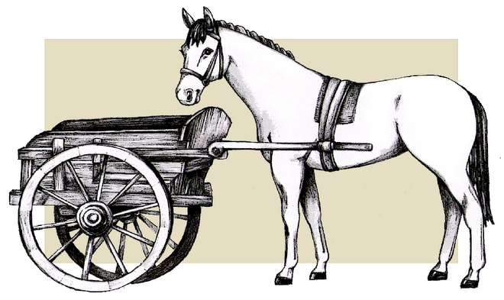
RDA versus a NRC data study
RDA
NRC data study
international
U.S.
Focus: implementation
Focus: planning
short term (12 - 18 month) time frame
long term planning
NSF sponsored
agency independent
evolutionary membership
planned, balanced stakeholder perspectives
1000 flowers != garden
The two efforts seem complementary

Slide 39
Collaboration Area Structure
ESIP Clusters
Agriculture & Climate
Cloud
Decisions
Disasters
Discovery
Documentation
Earth Science Data Analytics
Energy & Climate
Info Quality
Science Software
Semantic Web
Features
Formed by sending VP email
For any reason
Ends when the last person hangs up
Clusters
Formality
Least
Most

Slide 40
Collaboration Area Structure
Features:
Created by Assembly or Committee
Task-oriented
Budget
ESIP Working Groups
Data Study
Drupal
Climate Education
Visioneers
Clusters
Working
Groups
Formality
Least
Most

Slide 41
Collaboration Area Structure
Standing Committees
Data Stewardship
Education
Information Technology and Interoperability
Products and Services
Administrative Committees
Constitution and Bylaws
Finance and Appropriations
Partnership
Features
Chair elected by Assembly
Chair serves on Executive Committee
Budget
Clusters
Working
Groups
Committees
Least
Formality
Most

Slide 42
Potential outcomes of a community study
Identification of stakeholders
Call to action

