Slide 1

Building a Conceptual Model for PM over Hong Kong: A Weight-of-Evidence Approach to Evaluating
Source Apportionment Results
Jay Turner, Varun Yadav
Washington University in St. Louis
Zibing Yuan, Alexis Lau
Hong Kong University of Science and Technology
Peter Louie
Hong Kong Environmental Protection Department
Air Quality Management
December 6-7, 2012
Mumbai, India

Slide 2
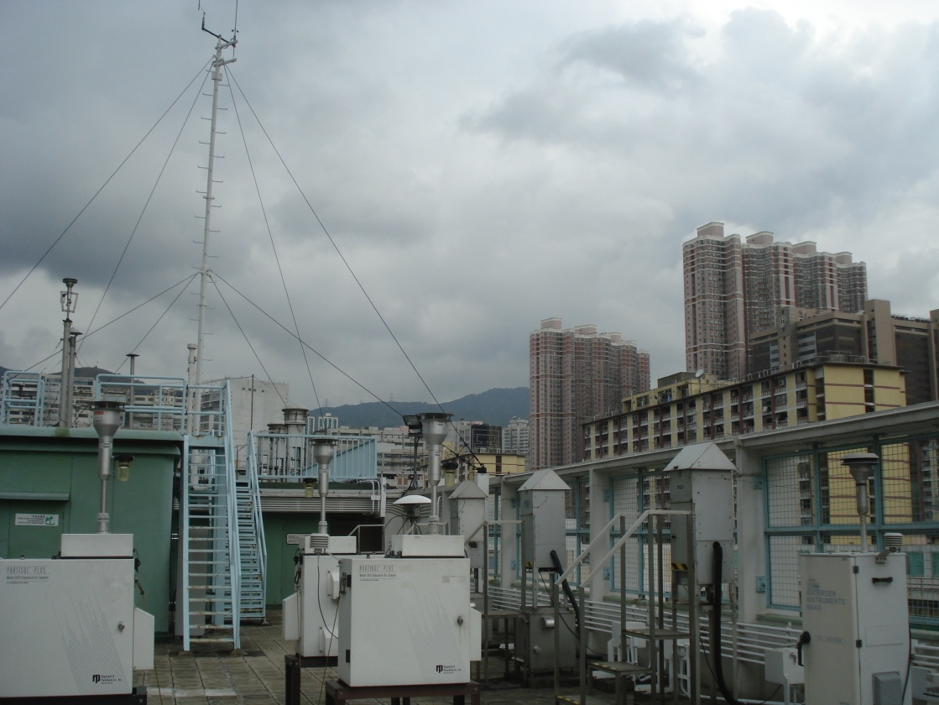
Integrated Data Analysis and Characterization
of Particulate Matter in Hong Kong
Project funded by Hong Kong Environmental Protection Department (HKEPD)
Update PM₁₀ and PM_{2.5} source apportionments for Hong Kong
Develop a conceptual model for ambient PM over Hong Kong

Slide 3
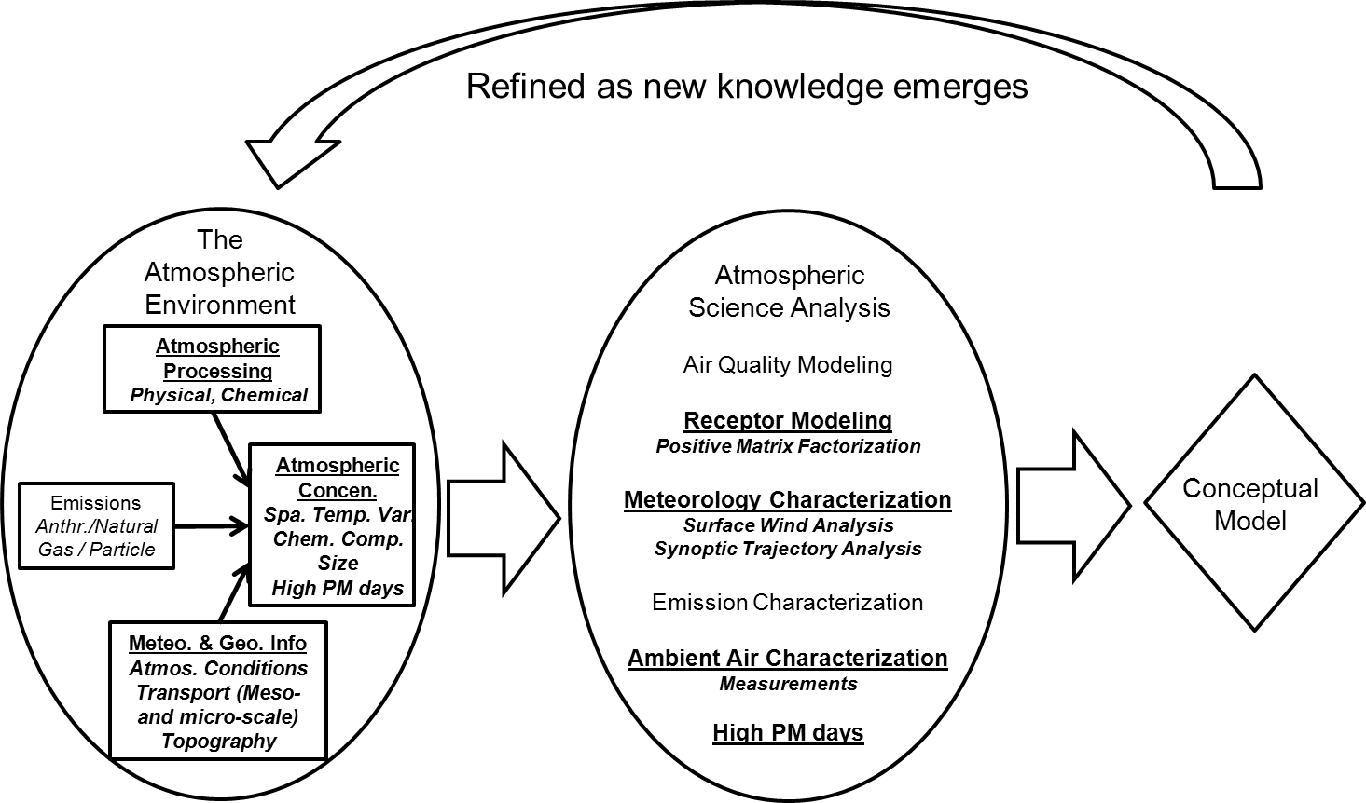
Conceptual Model Framework
underlined = this study

Slide 4
Data Analysis Approach
PM₁₀, PM_{2.5}
(24 hour, speciated)
Air Mass Back
Trajectories
TEOM
(hourly, PM₁₀)
Datasets
Source
Apportionment
Air Mass
Clustering
Baseline-Excess
Approach
Source
Contribution
Estimates
Excess
Concentration
Temporal
Trends
Air Mass based
Temporal
Trends
Local/Regional
Contributions
Total
Mass
Notes:
In addition to conventional source apportionment analysis on filter-based speciated PM10 and PM2.5 mass, additional analysis utilizing the structure of HK TEOM monitoring network were also performed to check the temporal trends over the region. Air mass trajectories were then used to gauge the impact of long-range transport of secondary pollutant

Slide 5
Today’s Presentation
A series of snapshots from the conceptual model development (process-focused)
Examples from the weight-of-evidence used to support the source apportionment

Slide 6
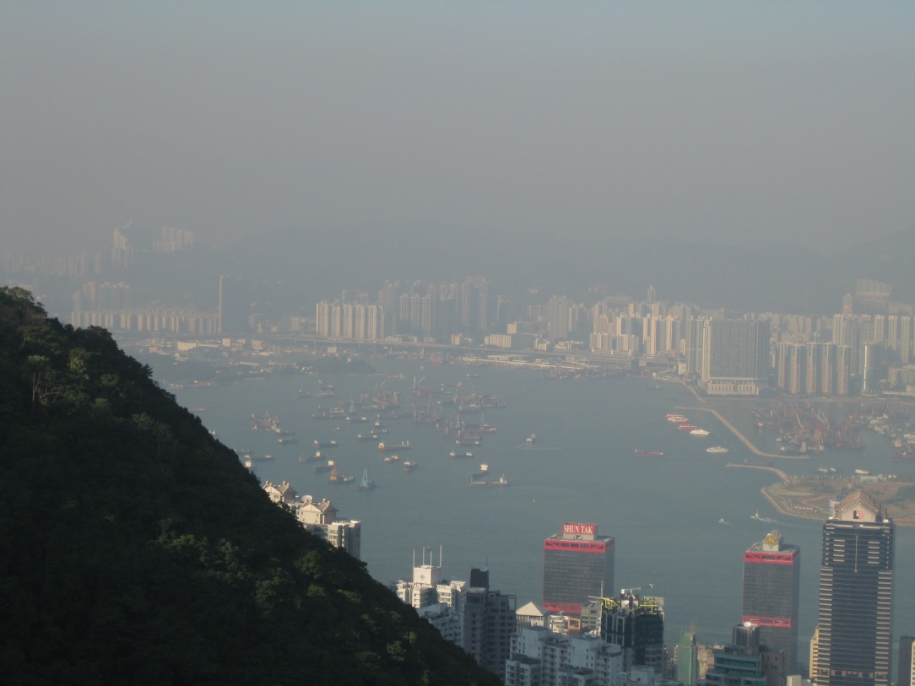
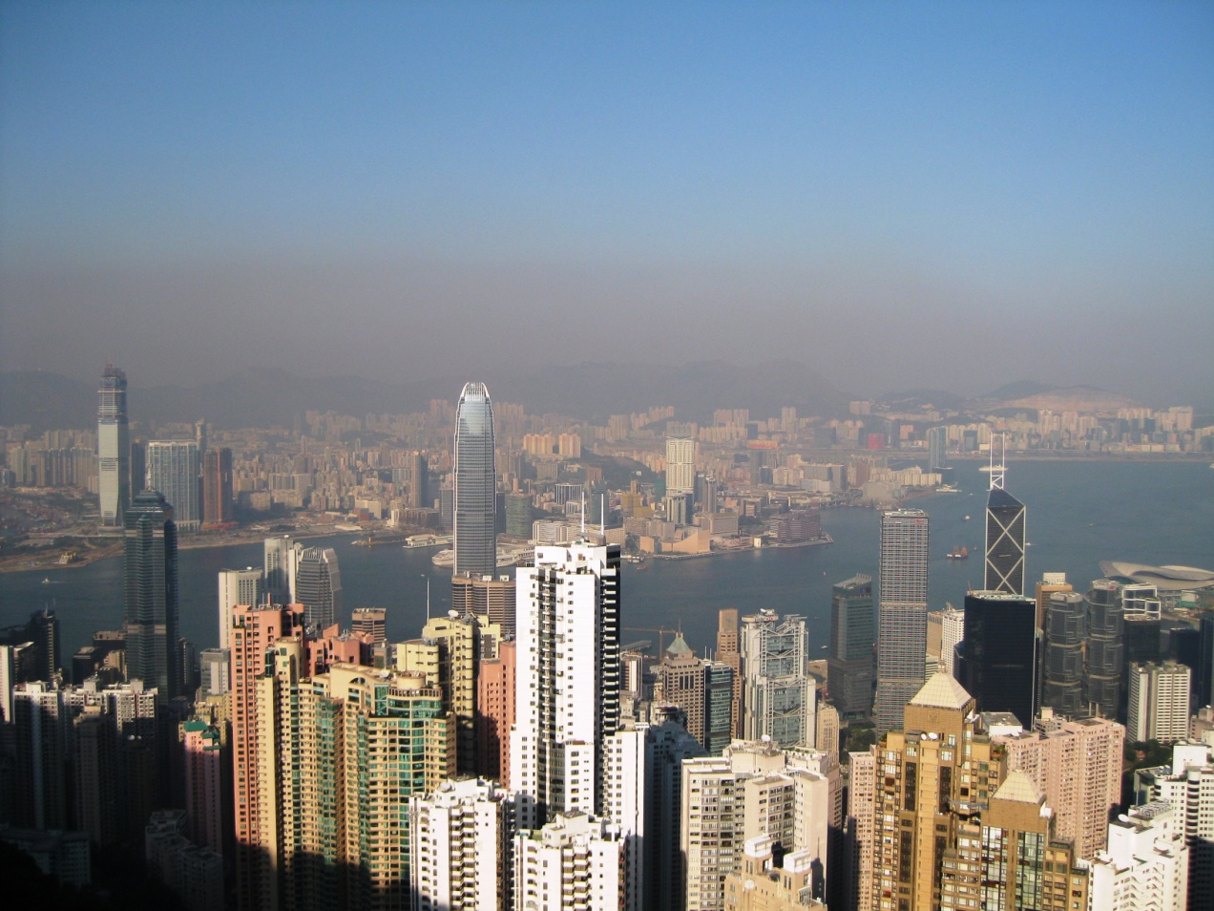

Hong Kong and Haze
January 2012

Slide 7
Hong Kong Air Quality:
Two Metrics for Long-Term Trends
particulate matter mass
hours with poor visibility
Notes:
Now, for a larger spatiotemporal scale, I will discuss the work done for Hong Kong Environmental Protection Dept. In spite of a various regulation placed on vehicle based emissions to improve the air quality over the past decade, the overall PM concentration over HK remained rather consistent as shown by the annual average PM10 mass measured by TEOM. However, the frequency of low visibility, marked with solid black circles, has increased almost three-folds. A simple look at the annual averages of filter based sulfate, shown in yellow, associated with long range transport of pollutant and total carbon, of which EC from vehicles is a significant factor guides us to understand this complex behaviour.

Slide 8
Hong Kong Air Quality – Long Term Trends
Yuan, Lau, Yadav, Turner, and Louie (submitted)
dramatic change in particulate matter composition, 1998-2003
Notes:
Now, for a larger spatiotemporal scale, I will discuss the work done for Hong Kong Environmental Protection Dept. In spite of a various regulation placed on vehicle based emissions to improve the air quality over the past decade, the overall PM concentration over HK remained rather consistent as shown by the annual average PM10 mass measured by TEOM. However, the frequency of low visibility, marked with solid black circles, has increased almost three-folds. A simple look at the annual averages of filter based sulfate, shown in yellow, associated with long range transport of pollutant and total carbon, of which EC from vehicles is a significant factor guides us to understand this complex behaviour.

Slide 9
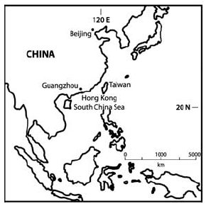
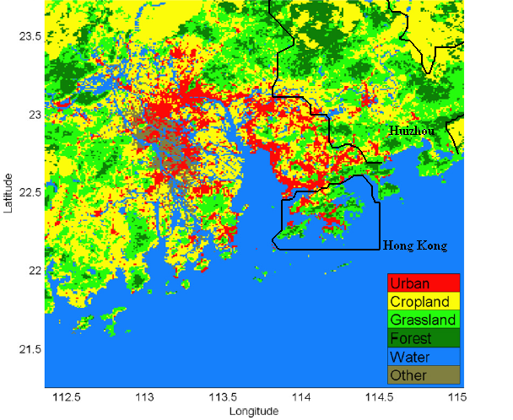
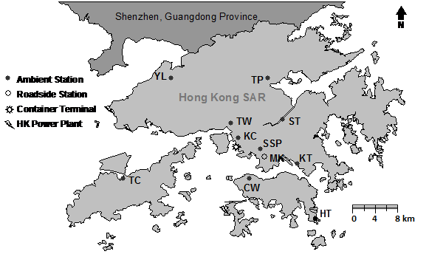
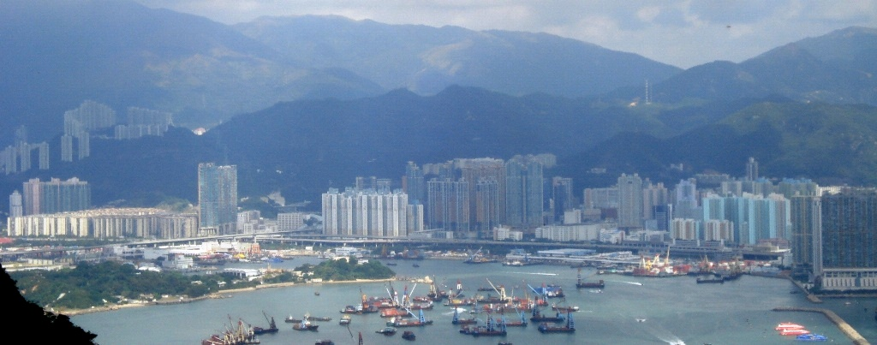
Hong Kong – A Complex Setting
Pearl River Delta (PRD)
Notes:
Hong kong is located along the south-eastern coast of China. Spread over an area of roughly 30km by 40km, hong kong consists of cluster of islands with hilly terrains. HKEPD traditionally defines any source located out side the HK administrative region as regional source, but note that heavily industrialized Pearl River Delta is located just north-west of HK.

Slide 10
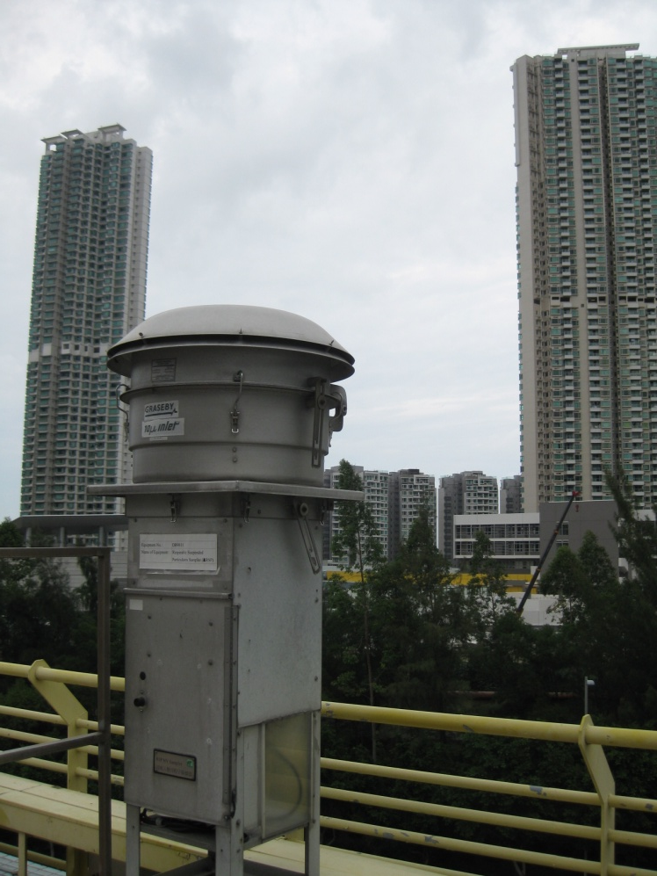
Hong Kong PM₁₀
Speciation Network
Long time series (12+ years)
High volume sampler
  Measurement artifacts for nitrate and organic carbon
1-in-6 day 24-hour integrated samples
  Seven sites routinely operated since 1998 (additional sites for portions of this time period)
Sampling not synchronized across sites
  Can’t assess day-specific spatial variability
  Can construct a daily time series for Hong Kong region, at least for regional scale components

Slide 11
Hong Kong PM₁₀ Speciation Network

Slide 12
Modeling Tools – This Study
Multivariate Factor Analysis Models
  Positive Matrix Factorization (PMF)
  Principal Components Analysis (PCA) with Absolute Principle Components Scores (APCS)
    Absolute Principle Components Analysis (APCA)
  Unmix
Other Multivariate Models
  Chemical Mass Balance (CMB)

Slide 13
Source Apportionment - Steps
data
Collection
Validation
Exploration
modeling
Data Conditioning
Model Execution
assessment
Evaluation
Interpretation

Slide 14
Source Apportionment – This Study
data
Data Quality Assessment
Collection
Validation
Exploration
modeling
Data Conditioning
Model Execution
assessment
Evaluation
Interpretation

Slide 15
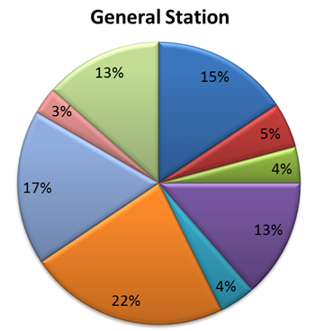
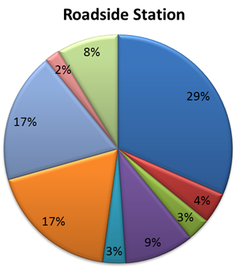
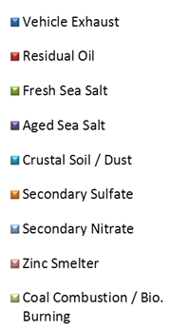
PM₁₀ Source Contribution Percentages
(marine source)
(maybe)
Secondary sulfate factor gives the largest contribution, accounting for 22% of the ambient PM₁₀ in HK.
Contributions from vehicle exhaust, aged sea salt, secondary nitrate, and coal combustion / biomass burning factors are comparable, with each around 15%.
Contributions from residual oil, fresh sea salt, crustal soil, and zinc smelting (trace metals) factors are generally <5%.

Slide 16
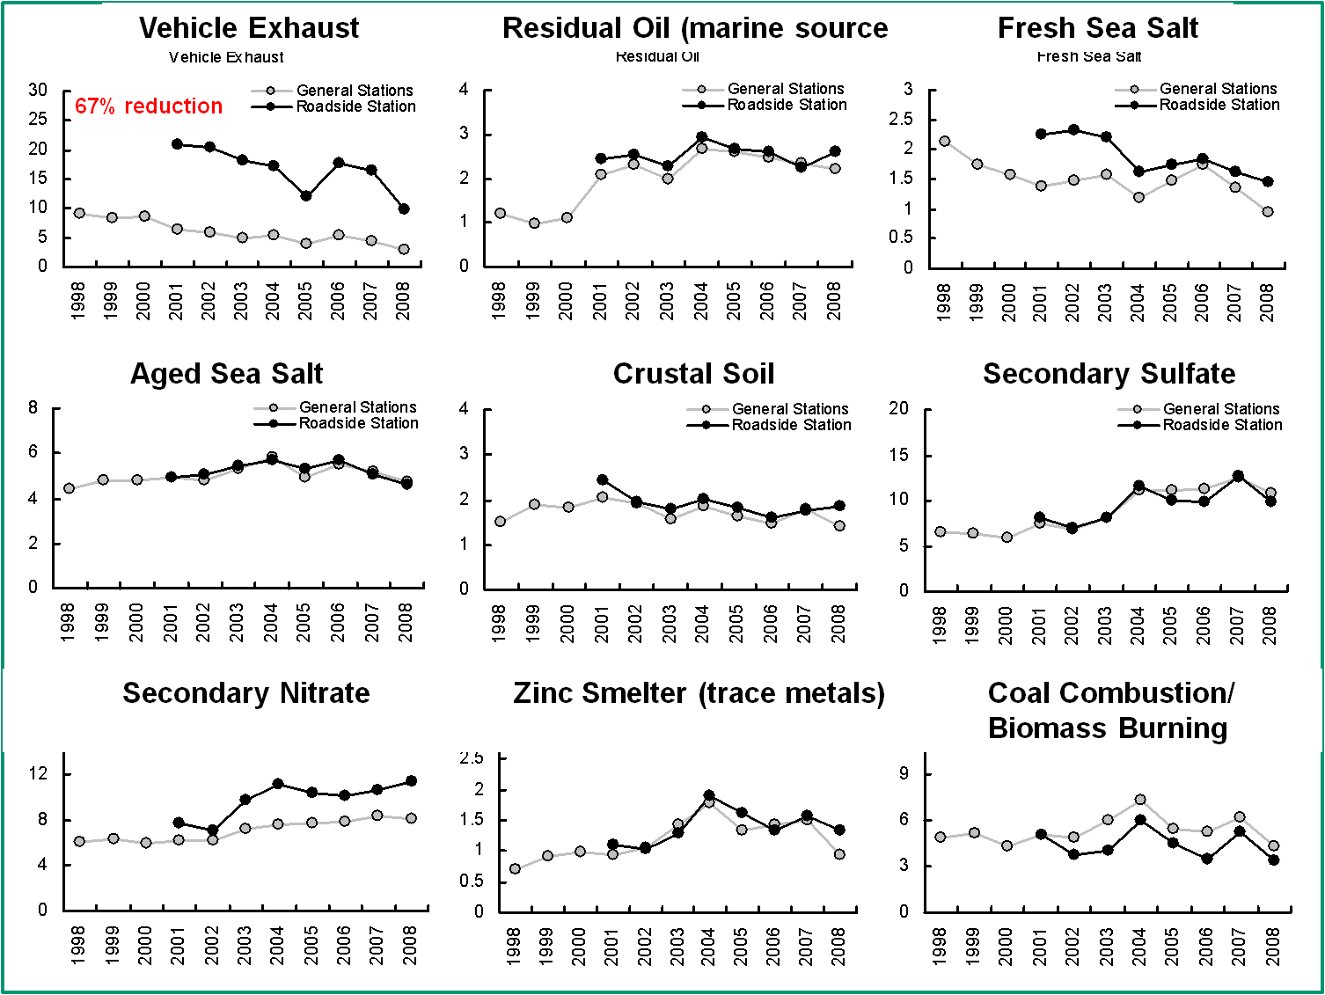
Annual Variation of PM₁₀ Source Contributions (μg/m³)
Roadside and General Stations

Slide 17
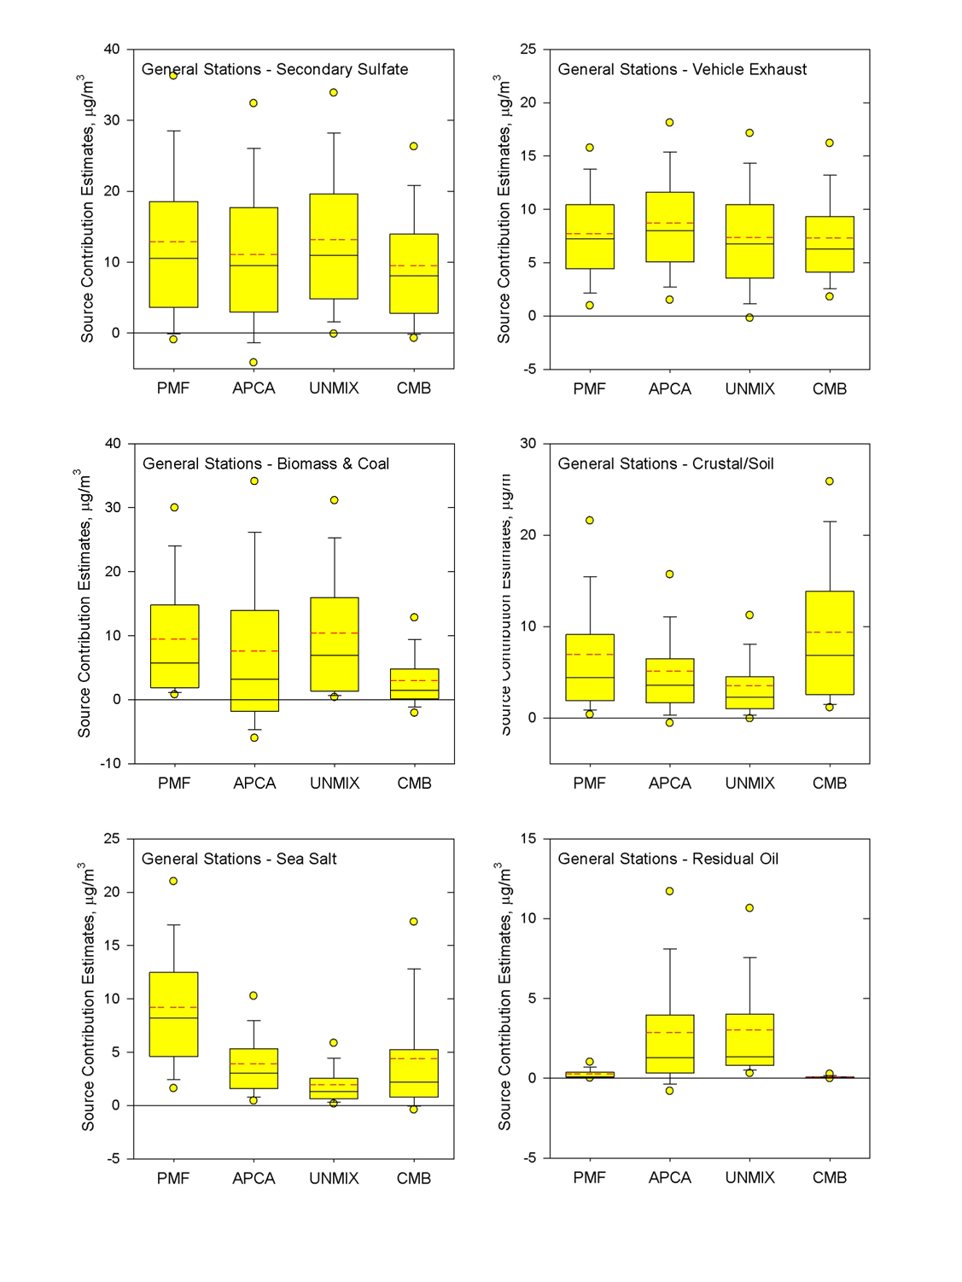
Different Models,
Sometimes
Different Results
We largely understand why, but beyond the scope of this discussion

Slide 18
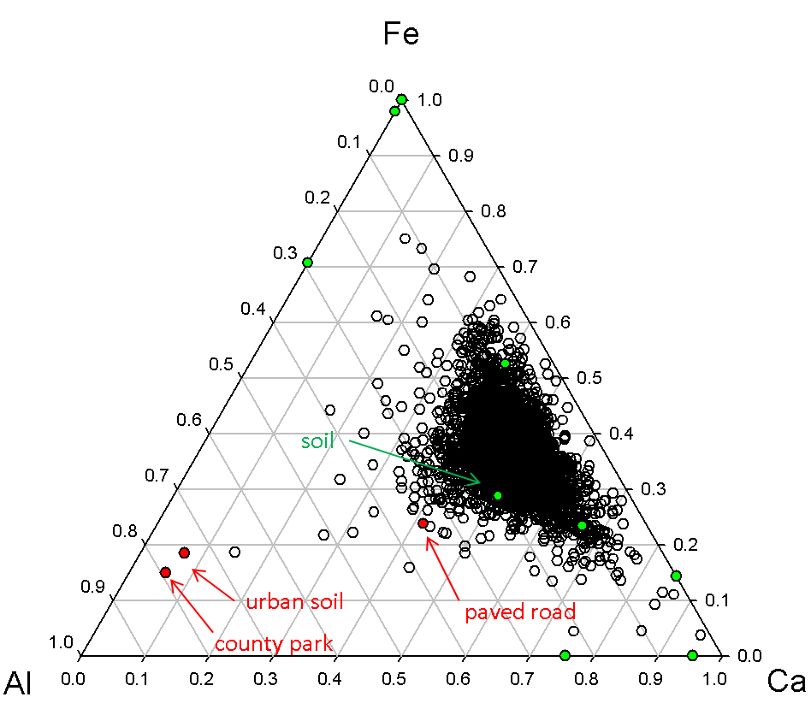
Some aspects make us a bit nervous…
Is soil apportioned correctly?
If so, do we understand its source?
Are the profiles and data even comparable (analytical )

Slide 19
Vehicle Exhaust Contributions :
Source Apportionment Modeling versus Emission Inventory
reduced major axis (RMA) regression:
our modeling agrees with the
(independently developed)
emissions estimates!
Hong Kong air pollutant emission inventory, available at: http://www.epd.gov.hk/epd/english/environmentinhk/air/data/emission_inve_rsp_C.html
Notes:
Hong kong is located along the south-eastern coast of China. Spread over an area of roughly 30km by 40km, hong kong consists of cluster of islands with hilly terrains. HKEPD traditionally defines any source located out side the HK administrative region as regional source, but note that heavily industrialized Pearl River Delta is located just north-west of HK.

Slide 20
Hong Kong PM_{2.5} Speciation Network
1-in-3 day 24-hour integrated sampling with three PM_{2.5} FRM samplers
Three-to-four sites operated for three one-year periods over the past decade
Different samplers and analyses compared to PM₁₀

Slide 21
PM_{2.5} Error Structures
Lab-reported error structures strong function of analysis batch
Example… Pb for 2008-2009 sampling campaign
Dashed lines is the error structure from the collocated data

Slide 22
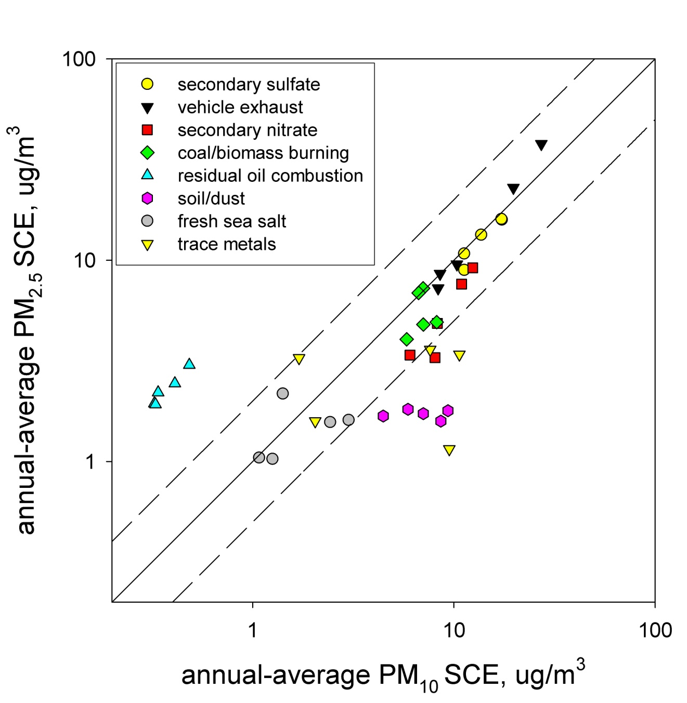
PM_{2.5} versus PM₁₀ Source Contributions

Slide 23
Relating Pollution to
Synoptic Air Mass Transport Patterns
Relate observed concentration at receptor to air mass transport history
  Air mass back trajectories, e.g., HYSPLIT
Approach #1… Assign concentration at receptor to points along back trajectory and estimate ensemble relationships for impacts, e.g.,
  Potential source contribution function (PSCF)
  Quantitative transport bias analysis (QTBA)
Approach #2… Classify air mass trajectories based on transport pattern similarities, independent of air pollutant data
  Use these “clusters” in air pollutant data analyses
  Not the same as synoptic typing (e.g., with PCA)

Slide 24
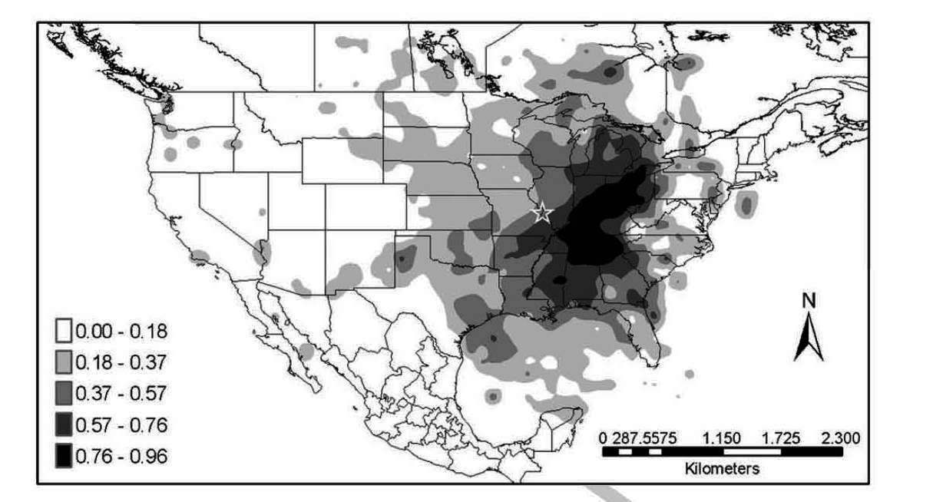
PSCF Example – Sulfate in St. Louis
Sulfate Potential Source Contribution Function
(PSCF) analysis, Lee and Hopke (2006)
Chemical Speciation Network Data (1-in-3 day)

Slide 25
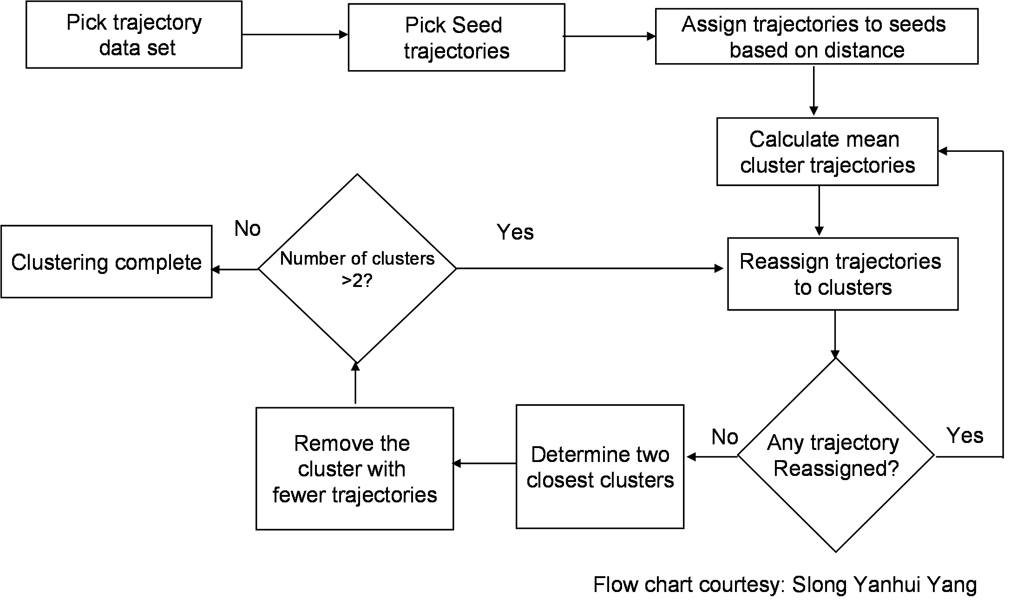
Clustering the Trajectories
Many approaches
  In this study we used Dorling’s algorithm¹ with refinements

Slide 26
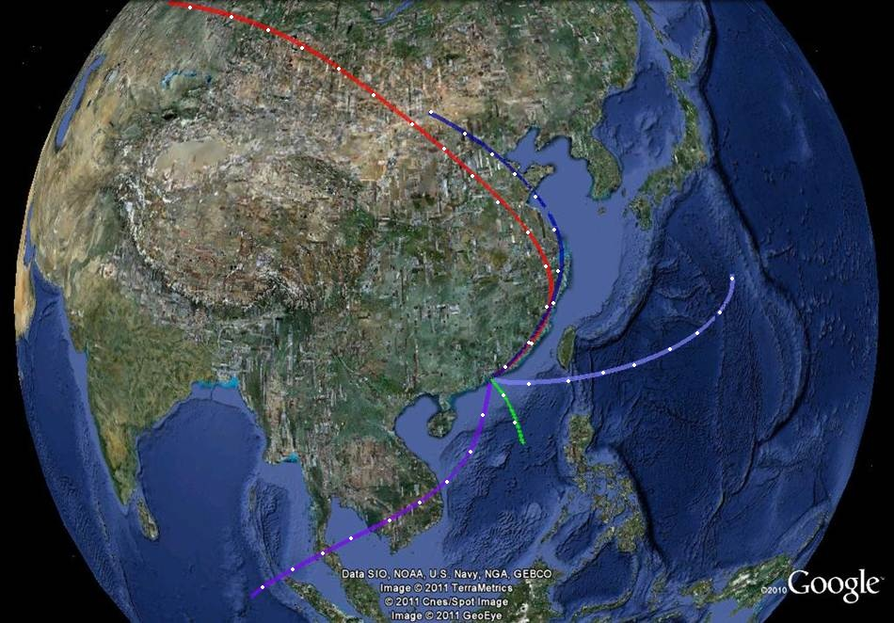
Clustering of Seven-Day Air Mass Back Trajectories
Generate air mass back trajectories (4/day for 11 years… more than 16,000 trajectories!)
Cluster into five categories
Examine relationships between particulate matter composition, concentration, and air mass transport pattern
Notes:
Hong kong is located along the south-eastern coast of China. Spread over an area of roughly 30km by 40km, hong kong consists of cluster of islands with hilly terrains. HKEPD traditionally defines any source located out side the HK administrative region as regional source, but note that heavily industrialized Pearl River Delta is located just north-west of HK.

Slide 27
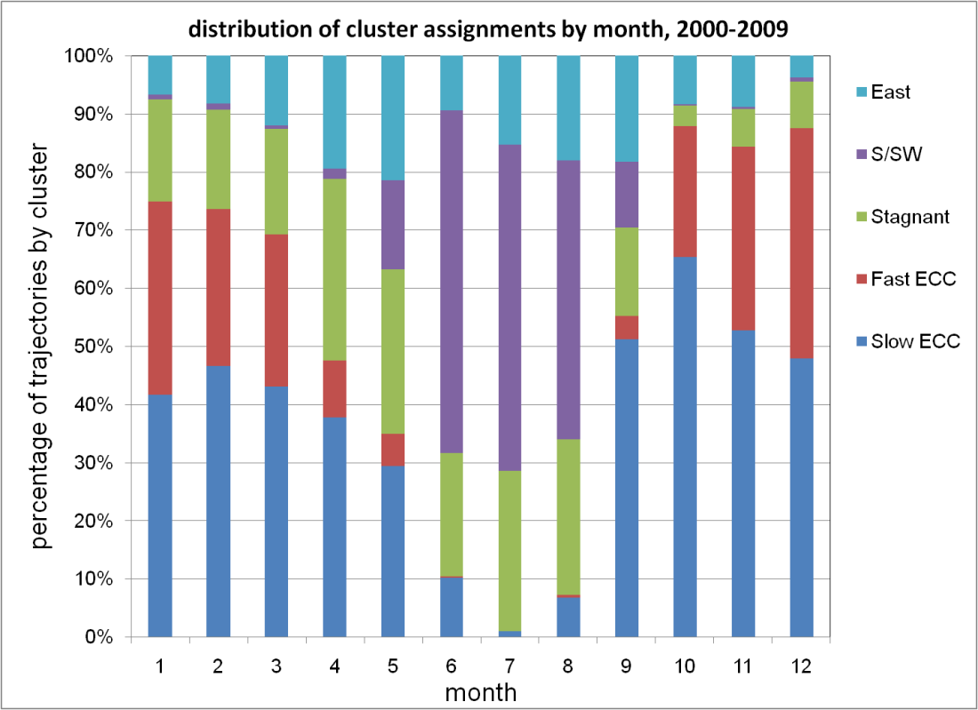
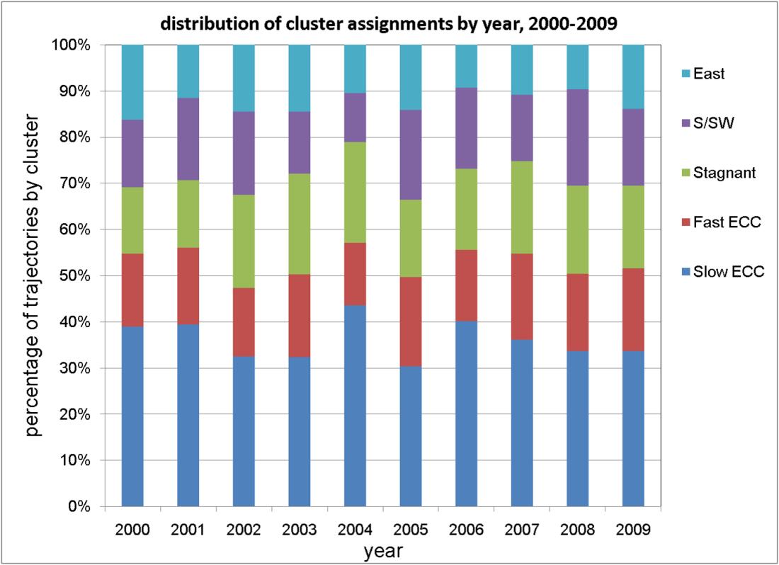
Air Mass Clusters – This Study
East Coast of China, relatively fast moving (ECC Fast)
East Coast of China, relatively slow moving (ECC Slow)
East
South/Southwest (S/SW)
Stagnant

Slide 28
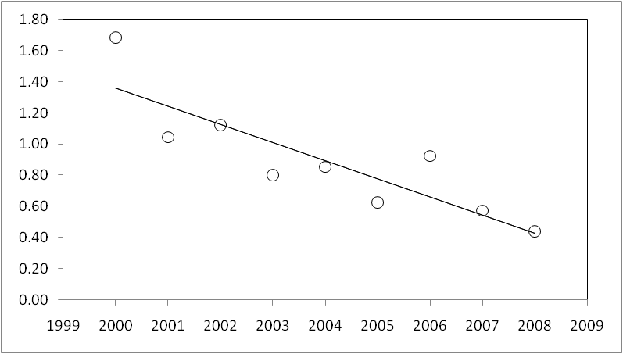
Cluster-Censored Trends in Source Contributions
Vehicular Exhaust
Notes:
Hong kong is located along the south-eastern coast of China. Spread over an area of roughly 30km by 40km, hong kong consists of cluster of islands with hilly terrains. HKEPD traditionally defines any source located out side the HK administrative region as regional source, but note that heavily industrialized Pearl River Delta is located just north-west of HK.

Slide 29
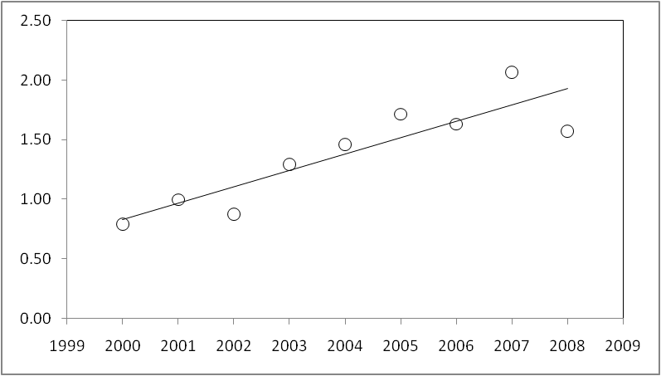
Cluster-Censored Trends in Source Contributions
Vehicular Exhaust
Secondary Sulfate
Thank you, mainland China!
Notes:
Hong kong is located along the south-eastern coast of China. Spread over an area of roughly 30km by 40km, hong kong consists of cluster of islands with hilly terrains. HKEPD traditionally defines any source located out side the HK administrative region as regional source, but note that heavily industrialized Pearl River Delta is located just north-west of HK.

Slide 30
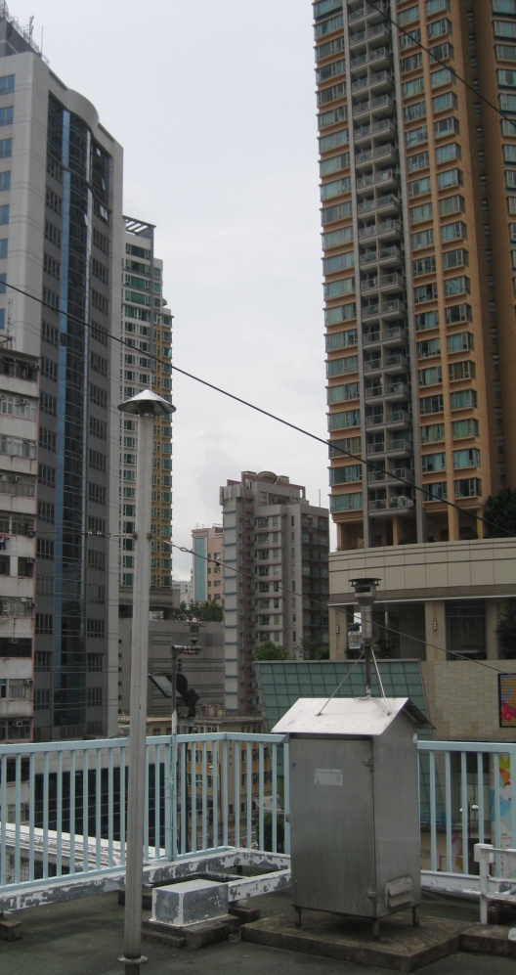
Hong Kong PM₁₀ Mass Network
Compared to the Air Quality Objectives
Hourly data set for more than ten years
          50°C TEOM
          Method continuity over time
          Measures nonvolatile mass, biased low compared to ambient concentrations
          Fourteen sites, including three roadway sites
          Additional quality assurance conducted

Slide 31
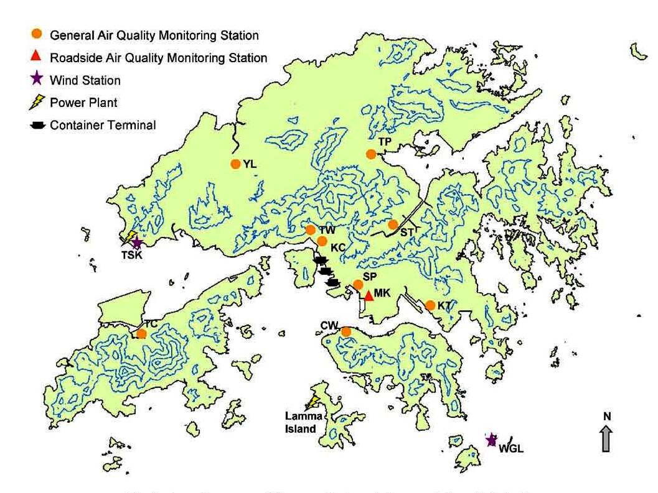
Hong Kong SAR and TEOM sites
CL
EN
CB
20 km
adapted from Yu et al. (2005)

Slide 32
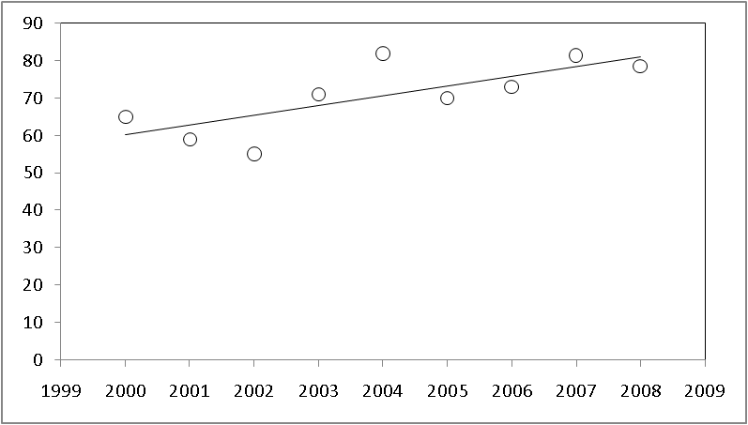
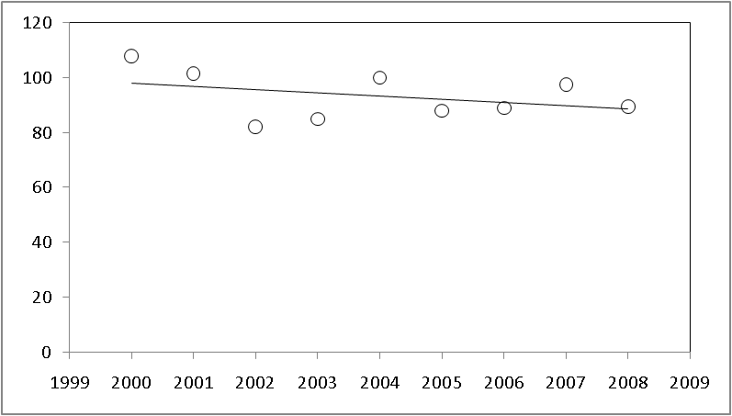
Interpreting the PM₁₀ Mass Data
YL station (general)
CB station (roadside)
For slow moving air masses from Eastern China…
PM₁₀, μg/m³
Impact of transport from China
Impact of transport from China balanced by decrease in vehicle contributions

Slide 33
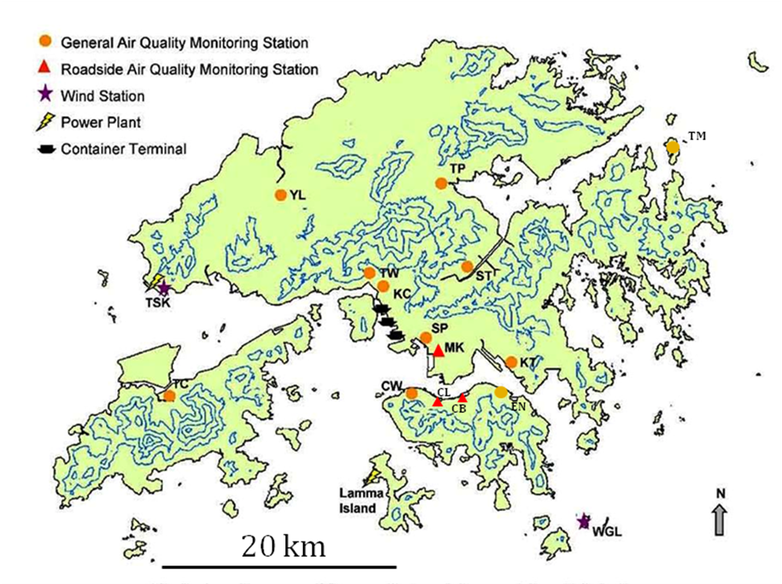
Cluster-Censored Temporal Trend – PM₁₀
Cluster: Slow ECC
Trend over 2000-09
  Degradation
  Statistically indifferent
  Improvement
Notes:
Hong kong is located along the south-eastern coast of China. Spread over an area of roughly 30km by 40km, hong kong consists of cluster of islands with hilly terrains. HKEPD traditionally defines any source located out side the HK administrative region as regional source, but note that heavily industrialized Pearl River Delta is located just north-west of HK.

Slide 34
Cluster-Censored Temporal Trend – PM₁₀
Cluster: East
Trend over 2000-09
  Degradation
  Statistically indifferent
  Improvement
Notes:
Hong kong is located along the south-eastern coast of China. Spread over an area of roughly 30km by 40km, hong kong consists of cluster of islands with hilly terrains. HKEPD traditionally defines any source located out side the HK administrative region as regional source, but note that heavily industrialized Pearl River Delta is located just north-west of HK.

Slide 35
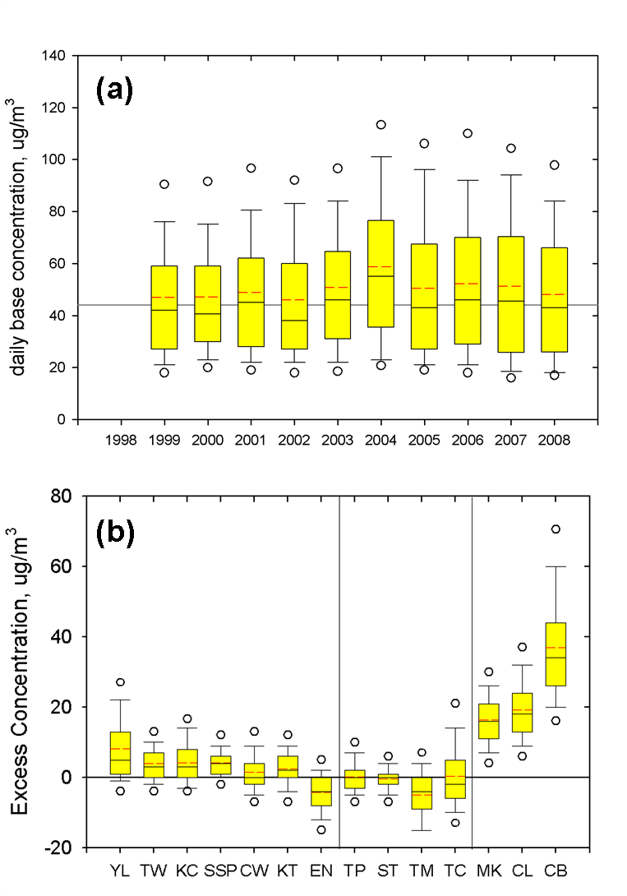
Contributions from “Not so Regional” Transport
Notes:
Hong kong is located along the south-eastern coast of China. Spread over an area of roughly 30km by 40km, hong kong consists of cluster of islands with hilly terrains. HKEPD traditionally defines any source located out side the HK administrative region as regional source, but note that heavily industrialized Pearl River Delta is located just north-west of HK.

Slide 36
Summary - I
Developing/refining methodologies to systematically examine spatial variability in pollutant concentrations
  Emphasis on the urban scale
  Critical to customize the analysis for the airshed being studied
In this presentation, demonstrated how:
  A battery of tools can be used to generate a weight-of-evidence for the drivers underlying spatiotemporal trends (Hong Kong)
This analysis contributes to the development of the conceptual model
Notes:
So finally, we infer that regulations placed by HKEPD have been affective at reducing vehcular emission. However, the increase in regionally transported secondary emissions, tends to mask their impact. As the next step, HKUST is now modelling the HK air pollution using CMAS which hopefully will strength these results.

Slide 37
Summary - II
Demonstrated the utility of sustained speciation monitoring
Added to the discussion on air toxics metals from marine activities
  Small contributor to PM, but perhaps important in health context
Contributed to a list of science questions, some being explored through the HK Supersite program, e.g.
  Better understanding of organic matter source contributions is needed, especially biomass and secondary OC (work underway by HKUST)

