Slide 1
ESIP Data Quality Telecom – May 05/21/14
Agenda:
Review of previous telecom and summary of the NASA ESDSWG Data Quality Group meeting. (10 minutes).
Presentation: Introduction to the ISO 19157 Standards by Ted Habermann, Director of Earth Science, The HDF Group . (20 minutes).
Group discussion and preparations to the 2014 ESIP Summer meeting. (30 minutes)
Gilberto A. Vicente
NASA GES-DISC Science Data Manager – Code 610.2
Gilberto.A.Vicente@nasa.gov

Slide 2
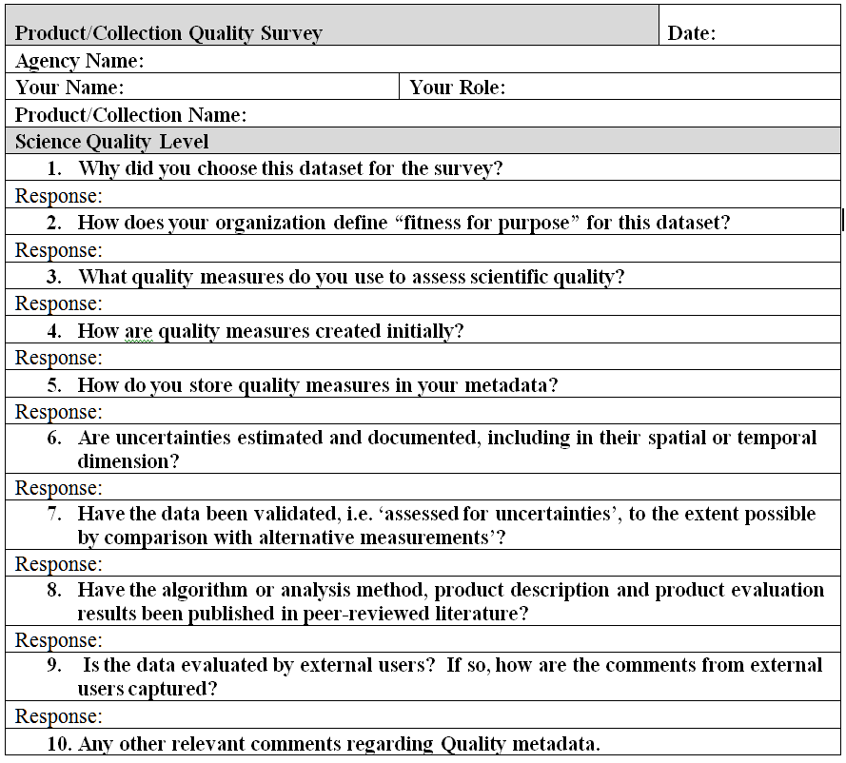
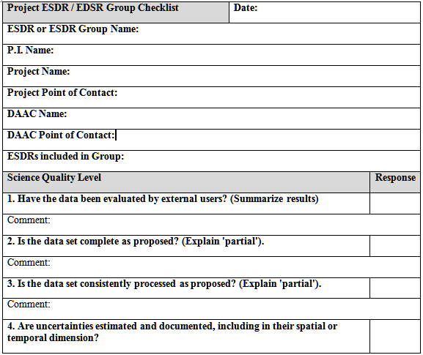
Data Quality Surveillance
CEOSS WGISS Metadata Quality Survey
MEaSUREs Product Quality Checklists

Slide 3
Data Quality – User’s perspective
From Chris Lynnes presentation: 2014 ESIP Winter meeting

Slide 4
Who are the users
General public
K-12 Teachers
Undergraduates
Graduate students
Professors
Education / Public Outreach specialists
Production Centers
Internal Data Providers
External Data Providers
Science Team
Cal/Va
QA and Testing
Data Analyst
Data Tech
Computer Scientist
Domain Scientist
Interdisciplinary Scientist
Operational User
Discipline-specific Modeler
Assimilation modelers
Climate Modelers
Web Services
Decision Support Systems
Data Analysis and Visualization Systems
From Chris Lynnes presentation: 2014 ESIP Winter meeting

Slide 5
Current system
proposed system
Quality
Properties
Different
Organization
Formats
Quality
Properties
One Standard
Organization
Format
Classified
User
Groups
Quality 1
Quality 1
USERS 1
Quality 2
Quality 2
Quality 3
Quality 3
USERS 2
Quality 4
TO ALL USERS
Quality 4
Quality 5
Quality 5
USERS 3
Quality 6
Quality 6
Quality 7
Quality 7
USERS 4
Quality 8
Quality 8
Quality 9
Quality 9

Slide 6
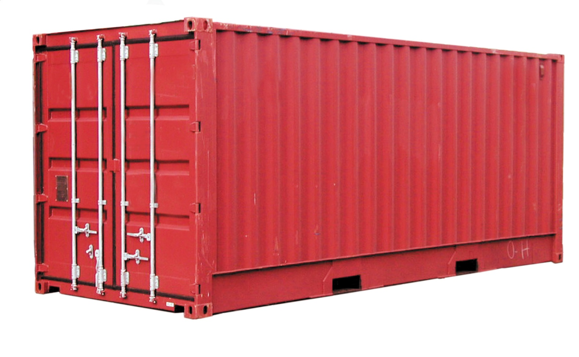
The containerization concept
TRANSPORTED PRODUCT
DIMENTIONS | OUTSIDE | INSIDE
Length | 20’ 0” | 19’ 4”
Width | 8’ 0” | 7’ 6”
Height | 8’ 0” | 7’ 1”
CARGO CAPACITY |  | 41,300 lb
EMPTY WEIGHT |  | 3,500 lb
EARTH SCIENCE DATA/PRODUCT
REQUIREMENTS | USERS | PRODUCERS
Coverage | Teacher | NASA
Resolution | Student | NOAA
Format | Public | USGS
… | … | …
The Data Quality Matrix

Slide 7
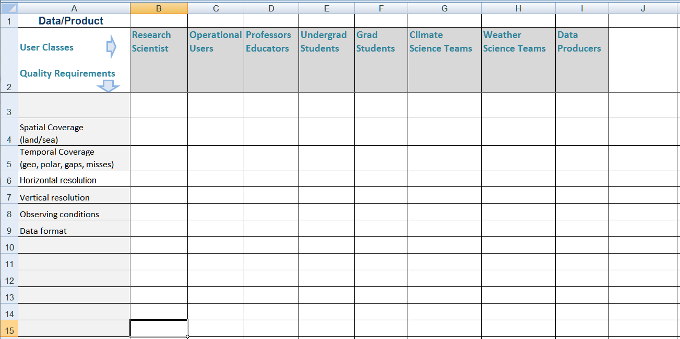
general data quality requirements
The consumer report approach
List of requirements
List of user classes
Rate the requirements for each user category

Slide 8
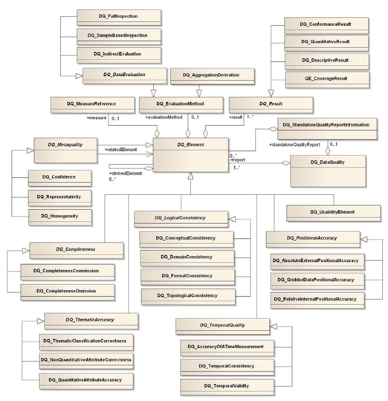
International Organization of Standards - ISO 19157
A unified conceptual model for the description of relevant data quality assessment parameters approved as an international standard.
Legacy of the ISO 19115

Slide 9
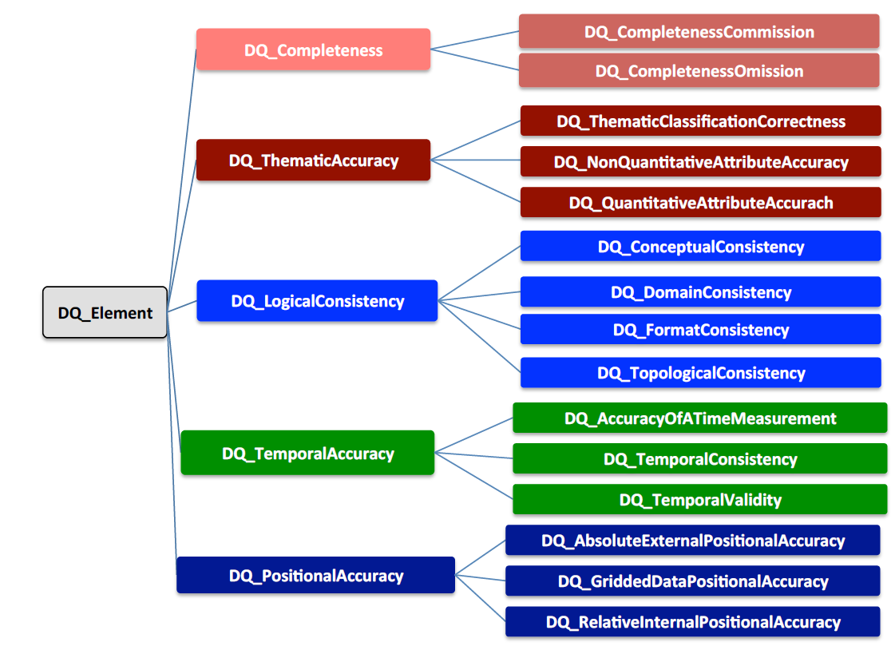
ISO 19157

