Slide 1
ROLE OF THE GEO AQ COMMUNITY OF PRACTICE
Gary J. Foley, PhD, USEPA
Co-Chair, GEO User Interface Committee
Co-Chair, US-Canada Int’l AQ Advisory Board
June 16, 2010

Slide 2
GEO 2005:
Communities of Practice:
The Theory

Slide 3

Communities of Practice are . . .
Groups of people who share a concern, a set of problems, or a passion about a topic and deepen their knowledge by interacting on an ongoing basis
Etienne Wenger
Richard McDermott
Bill Snyder
Cultivating Communities of Practice, Harvard Business School Press, 2002

Slide 4
Three characteristics are crucial:
Domain – the concern, interest or passion
Community – those who interact and/or value the interactions, often practitioners
Practice – members are practitioners that work toward some goal or outcome

Slide 5
Three characteristics are crucial:
Domain – the concern, interest or passion
Community – those who interact and/or value the interactions, often practitioners
Practice – members are practitioners that work toward some goal or outcome
A community of practice is not just an interest group

Slide 6
CoP Classic Characteristics
Self-organizing, Informal
Many kinds of members: contributors, lurkers, newbies, facilitators, etc.
Voluntary, based on trust
Joint learning; Sharing of best practices; Reusable knowledge bases
Require more than just discussions
Interested in data/information infrastructures, interoperability, sharing, integration
Members distributed across many disciplines that share the common concern, interest or passion

Slide 7
GEO User Interface Committee in 2005:
What conceptually would an AQ Communities of Practice look like?:

Slide 8
THE SPECTRUM OF USERS
From observations
AQ observations & AQ/ atmospheric models
Data-to-Information archiving & services
Decision support tool development
Decision making
Assessment of benefits
AQ/atmospheric scientists and modelers
AQ data managers and providers
Environmental process modelers & researchers
Policy Makers, Publ Health officials, AQ managers,
Public officials, advocacy groups and the Public
To societal benefits

Slide 9
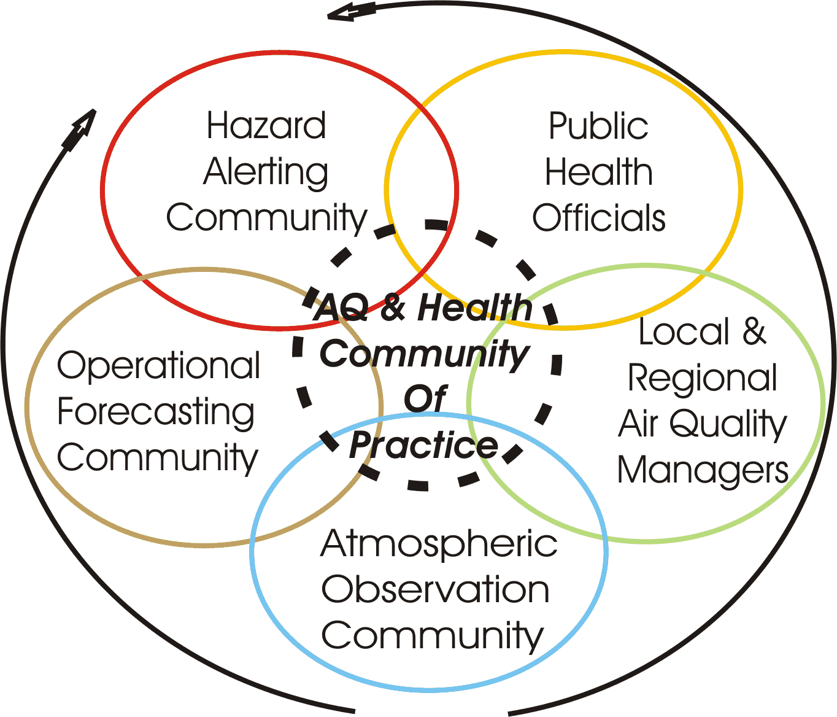
A Conceptual Air Quality & Health
Community of Practice (2005)
The Public
Communities
Have R&D &
Operational
Activities
Communities
Exist but Only
Have Limited
Interactions
in 2005

Slide 10
GEO 2010:
Communities of Practice:
The Status

Slide 11
Current GEO Communities of Practice
Air Quality
Biodiversity
Carbon Cycle
Coastal Zone
Cryosphere
Energy
Forests
Geohazards
Global Agricultural monitoring
Health & Environment
Integrated Water Cycle

Slide 12
Recent Presentations to the UIC
14th Meeting, February 2010
Carbon Community of Practice (R. Dargaville)
Energy Community of Practice (E. LeDrew)
Agriculture Community of Practice (J. S. Parihar)
Coastal Zone Community of Practice (H. P. Plag)
Water Community of Practice (R. Lawford)
The Way forward for the Cryosphere Theme (J. Key)
Air Quality Community of Practice (R. Husar)
Forest Community of Practice (M. Brady)
GeoHazards Community of Practice (S. Marsh)

Slide 13
What have we learned in GEO about global and local AQ so far?
For local AQ and health, it is 60 % community and 40 % technology to produce success
  The public wants environmental information, but depends upon the community to interpret it
  The community provides the context that lies between the data and the public, e.g. AIRNow Shanghai pilot
For transport, a good accomplishment is the linkage of WMO’s Sand & Dust Storm Warning System and MERIT’s Meningitis Decision Support Tool

Slide 14
Extra Slides

Slide 15
Public officials, Advocacy Groups and the Public
What do they care about?
Which environmental issues personally and/or professionally interest them?
What decisions do they regularly make and how do they get their information?
How would they assess the value if they could make better decisions?

Slide 16
Public Officials – What Benefits Might Interest Them?
The air is cleaner and safer to breath
Stimulate and encourage early adopters of new technologies
Widespread voluntary measures occur
Maintain the Country’s competitiveness (electricity and energy)
The Public is well-informed with real-time information, uses it & sees the benefits

Slide 17
The Public – What Benefits Might Interest Them?
The air is cleaner and safer to breath
How do I protect myself and my family when air pollution alerts occur?
What voluntary measures can I take?
How do my lifestyle & activities lead me and my family to greater involuntary risk?
How do my lifestyle & activities lead to greater pollution episodes and risk to my community?
How do I keep well-informed with real-time information and how should I use it?

